Slide 1
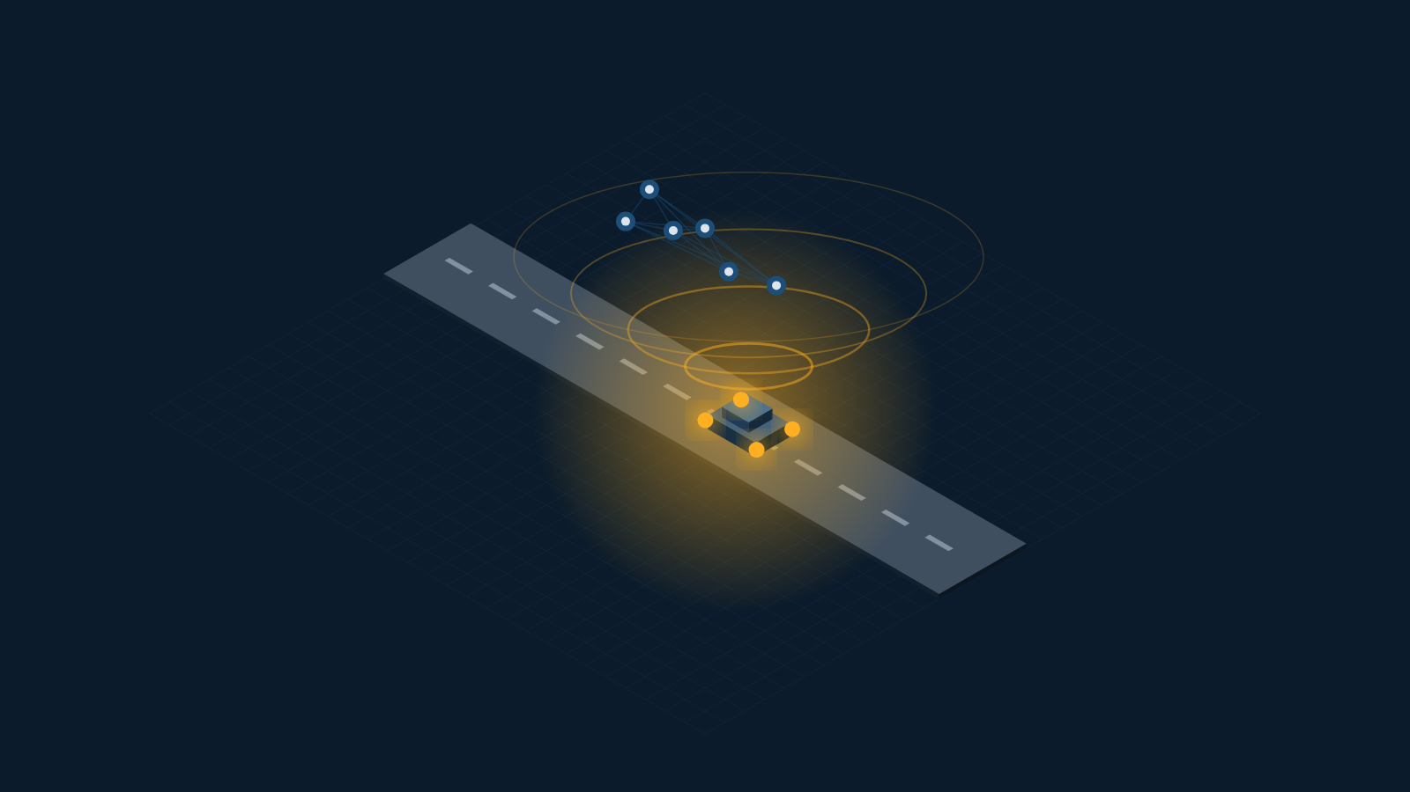
SWE4004 · CLOUD COMPUTING AND APPLICATIONS · PROJECT REVIEW 1
RoadAssist
A Cloud-Native, Offline-First Roadside Assistance Platform for India
“One Platform. Every Vehicle. Every Phone. Every Road.”
TEAM MEMBERS
V SAATWIK SAIRAAM
P SAI NIRISHA CHOWDARY
T V S JIGNESH
G PARTHAVI
24MIC7131
24MIC7122
24MIC7190
24MIC145
Backend & Cloud Database
Frontend & Mobile
AI & Data Services
DevOps, QA & Cloud Security
Course Faculty: Dr. Nagendra Panini Challa
Review 1 — Idea, Problem Statement, Architecture & Prototype
Notes:
Open with the tagline. State in one sentence: we are building a cloud-native roadside assistance platform for India, and this review covers the idea, the problem, the cloud architecture and a working prototype.

Slide 2
REVIEW 1
What We Will Cover
1
The Problem
2
Our Idea
Why roadside breakdown in India is an unsolved, high-stakes problem
One platform for every vehicle, every phone, every road
3
Cloud Foundation
4
Cloud Architecture
Delivery models, deployment model, enabling technologies, mechanisms
Scalability, load balancing, bursting, replication, storage
5
Cloud Security
6
Prototype, Enhancements & Output
Threats, encryption, PKI, IAM, SSO, security groups
How the system works end to end, including new road intelligence and life-safety capabilities
Notes:
Keep this to 20 seconds. Point out that sections 3, 4 and 5 map directly onto the six course modules.

Slide 3
SECTION 1
The Problem
A vehicle breaks down in India every few seconds. The person beside it has no reliable way to get help — and the worse the location, the worse the coverage.
63 L
1.7 L
30%
< 20%
km of road network
road deaths per year
of highway deaths
have organised RSA
Largest in the world after the USA — most of it outside any service network
India records the highest road fatality count globally
Attributed to delayed emergency response, not the crash itself
Roadside assistance today is a car-owner, metro-city privilege
The four failures we are solving
No signal — help apps assume 4G; breakdowns happen where there is none
No smartphone — a large share of drivers use feature phones
Cars only — bikes, autos, trucks and tractors are excluded
No data — no authority sees where breakdowns and crashes cluster
Notes:
Lead with the human situation, then the numbers. The four failures are the ones our design decisions trace back to — refer to them again in the architecture section.

Slide 4
SECTION 1
Why Existing Solutions Do Not Work
Existing option
What it does well
Where it breaks down
Insurance / OEM RSA
Bundled with car policies
Cars only · needs a call centre · no coverage on rural highways
Local mechanic contacts
Cheap and familiar
No verification, no pricing, no tracking, no accountability
General ride/logistics apps
Good dispatch technology
Assume constant connectivity and a smartphone
Government helpline (112)
Universal and trusted
Emergency only — cannot handle a flat tyre or a dead battery
The gap: no platform covers every vehicle class, works without connectivity, and reaches a feature phone.
Notes:
Do not attack competitors. Frame it as: each solves one slice well; nobody covers the intersection of all-vehicle, no-network, no-smartphone.

Slide 5
SECTION 2
Our Idea
RoadAssist Bharat is a cloud-hosted platform that connects any stranded vehicle to the nearest verified mechanic or emergency responder — over the internet when it exists, and over SMS, IVR or on-device intelligence when it does not.
1
2
3
4
Every Vehicle
Every Phone
Every Road
Every Second
Cars, bikes, autos, trucks, buses, tractors and EVs — one platform, vehicle-class-aware diagnosis
Smartphone app, web, and full SMS / IVR / USSD access for feature phones
Offline-first: on-device AI and cached maps keep working with zero signal
Automatic crash detection escalates to contacts and responders in under 10 seconds
Delivered as a cloud service, because it cannot be delivered any other way
Demand is unpredictable and geographically spread across a subcontinent; the emergency path must never go down; and a four-person team cannot own physical infrastructure. Cloud is not a hosting choice here — it is the enabling condition.
Notes:
This is the slide the panel remembers. Say the one-sentence definition slowly, then the four pillars, then land on why it must be cloud.

Slide 6
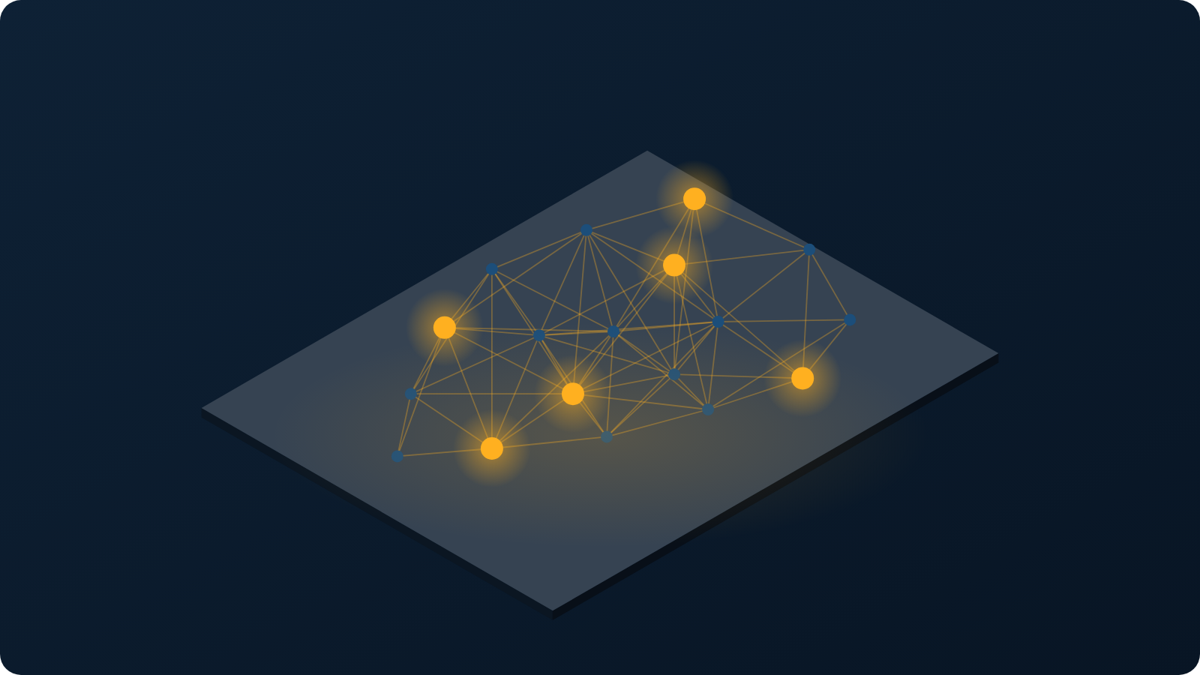
SECTION 2
The Platform at a Glance
7
client types served
Android · iOS · web · mechanic app · government · admin · feature phone
12
cloud services
Independently scalable, deployed on managed Kubernetes
3
availability zones
Every stateless service replicated; database with multi-AZ failover
0
connectivity required
One cloud platform · every vehicle class · every district · online or offline
On-device AI and SMS keep the core journey alive with no network
Notes:
Use the map to make the scale point physically: this is not one city, it is a national network with a node wherever a vehicle is.

Slide 7
ENHANCEMENT 1 · EDGE AI
Edge AI & Road Hazard Engine
On-device road intelligence extends RoadAssist from vehicle assistance to road-condition awareness.
EDGE AI
PDI
RISK
On-Device Hazard Detector
Pavement Distress Index (PDI)
Empirical Bayes Blackspot Predictor
Lightweight model (≤ 15 MB) runs on the phone camera and flags potholes, unmarked speed-breakers and unpaved roads using the mitangshu11 dataset.
A live 0.0–1.0 road-roughness score converts visual road evidence into a compact severity signal for the routing and analytics layers.
Combines MoRTH accident data with spatial evidence to identify road segments with elevated crash risk and surface them as blackspot candidates.
→
→
→
→
CAMERA / IMU
ON-DEVICE MODEL
PDI + HAZARD
POSTGIS / ANALYTICS
SAFER DISPATCH
New intelligence layer: detect the road condition before dispatch decides how to reach the stranded user.

Slide 8
ENHANCEMENT 2 · SMART BACKEND
Smart Backend & Highway Mapping
Precise highway positioning and fast spatial lookup make roadside dispatch location-aware at highway scale.
1
Highway Milestone (LRS) Resolution
2
H3 Hexagonal Grid · Resolution 8
PostGIS Linear Referencing System resolves locations such as NH-44 KM 142.5 into an exact position on the highway network.
Uber H3 indexing groups responders and mechanics into spatial cells, enabling fast nearest-provider lookups with a target of < 50 ms.
3
Hazard-Aware Dispatch Routing
4
One Spatial Backbone
Routing uses road-condition signals from the hazard engine to avoid severely damaged roads when sending tow trucks or ambulances.
LRS gives the exact highway reference; H3 accelerates proximity search; routing combines both with live hazard context.
INCIDENT
→
LRS LOCATION
→
H3 CELL
→
NEAREST RESPONDER
→
HAZARD-AWARE ROUTE
→
ARRIVAL

Slide 9
ENHANCEMENT 3 · LIFE SAFETY
Life-Safety & Offline Resilience
The emergency path remains usable without internet, while the human-confirmation step prevents false dispatches.
OFFLINE
100 Hz IMU
SMS + IVR
Zero-Internet Offline Client
Crash-to-Responder Engine
Feature Phone Gateway
SQLite local storage plus offline maps keep fault diagnosis and roadside requests usable with no network. Requests sync when connectivity returns.
100 Hz IMU sensing detects crash signatures. A 30-second cancellation countdown gives the user time to stop a false alarm before automatic location dispatch.
SMS + IVR commands — MADAD, SOS and STATUS — extend the core journey to feature phones in 8 Indian languages.
EMERGENCY PATH
0s
0–30s
2s
4s
≤10s
Crash signal
Cancel window
SMS location
Responder lookup
Dispatch path
Safety rule: AI can raise an incident, but the dispatch path remains confirmation-aware.

Slide 10
ENHANCEMENT 4 · GOVERNMENT & COMPLIANCE
Government & Compliance Module
RoadAssist becomes a data-to-action layer for highway authorities while protecting citizens from re-identification.
MoRTH
HEATMAP
k ≥ 10
MoRTH Statutory Blackspot Portal
Blackspot + Road Condition View
DPDP Act 2023 Privacy Layer
District-level heatmaps expose high-risk road segments and support automatic monthly statutory PDF reporting for government workflows.
Combine accident-derived risk with PDI and detected hazards to help authorities prioritize inspection, maintenance and intervention.
Query-level k-anonymity (k ≥ 10) suppresses results that could expose a small identifiable group of citizens.
ACCIDENT DATA
→
ROAD SIGNALS
→
PRIVACY FILTER
→
DISTRICT VIEW
→
REPORTING
MoRTH
PDI + hazards
k ≥ 10
Heatmap
Monthly PDF
Public value: safer roads and better targeting without exposing individual citizen records.

Slide 11
MODULE 1 · GOALS, BENEFITS, RISKS
Why This System Must Be Cloud-Based
Elastic demand
1
Breakdown load peaks 6× at rush hour and spikes during monsoon and festivals
Proportional cost
2
We pay for the peak only while it lasts — impossible with owned servers
National reach
3
Multi-region presence puts compute near the user across the country
High availability
Risks we accept, and how we answer them
4
Vendor lock-in → containers and open standards, portable across providers
The emergency service is replicated across availability zones
Data sovereignty → all data resident in Indian regions only
Reduced control → compensated by monitoring, SLOs and audit logging
Notes:
The chart is the argument: a 10x swing between the quietest and busiest hour. Owned hardware must be sized for the peak and idles the rest of the day.

Slide 12
MODULE 1 · MODELS, ROLES AND BOUNDARIES
Where We Sit in the Cloud Stack
Cloud delivery models — we consume two, and provide one
Cloud deployment model — hybrid, by necessity
SaaS
we PROVIDE
Public cloud
RoadAssist app, mechanic portal and government dashboard delivered to end users
Main platform — booking, dispatch, AI, analytics. Elastic and cost-proportional.
PaaS
we CONSUME
Private / dedicated
Managed Kubernetes, managed PostgreSQL, managed message queue
Government incident data and citizen medical records — isolation is a legal requirement.
IaaS
we CONSUME
Edge / on-device
Virtual servers, virtual networks, block and object storage
Crash detection and diagnosis run on the phone, so the system survives zero connectivity.
Roles and boundaries
Cloud provider: the data centre, hypervisor and managed services. · Cloud consumer (us): application, data and configuration. · Cloud service owner: our team owns every RoadAssist service. · Cloud resource administrator: P4. · The organisational boundary ends at our virtual network; the trust boundary extends into every managed service we call.
Notes:
Be precise here — examiners like this slide. We are simultaneously a cloud consumer (of IaaS and PaaS) and a cloud provider (of SaaS to citizens, mechanics and government).

Slide 13
MODULE 2
Cloud Enabling Technologies We Use
Data centre technology
Region: Mumbai (primary) · Hyderabad (DR)
1
Multi-region, multi-AZ Indian regions with redundant power, cooling and network paths
Virtualization technology
Docker containers on Kubernetes nodes
2
Hardware-level virtual servers plus OS-level containers for every microservice
Web technology
OpenAPI 3.1 · TLS 1.3 · WSS
3
REST over HTTPS, WebSocket for live tracking, and a Progressive Web App client
Multitenant technology
Row-level isolation + per-tenant encryption keys
4
One deployment serves citizens, mechanics, fleets and government tenants
Service technology
12 services · gateway · async event bus
5
Loosely coupled services behind an API gateway, communicating over an event bus
Notes:
Say which one is least obvious: multitenancy. Four different user classes share one deployment, isolated by row-level security and separate encryption keys.

Slide 14
MODULE 3
Cloud Infrastructure Mechanisms in Our Design
1
2
3
Network perimeter
Virtual server
Cloud storage device
Virtual private cloud with private subnets; a single public ingress protected by a web application firewall. No service is directly reachable from the internet.
Kubernetes worker nodes built from hardened, pre-patched machine images. Nodes are replaceable, never repaired in place.
Block volumes for the database, object storage for diagnostic photos and offline map packs, encrypted at rest.
4
5
Cloud usage monitor
Resource replication
Metrics, logs and distributed traces collected for every request — feeding autoscaling, billing visibility and SLO alerts.
Database replicas across availability zones; stateless services replicated behind the load balancer; object storage replicated to a second region.
Notes:
All five mechanisms from Module 3 appear in our design. If asked which matters most for us: resource replication, because the emergency service must survive the loss of an availability zone.

Slide 15
MODULE 4
Fundamental Cloud Architectures Applied
1
2
3
4
Workload distribution
Resource pooling
Dynamic scalability
Elastic resource capacity
Requests spread across replicas of every stateless service
Shared pools of compute, database connections and cache reused by all tenants
Autoscaler adds pods when request queue depth rises, removes them when it falls
Node pool grows and shrinks automatically with the pod count
5
6
7
8
Service load balancing
Cloud bursting
Elastic disk provisioning
Redundant storage
Layer-7 balancer with health checks; unhealthy replicas removed from rotation
Monsoon and festival surges burst into additional on-demand capacity, then release it
Storage volumes expand on demand; we are billed for what is consumed
Primary and secondary storage replicated across zones with automatic failover
Notes:
Do not read all eight. Pick three and explain them concretely: dynamic scalability, cloud bursting during monsoon, and redundant storage for the emergency path.

Slide 16
ARCHITECTURE
System Architecture — Mapped to the Cloud Service Layers
SaaS
Mobile App
(Android / iOS)
Web PWA
Mechanic App
Govt Dashboard
Feature Phone
SMS · IVR · USSD
delivered to users
PaaS
API GATEWAY · Web Application Firewall · TLS Termination · Layer-7 Load Balancer · Rate Limiting
we build on
Auth &
IAM
Booking
Dispatch
Vehicle
Emergency
AI Service
Analytics
Auto-scaling pods on managed Kubernetes · stateless · replicated across 3 availability zones
IaaS
PostgreSQL
Multi-AZ + replicas
Redis Cache
resource pooling
Object Storage
photos · map packs
Event Bus
async messaging
Monitoring
usage monitor
runs it all
Virtual Servers · Virtual Private Cloud · Private Subnets · Block & Object Storage · Encrypted at Rest
Every box maps to a Module 3 mechanism or a Module 4 architecture. The emergency service (red) is deployed separately so it survives failure of the rest of the platform.
Notes:
Walk it top to bottom in three sentences — clients, gateway and services, then data and infrastructure. Then point at the red box and explain why the emergency service is isolated.

Slide 17
MODULE 6
Cloud Security — Threats and Mechanisms
Threat agents and cloud security threats
Security mechanisms we implement
Anonymous attacker
Denial of service against the public API
Encryption
Hashing
TLS 1.3 in transit; AES-256 at rest; column-level encryption for medical and identity data
Argon2 for credentials; SHA-256 hash chain making the audit log tamper-evident
Malicious service agent
Traffic eavesdropping between services
Trusted attacker
A verified mechanic escalating privileges
Digital signature
PKI
Signed payloads on the emergency 112 handoff and on all partner webhooks
Certificate authority issuing per-officer certificates for government portal access
Malicious insider
Staff access to citizen medical records
Traffic eavesdropping
Intercepting location data in transit
IAM
Single Sign-On
Insufficient authorization
Reading another user's booking by changing an ID
Seven roles, resource-scoped permissions, least privilege, no standing production access
One token issued at login, honoured across all services for its short lifetime
Virtualization attack
Escaping a container onto the host
Security groups
Hardened images
Overlapping trust boundaries
A shared tenant leaking data across tenants
Default-deny virtual firewalls; each service reachable only by its declared callers
Minimal, pre-patched machine images; nodes replaced rather than patched in place
Notes:
Pair each threat on the left with the mechanism on the right that answers it. The examiner will usually ask for one such pairing — insufficient authorization answered by resource-scoped IAM is the cleanest.

Slide 18
PROTOTYPE
How It Works — End to End
1
2
3
4
5
6
Trigger
Capture
Diagnose
Dispatch
Track
Resolve
Vehicle breaks down, or the on-device model detects a crash
Symptoms by voice, photo or OBD scan — works fully offline
AI service returns probable fault, severity and parts needed
Geospatial query ranks nearby verified mechanics and sends offers
Live location streamed over WebSocket until the mechanic arrives
Work completed, digital invoice, cashless payment, rating
When there is no network — the path that makes this different
On-device AI
Local queue
SMS / IVR
Auto-sync
Diagnosis and crash detection run on the phone in under 120 ms
The request is stored on the device and marked pending
A feature phone completes the whole journey over text or a voice menu
On reconnect the queue replays; conflicts resolve server-side
Emergency path — under 10 seconds
Crash detected on device
30-second cancel window
Contacts alerted with live location
Nearest responder notified
ERSS 112 handoff on confirmation
Notes:
Walk the six steps quickly, then slow down for the offline row — that is the differentiator. Finish on the emergency strip and state the 10-second target.

Slide 19
PROTOTYPE
Final Output — What We Have Built
Request Help
AI Diagnosis
Live Tracking
Review 1 — completed
Vehicle: Maruti Swift
Confidence: HIGH
Mechanic assigned
Cloud infrastructure provisioned
Location auto-detected
Ramesh K. · 4.8 ★
Virtual network, subnets, security groups, Kubernetes cluster
NH-48 · KM 212
Likely cause
Database deployed and seeded
Battery discharge
ETA 12 min
60 tables, multi-AZ, 100,000 rows of test data
PROBLEM
Distance 4.2 km
Authentication working end to end
Engine won't start
Severity 3 / 5
OTP login, token rotation, role-based access control
Parts: jump kit, battery
[ CALL ] [ CHAT ]
[ REQUEST ASSISTANCE ]
CI/CD pipeline live
Every commit built, tested and security-scanned automatically
DO NOT DRIVE
Clickable prototype
Complete request journey, in Hindi, on a low-end phone
Live demonstration follows this slide.
Notes:
Show the real prototype on a phone if the room allows. If not, the recorded demo is the backup — never rely on live WiFi.

Slide 20
IMPLEMENTATION
Technology Stack
Cloud & Infrastructure
Backend & Data
Frontend & Mobile
AI & Operations
Kubernetes (managed)
Node.js · NestJS microservices
React Native — Android and iOS
Python · PyTorch · ONNX · road hazard model
Docker containers
PostgreSQL + PostGIS (multi-AZ) · LRS
Next.js progressive web app
FastAPI model serving · PDI / blackspot analytics
Terraform — infrastructure as code
Redis cache · H3 Res 8 · event bus
SQLite + offline maps + local sync
Prometheus · Grafana monitoring
Virtual private cloud, security groups
Object storage for media
SMS · IVR · USSD gateway
GitHub Actions CI/CD
Every component is open source or a managed cloud service on a free tier — total infrastructure cost for the project: ₹0.
Notes:
Mention that the stack was chosen for portability — containers mean we are not locked to one cloud provider, which answers the vendor lock-in risk raised earlier.

Slide 21
PLAN
Roadmap to Review 2 and Review 3
REVIEW 1
25%
Problem validated · cloud architecture designed · database and authentication deployed · prototype built
Weeks 1 – 5
COMPLETE
REVIEW 2
70%
AI diagnosis + road hazard engine · LRS/H3 mapping · offline engine · SMS and IVR end to end
Weeks 6 – 12
NEXT
REVIEW 3
100%
Emergency engine · MoRTH portal + privacy layer · load, chaos and security testing · production deployment with disaster recovery
Weeks 13 – 18
PLANNED
Notes:
Keep this short. The point is that Review 1 is genuinely complete, and Review 2 has a defined scope rather than a vague promise.

Slide 22
CONCLUSION
A cloud problem, solved with cloud architecture
Unpredictable, national-scale demand
A service that must never fail
answered by dynamic scalability, elastic capacity and cloud bursting
answered by multi-AZ replication, redundant storage and load balancing
Sensitive personal and medical data
Four students, no hardware budget
answered by encryption, PKI, IAM, SSO and default-deny security groups
answered by IaaS and PaaS consumption on a pay-as-you-go basis
Thank you · Questions
SWE4004 — Cloud Computing and Applications · Review 1
Notes:
Close on the four pairings. Each names a problem and the specific cloud concept that answers it — that is the argument of the whole deck in four lines.

