Slide 1
Vehicle Service Demand & Workshop Resource Prediction Using NLP and Machine Learning
Student Name: Sayooj
Course / Batch: Data Science
Institution: Trycod Tech School
Guide/Mentor: [Add your guide/mentor name]

Slide 2




A hybrid system for predicting workshop demand and resources
Project Overview: A hybrid NLP + Machine Learning system that analyzes customer vehicle-service text, vehicle information, service history, and workshop conditions to predict service demand and workshop resource requirements.
Expected number of service vehicles
Expected workshop workload
Required technicians
Required service bays

Slide 3





Manual planning makes changing workshop demand difficult to manage
Vehicle service centers receive different types of customer complaints and service requests every day.
Estimate upcoming service demand
Plan technicians and allocate service bays
Objective: Develop an NLP and Machine Learning system that analyzes customer complaints, vehicle symptoms, service history, technician notes, customer concerns, vehicle information, workshop conditions, local demand, and appointment backlog.
Prepare spare parts
Manage appointment backlogs
Handle periods of high workshop workload

Slide 4
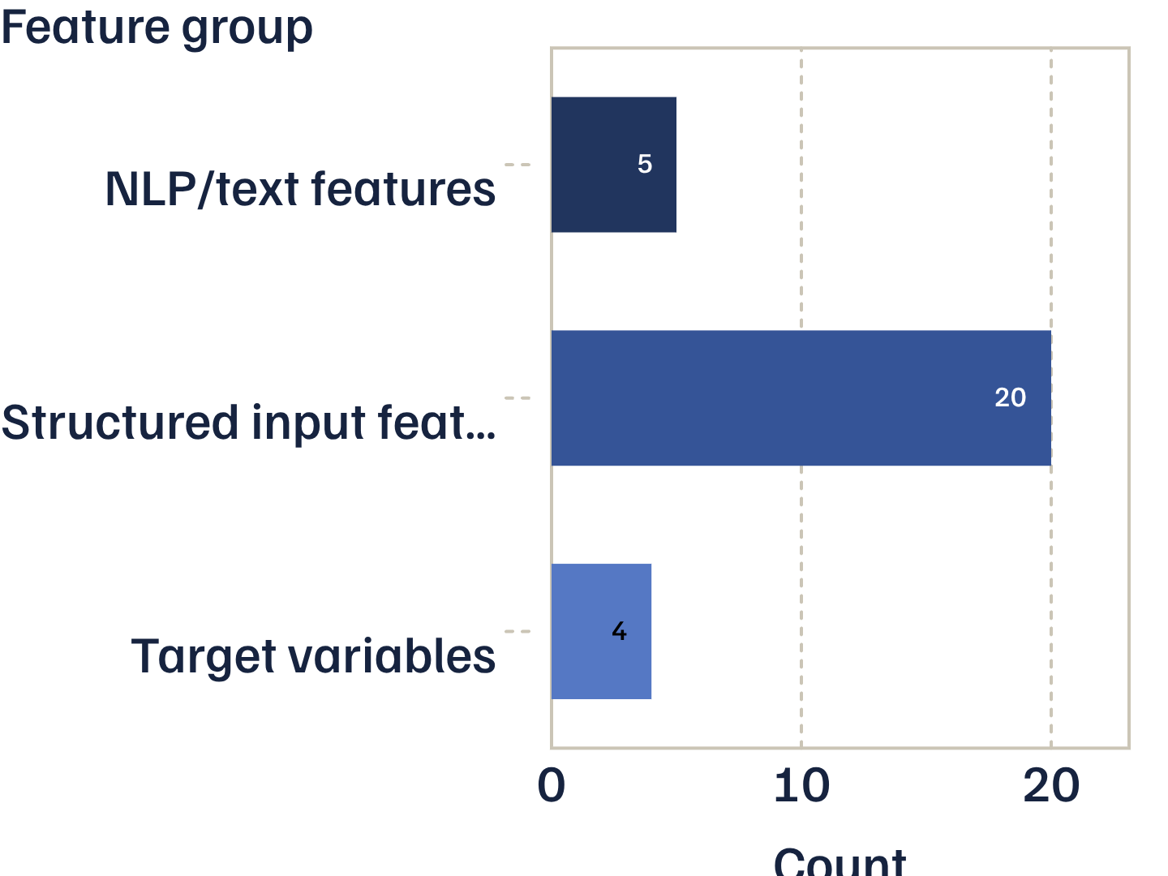
The dataset combines five text inputs with vehicle, customer, and workshop signals
Dataset: Vehicle Service Resource Prediction Dataset
Source: Project-generated synthetic dataset created specifically for academic NLP and Machine Learning experimentation
Scale: 50,000 records and 29 columns
Inputs: 5 NLP/text features and 20 structured input features
Outputs: Service Demand, Workshop Load Forecast, Technicians Required, Service Bays Required

Slide 5
Preprocessing turns service language and workshop context into a usable feature matrix
Raw Dataset
Missing Value Handling
Duplicate Checking
Text Cleaning
TF-IDF Vectorization
Categorical Encoding
Numerical Feature Preparation
Feature Combination
Train-Test Split
Five text features: Customer Complaint, Vehicle Symptoms, Service History, Technician Notes, Customer Concern
Text cleaning: lowercase, punctuation removal, whitespace cleanup
TF-IDF with unigrams + bigrams and a maximum of 1,000 features per text field
One-Hot Encoding for vehicle type, engine type, service category, season, customer segment, and workshop zone

Slide 6
Four XGBoost regressors convert mixed features into four workshop predictions
01
02
03
04
Dataset
Data Preprocessing
Five NLP Text Features
TF-IDF
05
06
07
08
Vehicle & Workshop Data
One-Hot Encoding
Feature Combination
Train-Test Split
09
10
11
12
XGBoost Regression
Multiple Predictions
Evaluation
Gradio Interface
Four separate XGBoost regression models predict Service Demand, Workshop Load Forecast, Technicians Required, and Service Bays Required.
XGBoost was selected because it handles nonlinear relationships, large datasets, complex feature interactions, and regression tasks.

Slide 7
Evaluation uses regression metrics, with notebook results still to be entered
This project is primarily a Regression Problem because the system predicts numerical values.
R² Score: Measures how well the model explains variation in the target
MAE: Measures average absolute prediction error
RMSE: Gives higher penalty to larger errors
Training setup: 80% training data, 20% testing data, Random State = 42. Do not mention cross-validation or hyperparameter tuning unless completed in the notebook.
Target | MAE | RMSE | R²
Service Demand | [Enter actual value] | [Enter actual value] | [Enter actual value]
Workshop Load Forecast | [Enter actual value] | [Enter actual value] | [Enter actual value]
Technicians Required | [Enter actual value] | [Enter actual value] | [Enter actual value]
Service Bays Required | [Enter actual value] | [Enter actual value] | [Enter actual value]

Slide 8
The Gradio interface turns predictions into a workshop preparation recommendation
Sample Input: SUV; 5 years; 70,000 KM; Petrol; Engine service; engine vibration and unusual noise during acceleration; rough idle and slow acceleration; workshop load 60%; technician availability 75%; local demand index 60.
Recommendation: Prepare the workshop for approximately 58 vehicles. Arrange 8 technicians and 11 service bays. Expected workshop load is 69%.
Real-world impact: estimate workload, plan technicians, allocate service bays, prepare spare parts, manage backlogs, reduce waiting time, and support business decisions.
Service Demand: 58 vehicles
Workshop Load Forecast: 69%
Technicians Required: 8
Service Bays Required: 11
Demand Level: Medium
Parts Requirement: Medium

Slide 9
The system’s next step is broader data, richer language support, and deployment
More Real-World Data: Use actual service-center records instead of synthetic academic data.
Multilingual NLP: Support Malayalam, Hindi, Tamil, and other regional languages.
Advanced NLP: Explore Word Embeddings, LSTM, BERT, and Transformer Models.
Additional Features: Weather, traffic, holidays/events, regional vehicle trends, real-time appointments, and spare-parts inventory.
Deployment: Web Application, Mobile Application, Cloud Prediction Service, or Service-Center Management System.
Conclusion: NLP and Machine Learning can support automotive workshop planning by combining customer text, vehicle information, and workshop information to predict four resource requirements.

Slide 10
Thank You
Questions & Answers?
Vehicle Service Demand & Workshop Resource Prediction Using NLP and Machine Learning
Sayooj | Data Science | Trycod Tech School

