Slide 1
AN ANDROID APPLICATION WHICH SENDS ENCRYPTED MULTIMEDIA MESSAGE
Presenting By:
Murtuza mehdi
Naveen Farooq
Uzair Saeed
Supervisor:
Ma’am Sumeera Hashmi

Slide 2

Objectives
Introduction to steganography
Background
Problem Statement
Project Scope
Project Objective
Gantt Chart
Tools and Languages
Conclusion
References

Slide 3


Slide 4
Introduction to Steganography
Steganography comes from the Greek steganos (covered or secret) and graphy (writing or drawing).
Steganography is defined as "the art of hiding messages inside media files“
There are many different methods of performing steganography, but we are using LSB (Least Significant Bit) ones.

Slide 5
Background
Steganography is an ancient technique of covert communication.
The earliest form of Steganography has been reported by the Chinese.
A king named Histiaeus encouraged the Aristagoras of Miletus to revolt against the Persian king. He used to tonsure the head of his most trusted servants and tattooed the scalps with secret message and waited for the hair to grow.

Slide 6
Problem Statement
According to our research most of applications are develop used to only hide text message into an image. And the size of the text is very limited and these applications don’t hide the text in video.
How can we send a secret message to the destination.
Small Size text.
Other steganography applications change the original image type into other type.

Slide 7
Project Scope
The proposed system will be an android-based application, which will have an algorithm at its core for encoding and decoding. This application will take an image or video, message and password as inputs, probably from a camera or user can use their gallery to choose the image or video then LSB algorithm will apply. After that user can save that encrypted media or can send it to another person. The other person can decode the image by entering the correct password.
Pros
Peer-to-Peer private communication.
Maintain anonymity.

Slide 8
Project Objectives
The aim and objectives of the Project are:
To store a secret message in image and video.
To send the encrypted media to the receiver.
To protect the message from being viewed by third party.
To restore the message from media without losing its integrity.

Slide 9
Procedure

Slide 10
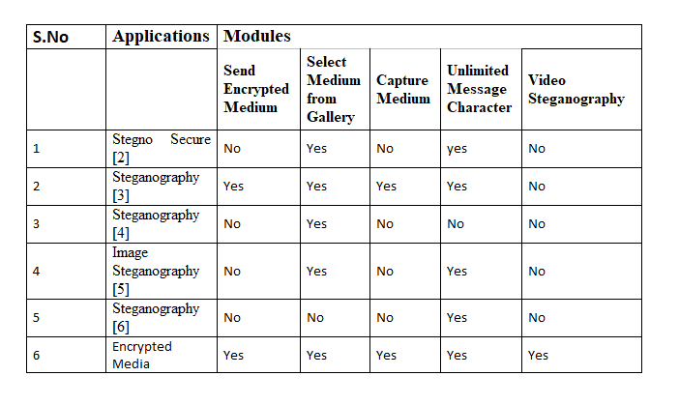
Litrature Review

Slide 11
Tool and Languages
Tool:
Visual Studio Code
Xampp
Languages
React Native (Frontend)
Laravel Framework (Backend)

Slide 12
Conclusion
Steganography is an ancient technique of hiding information by embedding messages within other, seemingly harmless messages, graphics or sounds. In ancient days, it was widely used technique to transfer a hidden message via some medium. However, in modern times, steganography can be looked into as the study of the art and science of communicating in a way, which hides the existence of the communication. The Steganography message is called Plaintext. Medium used to hide any message, in case of image called as Stego-image or in case of video called Stego-video.

Slide 13
Conclusion
The proposed system was an android-based application, which had an algorithm at its core for encoding and decoding. This application can take an image or video, message and password as inputs, probably from a camera or user can use their gallery to choose the image or video then LSB algorithm will apply. After that user can save that encrypted media or can send it to another person. The other person can decode the image by entering the correct password. Encoding and Decoding can be done or read by using a Password and the message will remain hidden for all those who don’t know the decoding password.

Slide 14
References
https://www.ukessays.com/essays/english-language
https://www.slideshare.net/jsdcuraj/project-ppt-21359799?from_action=save

