Slide 1
AN ANDROID APPLICATION WHICH SENDS ENCRYPTED MULTIMEDIA MESSAGE
Presenting By:
Murtuza mehdi
Naveen Farooq
Uzair Saeed
Supervisor:
Ma’am Sumeera Hashmi

Slide 2

Objectives
Introduction to steganography
Background
Problem Statement
Project Scope
Project Objective
Gantt Chart
Tools and Languages
Conclusion
References

Slide 3


Slide 4
Introduction to Steganography
Steganography comes from the Greek steganos (covered or secret) and graphy (writing or drawing).
Steganography is defined as "the art of hiding messages inside media files“
There are many different methods of performing steganography, but we are using LSB (Least Significant Bit) ones.

Slide 5
Background
Steganography is an ancient technique of covert communication.
The earliest form of Steganography has been reported by the Chinese.
A king named Histiaeus encouraged the Aristagoras of Miletus to revolt against the Persian king. He used to tonsure the head of his most trusted servants and tattooed the scalps with secret message and waited for the hair to grow.

Slide 6
Problem Statement
How can we send a secret message to the destination.
Small Size text.
Other steganography applications change the original image type into other type.

Slide 7
Project Scope
This application will be accessed through a Mobile application anyone with an internet connection can use it. There will be a special mobile app for IOS and Android which the users can easily download and use on their devices.
Helpful for Users.
Easy to Use.
High secured Steganography Algorithm.
Helpful against Information hackers.

Slide 8
Project Objectives
Main concern of our project is data security and some other objectives are:
To store a secret message in image.
To send the encrypted image to the receiver.
To protect the image from being viewed by third party.
To restore the stored message in image.

Slide 9
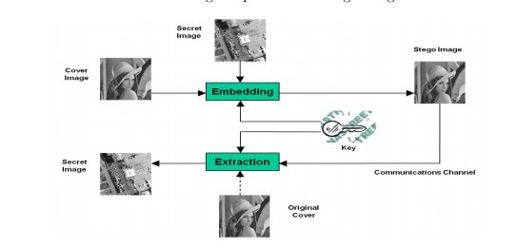
Procedure

Slide 10
Tool and Languages
Tool:
Android Studio
Languages
Java(Backend)
XML(Frontend)

Slide 11
Conclusion
In this project, we proposing a new framework of an image steganography system to hide a digital text of a secret message.
In this project is actually a mobile application platform that will send information from different social media platforms with secure encrypte it into any image with a key that decrypte it from any mobile with software.

Slide 12
References
https://www.ukessays.com/essays/english-language
https://www.slideshare.net/jsdcuraj/project-ppt-21359799?from_action=save

