Slide 1
Satellite/Aerial Image Retrieval
Group Members
Daksh Gupta - A20351161
Sandeep Baradi - A20352613
Ashwani Panwar - A20384632
Hatim Dhuliawala - A20351495

Slide 2
Approach
We divide the bounding box edges into parts of equal length; creating part*part (default part is 3) intersection of sample points.
For each sample point we find the max resolution (levelofDetail) for which the image is available; we take maxLevel as min among all values
We retrieve all tiles that lie in the box as well as tiles that cross the edges of the box.
We shift our coordinate axis to top left of this image from origin coordinates of whole map. Thus change pixel x,y measures of 2 pairs of lat long coordinates .
Using these measures we crop the image.

Slide 3
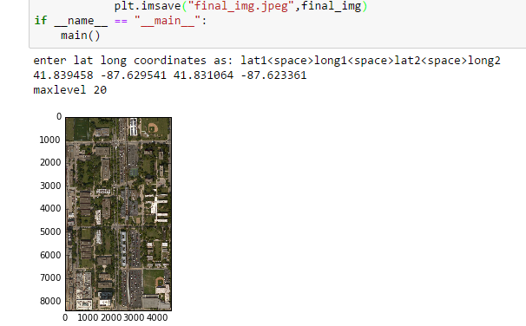
Output

Slide 4
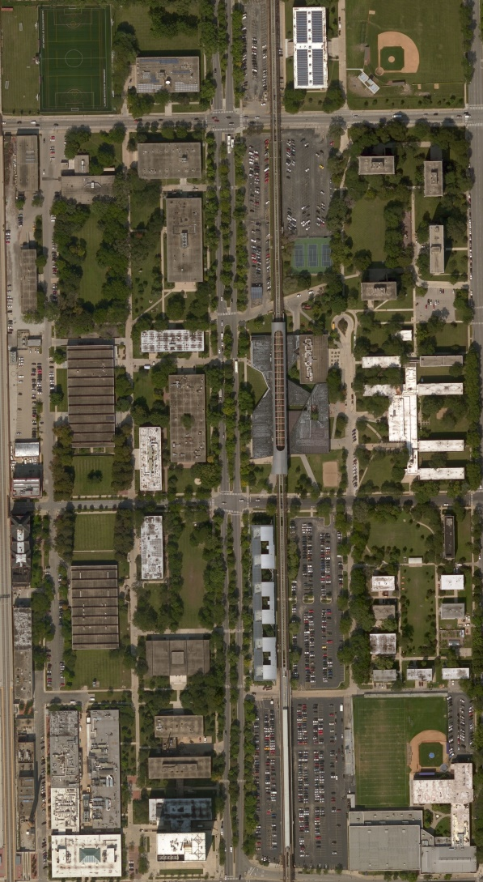
Output

