Slide 1
Project 03: Interpolation & Image Warping
Team Members
Jogalekar, Aditya : 3189939
Morbagal ,Tejas : 3200842
Rajan Heena : 3205531
Khan, Saba : 3179769
Shetty. Sachin : 3201423
Malik, Hirra : 3212661

Slide 2
Radial Basis Interpolation
We are using a Gaussian solution, but, there are other different option:
Multiquadratic (most common, by default in Scipy)
Inverse multiquadratic
Thin-plate spine
We are reconstructing unknown functions from known data.
Here, we look for weights w I
The solution is: w = φ −1 · y
y is the vector of values we want to learn

Slide 3
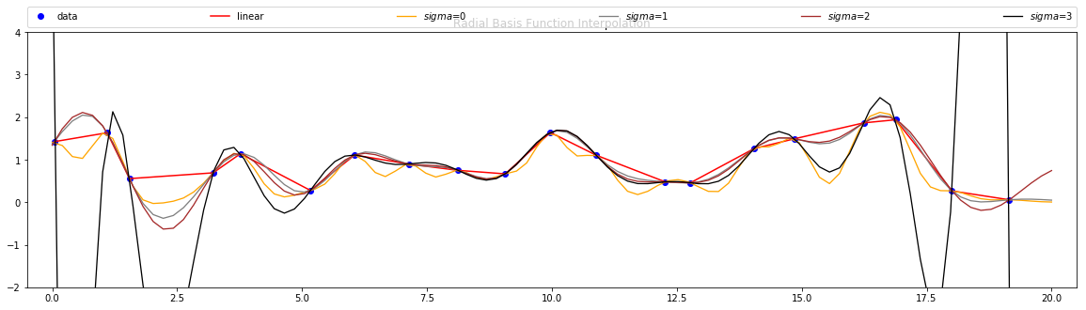
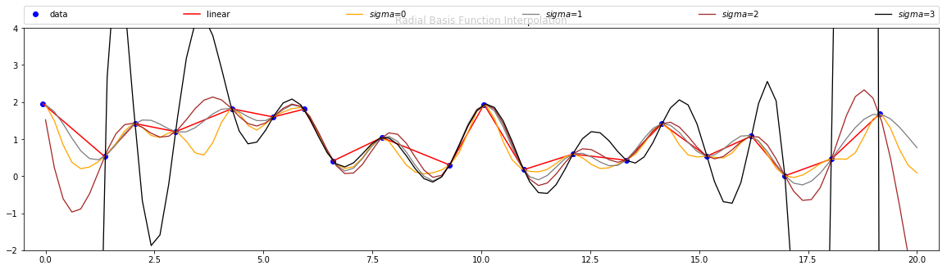
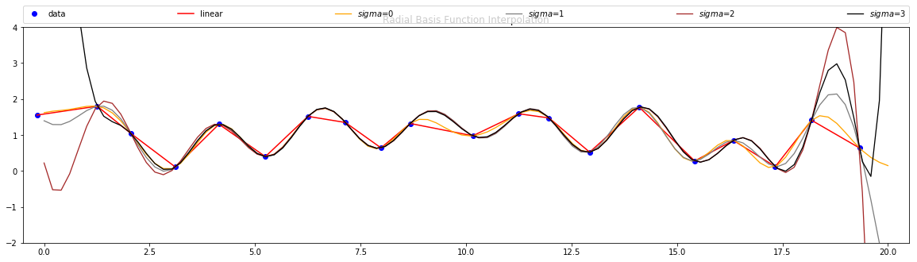
Scipy implementation
epsilon_arr = [ 0.5, 1, 2, 4 ]
epsilon_arr = [ 2, 4, 6, 8 ]
epsilon_arr = [ 1, 2, 3, 4 ]

Slide 4
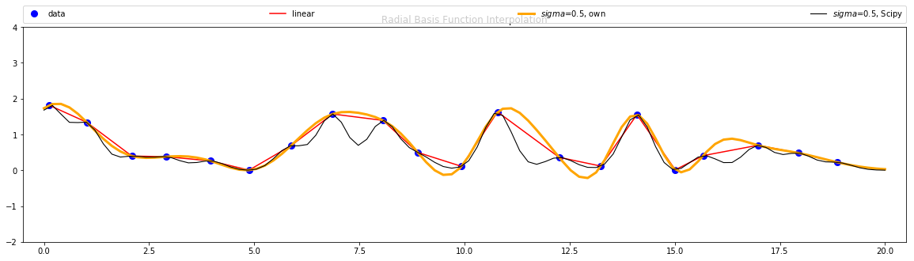
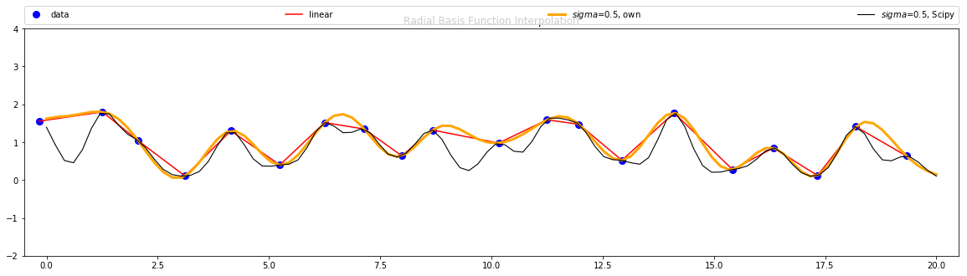
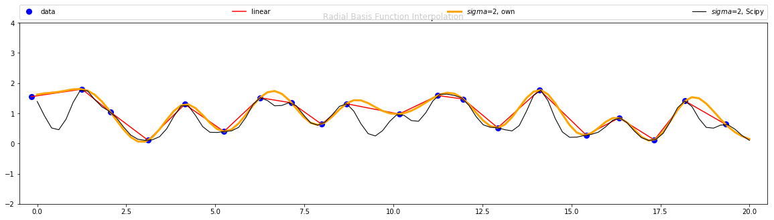
Local implementation
sigma = 0.5
sigma = 1
sigma = 1
sigma = 2

Slide 5
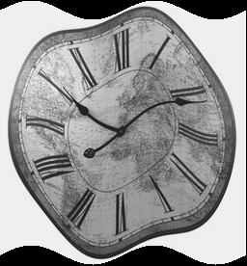
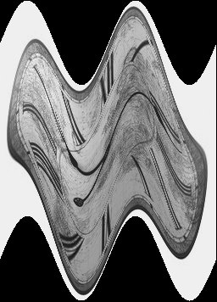
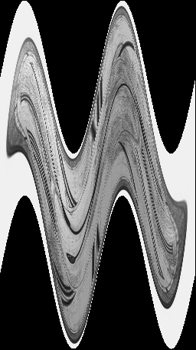
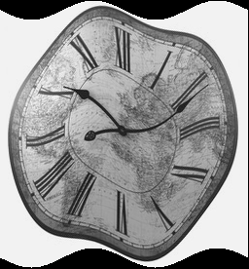
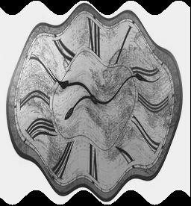
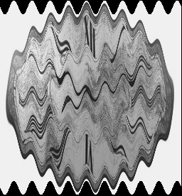
3.2 Warps (amplitude & frequency variation)
amp = 10
amp = 50
amp = 100
freq = 2
freq = 4
freq = 10

Slide 6
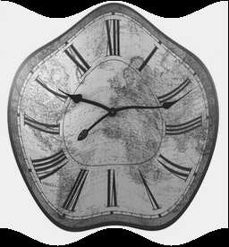
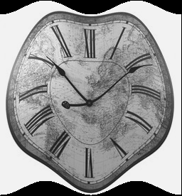
3.2 Warps (phase variation)
phase = 0
phase =pi/2
phase = pi
phase = -pi/2

Slide 7
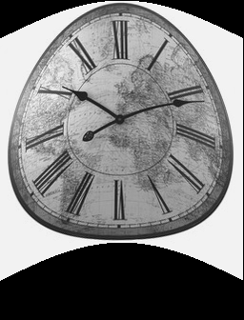
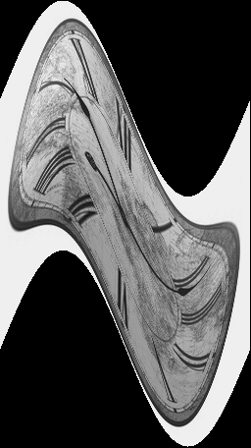
3.2 Warps (output images)
amp = 40
freq = 0.5
phase = 0
amp = 100
freq = 1
phase = 0

Slide 8
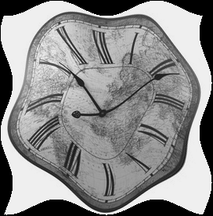
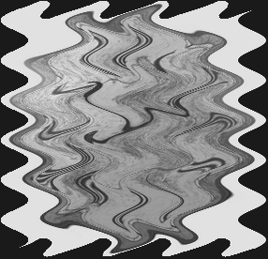
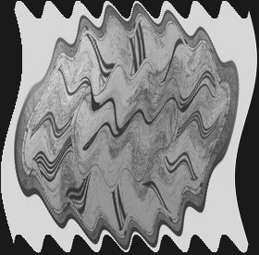
3.2 Warps (output images)
amp = 8,10
req = 2,2
phase = 0, -pi/2
amp = 15,10
freq = 6,4
phase = -pi/2, 0
amp = 12,10
freq = 1,8
phase = pi, 0

Slide 9
Task 3.3 Cylinder anamorphosis
An anamorphosis is a deformed image that appears in its true shape when viewed in some "unconventional" way. The cylindrical anamorphosis, as the term says, shows the image as a cylinder or circular shape

Slide 10
Task A:
Take the Image
Find the Centre of the Image
Fix a radius to turn the image into a circular one
width, height = input_image.shape[0], input_image.shape[1]
mid_x, mid_y = width/2, height/2
Create a mesh

Slide 11
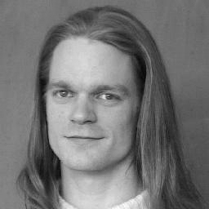
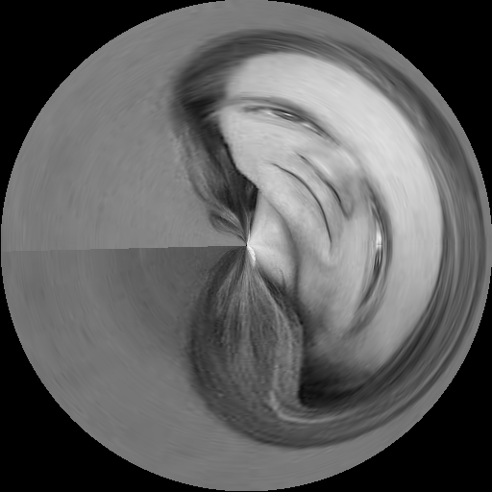
Calculate angle to center
Calculate distance to center and compare to max distance proportion excluding the range
Higher the angle, from right most part get the y index (For Vertical)
Higher the fraction to center, get from upper x index (For horizontal)
Rotate the image Clockwise about the centre.

Slide 12
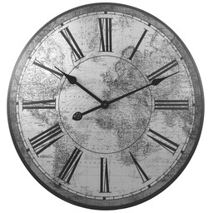
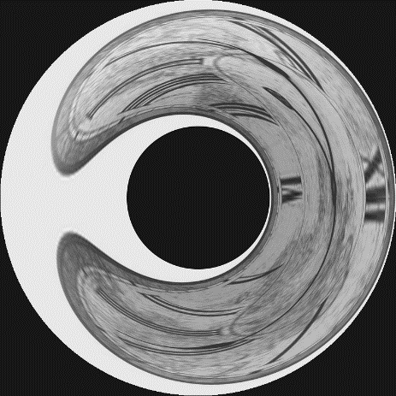
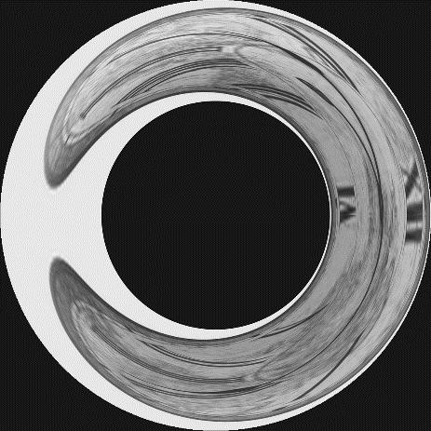
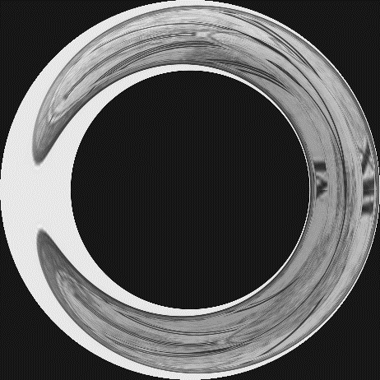
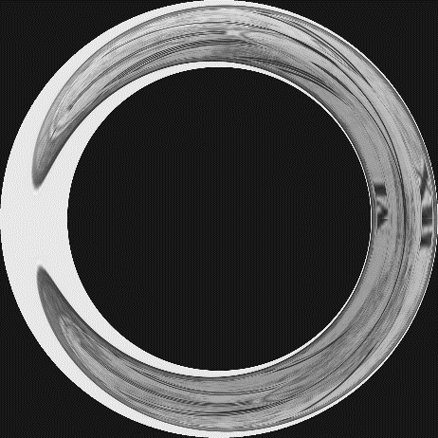
Task B
In Task 1 we rotated the image along the centre, but to form the donut we need to keep an inner loop of a fixed radius and rotate the image along that loop.
Original
Radius=2
Radius=4
Radius=6
Radius=8

Slide 13
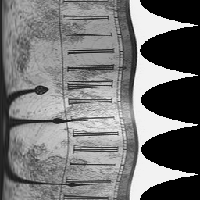
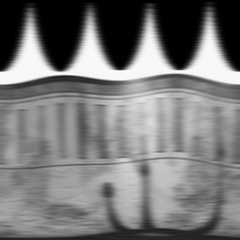
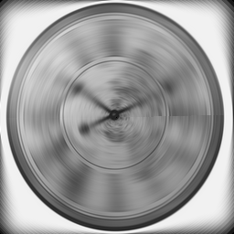
Task 3.4 Angular Gaussian Blur
ransforming from (x; y) to (r; φ) coordinates, apply a 1D Gaussian filter along the φ dimension of the image,
and then transform it back into (x; y) coordinates
f [x, y]
F[r,φ]
blur along φ axis
g [x, y]

Slide 14
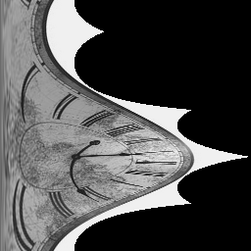
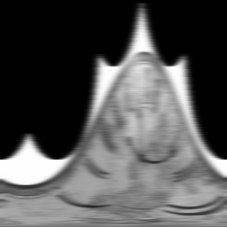
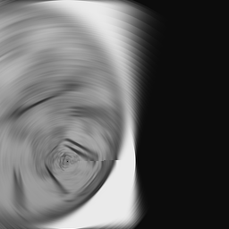
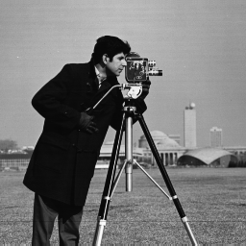
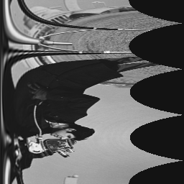
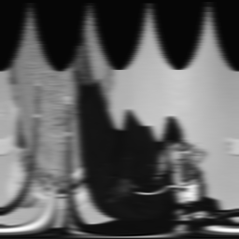
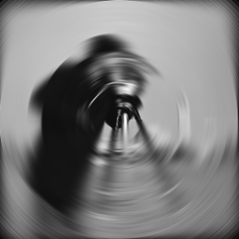
Task 3.4 Playing Around with center and other images
Blur along the centre 180px and 180px, we can see a different result

Slide 15
3.5: Perspective Mapping Between Quadrilaterals
Calculate the transformation matrix so our image fits inside the poster.
The solution is Homography.
Homography is a transformation matrix that maps the points in one image to the corresponding points in other image.

Slide 16
How to do it?
Load the images

Slide 17
How to do it?
2. Define the corners where to put the small image
3. Calculate homography between source and destination points
4. Generate warped small image in an image size like the destination one
5. Black out polygonal area in destination image 6. Add warped source image to destination image

Slide 18
THANK YOU

