Slide 1
SPORTS BOARDCAST
SCHEDULING TOOLS

Slide 2
About Project
SPORTS BOARDCAST SCHEDULING TOOLS CAN HELP WITH PLANNING AND EXECUTING
SPORTS PRODUCTIONS,INCLUDING SCHEDULING COMMUNICATION BOARDCASTING

Slide 3
PROBLEM STATEMENT
BOARDCAST :- which includes properties like event_id , event_name, and timings
BOARDCASTMANAGER:- which will CRUD operations , scheduling , and rights management

Slide 4
library included
tkinter :- That allows developers to create a graphical user interface(GUI’S) for python applications
messagebox:- A dialog box used to display messages
scrolledtext:- A text box which is used edit large amount of text in a scrollable area

Slide 5
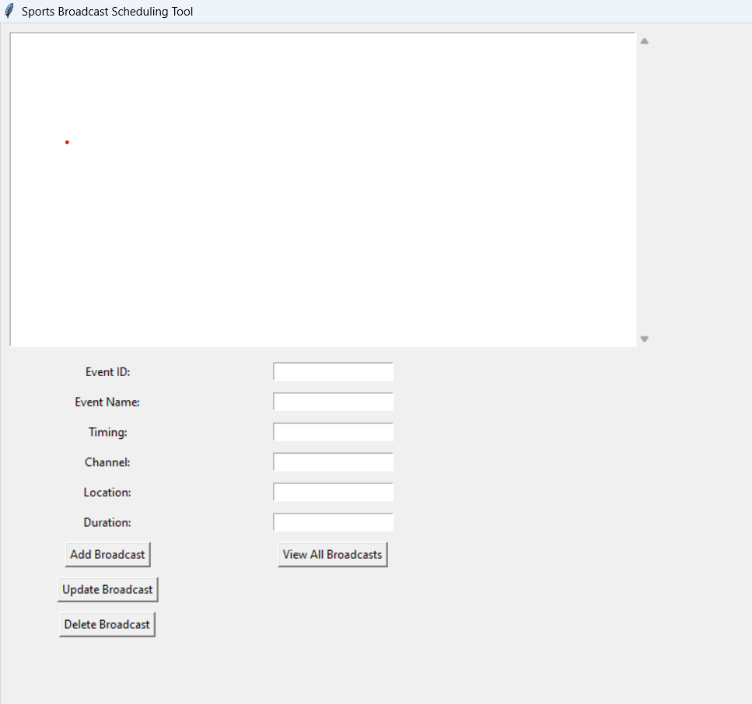
OUTPUT MENU

Slide 6
ADD BOARDCAST:- The user can fills details about the Boardcast event such as
Event_id ,name, timing , channel etc
UPDATE BOARDCAST:- update Boardcast button is used to modify the existing data
DELETE BOARDCAST:- to remove or delete the existing data
VIEW-ALL BOARDCAST:- to display a list of all the boardcast currently stored in a system

Slide 7
Thank you

