Slide 1
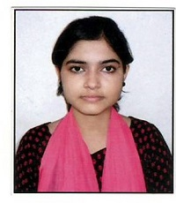


Saba Haque
Analyst/Software Engineer
Bachelor of Technology
Computer Science Engineering :
2015 – 2019
Skills .NET
C and C++
SQL
HTML and CSS
Database:
SQL database - MySQL
Web Technologies:
Html
CSS3
JavaScript
Tools:
Visual studio 2019
Additional Details:
Leadership
Hardworking
Self Motivated
Quick Learner
Team management
Areas of interest and hobbies:
Listening to music
Playing games
Kolkata
Saba.haque@capgemini.com
7991106417
A4
A self – driven learner eager to work in a team of dedicated people and serve a key role in the enhancement and development of the project.
Ready to learn new technologies/frameworks and implement them to further improve my knowledge.
Possess good verbal communication skills and ability to grow and utilize my skill continuously.
Ready to learn new technologies and implement them to further improve my knowledge.
Eager to work in a team of dedicated people and serve a key role in the enhancement and development of the project.
Medicine Monitoring system:
Developed a web application called Medicine Monitoring System using Asp.net Core MVC, Web Api and Mircrosoft SQL.
AZ – 900 Microsoft Azure Fundamental Certification:
Completed AZ – 900 Microsoft Azure Fundamental Certification.
Completed mandatory learning on .degreed platform

