Slide 1
FAST FOOD RESTURANT
Management System
Client Name: Taimoor Khan

Slide 2
Group Members
Sabahat Ijaz p16-6055
Noormah Omar Khan p16-6040
Laiba Gul p16-6117
Muhammad Toqeer p16-6069
Hamza Bukhari p16-6058
Muhammad Hamza
Yousaf Khan
Ammar Khan
Mudassar Athar

Slide 3
objective
As we know today world is of technology. Computer is basic need of every field. This project will facilitate every restaurant organization. As it will help store information and calculation about their profits, sales and employees etc.
To build a software for FAST FOOD RESTURANT which would help them in analysing their sales and control sales and customers and to analyse the best sales and the best customer of the month.

Slide 4
Actors of the system:
Operator
Admin

Slide 5
TOP 10 Requirements
Admin login
Operator login
Remove items, promotions, deals, operators, customer (by admin)
Add items ,promotions, deals, operators (by admin)
Add customer and sales (by operator)
Update items, promotions, deals, operators (by admin)
Search for item, sale, and customer.
Make bill in PDF format.
Make graph based on information in Databases.
Database having Admin, customer, sales and operator information

Slide 6
More requirements
Regular customer details(some sort of ID number)
Multiple search type either ID, Date, Name
Create new employee(waiter, operator)
Discount log maintenance
Create user (admin)
Printer linking and usage
Graph features i.e. top products, top customers, daily weekly and monthly sales record
Display of statistics every time.

Slide 7
Non functional requirements
Password Type
Email based or phone number based logins
Deals type(daily, weekly, monthly)
Determine user type(admin/operator)
Graph type i.e. pie, bar etc.

Slide 8
High rank requirements
Login operator/admin
Removal and Addition of features
Update items
Search Bar
Bill
PDF Form
Graph for Judgments

Slide 9
Proposed solution
Concept of:
Agile Mode
Classes
Database
MVC
l

Slide 10
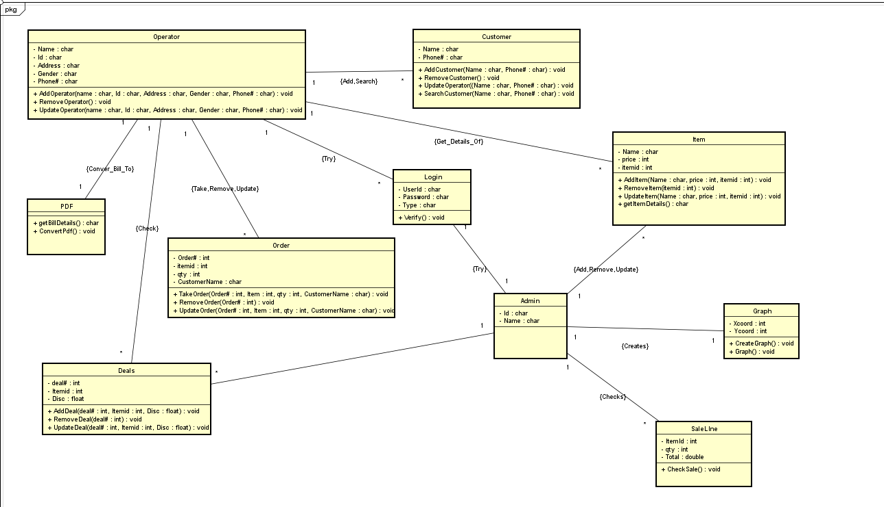
Class diagram

Slide 11
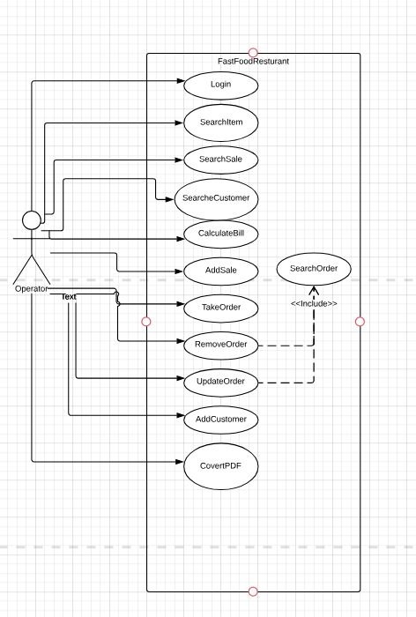
Use case diagram
Operator interaction

Slide 12
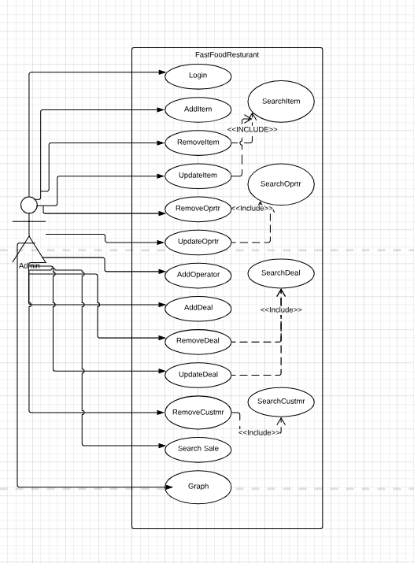
USE CASE DIAGRAM
Admin Interaction

Slide 13
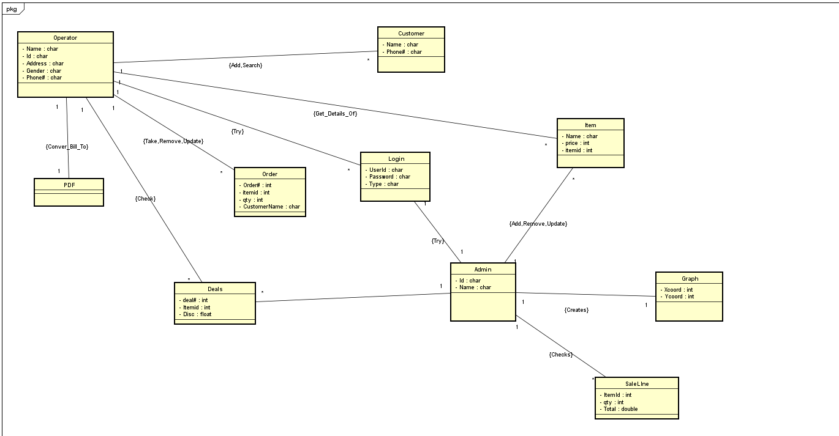
Domain model

