Slide 1
Gold Analysis Agent
AI-powered gold market analysis using Alpha Vantage, news feeds, Gemini LLM, and Streamlit.
Hadi Sabahi

Slide 2
Project Objectives
Real-time gold data
News analysis
LLM-generated insights
Bilingual support (English/Persian)
Interactive UI

Slide 3
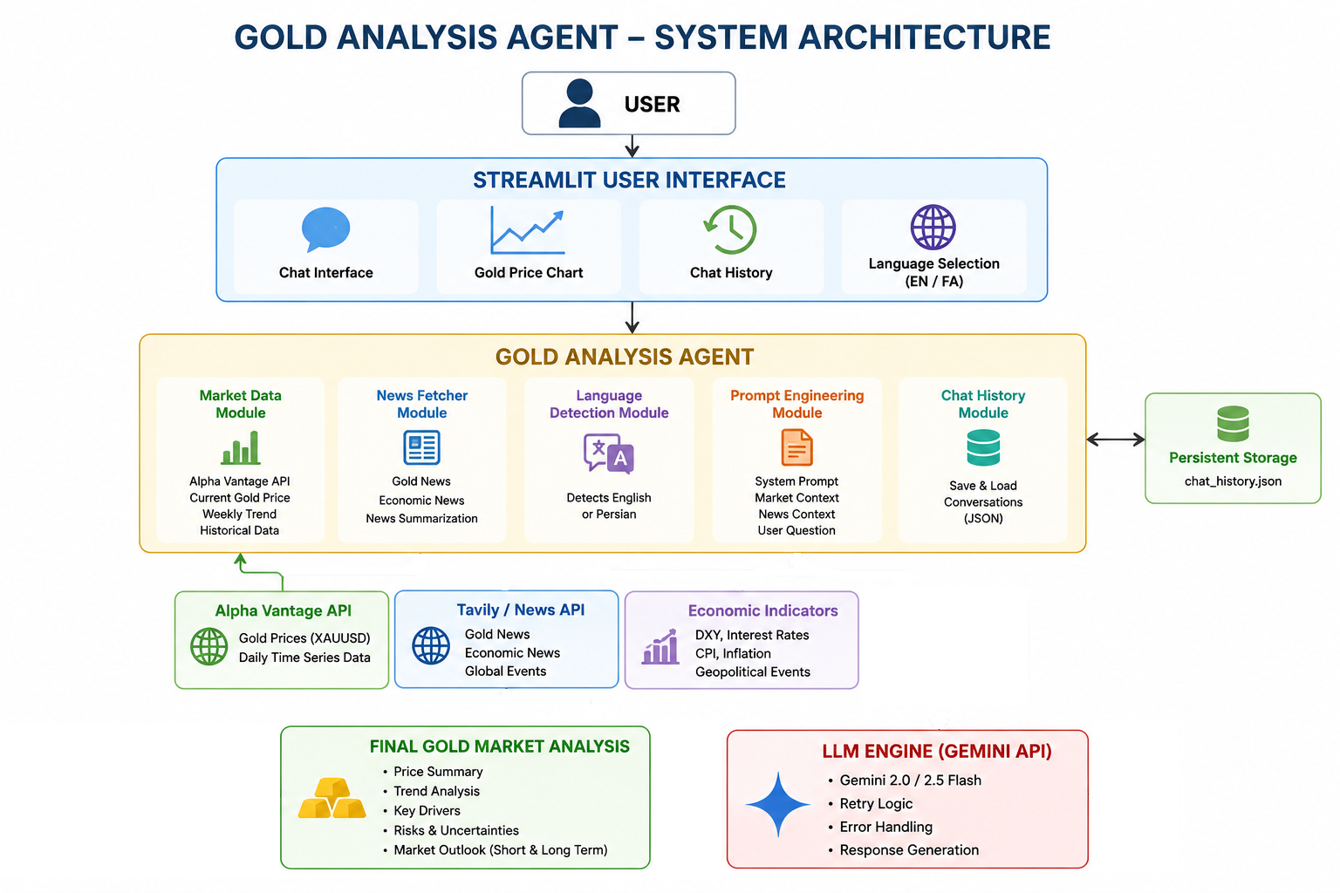


Slide 4
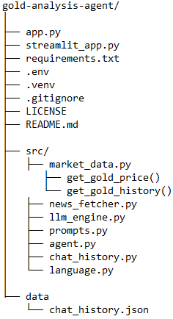
Folder Structure

Slide 5
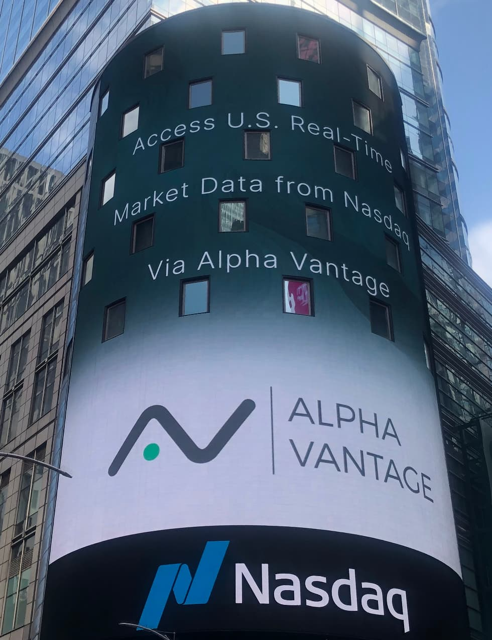
Market Data Module
Alpha Vantage API
Current gold price
Historical prices
Weekly trend calculation
Chart generation

Slide 6
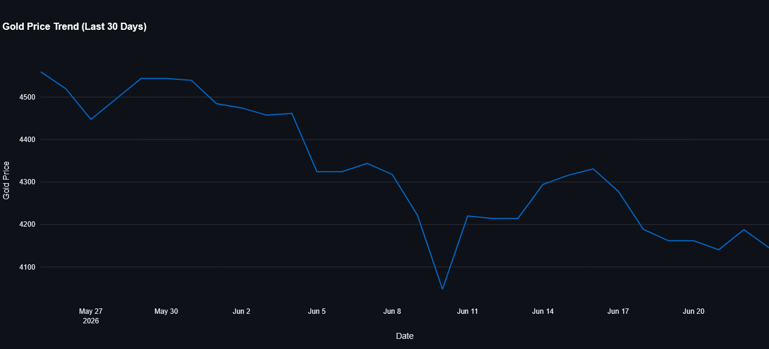

Slide 7
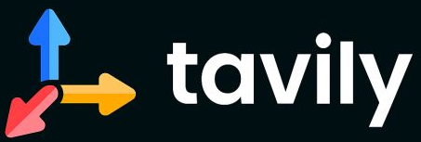
News Analysis Module
TAVILY
Fetch gold/economic news
Summarize key events
Assess impact on gold price
Provide context to LLM

Slide 8
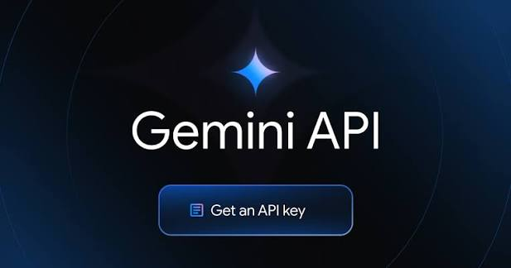
LLM Engine
Gemini API, model="gemini-2.5-flash-lite"
Prompt engineering
Retry logic, max retries = 4
Error handling
Structured JSON input

Slide 9

Streamlit Interface
Chat interface
Gold price chart
Conversation history
English/Persian support

Slide 10
Sample Prompt #1
Q: What impact is the current strength of the US Dollar Index (DXY) having on gold?
A: The current strength of the US Dollar Index (DXY) is exerting downward pressure on gold prices.
Market Trend: Gold prices have experienced a significant decline, tumbling more than 3% to below $4,000 per ounce, reaching their lowest level since November 2025. The weekly change for gold shows a decrease of 3.06%.
Key Drivers:
Stronger US Dollar: A stronger dollar generally makes gold, which is priced in dollars, more expensive for holders of other currencies, thus reducing demand. The DXY itself has shown upward movement in some data points.
Hawkish Fed Expectations: Growing expectations of further interest rate hikes by the Federal Reserve are a significant driver. Markets are increasingly pricing in a Fed rate hike in September, which increases the attractiveness of dollar-denominated assets and higher-yielding investments over non-yielding gold. The traditional inverse relationship between interest rates and gold prices is highlighted in the provided news.
Diminished Safe-Haven Appeal: Despite geopolitical uncertainties, gold has struggled to act as a traditional safe haven, further contributing to its price weakness.
Risks:
Further Dollar Strength: Continued appreciation of the US Dollar could lead to further price erosion for gold.
Aggressive Fed Policy: More hawkish-than-expected monetary policy from the Federal Reserve could exacerbate the negative sentiment for gold.
Geopolitical Escalation: While currently not supporting gold, a significant escalation in geopolitical tensions could potentially shift sentiment and drive demand for safe-haven assets, though this is not the current trend.
Short-Term Outlook: The immediate outlook for gold appears challenging as long as the US Dollar remains strong and the Federal Reserve signals a hawkish stance. The combination of these factors is likely to continue weighing on gold prices. However, the exact trajectory will depend on evolving Fed policy expectations and any significant shifts in geopolitical events.

Slide 11
Sample Prompt #2
Q: What is the outlook for gold this week?
A: The gold market has experienced a significant downturn, with prices tumbling over 3% this week to their lowest level since November 2025. The current price of $4060.07 reflects a substantial weekly decline of 3.06%.
Key Drivers:
Hawkish Fed Expectations: Growing expectations that the Federal Reserve will maintain a hawkish stance, with traders increasingly betting on an interest-rate increase later this year, are pressuring gold. The probability of a Fed rate hike in September has significantly increased.
Stronger US Dollar: A stronger US dollar is a primary headwind for gold, as the two assets often move inversely.
Geopolitical Uncertainty: Despite heightened geopolitical uncertainty, gold has struggled to act as a traditional safe-haven asset, indicating a shift in market sentiment or other dominant factors.
Risks:
Further Rate Hikes: Continued hawkish rhetoric or actual rate hikes from the Fed would likely exert further downward pressure on gold prices.
Dollar Strength: Sustained strength in the US dollar poses an ongoing risk to gold's valuation.
Diminished Safe-Haven Appeal: The market's current disinterest in gold as a safe haven during geopolitical events suggests that this traditional driver may be less impactful in the short term.
Short-Term Outlook:
The immediate outlook for gold appears challenging. The combination of increasing odds of Fed rate hikes and a strengthening US dollar suggests that downward pressure may persist. While geopolitical tensions could theoretically offer support, current market behavior indicates this is not a dominant factor. The market is closely watching inflation data and Fed commentary for any shifts in policy expectations. The current trend suggests a cautious sentiment for gold in the near term.

Slide 12
Sample Prompt #3
Q: What are the effects of geopolitical tensions on gold?
A: Market Trend:
The gold market is currently experiencing a downward trend, with prices tumbling over 3% in the past week to below $4,000 per ounce, reaching their lowest level since November 2025. The year-to-date performance shows a decline of approximately 5%, and the metal is nearly 20% below its January record high.
Key Drivers:
Stronger US Dollar: A strengthening US dollar is a significant headwind for gold, as it makes the precious metal more expensive for holders of other currencies.
Hawkish Federal Reserve Stance: Growing expectations that the Federal Reserve will maintain a hawkish stance, with increased probability of an interest rate hike in September, are pressuring gold prices. Higher interest rates generally make non-yielding assets like gold less attractive.
Geopolitical Uncertainty (Limited Impact): While geopolitical tensions, such as the conflict involving Iran, are present, gold has struggled to retain its traditional safe-haven appeal. This suggests that other factors are currently overriding its safe-haven status.
Inflation Concerns: A surge in oil prices, potentially linked to geopolitical events, has fueled inflation concerns. Historically, gold can act as an inflation hedge, but this effect appears subdued in the current environment.
Risks:
Further Fed Tightening: Continued hawkish signals from the Federal Reserve could lead to further appreciation of the US dollar and higher interest rates, posing a risk to gold prices.
Escalation of Geopolitical Tensions: While currently not a strong driver, a significant escalation of geopolitical conflicts could potentially revive gold's safe-haven demand, though this is uncertain given recent price action.
Economic Slowdown: A broader global economic slowdown could also influence gold's trajectory, but the immediate focus appears to be on monetary policy and currency strength.
Short-Term Outlook:
The short-term outlook for gold appears cautious. The prevailing headwinds of a strong US dollar and hawkish Fed expectations are likely to continue weighing on prices. The market is currently not fully pricing in the traditional safe-haven demand associated with geopolitical uncertainty. There is a notable divergence between heightened geopolitical tensions and gold's performance, indicating a complex interplay of market forces. The lack of a clear revival in gold's safe-haven appeal amidst current geopolitical events suggests that further price declines are a possibility if these dominant drivers persist.

Slide 13
Sample Prompt #4
Q: آیا الان زمان مناسبی برای خرید طلا است؟
A: در حال حاضر، بازار طلا با چالش‌هایی روبرو است که بر قیمت آن تأثیر گذاشته است.
روند بازار:
قیمت طلا در هفته گذشته حدود ۳.۰۶ درصد کاهش یافته و به ۴۰۶۰.۰۷ واحد رسیده است.
این کاهش، قیمت طلا را به پایین‌ترین سطح از نوامبر ۲۰۲۵ رسانده است.
عوامل کلیدی:
تقویت دلار آمریکا: افزایش ارزش دلار آمریکا فشار نزولی بر قیمت طلا وارد می‌کند.
انتظارات نرخ بهره فدرال رزرو: افزایش احتمالات مبنی بر افزایش نرخ بهره توسط فدرال رزرو در آینده نزدیک، جذابیت دارایی‌های با بازدهی ثابت مانند طلا را کاهش می‌دهد. اخبار نشان می‌دهد که احتمال افزایش نرخ بهره در سپتامبر از ۲۹٪ به حدود ۶۸٪ افزایش یافته است.
عدم اطمینان ژئوپلیتیکی: با وجود تنش‌های ژئوپلیتیکی، طلا نتوانسته است نقش سنتی خود را به عنوان یک دارایی امن به طور کامل ایفا کند.
ریسک‌ها:
سیاست‌های انقباضی فدرال رزرو: ادامه سیاست‌های انقباضی و افزایش نرخ بهره می‌تواند ادامه دهنده روند نزولی قیمت طلا باشد.
تقویت مداوم دلار: هرگونه تقویت بیشتر دلار آمریکا می‌تواند فشار بیشتری بر طلا وارد کند.
چشم‌انداز کوتاه‌مدت: با توجه به فشارهای فعلی ناشی از دلار قوی و انتظارات افزایش نرخ بهره، چشم‌انداز کوتاه‌مدت برای طلا همچنان با عدم اطمینان همراه است. در حالی که طلا به طور سنتی در زمان عدم اطمینان اقتصادی و ژئوپلیتیکی مورد توجه قرار می‌گیرد، عوامل فعلی مانند سیاست‌های پولی آمریکا در حال حاضر بر آن غلبه کرده‌اند.
نکته: اطلاعات ارائه شده بر اساس داده‌های موجود است و بازار طلا می‌تواند به سرعت تغییر کند.

Slide 14
Challenges & Solutions
API rate limits → Alpha Vantage
Gemini quota limits → Retry/Fallback
History persistence → JSON storage
Sanction Restrictions → VPN

Slide 15
Future Improvements
Technical indicators (MA, RSI, MACD, …)
Sentiment analysis
Multi-agent architecture
Portfolio recommendations

Slide 16
Conclusion
The Gold Analysis Agent combines market data, news, and LLM reasoning to generate understandable gold-market insights.

