Slide 1

Pneumpredict
A Deep Learning Assisted
Classification Web App to Predict Pulmonary Infection from Conventional X-rays
~ Dr. Sabahuddin Ahmad

Slide 2
X-rays detect pulmonary infections quickly
Pulmonary (lung) infections are life threatening
Pneumonia is a classical example, mostly caused by virus & bacteria
COVID-19 virus infects lungs, causing pneumonia
The air sacs within lungs fill up with fluid or pus in pneumonia
X-ray provides a diagnostic image within 15 minutes
An expert to interpret the result may not be immediately available

Slide 3
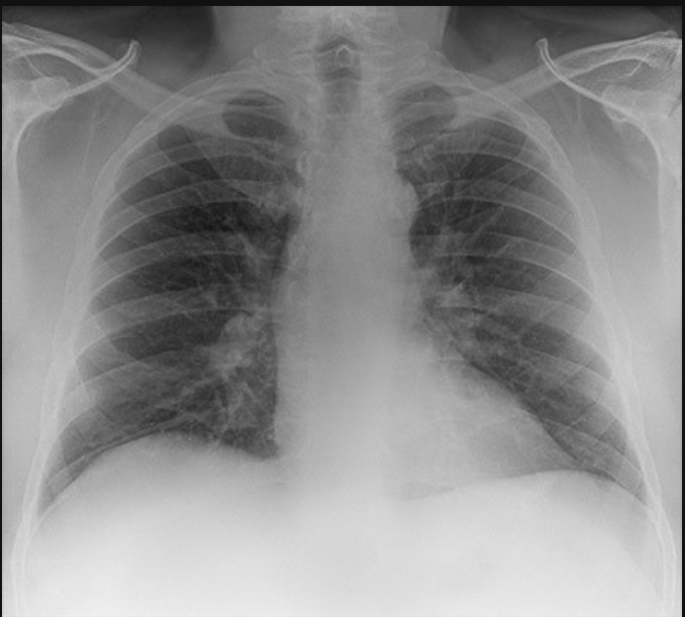
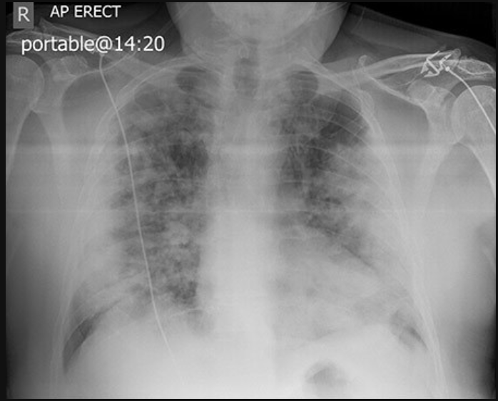
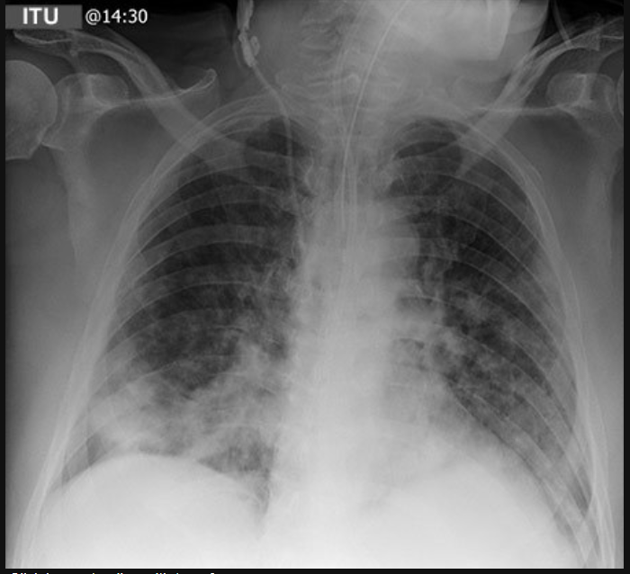
Journey of a Covid19 patient in X-rays
lungs clear & healthy
(2 years before)
lungs severely infected
(Day 1 of hospitalization)
lungs recovering
(Day 5 of hospitalization)
©Radiology Masterclass

Slide 4
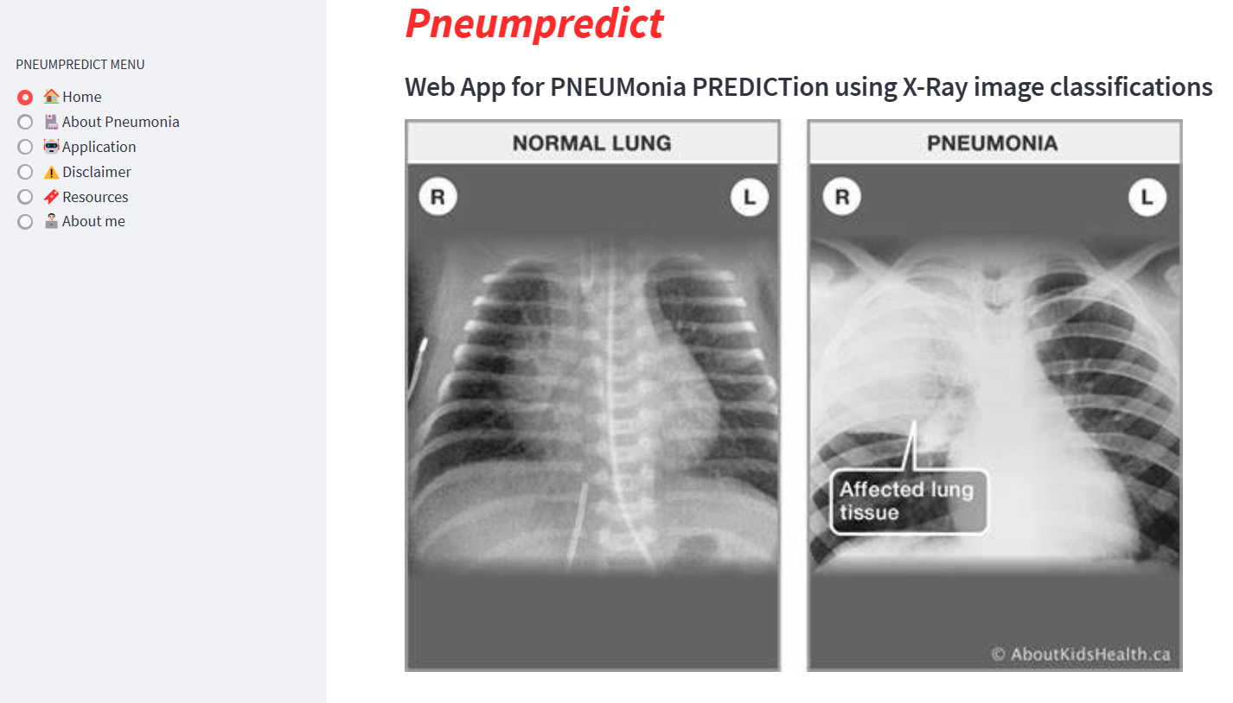

Application interface:
URL: https://sabahuddinahmad-pneumpredict-app-v1-ofjwfn.streamlit.app
Scan Me

Slide 5
Limitations of computer vision on (lung) X-rays
Data augmentation (by rotation, zooming, tilting) does not work
Cannot be classified for the cause (viral, bacterial or other reasons)
Accuracy of model depends on the quality of the images
X-ray may have noise in patients (due to medical devices, support)

Slide 6
You can have data without information, but you cannot have information without data
– Daniel Keys Moran

