Slide 1
Pre-qiime2: quality control and removing adapters
Sierra Smith
UPRM qiime2 Workshop

Slide 2
Programs Used
Fastqc
https://github.com/s-andrews/FastQC
Trim_galore
https://github.com/FelixKrueger/TrimGalore

Slide 3
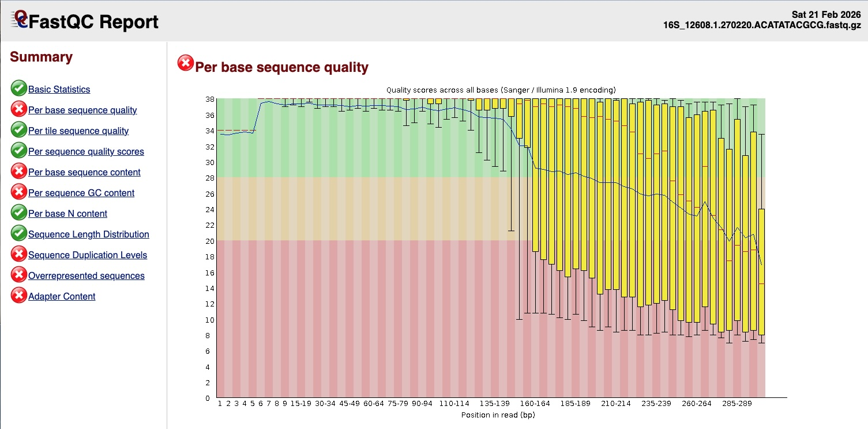
Programs Used
Sample ID
Raw reads
Fastqc
https://github.com/s-andrews/FastQC
Trim_galore
https://github.com/FelixKrueger/TrimGalore

Slide 4
Programs Used
Raw reads
Fastqc
https://github.com/s-andrews/FastQC
Trim_galore
https://github.com/FelixKrueger/TrimGalore
Quality Score

Slide 5
Programs Used
Raw reads
Fastqc
https://github.com/s-andrews/FastQC
Trim_galore
https://github.com/FelixKrueger/TrimGalore
Quality Score
Default

Slide 6
Programs Used
Raw reads
Fastqc
https://github.com/s-andrews/FastQC
Trim_galore
https://github.com/FelixKrueger/TrimGalore
Quality Score

Slide 7
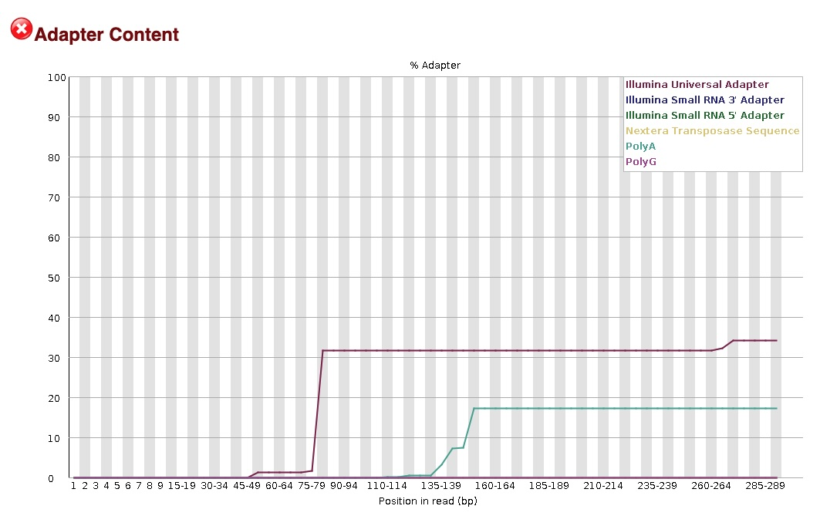
Programs Used
Adapter
Auto-Detect
Raw reads
Fastqc
https://github.com/s-andrews/FastQC
Trim_galore
https://github.com/FelixKrueger/TrimGalore

Slide 8
Programs Used
Fastqc
https://github.com/s-andrews/FastQC
Trim_galore
https://github.com/FelixKrueger/TrimGalore

Slide 9
Programs Used
Trim_galore
trim_galore -q 20 --fastqc -o trimmed_reads ./*.fastq.gz

Slide 10
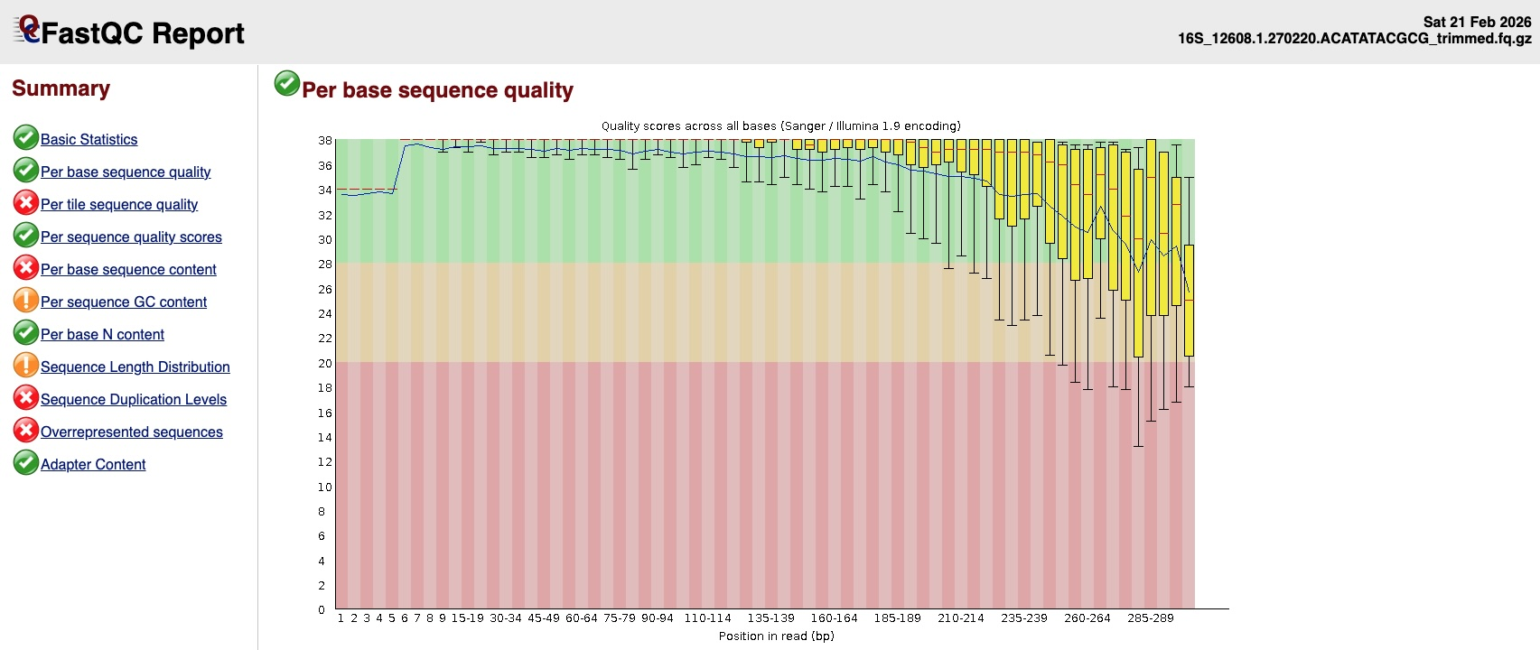
Programs Used
Trim_galore
Trimmed reads
Much better!

Slide 11
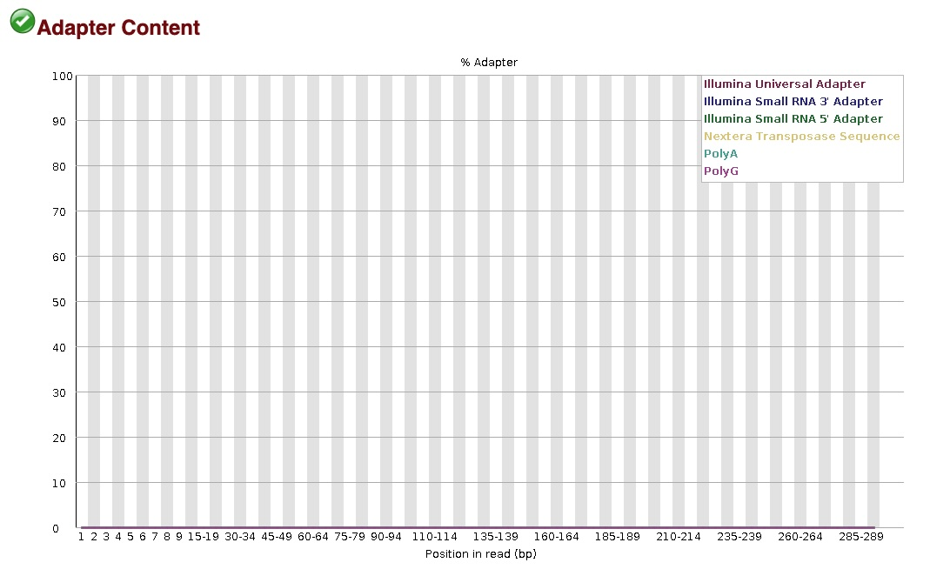
Programs Used
Trim_galore
Trimmed reads
No adapters!

Slide 12
trimmed_reads.zip
Workflow
unzip trimmed_reads.zip
Import into qiime2 via manifest file

Slide 13
Poll, take 2!
https://forms.gle/gBCuXjs6jcxfxGWw5

