Slide 1
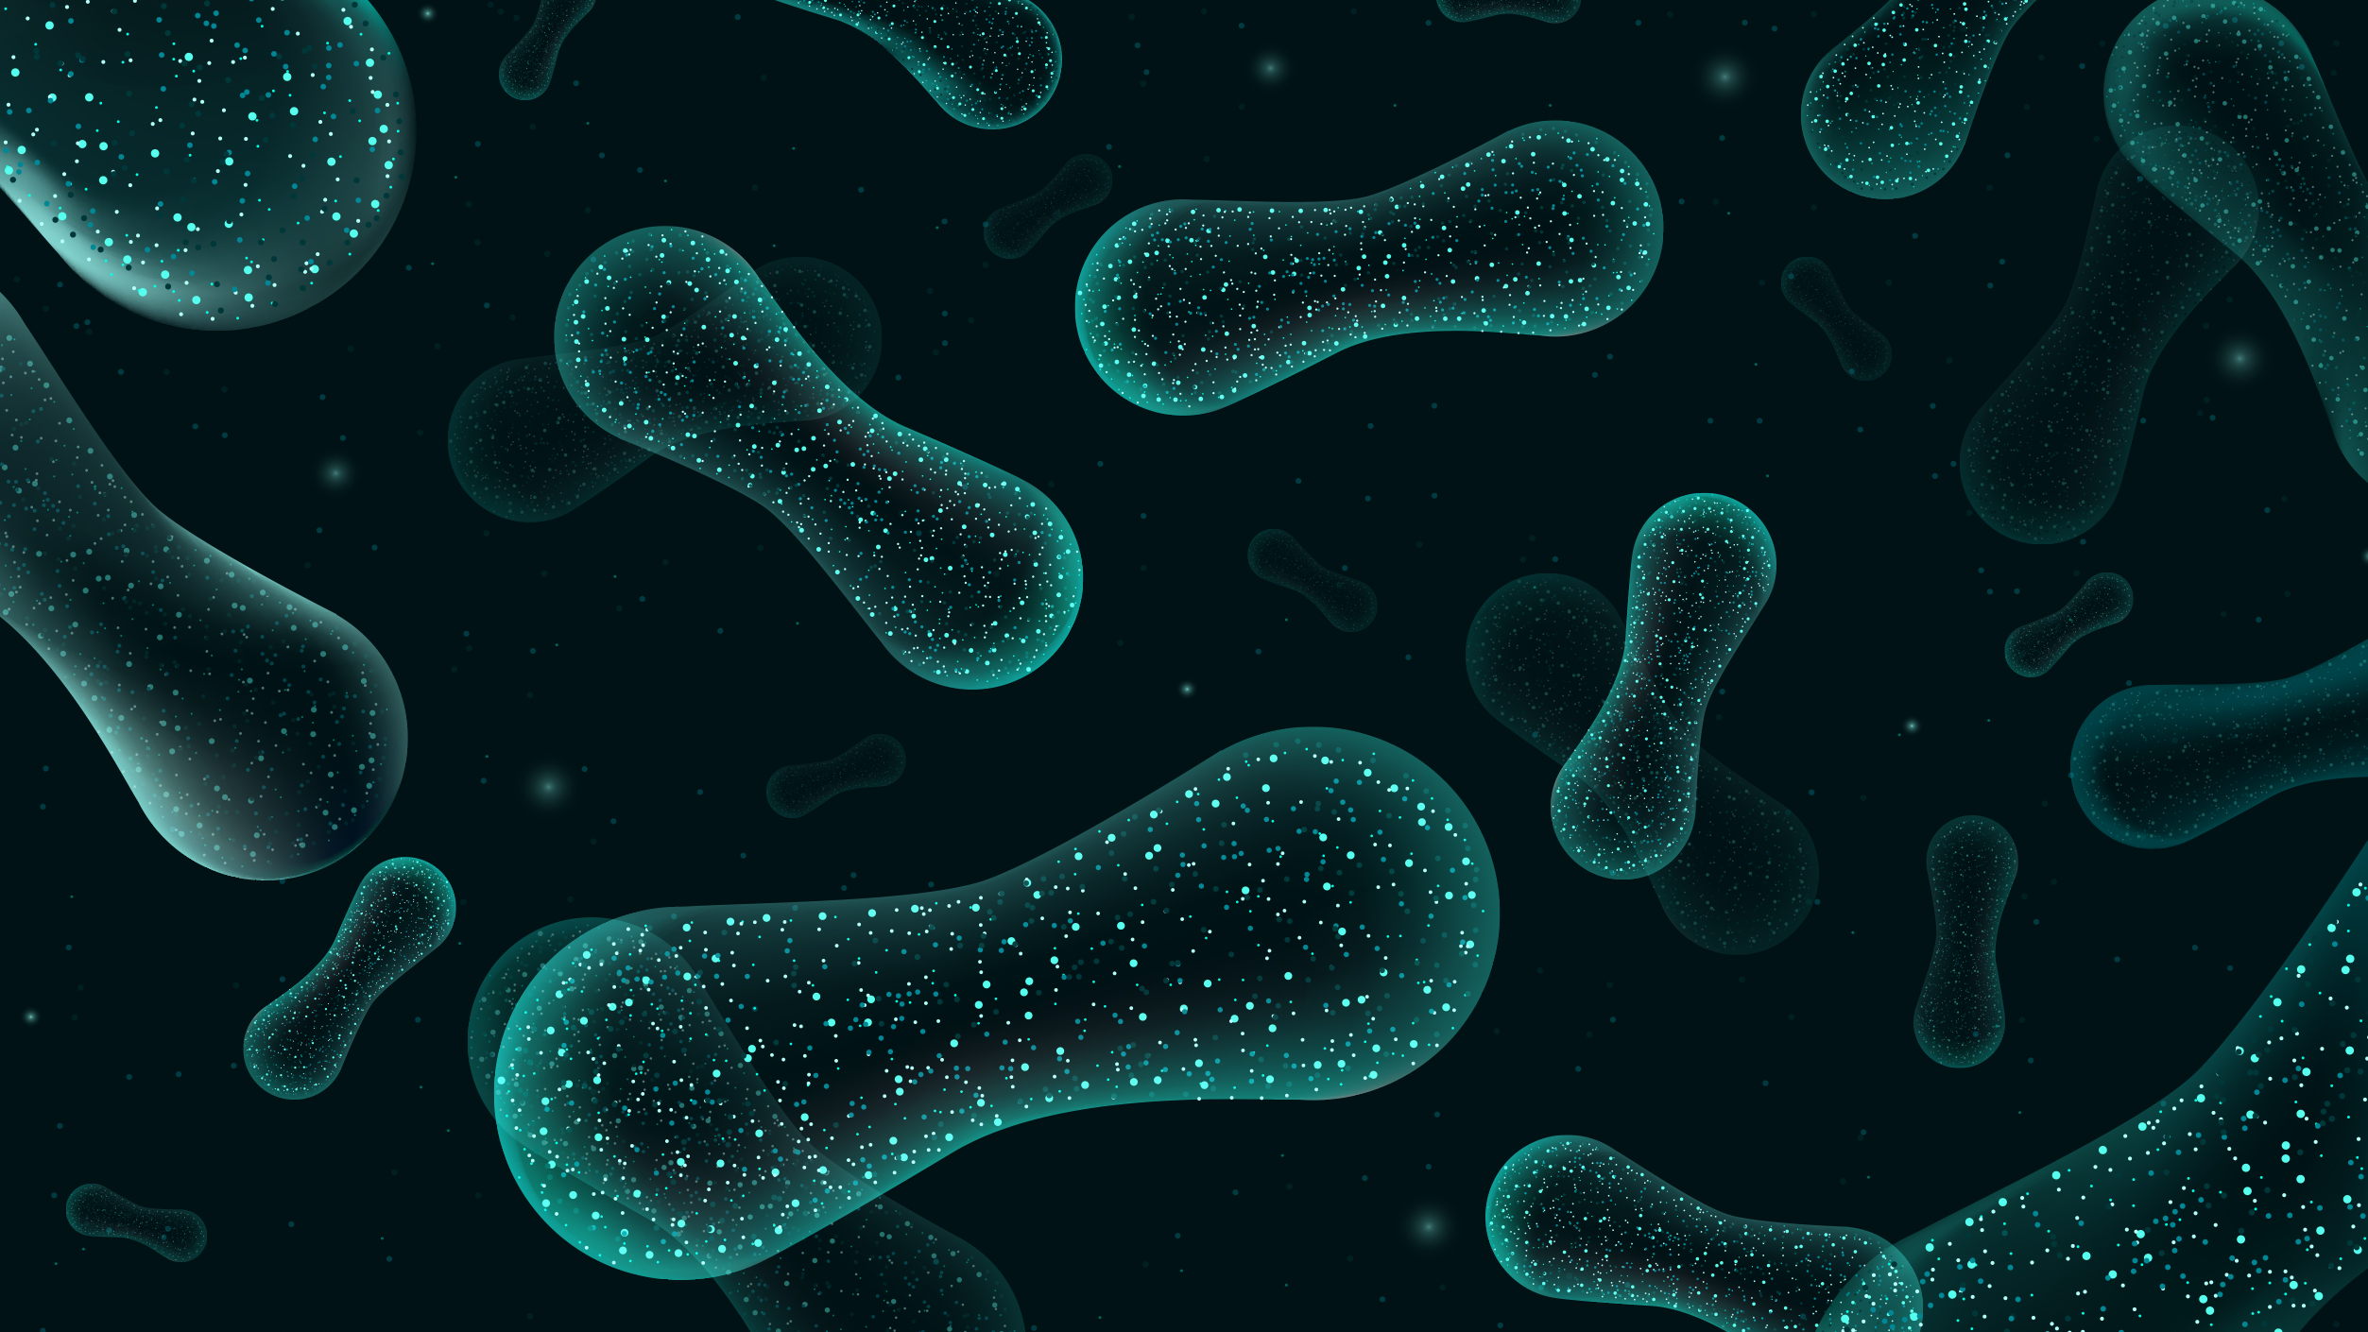
Potential Questions and Datasets
Sierra Smith
UPRM
March 18, 2026

Slide 2
Geographic Location and Temporal
Different geographic locations of collection:
Monterey, San Diego, Puerto Nuevo
Seasonal variation:
Summer 2016 vs. Summer 2017 vs. Winter 2016
Keep in mind:
Data is on plate 2, would need to trim adapters
16S and 18S need to be run separately
Must include at least one water control sample from each site

Slide 3
Geographic Location and Temporal
Different geographic locations of collection:
Monterey, San Diego, Puerto Nuevo
Seasonal variation:
Summer 2016 vs. Summer 2017 vs. Winter 2016
Keep in mind:
Data is on plate 2, would need to trim adapters
16S and 18S need to be run separately
Must include at least one water control sample from each site

Slide 4
Geographic Location and Temporal
Different geographic locations of collection:
Monterey, San Diego, Puerto Nuevo
Seasonal variation:
Summer 2016 vs. Summer 2017 vs. Winter 2016
Keep in mind:
Data is on plate 2, would need to trim adapters
16S and 18S need to be run separately
Must include at least one water control sample from each site

Slide 5
Geographic Location and Temporal
Different geographic locations of collection:
Monterey, San Diego, Puerto Nuevo
Seasonal variation:
Summer 2016 vs. Summer 2017 vs. Winter 2016
Keep in mind:
Data is on plate 2, would need to trim adapters
16S and 18S need to be run separately
Must include at least one water control sample from each site

Slide 6
Geographic Location and Temporal
Different geographic locations of collection:
Monterey, San Diego, Puerto Nuevo
Seasonal variation:
Summer 2016 vs. Summer 2017 vs. Winter 2016
Keep in mind:
Data is on plate 2, would need to trim adapters
16S and 18S need to be run separately
Must include at least one water control sample from each site

Slide 7
Geographic Location and Temporal
Different geographic locations of collection:
Monterey, San Diego, Puerto Nuevo
Seasonal variation:
Summer 2016 vs. Summer 2017 vs. Winter 2016
Keep in mind:
Data is on plate 2, would need to trim adapters
16S and 18S need to be run separately
Must include at least one water control sample from each site

Slide 8
Expanded Tissue/Sample Type
Additional tissues with full dataset:
Gut
Radula Sac
Shell
Egg/Egg sac
Keep in mind:
Data is on plate 2, would need to trim adapters
16S and 18S need to be run separately

Slide 9
Expanded Tissue/Sample Type
Additional tissues with full dataset:
Gut
Radula Sac
Shell
Egg/Egg sac
Keep in mind:
Data is on plate 2, would need to trim adapters
16S and 18S need to be run separately

Slide 10
Expanded Tissue/Sample Type
Additional tissues with full dataset:
Gut
Radula Sac
Shell
Egg/Egg sac
Keep in mind:
Data is on plate 2, would need to trim adapters
16S and 18S need to be run separately

Slide 11
Experimental Datasets
Whole gland at different pressures
1 atm vs. 100 PSI vs. 300 PSI
Exposure to prey
Keep in mind:
All data is on plate 1, no need to trim adapters
16S and 18S need to be run separately
Must include 1 water control sample from prey exposure experiment

Slide 12
Experimental Datasets
Whole gland at different pressures
1 atm vs. 100 PSI vs. 300 PSI
Exposure to prey
Keep in mind:
All data is on plate 1, no need to trim adapters
16S and 18S need to be run separately
Must include 1 water control sample from prey exposure experiment

Slide 13
Experimental Datasets
Whole gland at different pressures
1 atm vs. 100 PSI vs. 300 PSI
Exposure to prey
Keep in mind:
All data is on plate 1, no need to trim adapters
16S and 18S need to be run separately
Must include 1 water control sample from prey exposure experiment

Slide 14
Experimental Datasets
Whole gland at different pressures
1 atm vs. 100 PSI vs. 300 PSI
Exposure to prey
Keep in mind:
All data is on plate 1, no need to trim adapters
16S and 18S need to be run separately
Must include 1 water control sample from prey exposure experiment

Slide 15
Experimental Datasets
Whole gland at different pressures
1 atm vs. 100 PSI vs. 300 PSI
Exposure to prey
Keep in mind:
All data is on plate 1, no need to trim adapters
16S and 18S need to be run separately
Must include 1 water control sample from prey exposure experiment

Slide 16
Preparatory Analyses for Proteomic/Metabolomic
Connect microbiome to proteomic data downstream
Sample size = 188
Connect microbiome, proteomic, AND metabolomic data
Sample size = 30
Impact of antibiotic treatment vs. gland in sterilized water vs. untreated gland
Keep in mind:
Most data is on plate 1, no need to trim adapters
16S and 18S need to be run separately
Diving into the literature to connect microbiome + metabolomic data

Slide 17
Preparatory Analyses for Proteomic/Metabolomic
Connect microbiome to proteomic data downstream
Sample size = 188
Connect microbiome, proteomic, AND metabolomic data
Sample size = 30
Impact of antibiotic treatment vs. gland in sterilized water vs. untreated gland
Keep in mind:
Most data is on plate 1, no need to trim adapters
16S and 18S need to be run separately
Diving into the literature to connect microbiome + metabolomic data

Slide 18
Preparatory Analyses for Proteomic/Metabolomic
Connect microbiome to proteomic data downstream
Sample size = 188
Connect microbiome, proteomic, AND metabolomic data
Sample size = 30
Impact of antibiotic treatment vs. gland in sterilized water vs. untreated gland
Keep in mind:
Most data is on plate 1, no need to trim adapters
16S and 18S need to be run separately
Diving into the literature to connect microbiome + metabolomic data

Slide 19
Preparatory Analyses for Proteomic/Metabolomic
Connect microbiome to proteomic data downstream
Sample size = 188
Connect microbiome, proteomic, AND metabolomic data
Sample size = 30
Impact of antibiotic treatment vs. gland in sterilized water vs. untreated gland
Keep in mind:
Most data is on plate 1, no need to trim adapters
16S and 18S need to be run separately
Diving into the literature to connect microbiome + metabolomic data

Slide 20
Preparatory Analyses for Proteomic/Metabolomic
Connect microbiome to proteomic data downstream
Sample size = 188
Connect microbiome, proteomic, AND metabolomic data
Sample size = 30
Impact of antibiotic treatment vs. gland in sterilized water vs. untreated gland
Keep in mind:
Most data is on plate 1, no need to trim adapters
16S and 18S need to be run separately
Diving into the literature to connect microbiome + metabolomic data

Slide 21
Preparatory Analyses for Proteomic/Metabolomic
Connect microbiome to proteomic data downstream
Sample size = 188
Connect microbiome, proteomic, AND metabolomic data
Sample size = 30
Impact of antibiotic treatment vs. gland in sterilized water vs. untreated gland
Keep in mind:
Most data is on plate 1, no need to trim adapters
16S and 18S need to be run separately
Diving into the literature to connect microbiome + metabolomic data

Slide 22
Preparatory Analyses for Proteomic/Metabolomic
Connect microbiome to proteomic data downstream
Sample size = 188
Connect microbiome, proteomic, AND metabolomic data
Sample size = 30
Impact of antibiotic treatment vs. gland in sterilized water vs. untreated gland
Keep in mind:
Most data is on plate 1, no need to trim adapters
16S and 18S need to be run separately
Lit review to understand how studies connect microbiome + metabolomic data

Slide 23
Questions?

