Slide 1
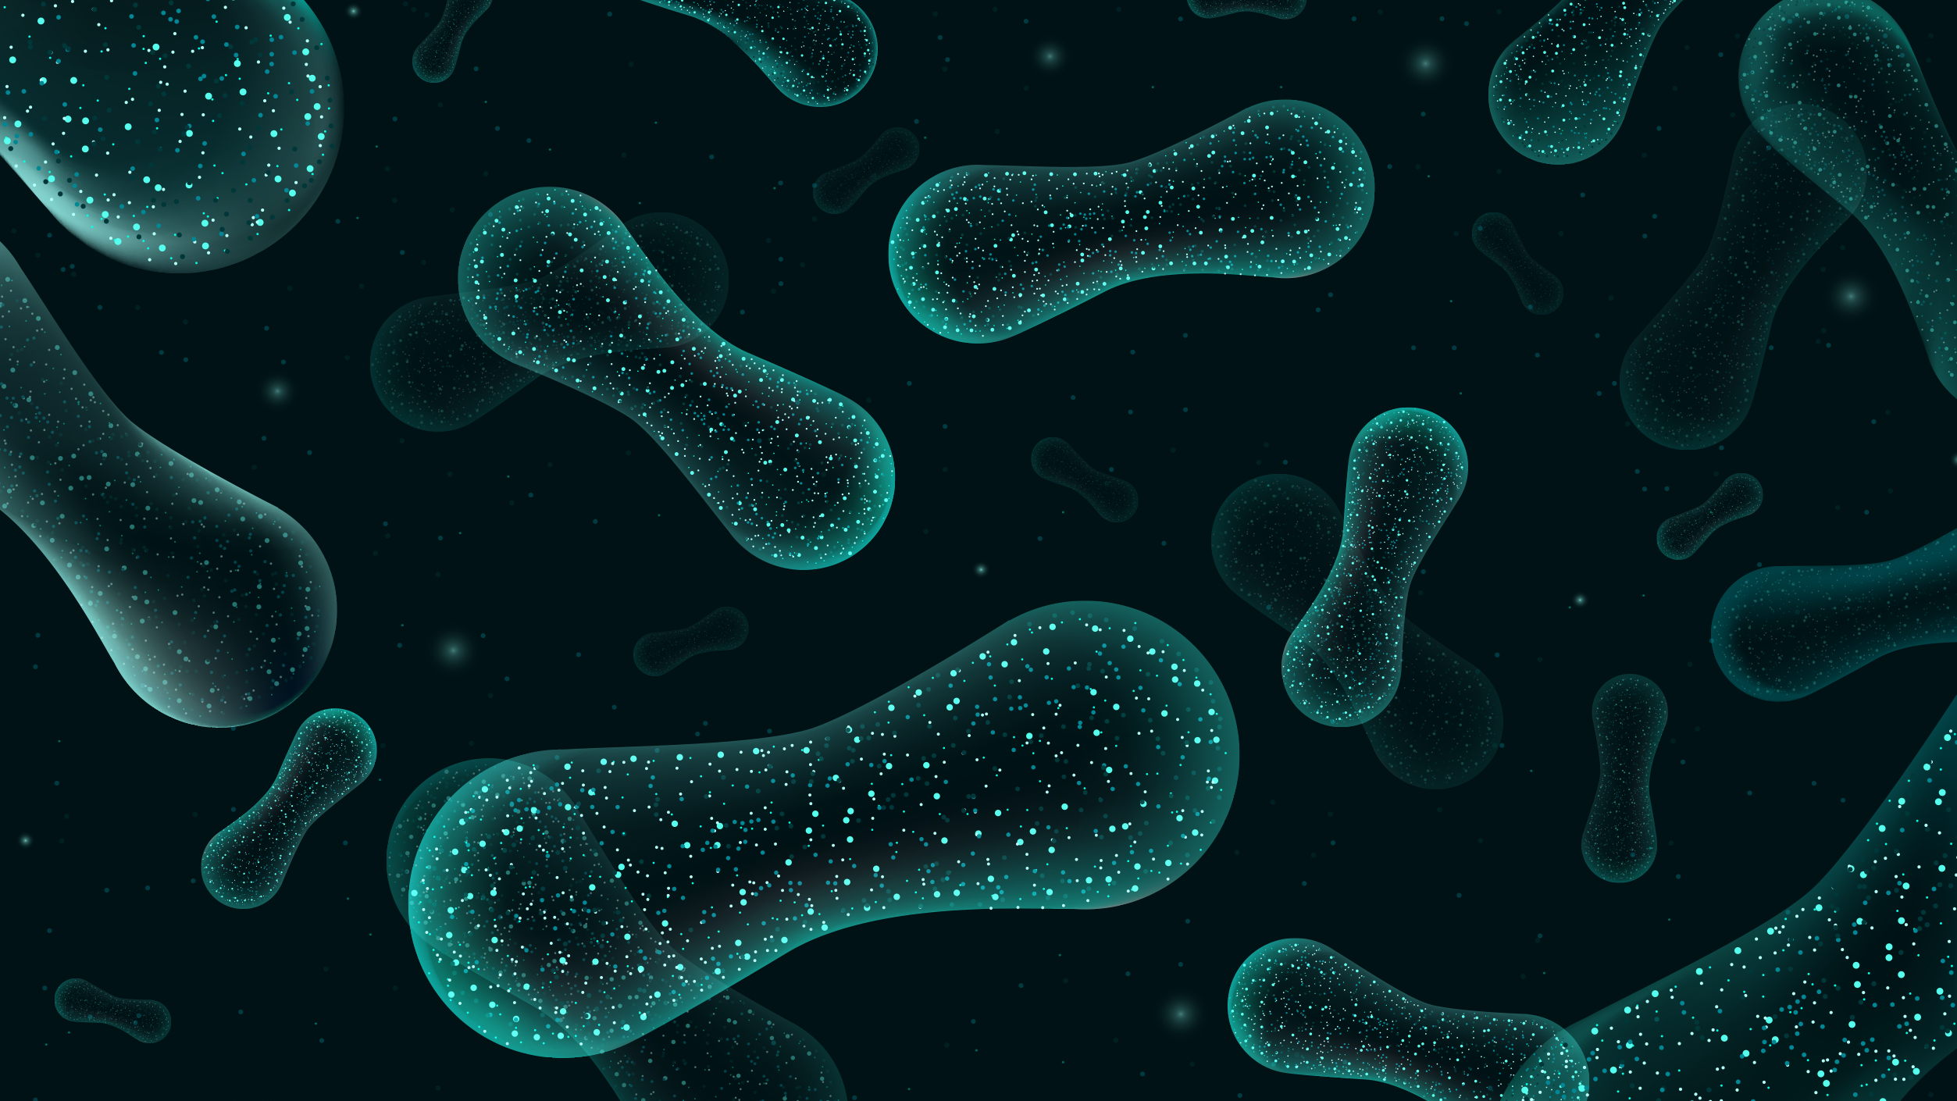
Lecture 2: Taxonomy, alignment, phylogeny, diversity metrics
Sierra Smith
UPRM qiime2 Workshop

Slide 2
Overview
Taxonomy
Taxonomic annotation of ASVs
Alignment
Multiple sequence alignment using mafft
Phylogeny
FastTree to create phylogeny of aligned sequences
Diversity Metrics
Alpha diversity
Beta diversity

Slide 3
Overview
Taxonomy
Taxonomic annotation of ASVs
Alignment
Multiple sequence alignment using mafft
Phylogeny
FastTree to create phylogeny of aligned sequences
Diversity Metrics
Alpha diversity
Beta diversity

Slide 4
Overview
Taxonomy
Taxonomic annotation of ASVs
Alignment
Multiple sequence alignment using mafft
Phylogeny
FastTree to create phylogeny of aligned sequences
Diversity Metrics
Alpha diversity
Beta diversity

Slide 5
Overview
Taxonomy
Taxonomic annotation of ASVs
Alignment
Multiple sequence alignment using mafft
Phylogeny
FastTree to create phylogeny of aligned sequences
Diversity Metrics
Alpha diversity
Beta diversity

Slide 6

Taxonomic annotation of ASVs
Download qza reference database directly from Silva
Weighted
Explanation
Uniform
Based on % sequence similarity
Field standard is at least 97% sequence similarity
Other options include Greengenes and GTDB on qiime2 data-resources page

Slide 7
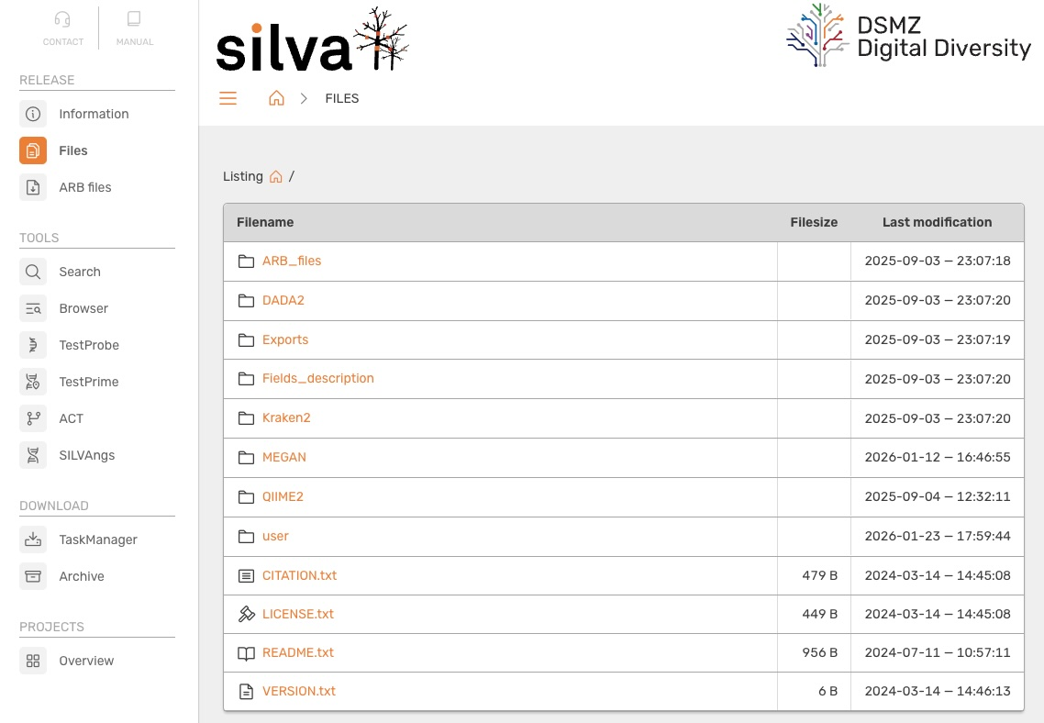
Taxonomic annotation of ASVs
Download qza reference database directly from Silva
Weighted
Explanation
Uniform
Based on % sequence similarity
Field standard is at least 97% sequence similarity
Other options include Greengenes and GTDB on qiime2 data-resources page

Slide 8
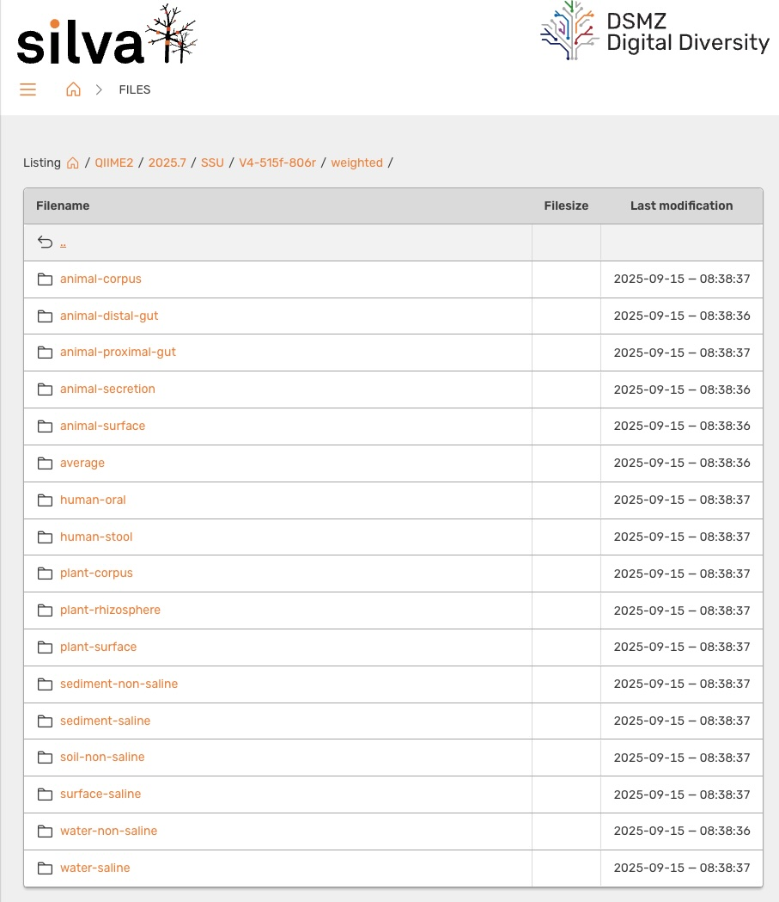
Taxonomic annotation of ASVs
SSU: Small Subunit (16S/18S)
LSU: Large Subunit
Download qza reference database directly from Silva
Weighted
Explanation
Uniform
Based on % sequence similarity
Field standard is at least 97% sequence similarity
Other options include Greengenes and GTDB on qiime2 data-resources page

Slide 9
Taxonomic annotation of ASVs
Region (V4)
Primer Pair
Download qza reference database directly from Silva
Weighted
Explanation
Uniform
Based on % sequence similarity
Field standard is at least 97% sequence similarity
Other options include Greengenes and GTDB on qiime2 data-resources page

Slide 10
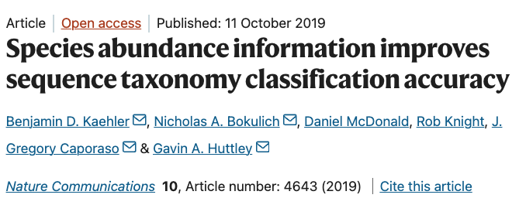
Taxonomic annotation of ASVs
Download qza reference database directly from Silva
Weighted
Includes environment-specific taxonomic abundance information to improve species-level classification
Uniform
Based on % sequence similarity
Field standard is at least 97% sequence similarity
Other options include Greengenes and GTDB on qiime2 data-resources page

Slide 11
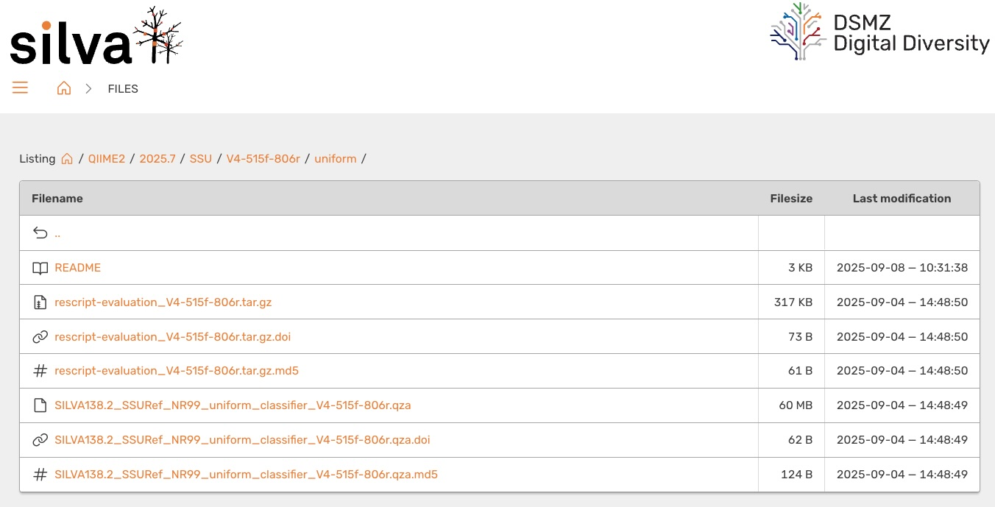
Taxonomic annotation of ASVs
Download qza reference database directly from Silva
Weighted
Includes environment-specific taxonomic abundance information to improve species-level classification
Uniform
Based on % sequence similarity
Field standard is at least 97% sequence similarity
Other options include Greengenes and GTDB on qiime2 data-resources page

Slide 12
Taxonomic annotation of ASVs
Based on % sequence similarity
Field standard is at least 97% sequence similarity
Other database options include Greengenes and GTDB on qiime2 data-resources page

Slide 13

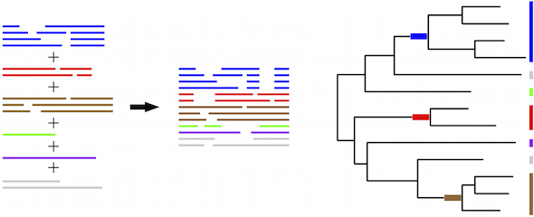
Sequence alignment and masking
Purpose: Identify regions of homology between sequences to predict evolutionary relationships
Process:
Use mafft to create a multiple sequence alignment
Mask (or filter) alignment to remove highly variable positions
https://mafft.cbrc.jp/alignment/server/merge.html

Slide 14
Constructing phylogeny of microbial sequences
Purpose: Use phylogenetic diversity metrics such as:
Faith’s Phylogenetic Diversity (Alpha)
Unifrac (Beta)
Weighted
Unweighted
Process:
Uses FastTree to create a phylogenetic tree from masked alignment
Creates an unrooted tree of microbial sequences
Root the tree to the midpoint of the longest tip-to-tip distance

Slide 15
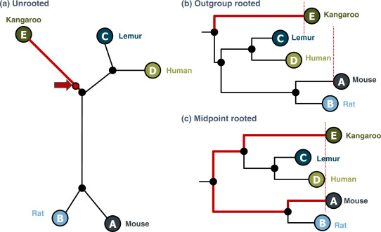
Constructing phylogeny of microbial sequences
Purpose: Use phylogenetic diversity metrics such as:
Faith’s Phylogenetic Diversity (Alpha)
Unifrac (Beta)
Weighted
Unweighted
Process:
Uses FastTree to create a phylogenetic tree from masked alignment
Creates an unrooted tree of microbial sequences
Root the tree to the midpoint of the longest tip-to-tip distance
Dr Richard Edwards

Slide 16
Constructing phylogeny of microbial sequences
Purpose: Use phylogenetic diversity metrics such as:
Faith’s Phylogenetic Diversity (Alpha)
Unifrac (Beta)
Weighted
Unweighted
Process:
Uses FastTree to create a phylogenetic tree from masked alignment
Creates an unrooted tree of microbial sequences
Root the tree to the midpoint of the longest tip-to-tip distance
Dr Richard Edwards

Slide 17
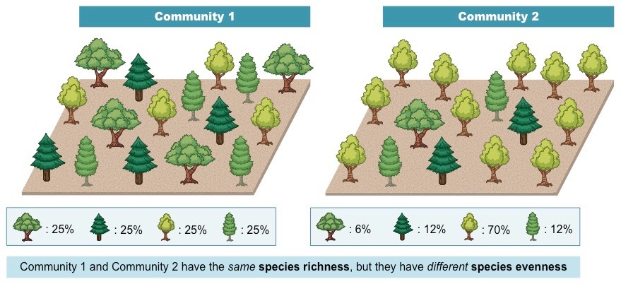
Diversity Metrics: Alpha
Shannon’s Diversity: community richness + evenness
Number of features
Distribution of counts among features
Observed ASVs: community richness
Counts of unique taxa
Faith’s Phylogenetic Diversity: community richness + phylogenetic relationships between features
Pielou’s Evenness: community evenness
Distribution of individuals among species
https://old-ib.bioninja.com.au/

Slide 18
Diversity Metrics: Alpha
Shannon’s Diversity: community richness + evenness
Number of features
Distribution of counts among features
Observed ASVs: community richness
Counts of unique features
Faith’s Phylogenetic Diversity: community richness + phylogenetic relationships between features
Pielou’s Evenness: community evenness
Distribution of individuals among species

Slide 19
Diversity Metrics: Alpha
Shannon’s Diversity: community richness + evenness
Number of features
Distribution of counts among features
Observed ASVs: community richness
Counts of unique features
Faith’s Phylogenetic Diversity: community richness + phylogenetic relationships between features
Pielou’s Evenness: community evenness
Distribution of individuals among species

Slide 20
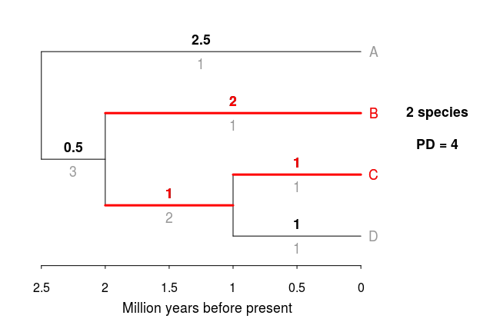
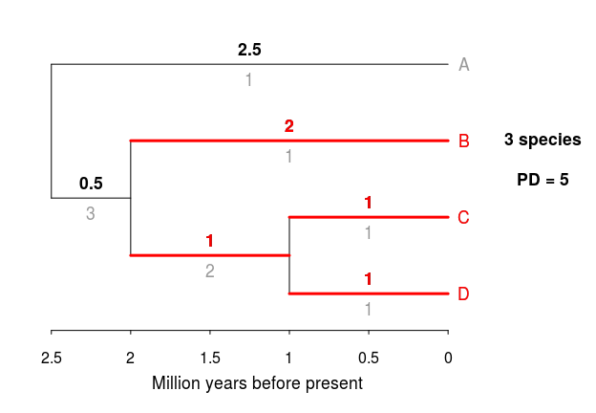
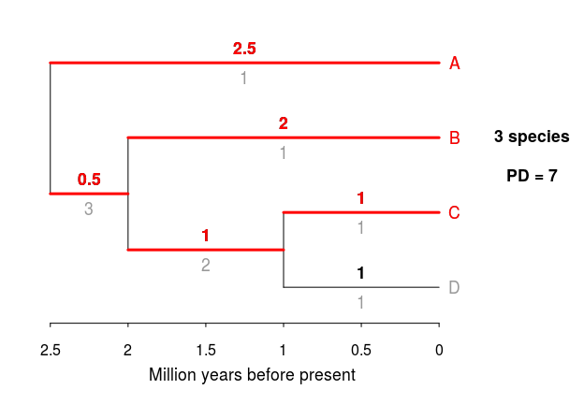
Diversity Metrics: Alpha
Sample 1
Shannon’s Diversity: community richness + evenness
Number of features
Distribution of counts among features
Observed ASVs: community richness
Counts of unique features
Faith’s Phylogenetic Diversity: community richness + phylogenetic relationships between features
Pielou’s Evenness: community evenness
Distribution of individuals among species
Sample 2
PD = Sum of branch lengths between taxa in a sample
Sample 3
https://sebpardo.github.io/ebirdtrees/

Slide 21
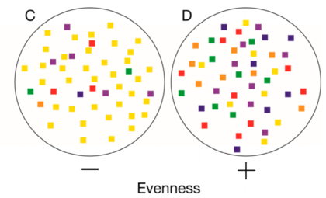
Diversity Metrics: Alpha
Shannon’s Diversity: community richness + evenness
Number of features
Distribution of counts among features
Observed ASVs: community richness
Counts of unique features
Faith’s Phylogenetic Diversity: community richness + phylogenetic relationships between features
Pielou’s Evenness: community evenness
Distribution of counts among different features
LaFevor and Pitts (2022) Agriculture

Slide 22
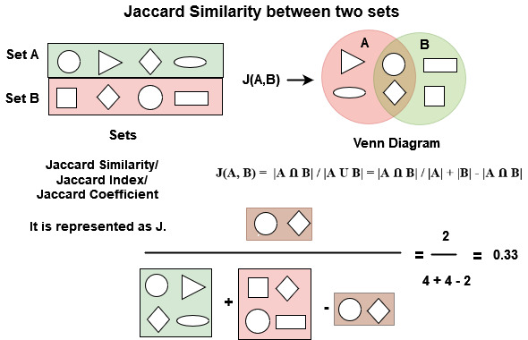
Diversity Metrics: Beta
Jaccard: community dissimilarity
Are features shared or not?
Bray-Curtis: community dissimilarity + abundance
What are the most abundant organisms in the community?
Unweighted-Unifrac: community dissimilarity + phylogenetic relationships
Weighted-Unifrac: community dissimilarity + phylogenetic relationships + abundance
https://www.geeksforgeeks.org/

Slide 23
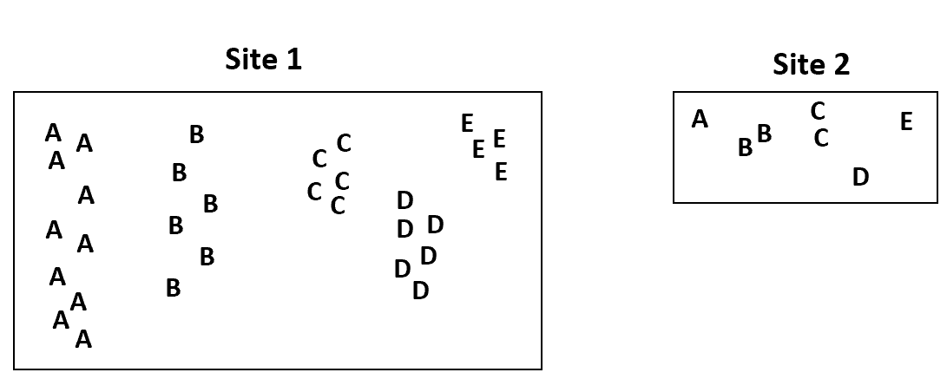
Diversity Metrics: Beta
Jaccard: community dissimilarity
Are features shared or not?
Bray-Curtis: community dissimilarity + abundance
What are the most abundant organisms in the community?
Unweighted-Unifrac: community dissimilarity + phylogenetic relationships
Weighted-Unifrac: community dissimilarity + phylogenetic relationships + abundance
BC
>
Zach Bobbitt

Slide 24
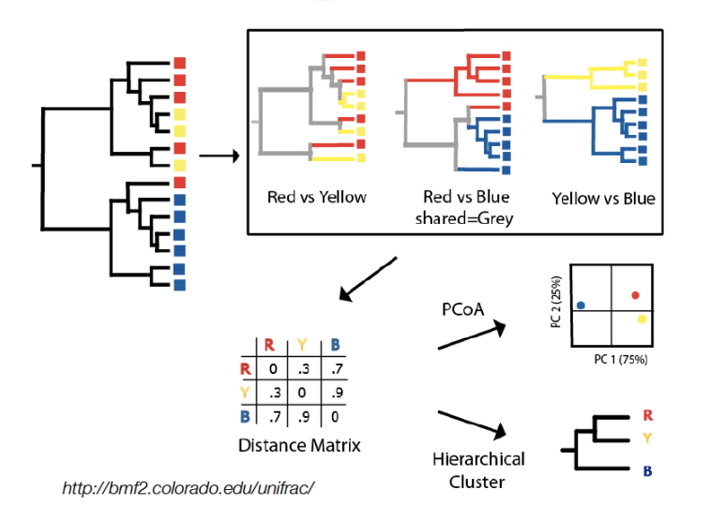
Diversity Metrics: Beta
Jaccard: community dissimilarity
Are features shared or not?
Bray-Curtis: community dissimilarity + abundance
What are the most abundant organisms in the community?
Unweighted-Unifrac: community dissimilarity + phylogenetic relationships
Weighted-Unifrac: community dissimilarity + phylogenetic relationships + abundance
Red vs. Yellow
Red vs. Blue
Yellow vs. Blue
PCoA
Distance Matrix
Hierarchical
Cluster

Slide 25
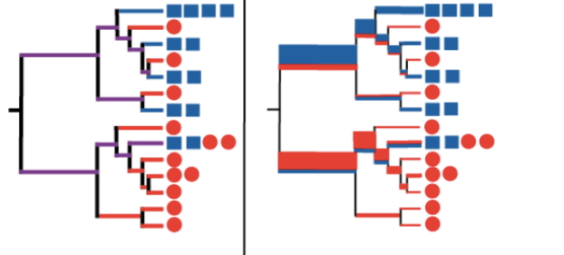
Diversity Metrics: Beta
Jaccard: community dissimilarity
Are features shared or not?
Bray-Curtis: community dissimilarity + abundance
What are the most abundant organisms in the community?
Unweighted-Unifrac: community dissimilarity + phylogenetic relationships
Weighted-Unifrac: community dissimilarity + phylogenetic relationships + abundance
Branch lengths weighted by abundance
Unweighted

Slide 26
Two non-parametric tests to assess diversity in qiime2
Alpha Diversity
Beta Diversity
Permutational
MANOVA
Kruskal-Wallis

Slide 27
Two non-parametric tests to assess diversity in qiime2
Alpha Diversity
Beta Diversity
Permutational
MANOVA
Kruskal-Wallis

Slide 28
Two non-parametric tests to assess diversity in qiime2
NOTE: For comparisons of > 2 groups correct for multiple tests
Alpha Diversity
Beta Diversity
Permutational
MANOVA
Kruskal-Wallis

Slide 29
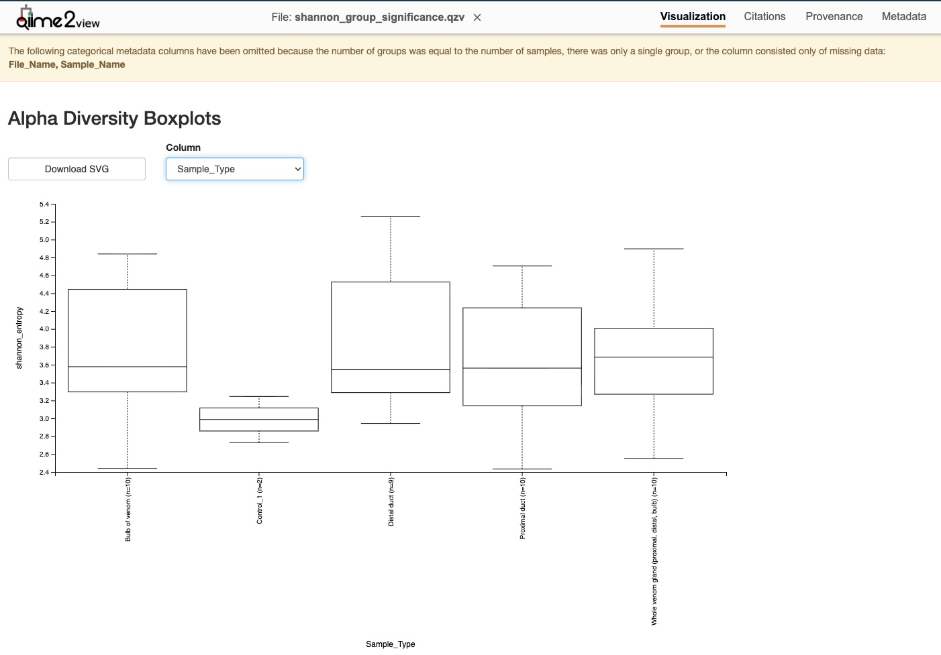
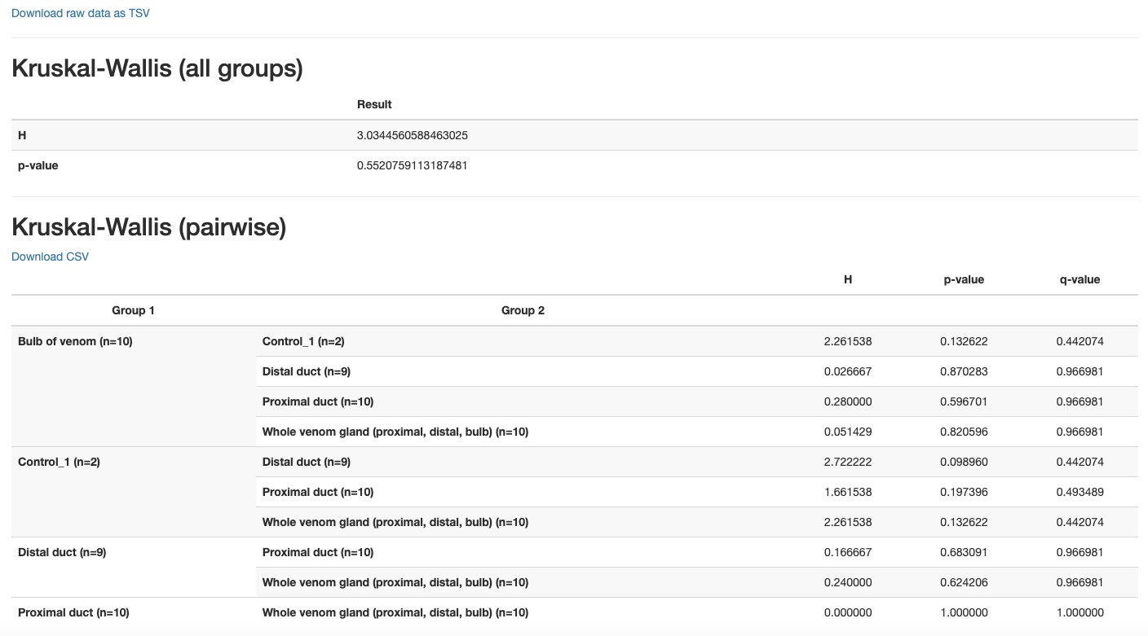
Alpha Diversity
Kruskal-Wallis

Slide 30
Alpha Diversity
Kruskal-Wallis

Slide 31
Alpha Diversity
Kruskal-Wallis

Slide 32
Alpha Diversity
Kruskal-Wallis

Slide 33
Alpha Diversity
Kruskal-Wallis
Example of “multiple tests”
Or calculate “corrected” p-values

Slide 34
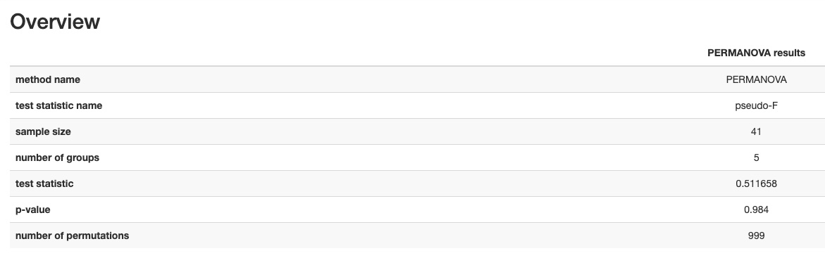
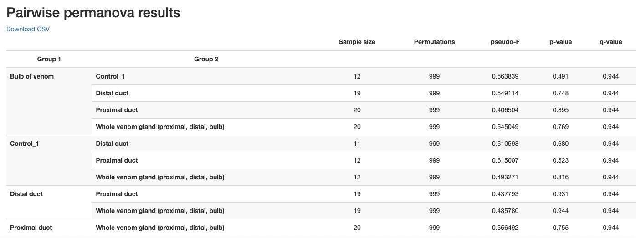
Beta Diversity
*Unweighted-Unifrac
Permutational
MANOVA
*Sample_Type

Slide 35
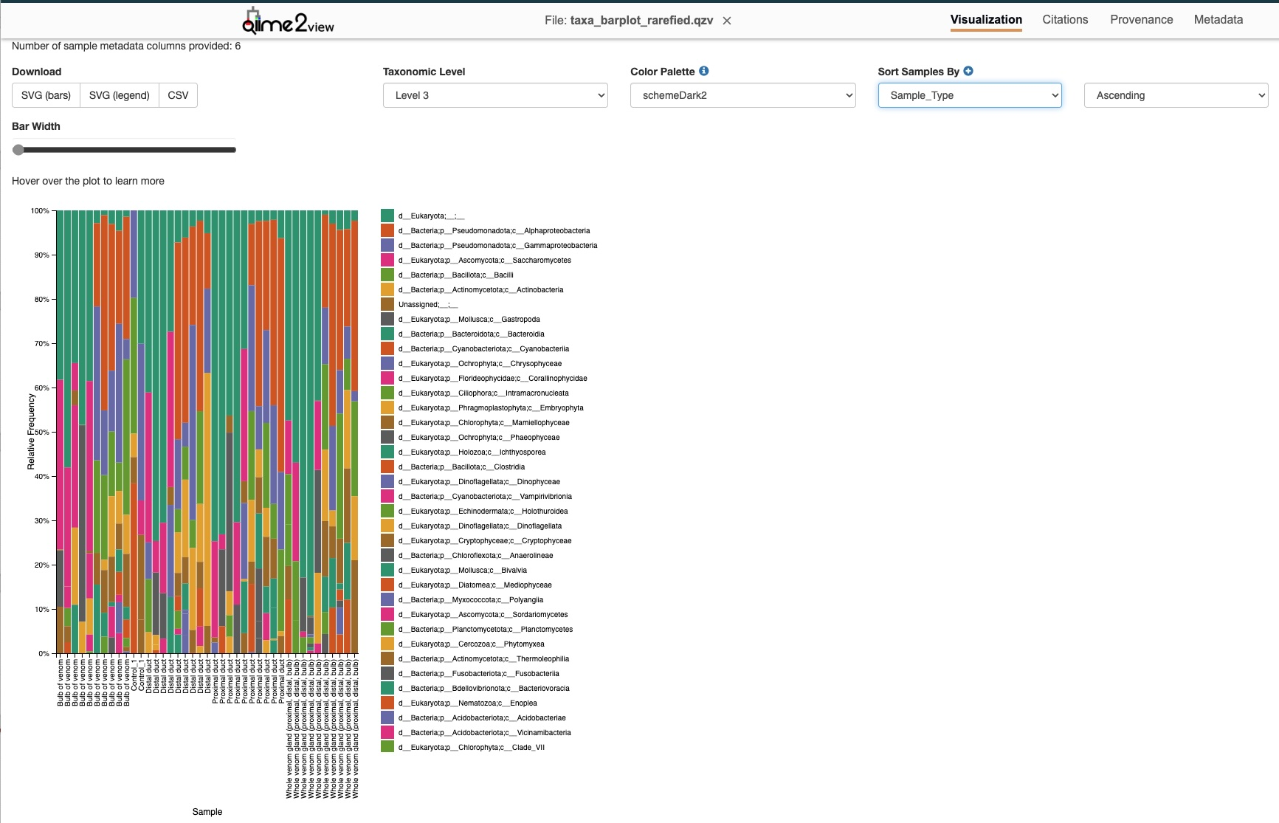
Bonus Visual!
Class Level
Taxa Barplot

Slide 36
Bonus Visual!
Taxa Barplot

Slide 37
Bonus Visual!
Taxa Barplot
Sample_Type

Slide 38
Questions?

