Slide 1
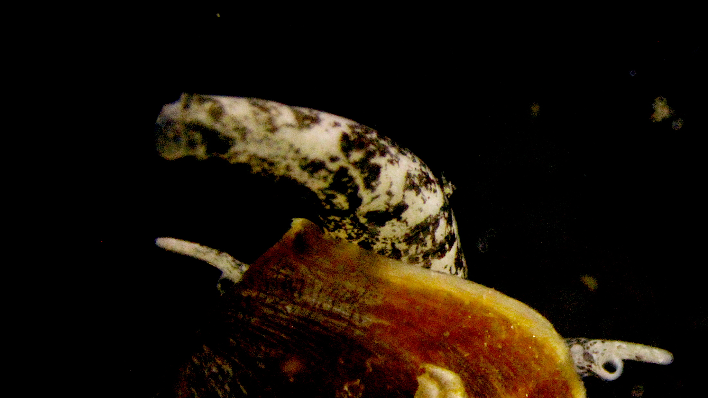
Hypothesis Testing and Visualization in R
Sabah Ul-Hasan, Ph.D.
University of Puerto Rico, Mayaguez

Slide 2
Overview

Slide 3
What AI did: On the right track, but ~75% correct

Slide 4
Utilizing AI as a tool *you can be lazy, but you need to fact-check
Session 1
Biological Meaning
Experiment
Pre-processing
QIIME2
More QC
Field Work
+
→
→
Illumina

Slide 5
Remainder Community Analyses Workflow
Pairing visualizations with your statistics for insight into the core community
Getting a General Idea
Import into R
→
→

Slide 6
Another amazing poll!
https://forms.gle/iQLJTJPLx7PksAVR6

Slide 7
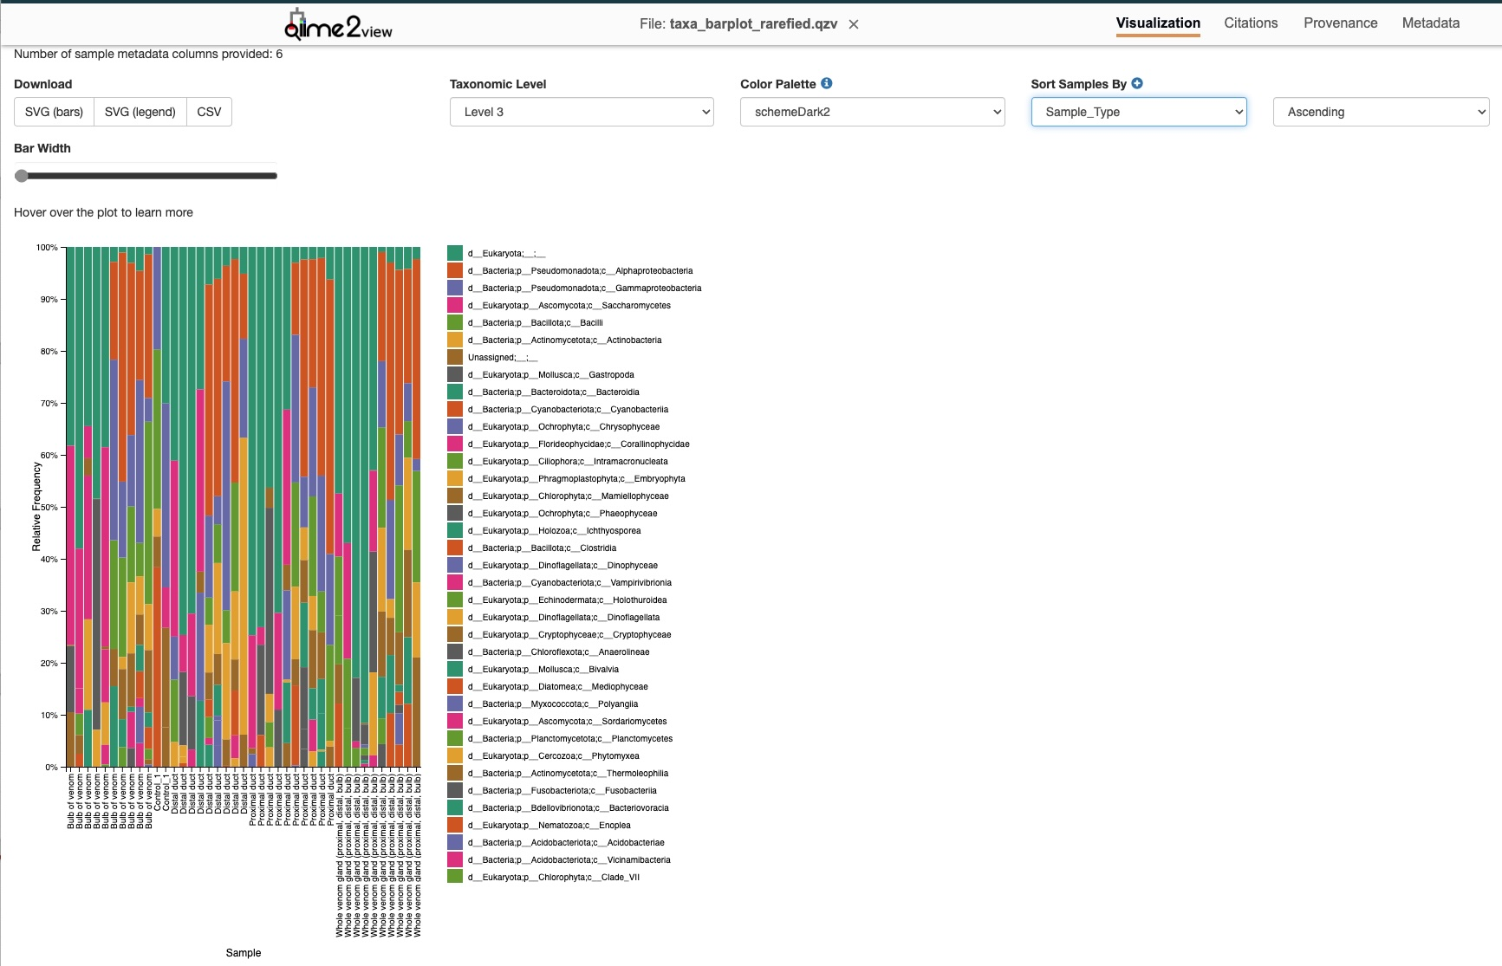
What does this tell us?
Sample_Type

Slide 8
Experimental Design, Statistics, and Visualizations

Slide 9
Experimental Design, Statistics, and Visualizations
You can have a good question, and you also need a good experimental design

Slide 10
Experimental Design, Statistics, and Visualizations
You can have a good question, and you also need a good experimental design Does the venom microbial community differ across the gland of C. californiconus? Is the experimental design sufficient for answering this question? If not, what needs to be included? Controls, n, assumptions, etc

Slide 11
Experimental Design, Statistics, and Visualizations
You can have a good question, and you also need a good experimental design Does the venom microbial community differ across the gland of C. californiconus? Is the experimental design sufficient for answering this question? If not, what needs to be included? Controls, n, assumptions, etc
Just because you have a p-value, doesn’t mean it’s real (or that it means something)

Slide 12
Experimental Design, Statistics, and Visualizations
You can have a good question, and you also need a good experimental design Does the venom microbial community differ across the gland of C. californiconus? Is the experimental design sufficient for answering this question? If not, what needs to be included? Controls, n, assumptions, etc
Just because you have a p-value, doesn’t mean it’s real (or that it means something) How do trust the results we see? Why statistics are important. And the difference of visuals vs results

Slide 13
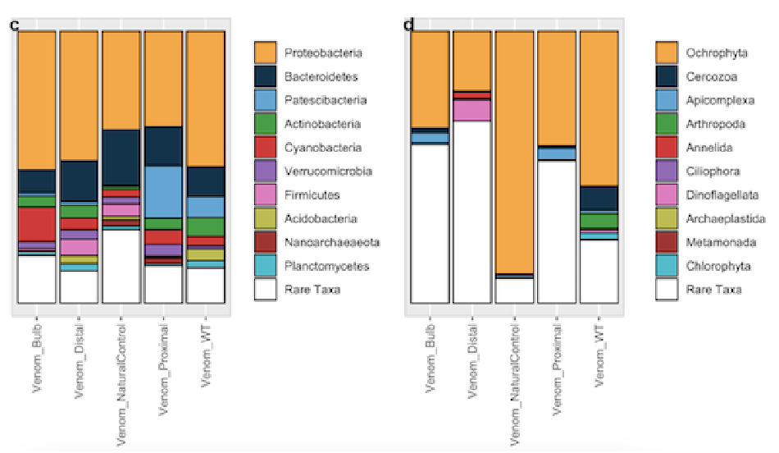
What could be some reasons behind these differences?
Sample_Type

Slide 14
The data doesn’t lie, but you need to understand your method
Ensure you’re interpreting your data correctly

Slide 15
Both are correct within the appropriate context
Sample_Type

Slide 16
Today’s Objectives
Importing our QIIME 2 results into R
Understanding the statistical tests we'll run and the plots we'll make
Creating publication-ready PCoA and relative abundance plots in ggplot2

Slide 17
Demo
UPRM_Workshop_RelAbund-SS.R UPRM-Workshop_PCoA-SS.R

Slide 18
Hypothesis Testing: Why do we need Alpha and Beta?
https://github.com/qiime2
https://r-graph-gallery.com/
https://microbiome.github.io/tutorials/

Slide 19
Hypothesis Testing: Why do we need Alpha and Beta?
Alpha diversity: Which groups are ‘richer’? Does the venom gland tissue type (e.g., distal vs. bulb) correlate to the diversity of the microbial community? Relative abundance bar plot to visualize the "who" behind the statistics
Beta diversity: PERMANOVA & homogeneity Is the composition of the community different between groups
https://github.com/qiime2
https://r-graph-gallery.com/
https://microbiome.github.io/tutorials/

Slide 20
Next Steps and Timeline Long-Term
Now that you’ve completed the entire analysis process, what’s clear and what remains hazy?
What would you do personally to improve the dataset? What would you do personally to improve the analysis?
What additional questions could be addressed with the data available?
What does this look like in terms of a publication and workflow?
https://github.com/qiime2
https://r-graph-gallery.com/
https://microbiome.github.io/tutorials/
Questions?

