Slide 1
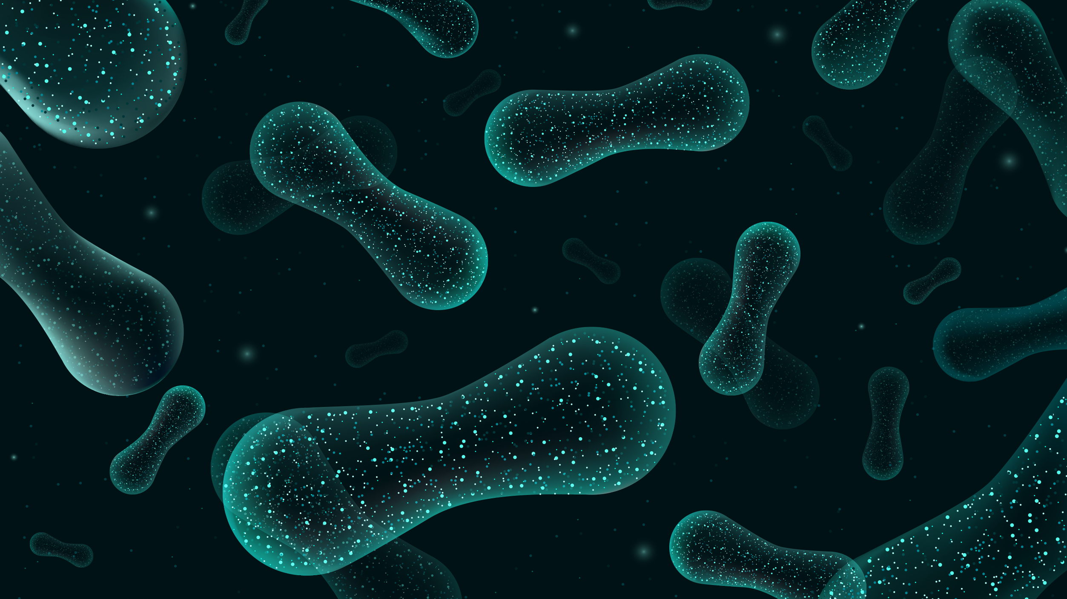
Lecture 2: Taxonomy, alignment, phylogeny, diversity metrics
Sierra Smith
UPRM qiime2 Workshop

Slide 2
ASV-Table Demo
Download and view reduced_42samp_tagplate1_asv-table.qzv
Alignment
Multiple sequence alignment using mafft
Phylogeny
FastTree to create phylogeny of aligned sequences
Diversity Metrics
Alpha diversity
Beta diversity

Slide 3
Breaking down this script…
qiime phylogeny align-to-tree-mafft-fasttree \
--i-sequences reduced_42samp_tagplate1_asv-seqs.qza \
--o-alignment aligned_42samp_asv-seqs.qza \
--o-masked-alignment masked-aligned_42samp_asv-seqs.qza \
--o-tree unrooted-tree_42samp.qza \
--o-rooted-tree rooted-tree_42samp.qza

Slide 4

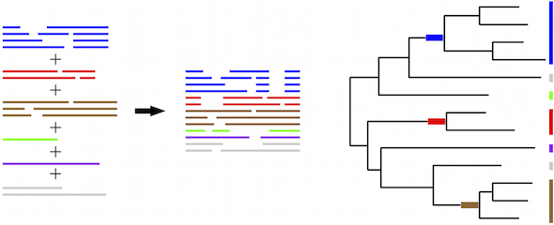
Sequence alignment and masking
Purpose: Identify regions of homology between sequences to predict evolutionary relationships
Process:
Use mafft to create a multiple sequence alignment
Mask (or filter) alignment to remove highly variable positions
https://mafft.cbrc.jp/alignment/server/merge.html

Slide 5
Breaking down this script…
qiime phylogeny align-to-tree-mafft-fasttree \
--i-sequences reduced_42samp_tagplate1_asv-seqs.qza \
--o-alignment aligned_42samp_asv-seqs.qza \
--o-masked-alignment masked-aligned_42samp_asv-seqs.qza \
--o-tree unrooted-tree_42samp.qza \
--o-rooted-tree rooted-tree_42samp.qza

Slide 6
Constructing phylogeny of microbial sequences
Purpose: Use phylogenetic diversity metrics such as:
Faith’s Phylogenetic Diversity (Alpha)
Unifrac (Beta)
Weighted
Unweighted
Process:
Uses FastTree to create a phylogenetic tree from masked alignment
Creates an unrooted tree of microbial sequences
Root the tree to the midpoint of the longest tip-to-tip distance

Slide 7
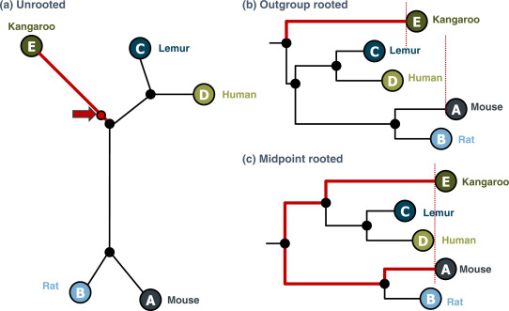
Constructing phylogeny of microbial sequences
Purpose: Use phylogenetic diversity metrics such as:
Faith’s Phylogenetic Diversity (Alpha)
Unifrac (Beta)
Weighted
Unweighted
Process:
Uses FastTree to create a phylogenetic tree from masked alignment
Creates an unrooted tree of microbial sequences
Root the tree to the midpoint of the longest tip-to-tip distance
Dr Richard Edwards

Slide 8
Breaking down this script…
qiime phylogeny align-to-tree-mafft-fasttree \
--i-sequences reduced_42samp_tagplate1_asv-seqs.qza \
--o-alignment aligned_42samp_asv-seqs.qza \
--o-masked-alignment masked-aligned_42samp_asv-seqs.qza \
--o-tree unrooted-tree_42samp.qza \
--o-rooted-tree rooted-tree_42samp.qza

Slide 9
Constructing phylogeny of microbial sequences
Purpose: Use phylogenetic diversity metrics such as:
Faith’s Phylogenetic Diversity (Alpha)
Unifrac (Beta)
Weighted
Unweighted
Process:
Uses FastTree to create a phylogenetic tree from masked alignment
Creates an unrooted tree of microbial sequences
Root the tree to the midpoint of the longest tip-to-tip distance
Dr Richard Edwards

Slide 10
Two non-parametric tests to assess diversity in qiime2
Alpha Diversity
Beta Diversity
Permutational
MANOVA
Kruskal-Wallis

Slide 11
Two non-parametric tests to assess diversity in qiime2
Alpha Diversity
Beta Diversity
Permutational
MANOVA
Kruskal-Wallis

Slide 12
Two non-parametric tests to assess diversity in qiime2
NOTE: For comparisons of > 2 groups correct for multiple tests
Alpha Diversity
Beta Diversity
Permutational
MANOVA
Kruskal-Wallis

Slide 13
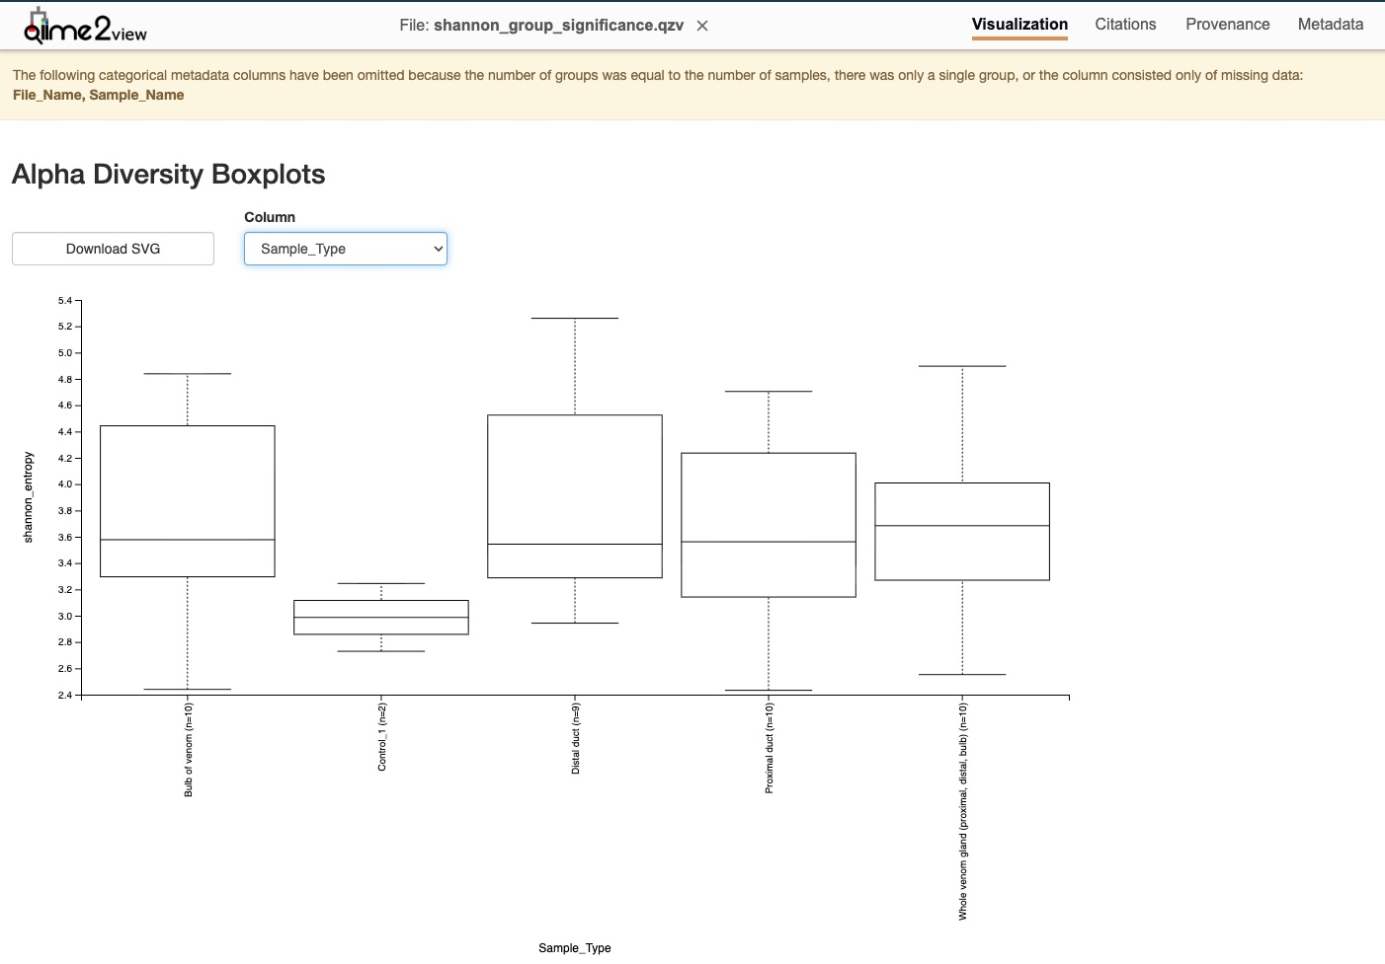
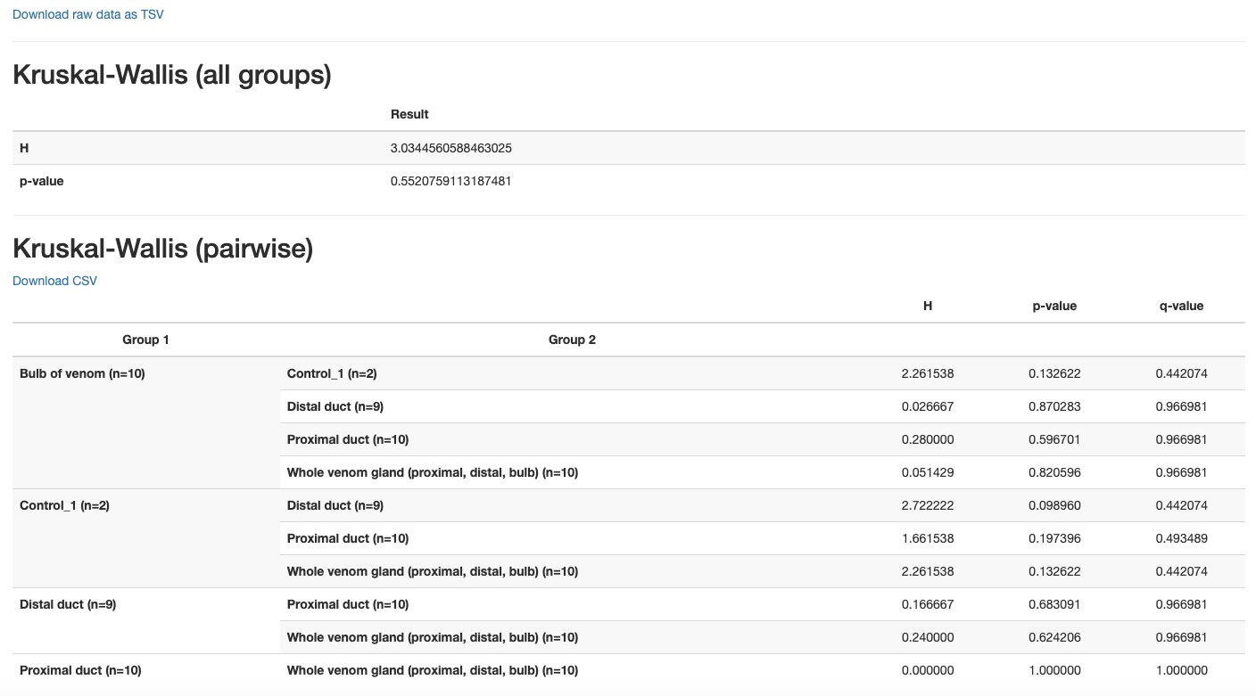
Alpha Diversity
Kruskal-Wallis

Slide 14
Alpha Diversity
Kruskal-Wallis

Slide 15
Alpha Diversity
Kruskal-Wallis

Slide 16
Alpha Diversity
Kruskal-Wallis

Slide 17
Alpha Diversity
Kruskal-Wallis
Example of “multiple tests”
Or calculate “corrected” p-values

Slide 18
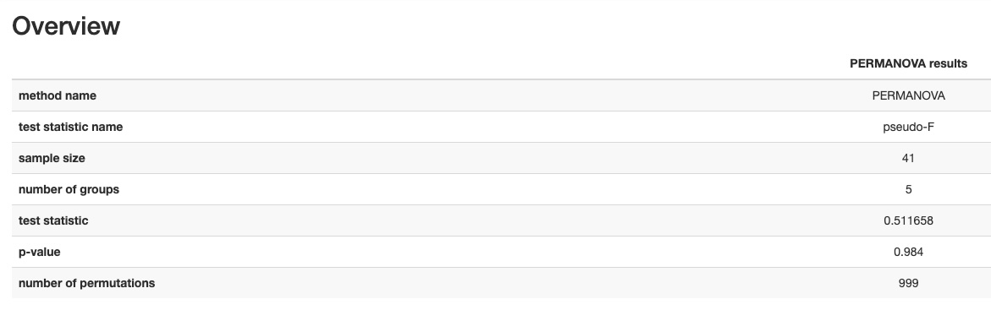
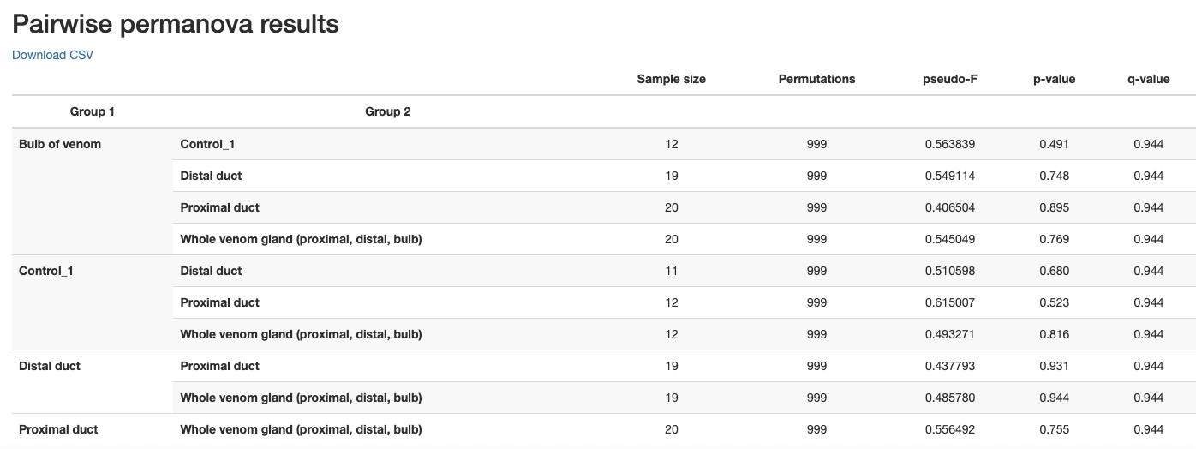
Beta Diversity
*Unweighted-Unifrac
Permutational
MANOVA
*Sample_Type

Slide 19
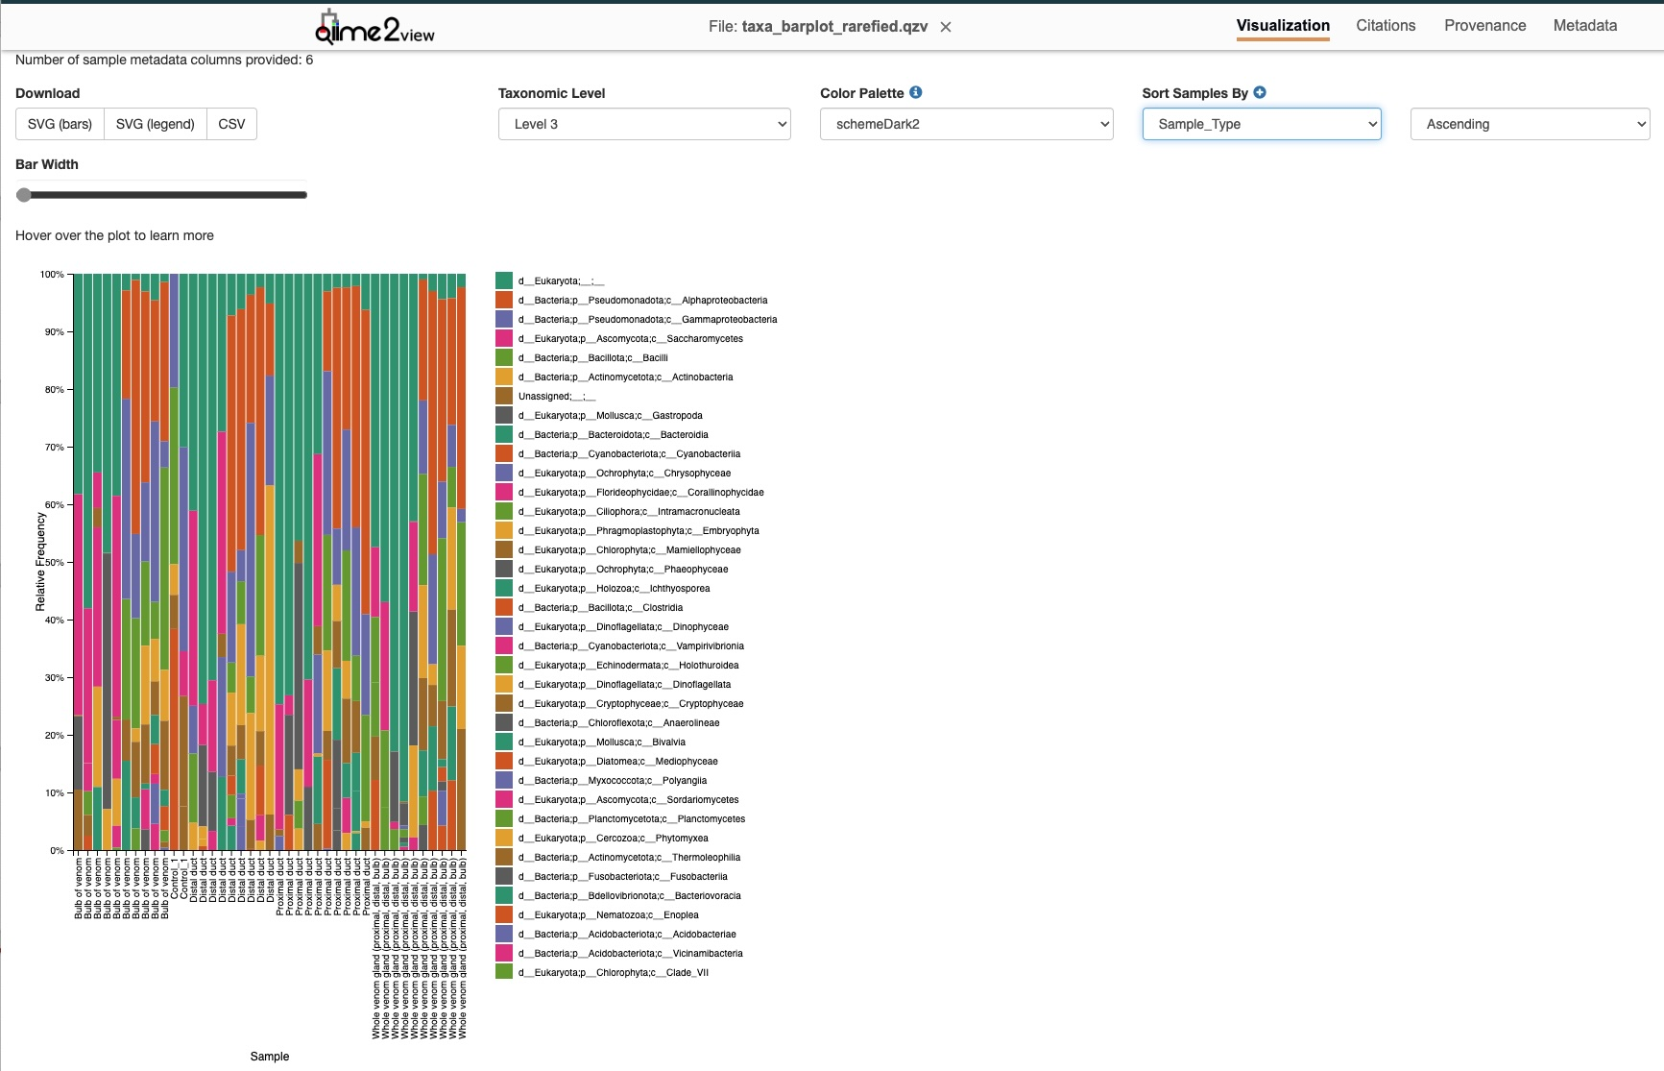
Bonus Visual!
Class Level
Taxa Barplot

Slide 20
Bonus Visual!
Taxa Barplot

Slide 21
Bonus Visual!
Taxa Barplot
Sample_Type

Slide 22
Questions?

Slide 23
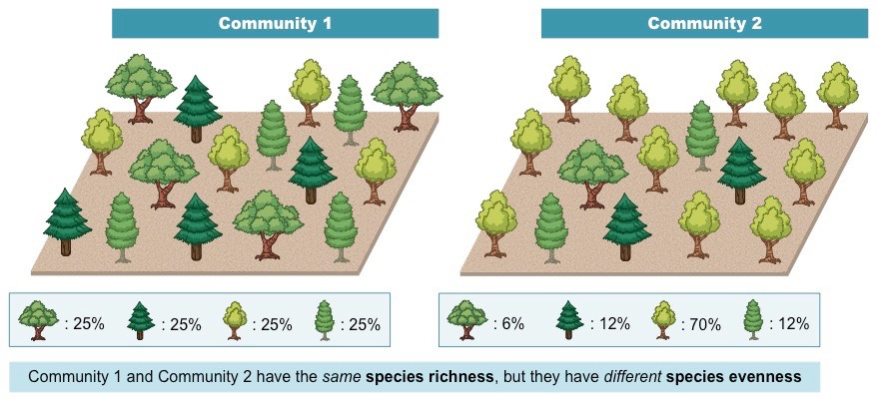
Diversity Metrics: Alpha
Shannon’s Diversity: community richness + evenness
Number of features
Distribution of counts among features
Observed ASVs: community richness
Counts of unique taxa
Faith’s Phylogenetic Diversity: community richness + phylogenetic relationships between features
Pielou’s Evenness: community evenness
Distribution of individuals among species
https://old-ib.bioninja.com.au/

Slide 24
Diversity Metrics: Alpha
Shannon’s Diversity: community richness + evenness
Number of features
Distribution of counts among features
Observed ASVs: community richness
Counts of unique features
Faith’s Phylogenetic Diversity: community richness + phylogenetic relationships between features
Pielou’s Evenness: community evenness
Distribution of individuals among species

Slide 25
Diversity Metrics: Alpha
Shannon’s Diversity: community richness + evenness
Number of features
Distribution of counts among features
Observed ASVs: community richness
Counts of unique features
Faith’s Phylogenetic Diversity: community richness + phylogenetic relationships between features
Pielou’s Evenness: community evenness
Distribution of individuals among species

Slide 26
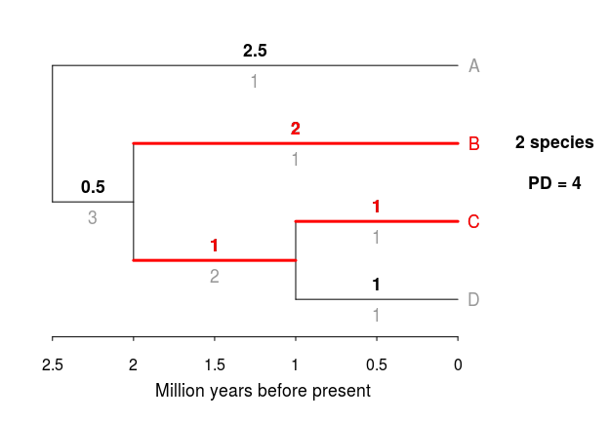
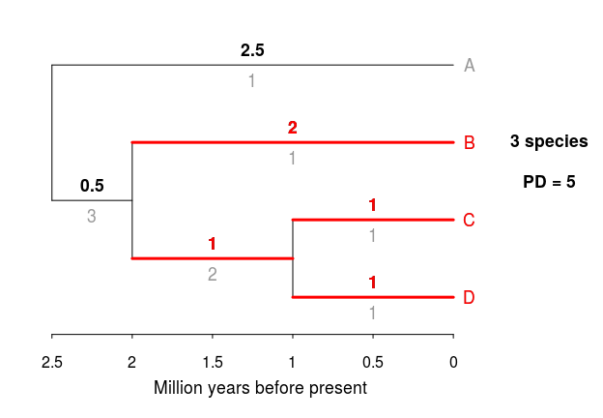
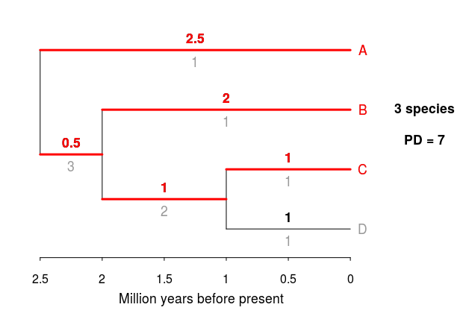
Diversity Metrics: Alpha
Sample 1
Shannon’s Diversity: community richness + evenness
Number of features
Distribution of counts among features
Observed ASVs: community richness
Counts of unique features
Faith’s Phylogenetic Diversity: community richness + phylogenetic relationships between features
Pielou’s Evenness: community evenness
Distribution of individuals among species
Sample 2
PD = Sum of branch lengths between taxa in a sample
Sample 3
https://sebpardo.github.io/ebirdtrees/

Slide 27
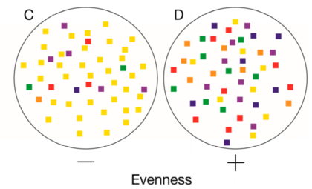
Diversity Metrics: Alpha
Shannon’s Diversity: community richness + evenness
Number of features
Distribution of counts among features
Observed ASVs: community richness
Counts of unique features
Faith’s Phylogenetic Diversity: community richness + phylogenetic relationships between features
Pielou’s Evenness: community evenness
Distribution of counts among different features
LaFevor and Pitts (2022) Agriculture

Slide 28
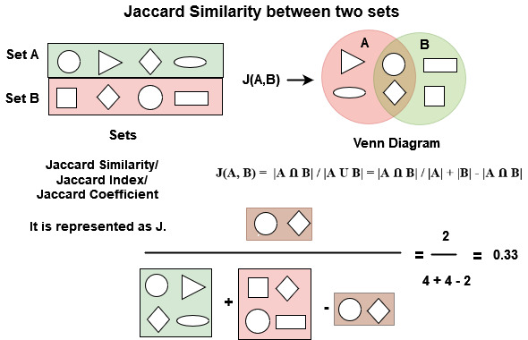
Diversity Metrics: Beta
Jaccard: community dissimilarity
Are features shared or not?
Bray-Curtis: community dissimilarity + abundance
What are the most abundant organisms in the community?
Unweighted-Unifrac: community dissimilarity + phylogenetic relationships
Weighted-Unifrac: community dissimilarity + phylogenetic relationships + abundance
https://www.geeksforgeeks.org/

Slide 29
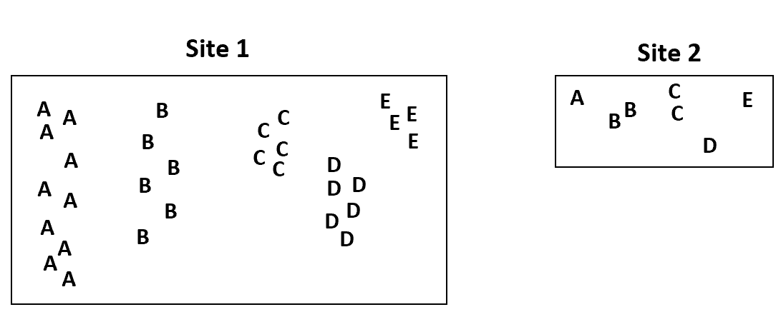
Diversity Metrics: Beta
Jaccard: community dissimilarity
Are features shared or not?
Bray-Curtis: community dissimilarity + abundance
What are the most abundant organisms in the community?
Unweighted-Unifrac: community dissimilarity + phylogenetic relationships
Weighted-Unifrac: community dissimilarity + phylogenetic relationships + abundance
BC
>
Zach Bobbitt

Slide 30
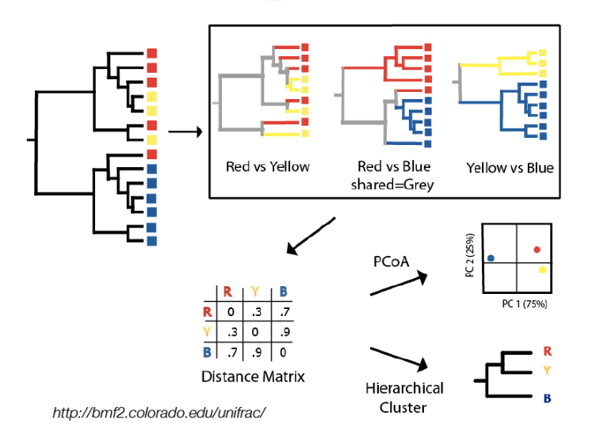
Diversity Metrics: Beta
Jaccard: community dissimilarity
Are features shared or not?
Bray-Curtis: community dissimilarity + abundance
What are the most abundant organisms in the community?
Unweighted-Unifrac: community dissimilarity + phylogenetic relationships
Weighted-Unifrac: community dissimilarity + phylogenetic relationships + abundance
Red vs. Yellow
Red vs. Blue
Yellow vs. Blue
PCoA
Distance Matrix
Hierarchical
Cluster

Slide 31
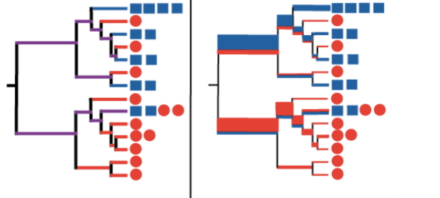
Diversity Metrics: Beta
Jaccard: community dissimilarity
Are features shared or not?
Bray-Curtis: community dissimilarity + abundance
What are the most abundant organisms in the community?
Unweighted-Unifrac: community dissimilarity + phylogenetic relationships
Weighted-Unifrac: community dissimilarity + phylogenetic relationships + abundance
Branch lengths weighted by abundance
Unweighted

