Slide 1

Project Title- Seasonal Agriculture Performance Analysis
Student Name - GAYATRI SATISH SABALE
College Name - Sanjivani College of Engineering, Kopargoan
AICTE STU ID : STU6a6c2c088adf31785474056

Slide 2

PROBLEM STATEMENT
Agricultural performance can change from one season to another because of factors such as weather, farming practices, resource usage and market conditions.
The given dataset contains information about agricultural activities, environmental conditions, crop production, resource usage and economic performance.
The main aim of this project is to study the dataset and find out how agricultural performance changes across different seasons. The analysis focuses on finding differences, patterns and relationships in the data.

Slide 3
Project Description
In this project, I analyzed an agricultural dataset containing information about different crops, seasons, locations, farming conditions and resource usage.
First, I explored the dataset to understand the columns and data types. Then I checked missing values and duplicate records and prepared the data for analysis.
After cleaning the data, I compared agricultural performance across Kharif, Rabi and Zaid seasons. I also studied yield, production, profit, revenue, costs, water usage, fertilizer usage and environmental conditions.
Different graphs and statistical methods were used to understand the differences between seasons. Finally, I identified the main observations and gave some recommendations based on the results.

Slide 4

WHO ARE THE END USERS?
Farmers
Can understand which seasons and farming conditions are giving better results.
Agricultural Planners
Can use seasonal information while planning agricultural activities.
Agricultural Researchers
Can study relationships between environmental conditions and crop performance.
Government and Agricultural Departments
Can use the findings as supporting information for seasonal planning and resource management.

Slide 5

Technology Used
Python
Used for data analysis and calculations.
Pandas
Used for reading, cleaning and analyzing the dataset.
NumPy
Used for numerical calculations.
Matplotlib
Used for creating graphs and charts.
SciPy
Used for statistical analysis.
Jupyter Notebook
Used to write and document the complete project.

Slide 6
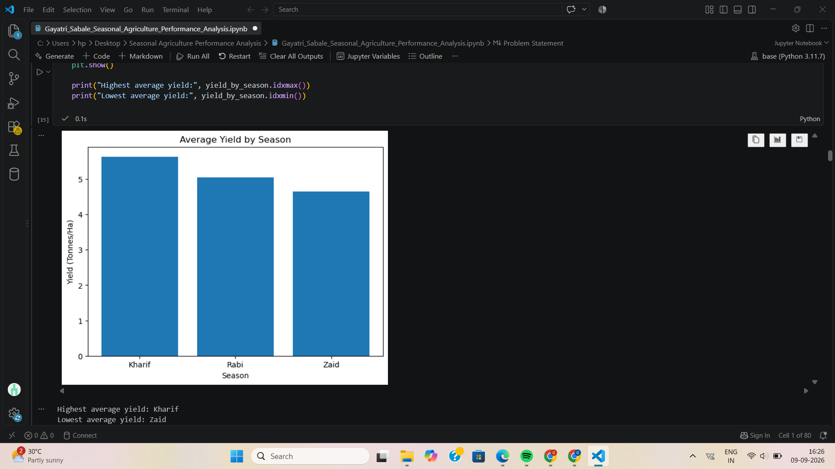
RESULTS
Observation:
I compared the average yield of Kharif, Rabi and Zaid seasons. Kharif has the highest average yield, while Zaid has the lowest average yield. This shows that crop yield changes with the season.

Slide 7
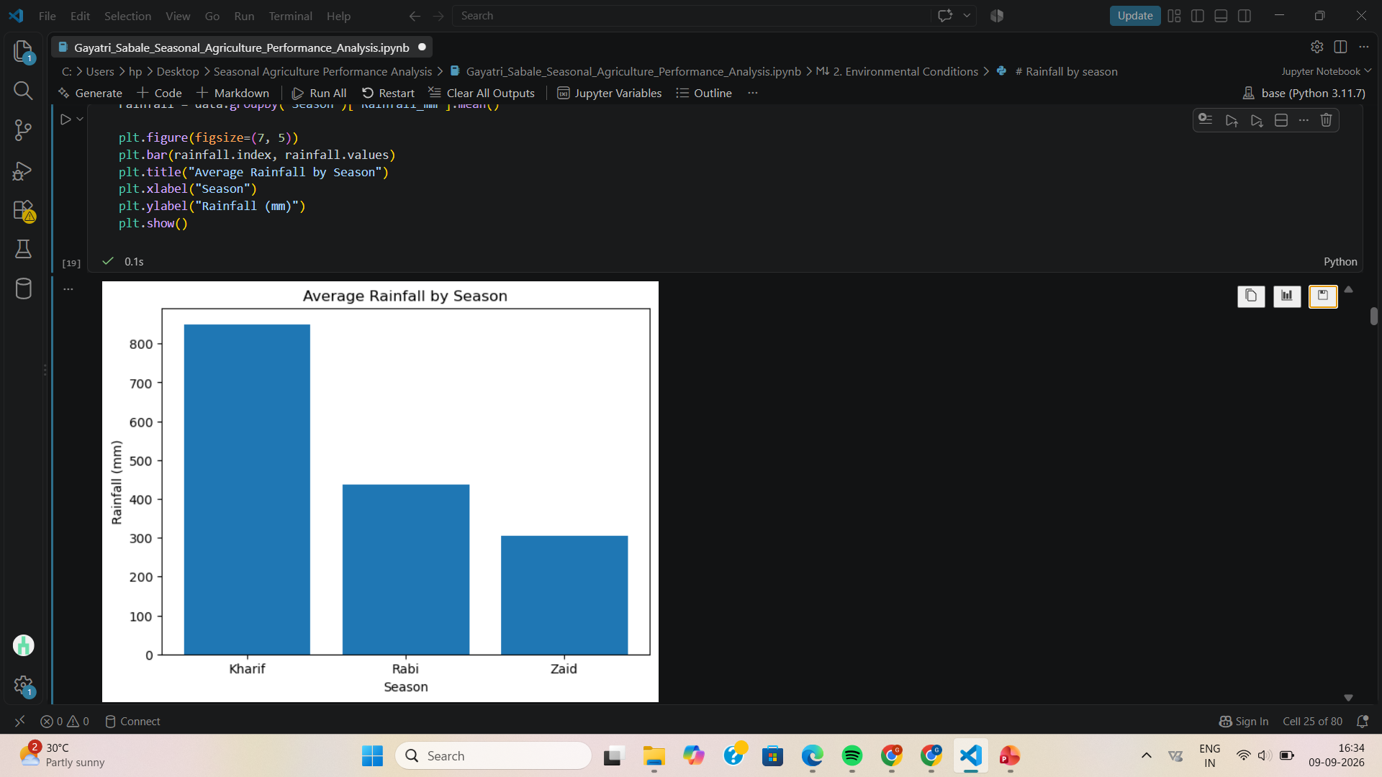
RESULTS
Observation:
I compared the environmental conditions across different seasons. The rainfall and temperature values vary between Kharif, Rabi and Zaid seasons. These changes in environmental conditions can affect crop performance and are useful for understanding seasonal differences.

Slide 8
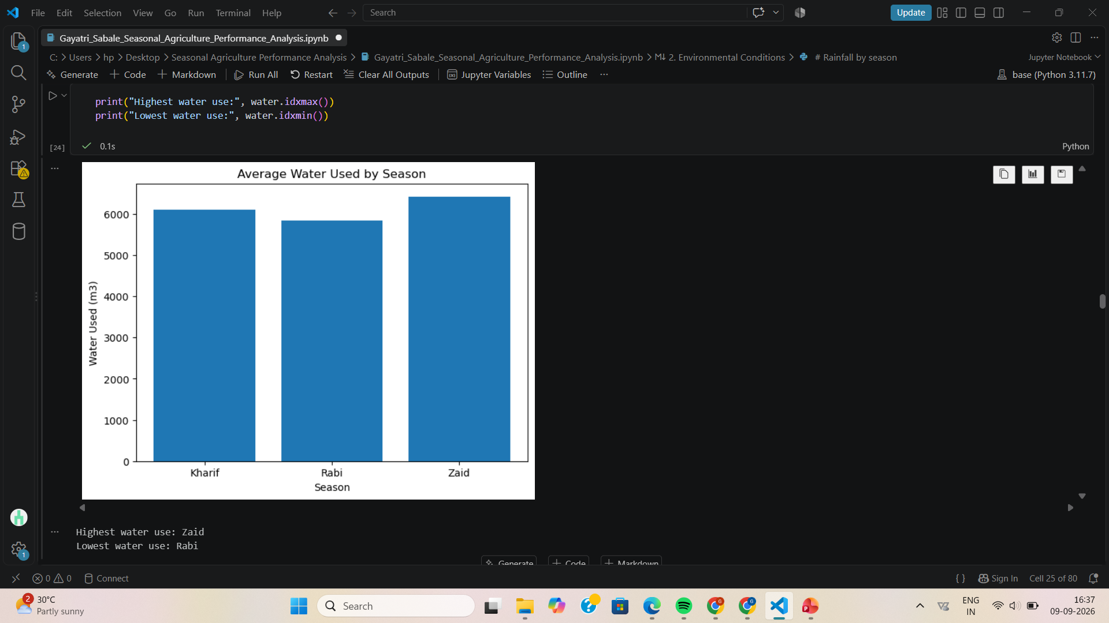
RESULTS
Observation:
I compared the use of water, fertilizer and other resources across different seasons. The results show that resource usage changes between seasons. Water usage and water efficiency help to understand how resources are being used for agricultural activities.

Slide 9
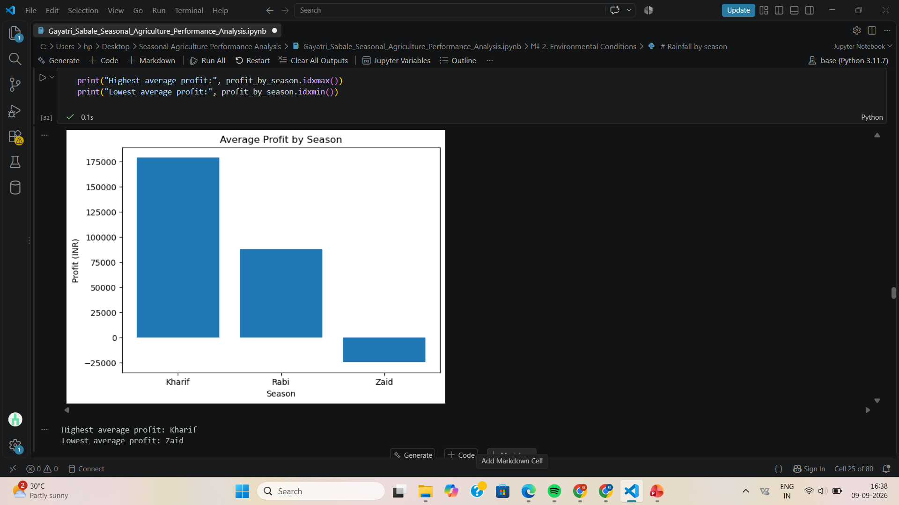
RESULTS
Observation:
I compared the revenue, total cost and profit across different seasons. The results show that the economic performance is different for each season. Profit comparison helps to understand which season gives better financial performance.

Slide 10
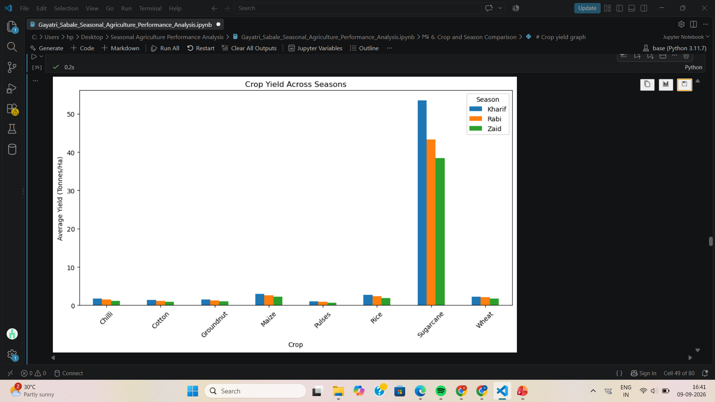
RESULTS
Observation:
I compared the average yield of different crops across Kharif, Rabi and Zaid seasons. Sugarcane has the highest yield in all three seasons, while pulses and cotton have comparatively lower yields. The graph also shows that Kharif generally has higher crop yield than Rabi and Zaid.

Slide 11
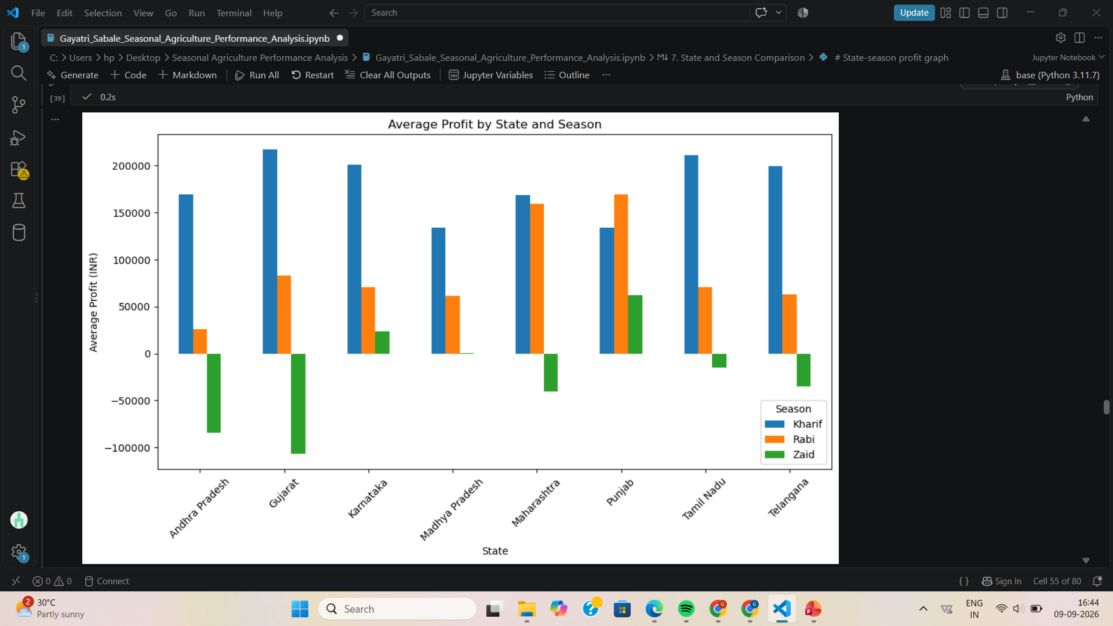
RESULTS
Observation:
I compared the average profit across different states and seasons. Kharif shows higher profit in most of the states, while Zaid profit varies and is negative in some states. Punjab shows relatively high profit in Rabi and Zaid compared with other states. The results show that profit changes depending on both the state and the season.

Slide 12
Future scope
More years of agricultural data can be added for better comparison.
More regions and crop types can be studied.
Weather data can be included in more detail.
Crop price changes can be analyzed along with production.
A prediction model can be developed to estimate crop yield.
A simple dashboard can be created to make the results easier to understand.
The analysis can be updated regularly when new agricultural data is available.

Slide 13
GitHub Link
https://github.com/sabalegayatri23/VOIS-AICTE-Seasonal-Agriculture-Performance-Analysis

Slide 14

VOIS Course completion certificate - Course name- Data Visualization

Slide 15
Thank you
Seasonal Agriculture Performance Analysis
Presented by: Gayatri Satish Sabale
Sanjivani College of Engineering, Kopargoan
.
.

