Slide 1
Containers(Docker)
By Jiten Palaparthi

Slide 2
What is a container?
A container is a self contained execution environment that shares the kernel of the host system and which is (optionally) isolated from other containers in the system.
A Linux® container is a set of 1 or more processes that are isolated from the rest of the system. All the files necessary to run them are provided from a distinct image, meaning Linux containers are portable and consistent as they move from development, to testing, and finally to production. (By RedHat)
Docker is a set of platform as a service (PaaS) products that use OS-level virtualization to deliver software in packages called containers.^{[6]} Containers are isolated from one another and bundle their own software, libraries and configuration files; they can communicate with each other through well-defined channels.^{[7]} Because all of the containers share the services of a single operating system kernel, they use fewer resources than virtual machines.^{[8]} (By Wiki)

Slide 3
Virtualization vs Containerization
Isn’t this just virtualization?
Virtualization lets your operating systems (Windows or Linux) run simultaneously on a single hardware system.
virtualization uses a hypervisor to emulate hardware, which allows multiple operating systems to run side by side. This isn’t as lightweight as using containers. When you have finite resources with finite capabilities, you need lightweight apps that can be densely deployed. Linux containers run natively on the operating system, sharing it across all of your containers, so your apps and services stay lightweight and run swiftly in parallel.
Containers share the same operating system kernel and isolate the application processes from the rest of the system. For example: ARM Linux systems run ARM Linux containers, x86 Linux systems run x86 Linux containers, x86 Windows systems run x86 Windows containers. Linux containers are extremely portable, but they must be compatible with the underlying system.
Linux containers are another evolutionary leap in how we develop, deploy, and manage applications. Linux container images provide portability and version control, helping ensure that what works on a developer’s laptop also works in production. Compared to virtual machines, a running Linux container is less resource-intensive, has a standard interface

Slide 4
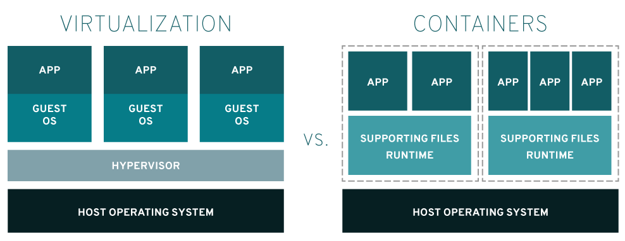
Virtualization vs Containerization

Slide 5
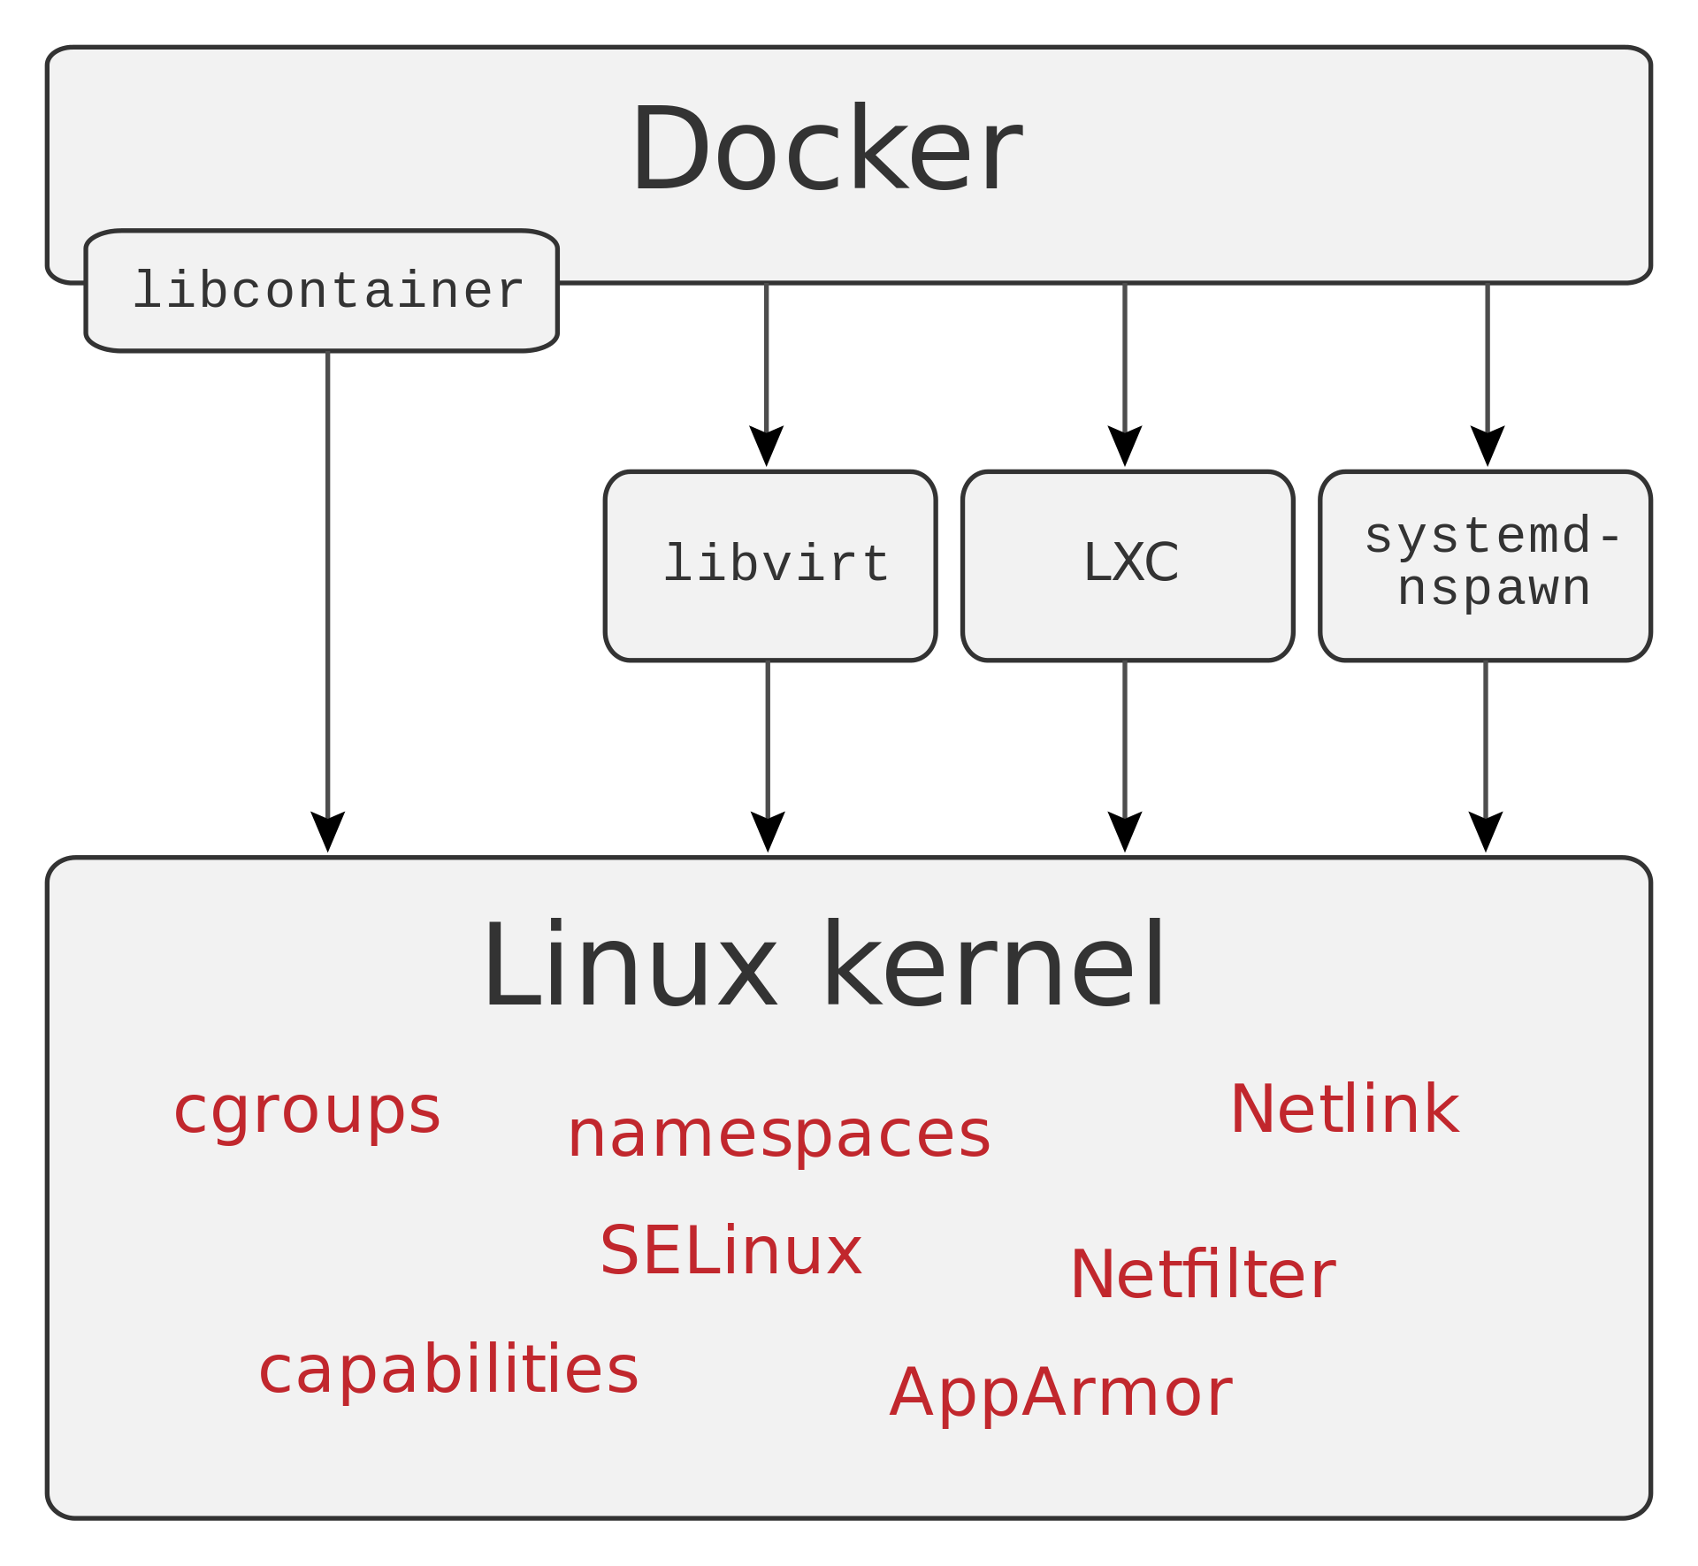
Docker

Slide 6
Components to run Docker Containers
libcontainer:creating containers with namespaces, cgroups, capabilities, and filesystem access controls. It allows you to manage the lifecycle of the container performing additional operations after the container is created
systemd-nspawn:used to run a command or OS in a light-weight namespace container. In many ways it is similar to chroot(1), but more powerful since it fully virtualizes the file system hierarchy, as well as the process tree, the various IPC subsystems and the host and domain name
LXC: The Linux Containers project (LXC) is an open source container platform that provides a set of tools, templates, libraries, and language bindings. LXC has a simple command line interface that improves the user experience when starting containers.LXC offers an operating-system level virtualization environment that is available to be installed on many Linux-based systems. Your Linux distribution may have it available through its package repository.
cgroup: (control groups) is a Linux kernel feature that limits, accounts for, and isolates the resource usage (CPU, memory, disk I/O, network, etc.) of a collection of processes. groups of processes are separated such that they cannot "see" resources in other groups
Important Namespaces:
The PID namespace provides isolation for the allocation of process identifiers (PIDs), lists of processes and their details. While the new namespace is isolated from other siblings, processes in its "parent" namespace still see all processes in child namespaces—albeit with different PID numbers.
Network namespace isolates the network interface controllers (physical or virtual), iptables firewall rules, routing tables etc. Network namespaces can be connected with each other using the "veth" virtual Ethernet device.
"UTS" namespace allows changing the hostname.
Mount namespace allows creating a different file system layout, or making certain mount points read-only.
IPC namespace isolates the System V inter-process communication between namespaces.
User namespace isolates the user IDs between namespaces.

Slide 7
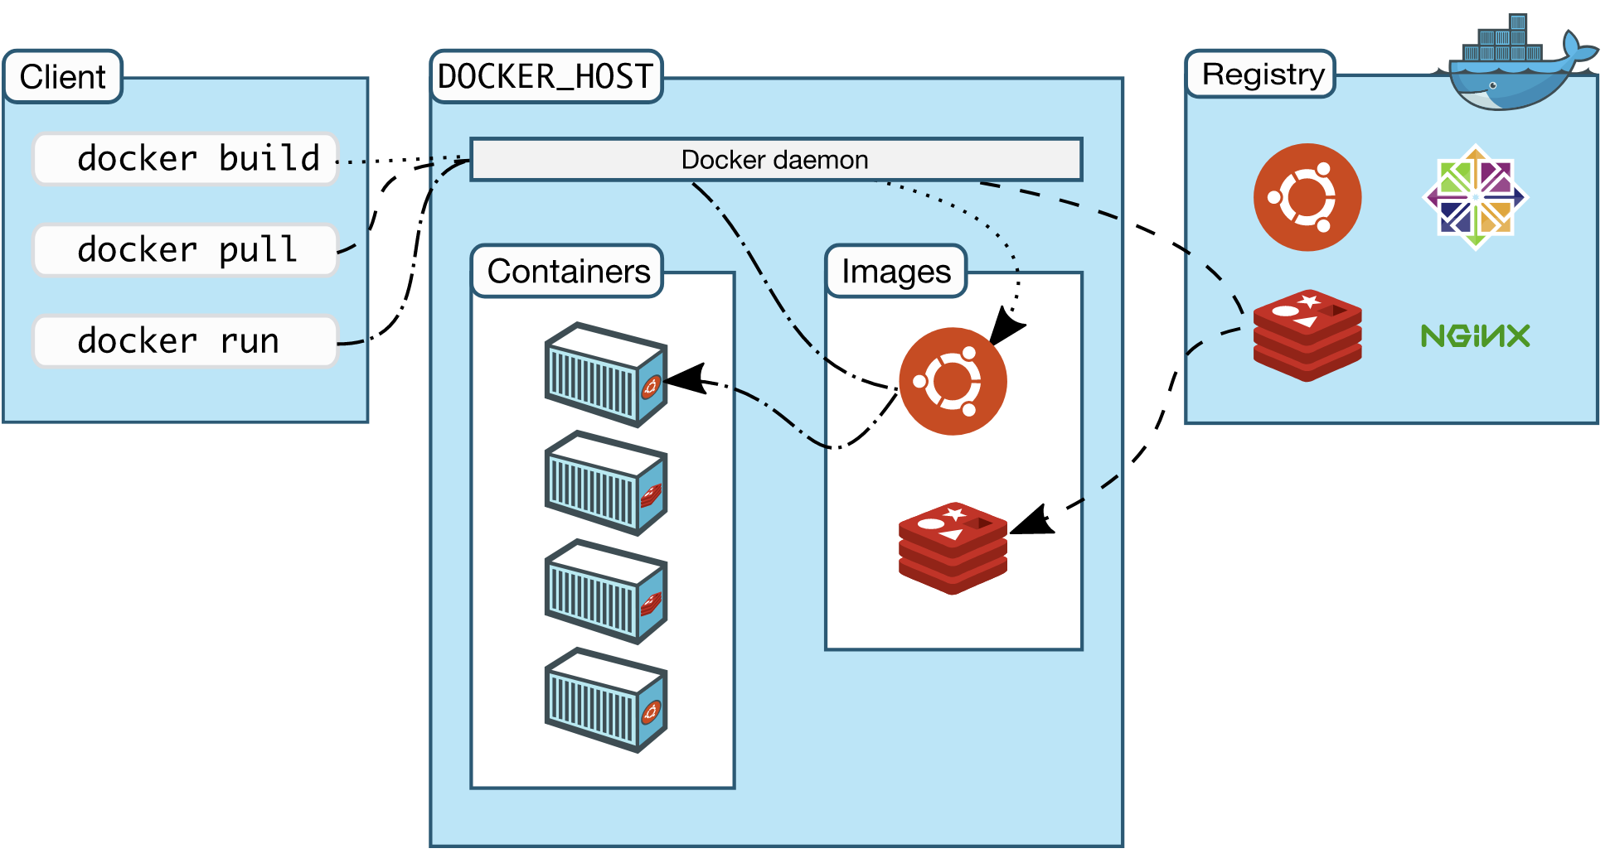
Docker Architecture

Slide 8
Docker Components
The Docker software as a service offering consists of three components:
Software: The Docker daemon, called dockerd, is a persistent process that manages Docker containers and handles container objects. The daemon listens for requests sent via the Docker Engine API.The Docker client program, called docker, provides a command-line interface (CLI), that allows users to interact with Docker daemons.
Objects: Docker objects are various entities used to assemble an application in Docker. The main classes of Docker objects are images, containers, and services.
  A Docker container is a standardized, encapsulated environment that runs applications. A container is managed using the Docker API or CLI.
  A Docker image is a read-only template used to build containers. Images are used to store and ship applications.
  A Docker service allows containers to be scaled across multiple Docker daemons. The result is known as a swarm, a set of cooperating daemons that communicate through the Docker API.
Registries: A Docker registry is a repository for Docker images. Docker clients connect to registries to download ("pull") images for use or upload ("push") images that they have built. Registries can be public or private. Two main public registries are Docker Hub and Docker Cloud. Docker Hub is the default registry where Docker looks for images.Docker registries also allow the creation of notifications based on events.

Slide 9
Docker Tools
Docker Compose is a tool for defining and running multi-container Docker applications.It uses YAML files to configure the application's services and performs the creation and start-up process of all the containers with a single command. The docker-compose CLI utility allows users to run commands on multiple containers at once, for example, building images, scaling containers, running containers that were stopped, and more.Commands related to image manipulation, or user-interactive options, are not relevant in Docker Compose because they address one container.The docker-compose.yml file is used to define an application's services and includes various configuration options. For example, the build option defines configuration options such as the Dockerfile path, the command option allows one to override default Docker commands, and more.[The first public beta version of Docker Compose (version 0.0.1) was released on December 21, 2013. The first production-ready version (1.0) was made available on October 16, 2014.
Docker Swarm provides native clustering functionality for Docker containers, which turns a group of Docker engines into a single virtual Docker engine. In Docker 1.12 and higher, Swarm mode is integrated with Docker Engine. The docker swarm CLI utility allows users to run Swarm containers, create discovery tokens, list nodes in the cluster, and more.The docker node CLI utility allows users to run various commands to manage nodes in a swarm, for example, listing the nodes in a swarm, updating nodes, and removing nodes from the swarm.Docker manages swarms using the Raft consensus algorithm. According to Raft, for an update to be performed, the majority of Swarm nodes need to agree on the update.[
Docker Volume facilitates the independent persistence of data, allowing data to remain even after the container is deleted or re-created.

Slide 10
docker client
docker cli is the docker client.
docker client is used to connect and perform operations on docker host/daemon/server on the host machine.
docker client can connect to any docker host as long as the host can be connected with-in or outside of the host network.
docker client uses docker host api(s) to perform required operation.
docker client has been developed using Go(aka GoLang).
In order to know the docker version of client and server use the following command
  docker version

Slide 11
docker commands
know the information about the docker environment
  docker info
to get help
  docker help
know the information about the docker containers
  docker ps
  docker ps -a # to get all containers

