Slide 1
My Apps
Sabareesan Murugesan

Slide 2
List of Apps
Google OAuth2 Integration
Pharmacy Management App
IoT App
IoT App
Soft Drinks App
Facebook Rest API application
Insurance policy advisor
Currency Converter
Jeopardy TV Game show
MP3 Meta Data Extractor
Pizza order application
Salesman Travel guide
Industry monitoring app
System Controller
Digital Signature
Network Firewall
Properties Management System

Slide 3
1)Google OAuth2 Integration
Software used: Java, Spring Boot, Rest API,Maria db, React
Description:The app required to be enabled with Google signup and signin. The user session is managed via session id and cookies.

Slide 4
2)Pharmacy Management App
Software Used: ReST Web services, Jersey, JAX -RS, Postgres, Java NIO Api, jQuery, HTML5
Description : The app has ReST Api in the back end.The pharmacist can communicate with back end via NIO Socket API. The varies models in the app can be managed via simple jQuery web interface

Slide 5
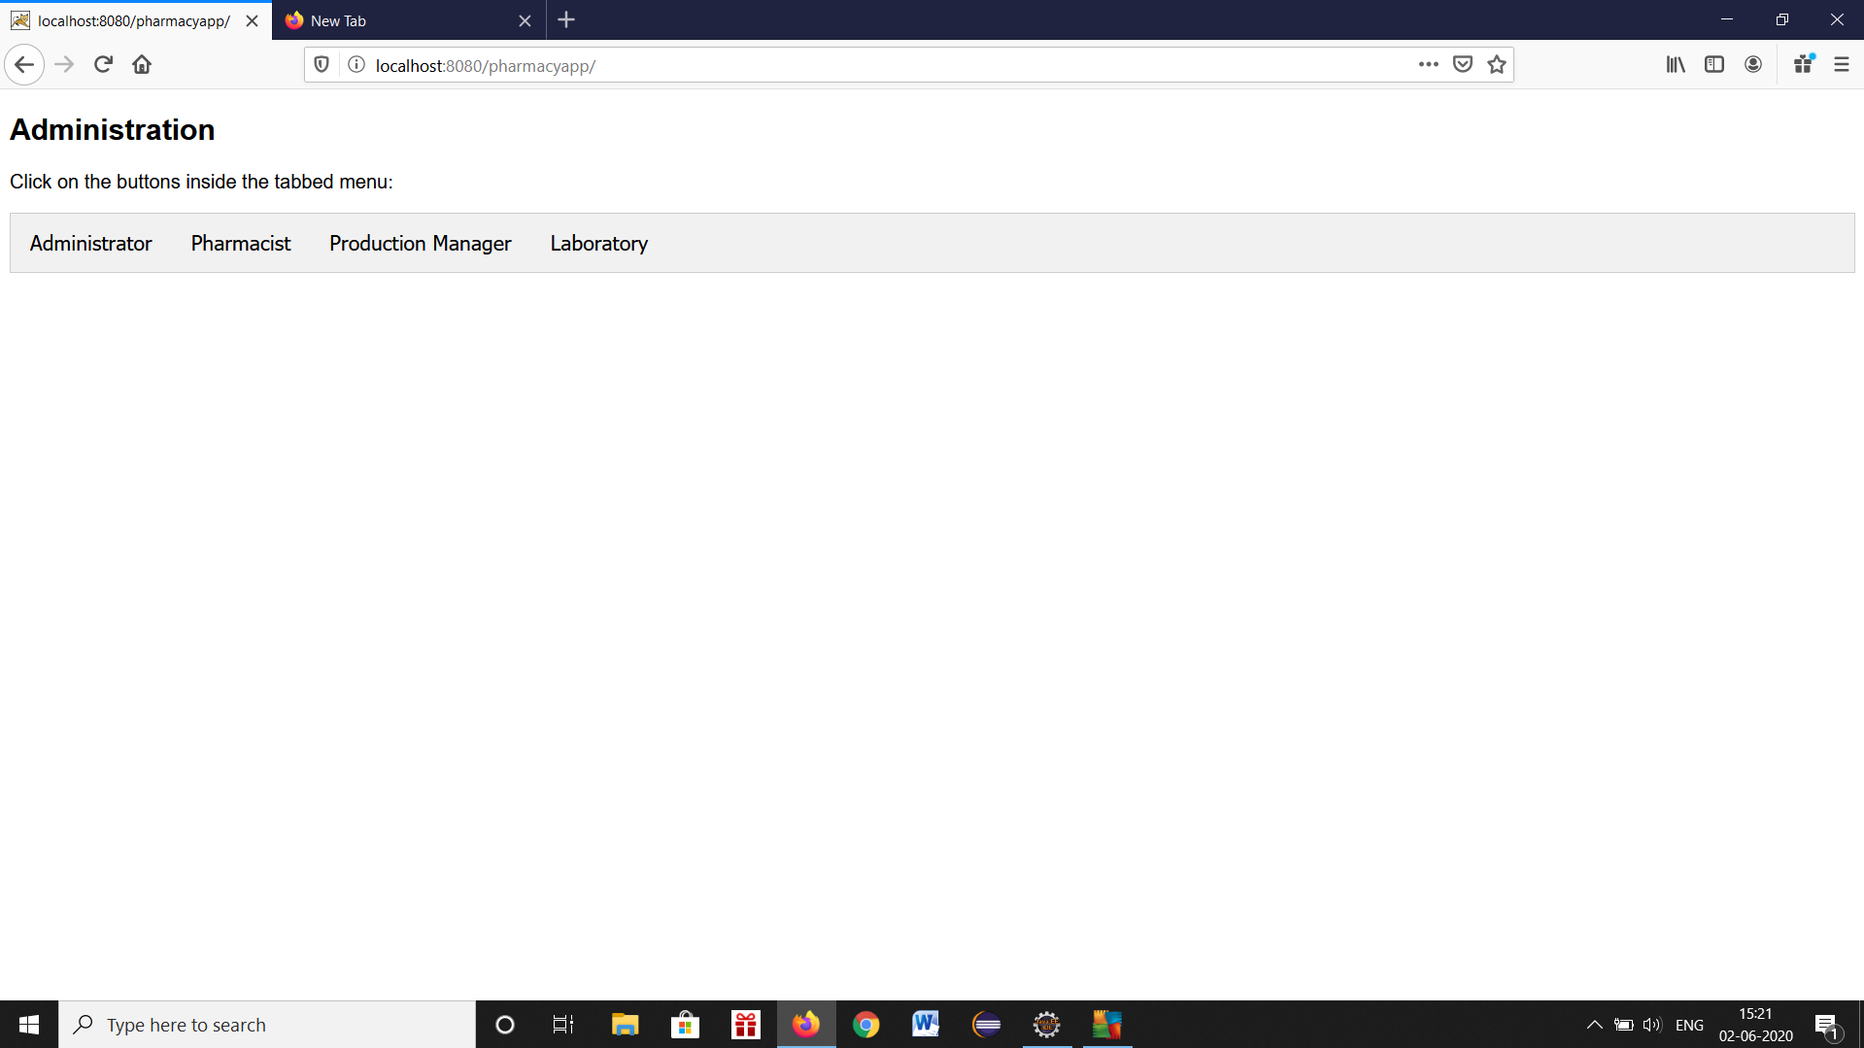
Pharmacy app screen shots

Slide 6
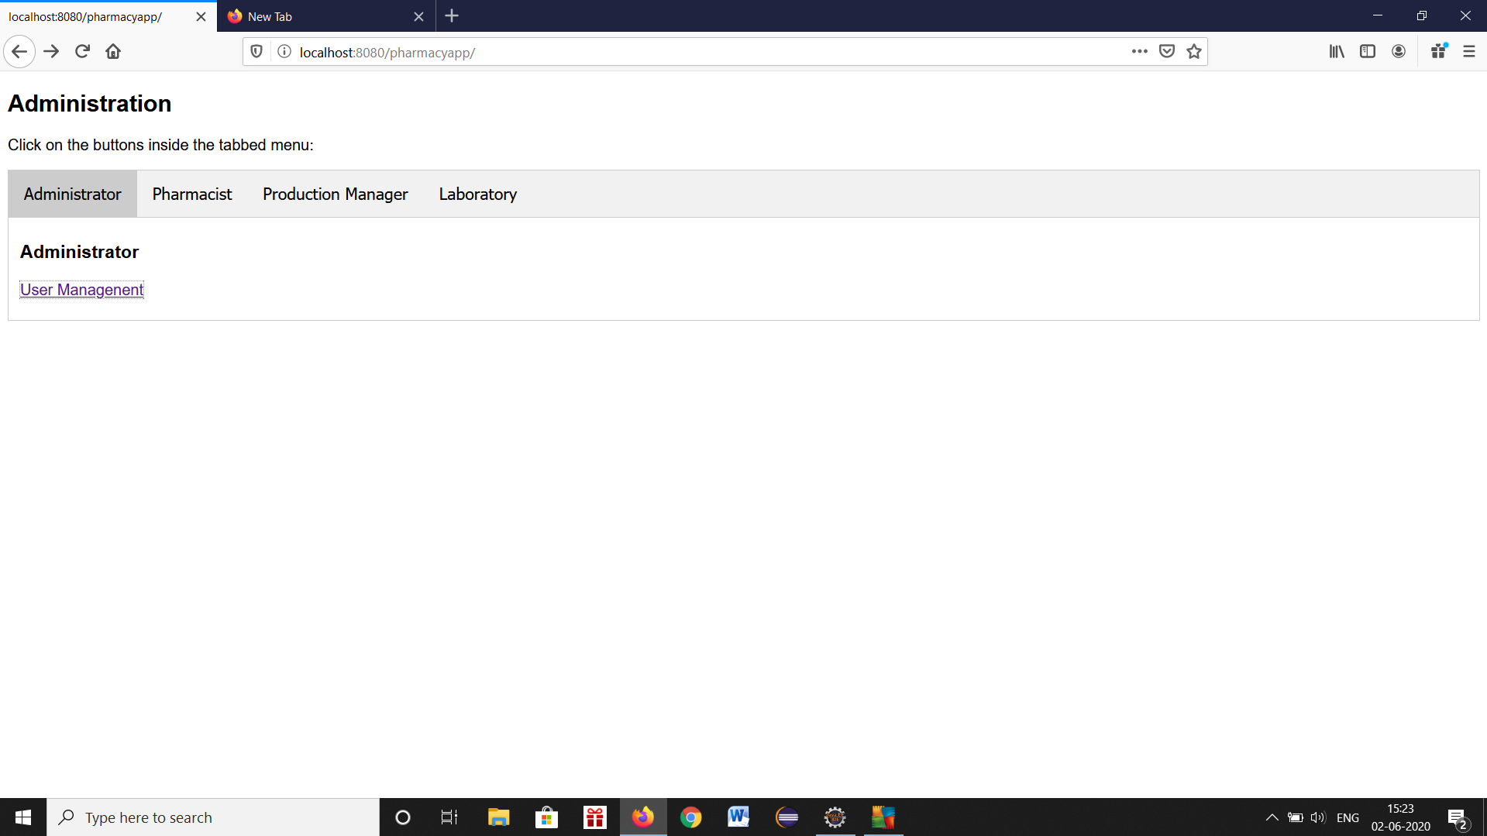

Slide 7
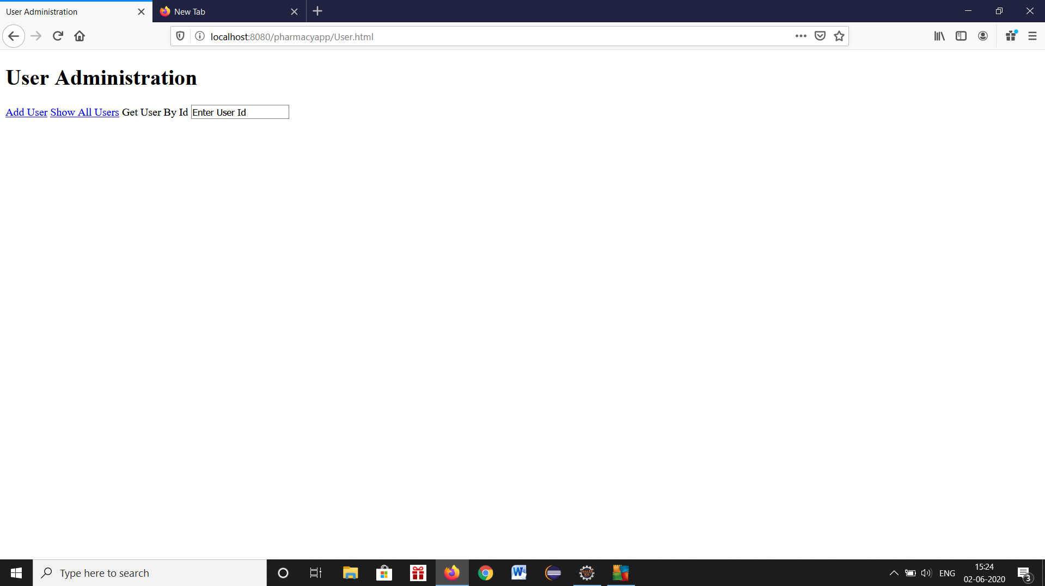

Slide 8
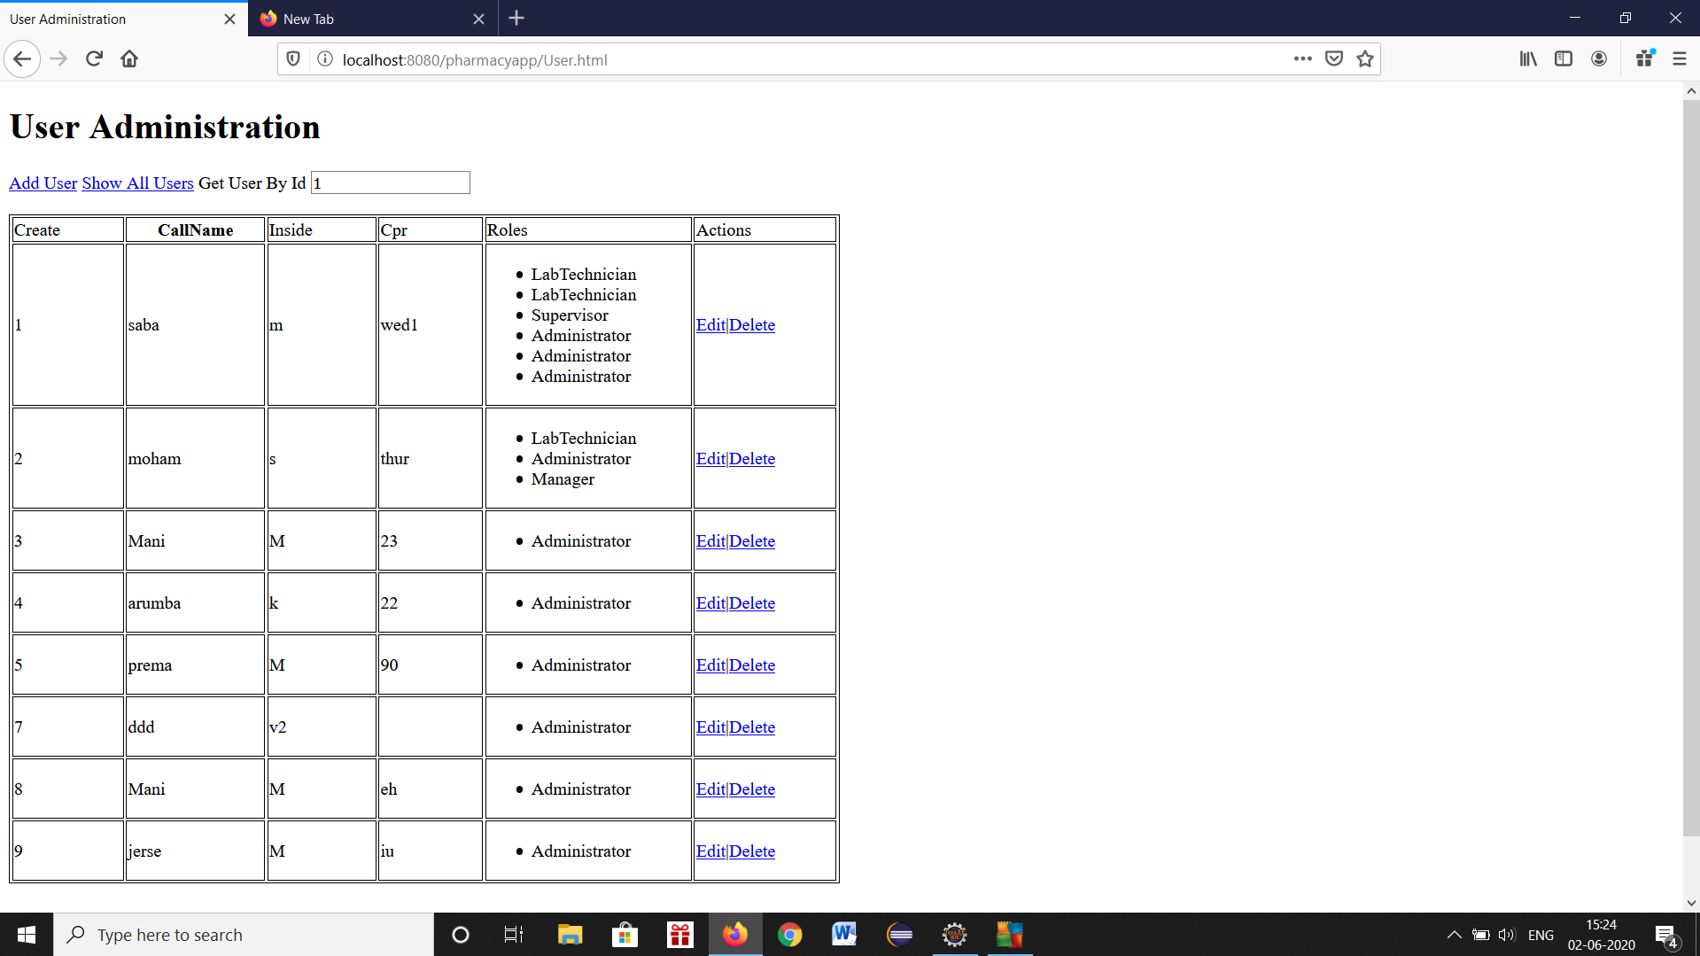

Slide 9
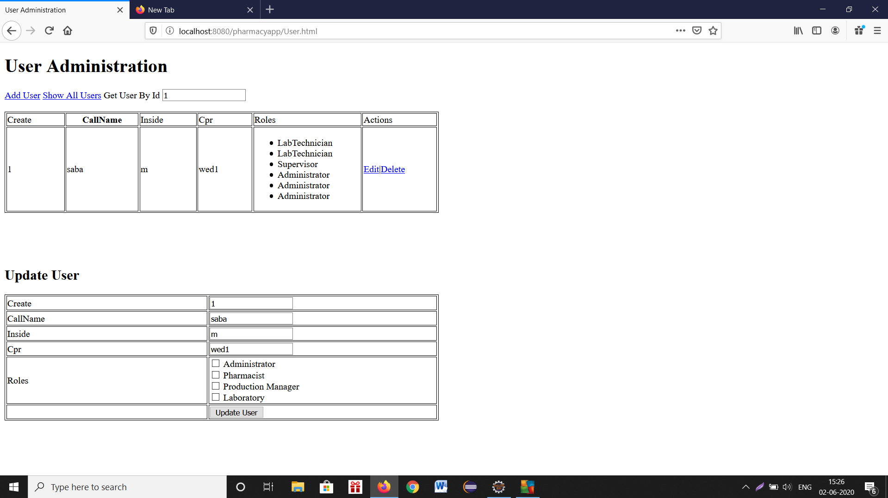

Slide 10
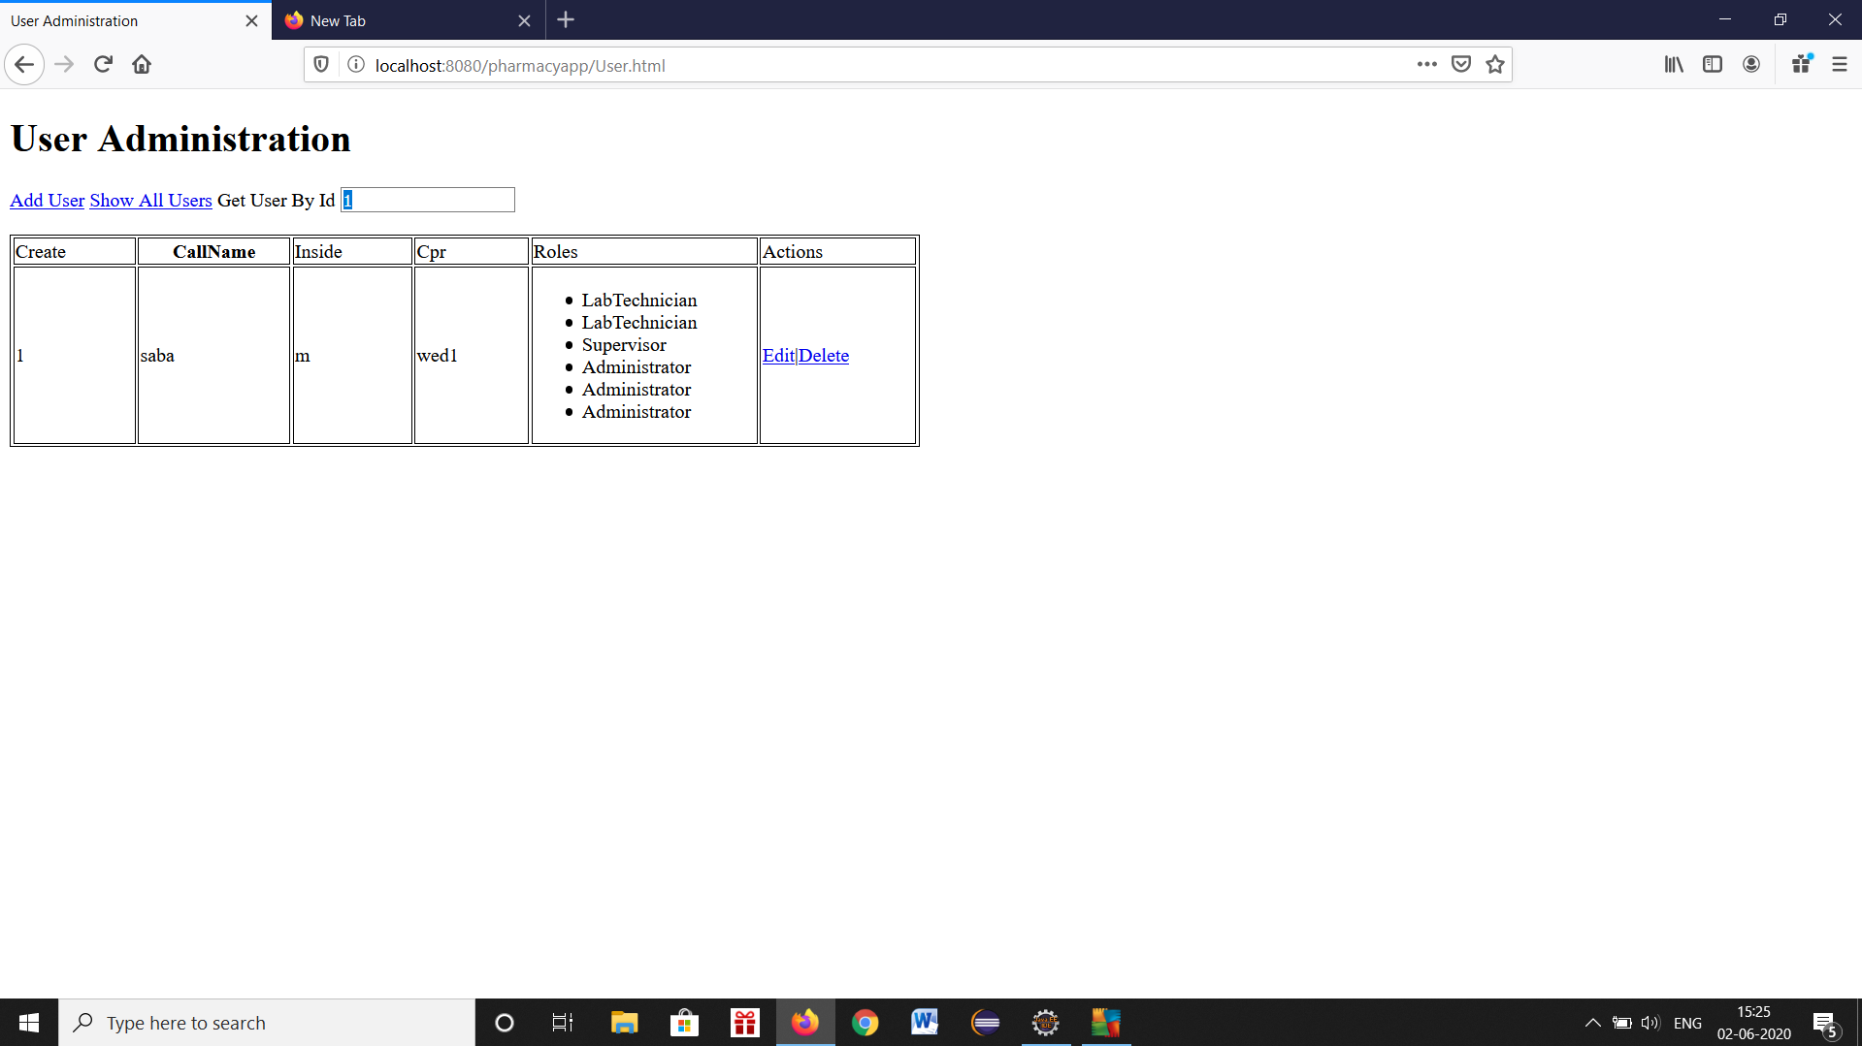

Slide 11
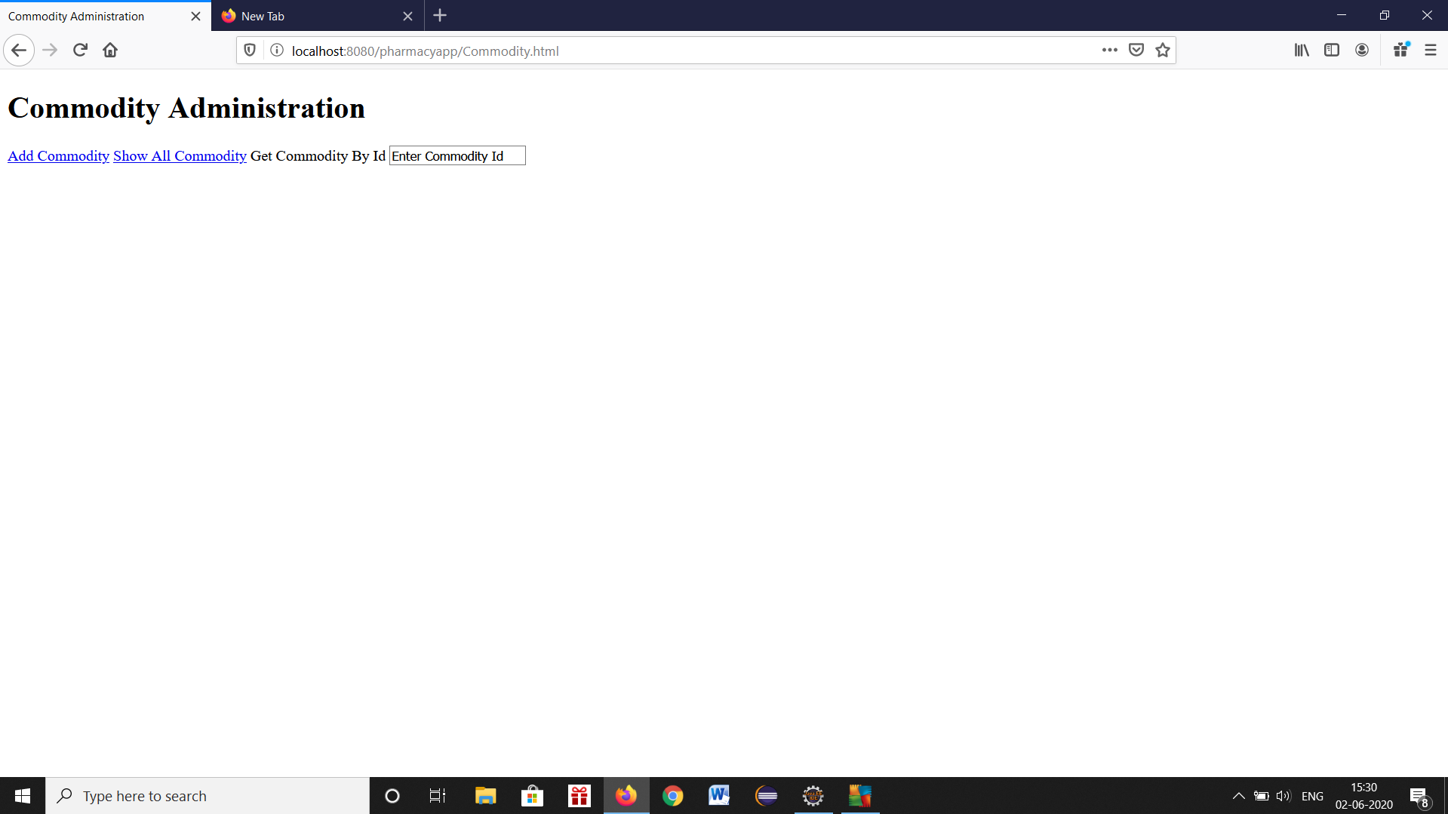

Slide 12
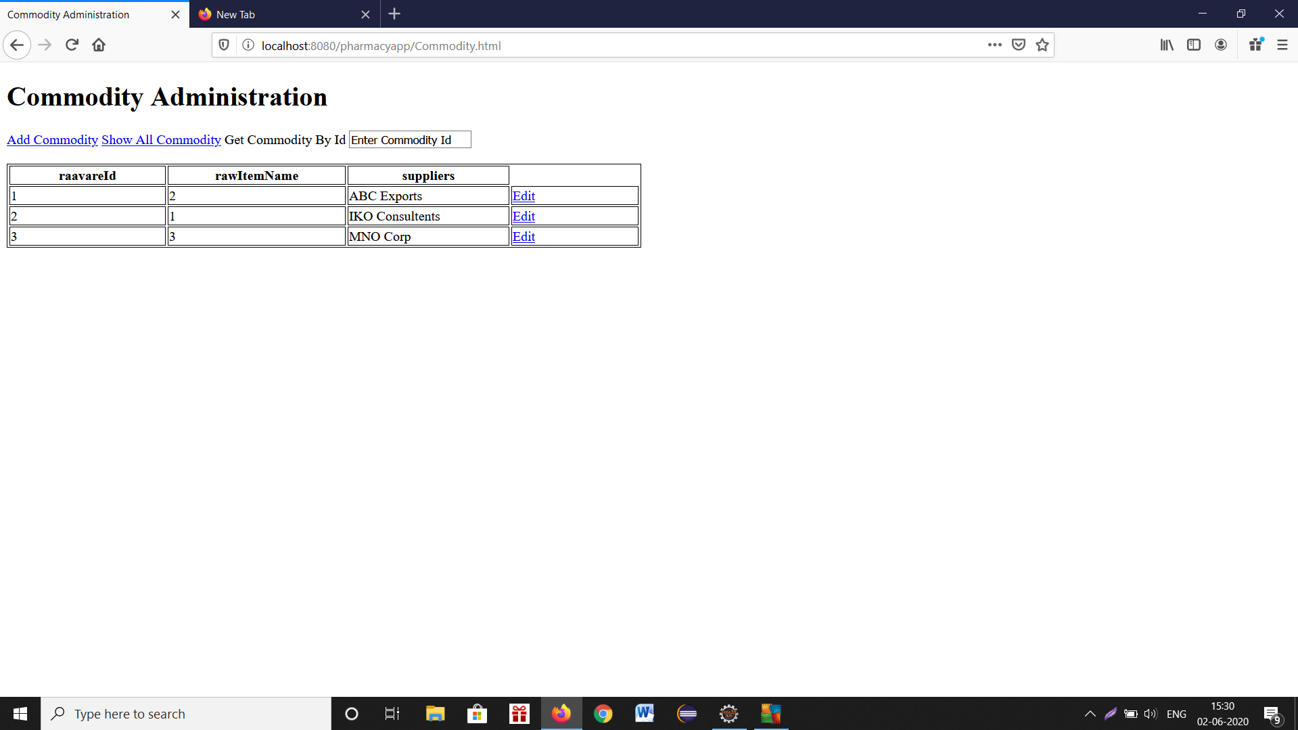

Slide 13
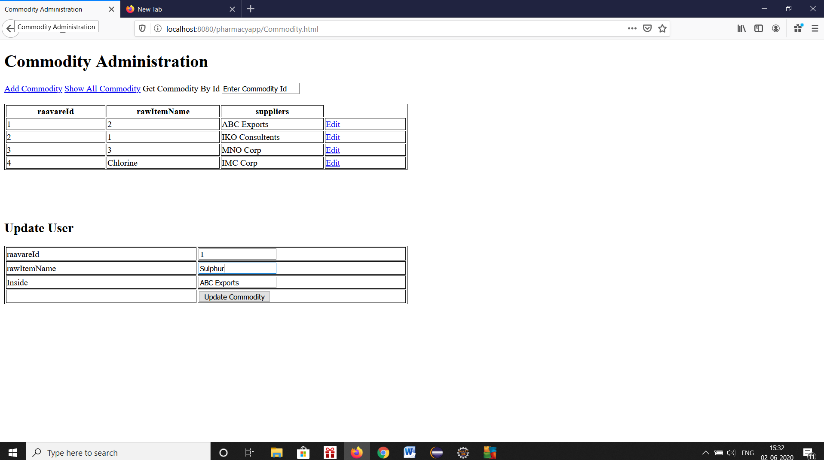

Slide 14
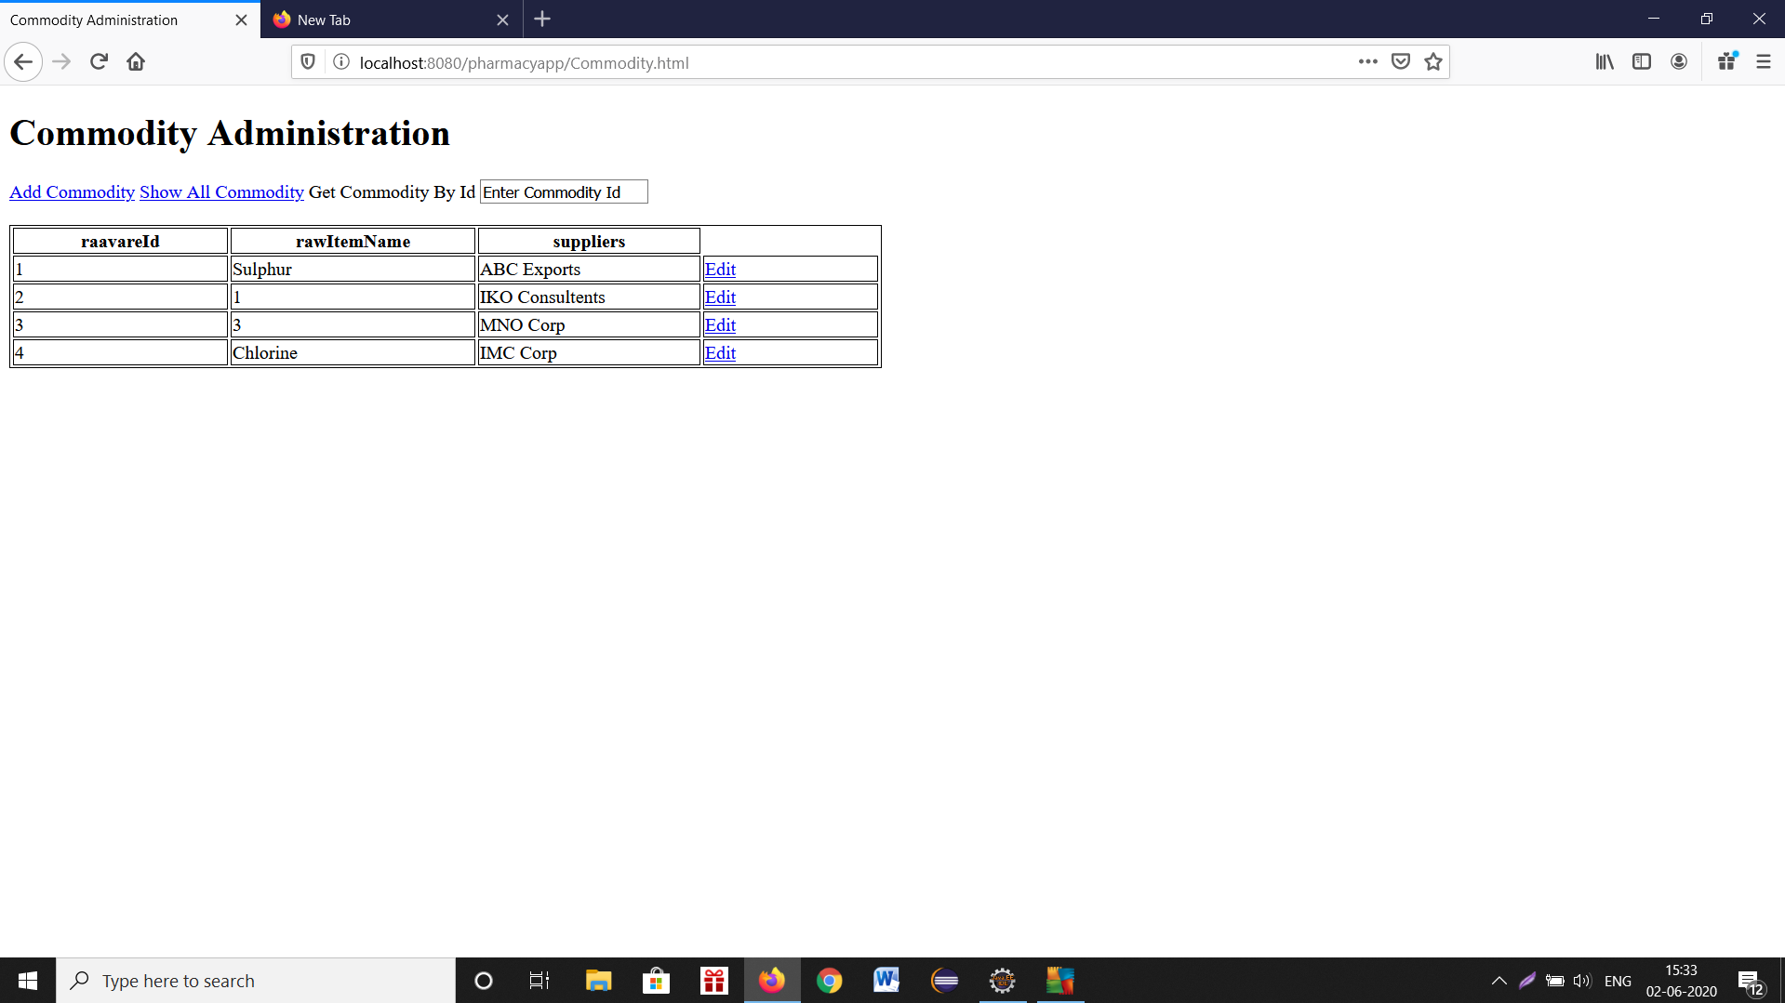

Slide 15
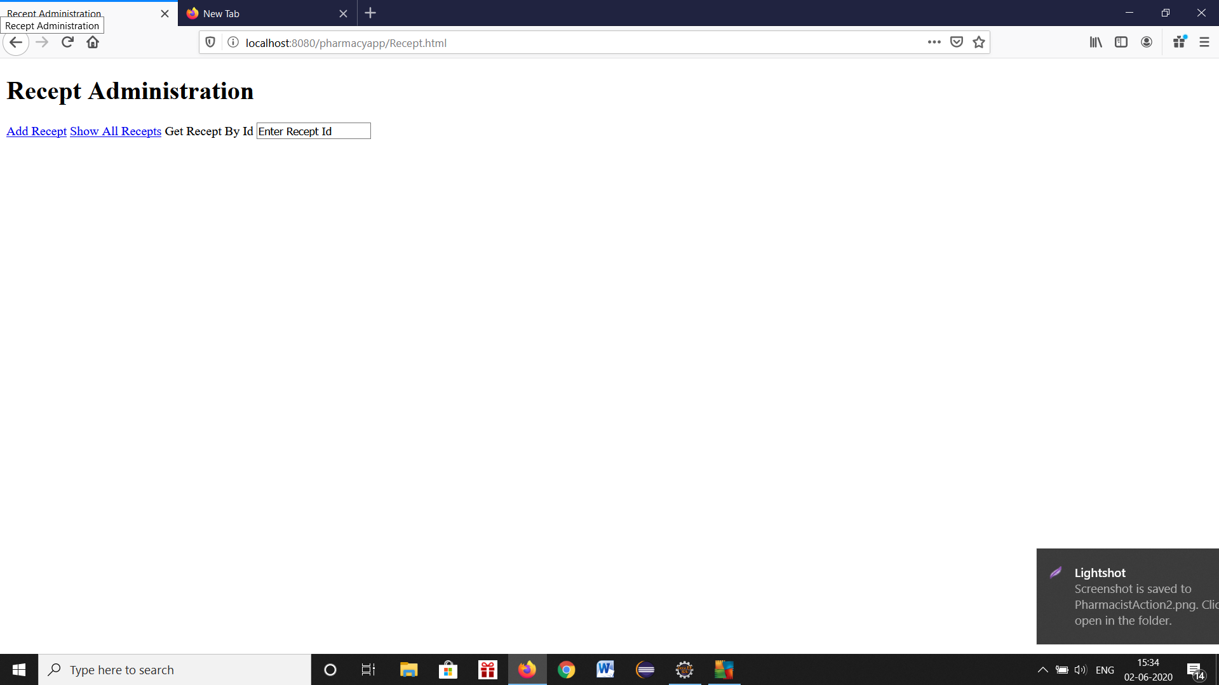

Slide 16
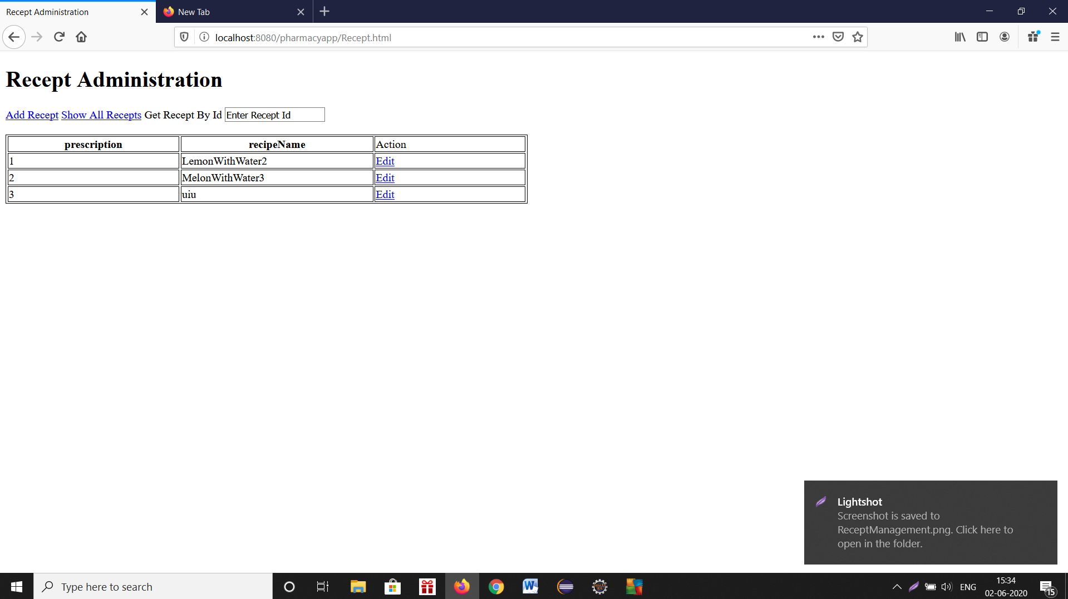

Slide 17
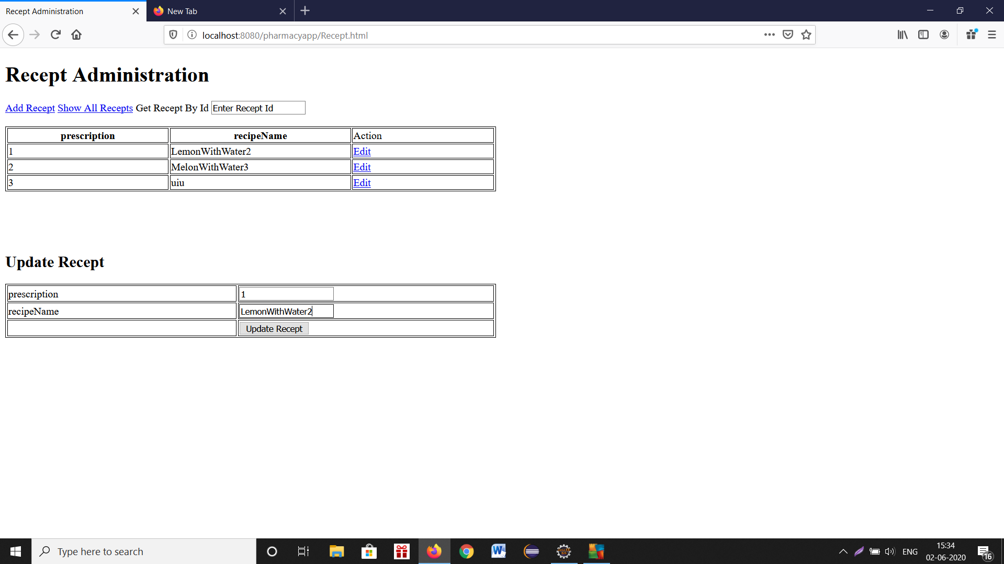

Slide 18
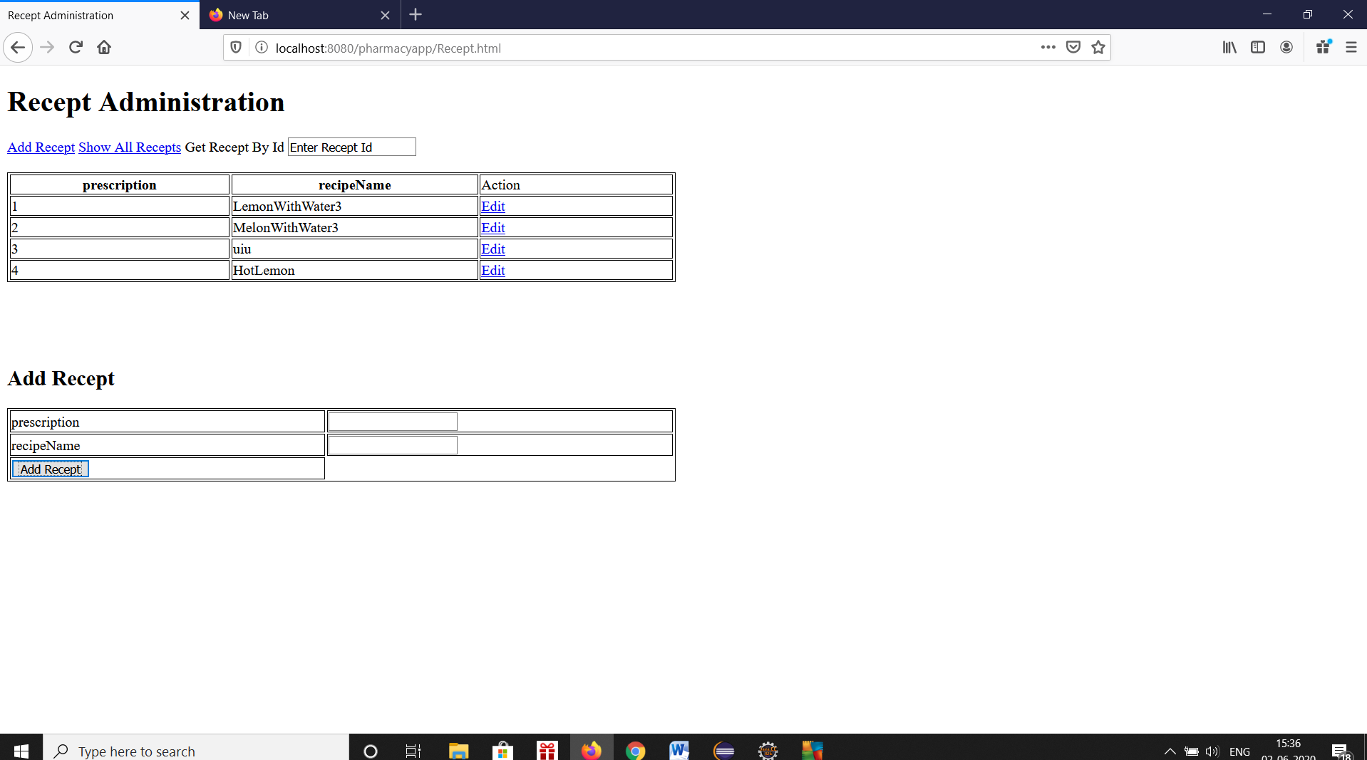

Slide 19
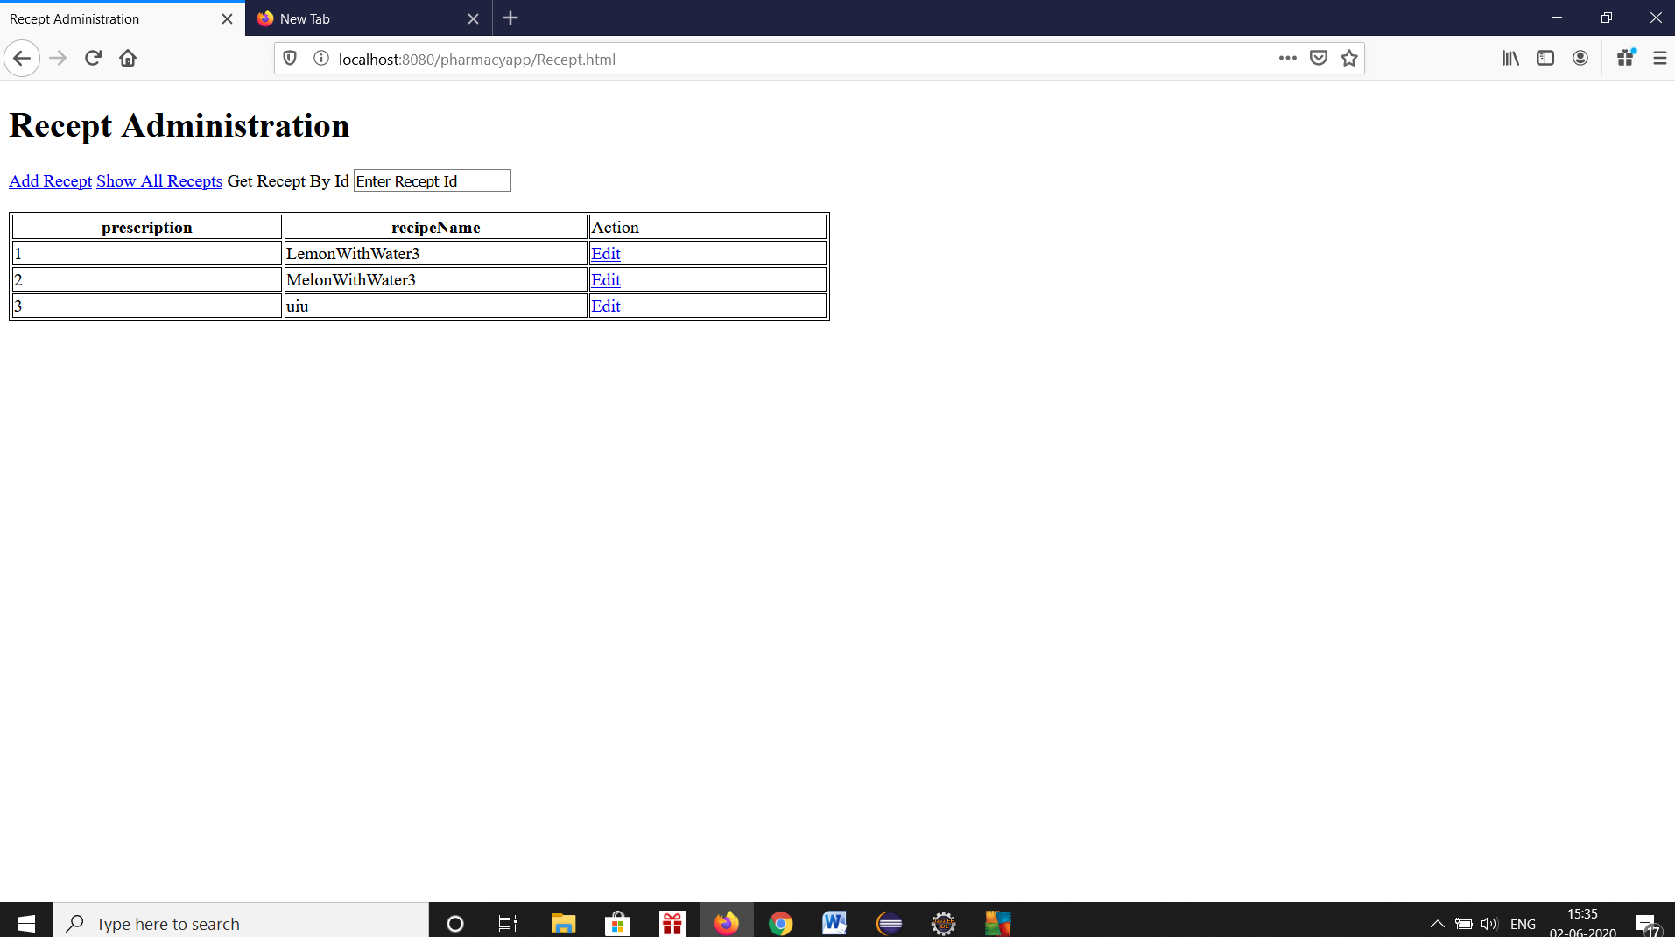

Slide 20
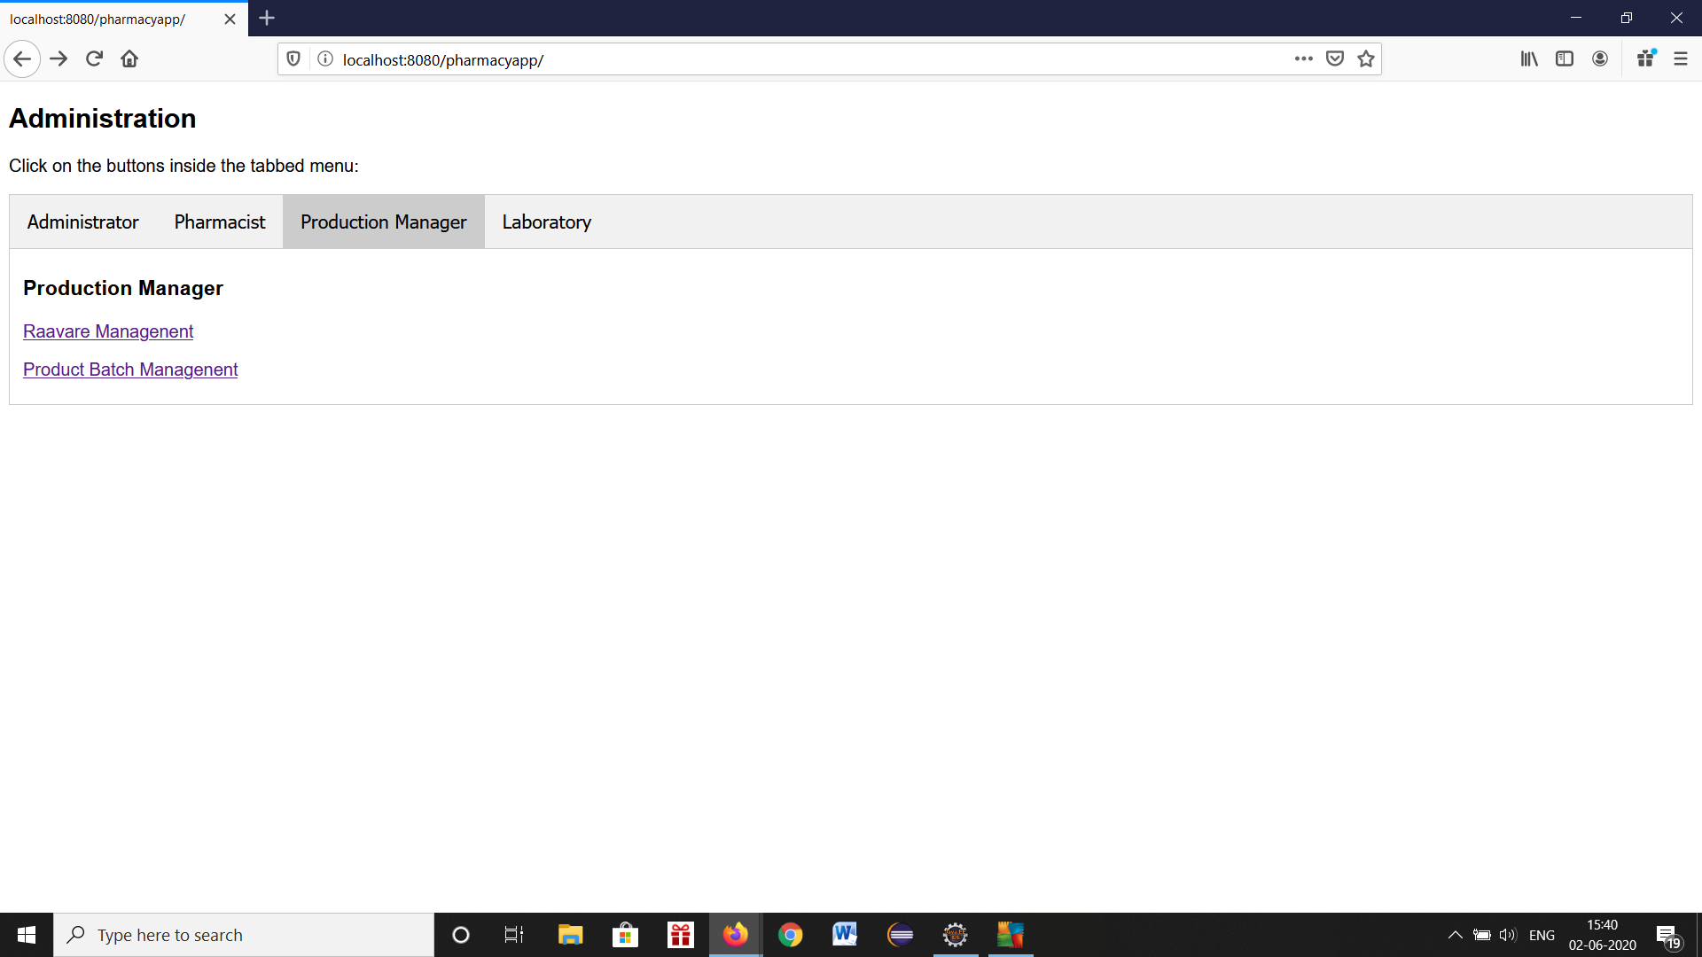

Slide 21
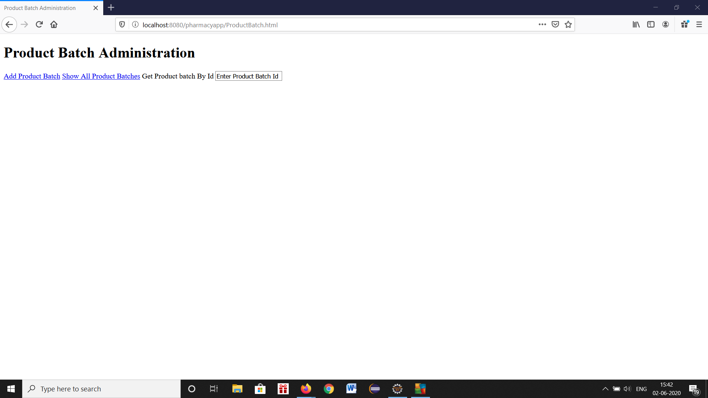

Slide 22
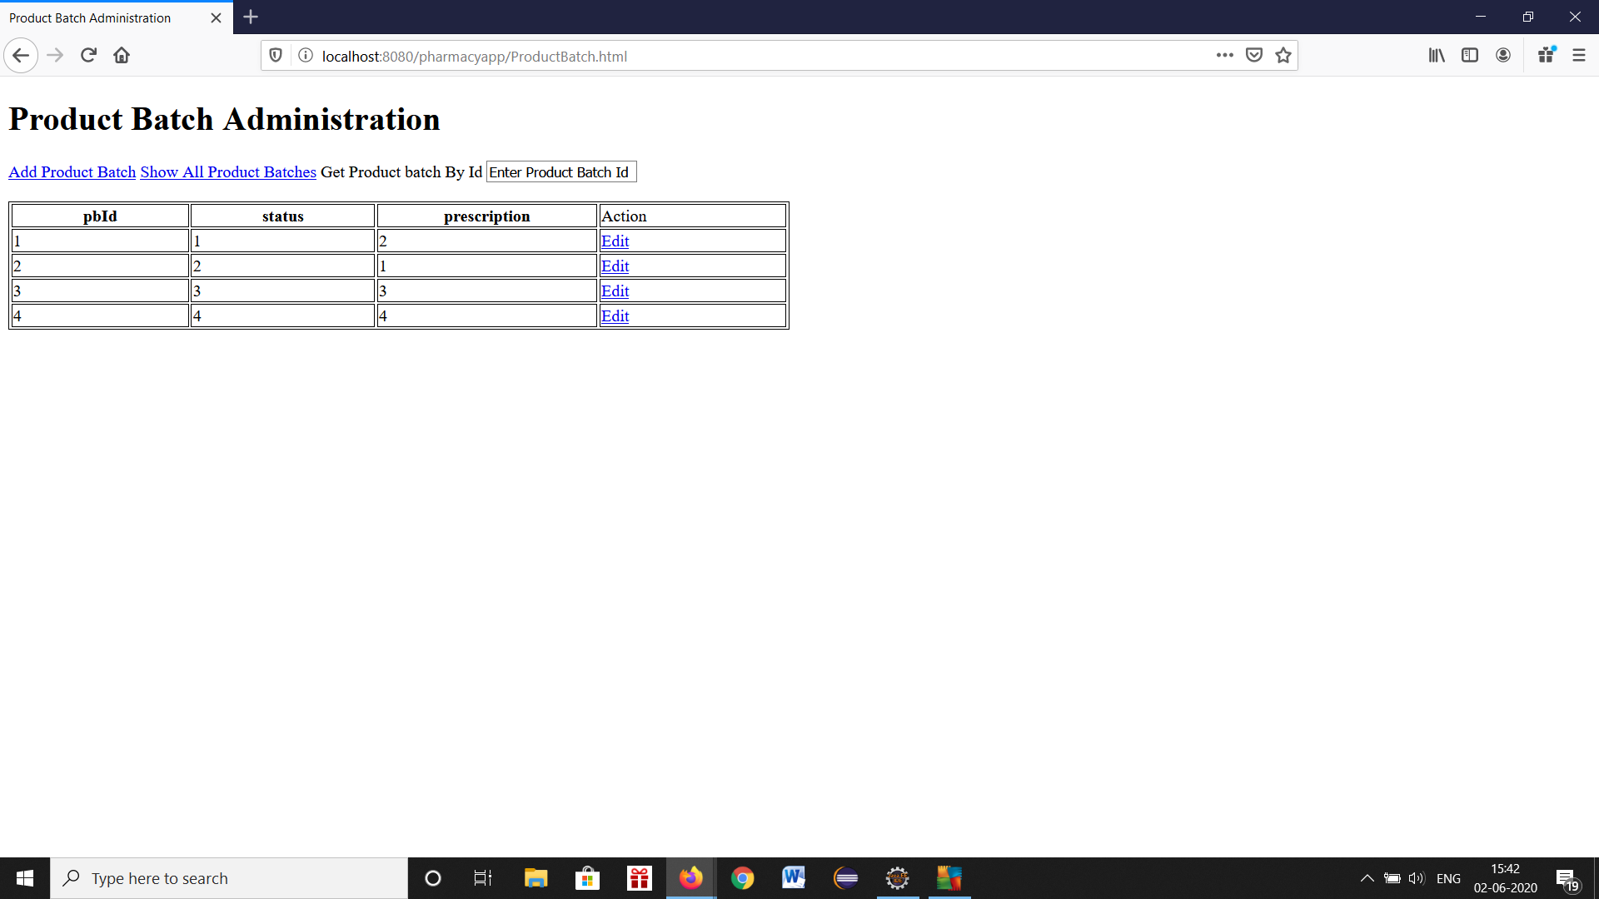

Slide 23
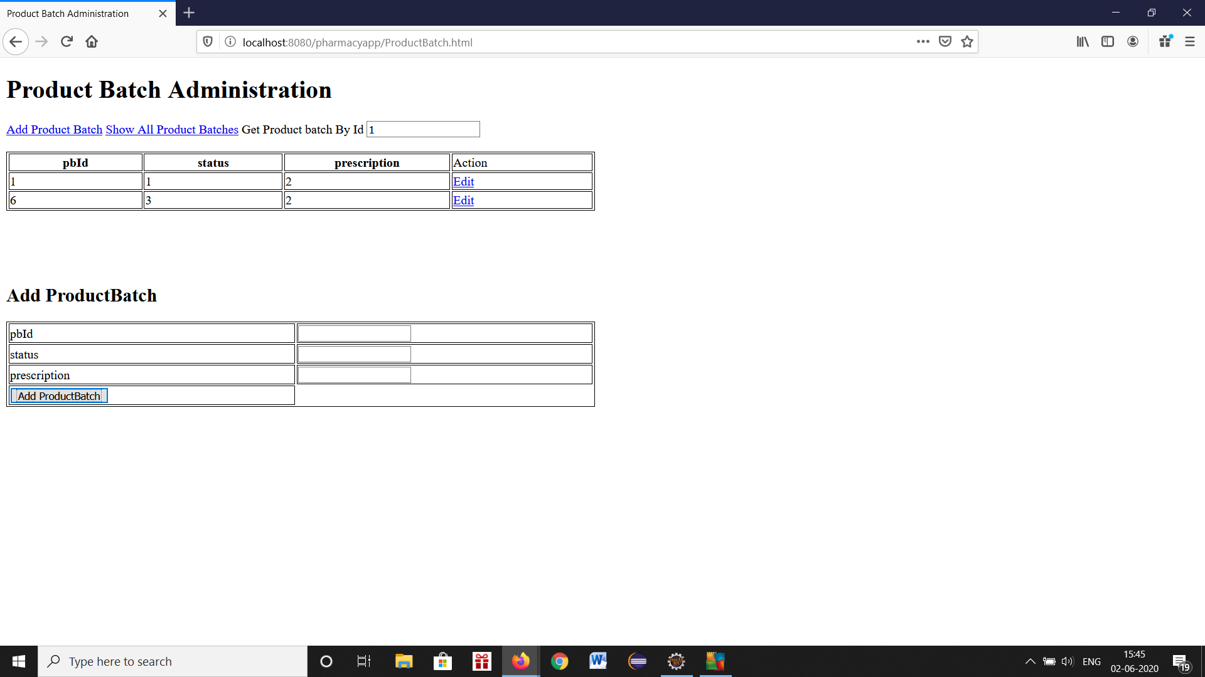

Slide 24
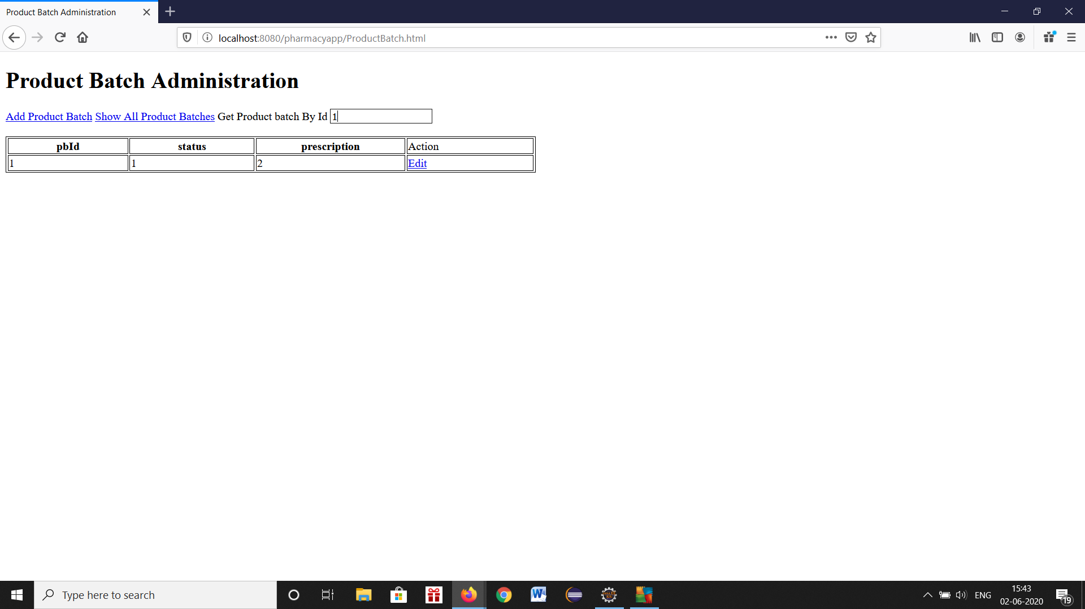

Slide 25
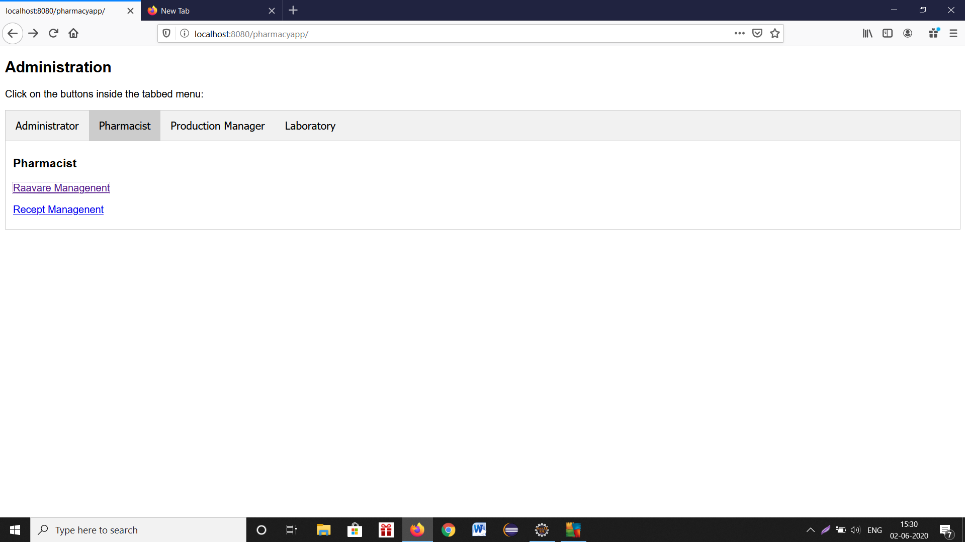

Slide 26
3)IoT HVAC App
Software Used: Java, Spring Boot, Micro service, AWS IoT, Postgres, AWS Java IoT SDK, OAuth2, Docker
Description: The IoT devices will send mqtt data to AWS IoT server. The Rest web service will fetch the mqtt data and process it. The user have role based to access to the api end points.

Slide 27
IoT HVAC App
The app is dockerized. It is deployed in AWS ElasticBeanstalk

Slide 28
4)IoT Security app
Software Used: Java, Spring Boot, Micro service, WSO2, Postgres, Elastic Search, Docker
Description: This application can control several devices, which are connected to the server through IoT protocol. The back end is developed as ReST API using java, Spring Boot and Go Lang.
Many small micro services were developed. They interact with each other.Neo4J is used to store data
Elastic Search has been used to search data

Slide 29
5)Facebook App
Language: Java
Server: Google App Engine
API: Rest FB API
Description: This application needs to be registered with users Facebook account as an application. The user can get analysis of his own Facebook data to get some useful information about his friend request and friends.
The app can read the friend requests, messages, time line.
It will analyze the user data
Based on the analysis, it will give suggestions like whether to allow the friend request or not.

Slide 30
6)Soft drinks App
Software Used: Java, Servlets, JSP, Rest Web Service, Jersey, JDBC
Server: Embedded Jetty, Oracle
Description: The user can order the soft drinks she wants to buy through web interface. The application also provides web services by which user can order the soft drinks.

Slide 31
7)Insurance policy advisor
Software used : JSP, Servlets
Server : Tomcat, My SQL
Description: The application gets building property information from the user. Based on the properties values it suggests the policies. The user can edit the property details.

Slide 32
8)Currency Converter
Software used: Java, JAXP
Description: The application gets the amount of money and the currency type from the user and gets the current currency rate from web as xml data. Then calculate and converts the amount in to another currency.

Slide 33
9)Jeopardy TV Game show
Language: Java
GUI: Java Swing
Jeopardy TV Game is a popular US TV show. This application simulates the Jeopardy game.

Slide 34
10)MP3 Meta Data Extractor
Language: Java
Description: The application will read all the MP3 files from the specified folder. It will find out the all information about the songs like artist, duration of the track, album name and show that information as a table.

Slide 35
11)Pizza order application
Language: Java
GUI: Java Swing
Description: This application is used for the pizza shop cashier. The cashier orders the pizza for the customer. The GUI shows available pizzas, soft drinks, and burgers available in the shop. The cashier can edit the order at any time

Slide 36
12)Salesman Travel guide
Software used: Java, JSF, Prime Faces, Google Distance Matrix API, JPA, Eclipse Link
IDE: Net Beans
Server: My Sql
Description: The application allows managers of the firm to specify the marketing executives, the cities the executive required to visit. When the executive logs in to the application, it shows the shortest path of the route he needs to take to visit all cities using Google Distances Matrix API.

Slide 37
13)Industry monitoring app
Software used: Java, Android Lollipop, Android Studio
Description: This application can run on any android device. This app will monitor the factory. The factory is monitored 24*7 by the app. The people can send sms or email to this app’s phone. Then this app will take photograph or video in the factory and email, MMS the image or video to the specified email or mobile number.

Slide 38
14)System Controller
Software used: Java, Servlets, JNI, VC++ DLL, C Windows Device Driver
Description: This application has a web user interface. The user can control the electric devices by this user interface. The application communicates with VC++ dll from servlet using JNI, VC++ dll communicates with C device driver. The device driver communicates with electrical interface through parallel port.

Slide 39
15)Digital Signature
Software used: Java, Servlet, Digital Signature, DSA, RSA, MD5, SHA
Server: MS SQL, Tomcat
Description: The user can generate sign his email using MD5 or SHA algorithms. In addition, user can generate RSA or DSA keys to encrypt the message. The application provides 2 benefits to the user. If intruder tampers the email when it is in transit, then it can be detected. If the intruder got the message, he cannot decrypt it without keys.

Slide 40
16)Network Firewall
Software used: Java, VC++, JNI
Description: The user can specify the IP address from which he does not want to receive any messages like email. The application will not allow the messages from those machines.

Slide 41
17)Properties Management System
Software used: Java, Swing, MS SQL
Description: This application is for the real estate agent. The agent can add, edit and delete property information. The application stores all the information about the property

