Slide 1
<> CODEMETRIX
CODEMETRIX
From Coding Activity to Actionable Performance Insights
TEAM NAME CodeMetrix
TEAM MEMBERS Sabareesh K • Sabarivasan P • Roshan M
DEPARTMENT II ECE E
C O D E M E T R I X
01

Slide 2
THE CHALLENGE
Problem Statement
Students practice coding on platforms like LeetCode and GitHub, but faculty often lack a centralized system to track and evaluate that progress effectively.
Manual Tracking
Manual tracking of students' coding progress across individual profiles.
Hard to Monitor at Scale
Difficult to monitor hundreds of students and keep records continually updated.
Inactive Students Missed
Faculty cannot easily identify inactive students early for timely guidance.
Scattered Data & Copy-Paste
Student performance is scattered without code authenticity and paste verification.
No Easy Comparison
Difficult to compare section-wise performance, daily streaks, and authentic logic.
Database Storage Limits
Saving raw code submissions quickly exhausts free cloud limits without an auto-purge.
C O D E M E T R I X
02

Slide 3
THE APPROACH
Proposed Solution
CodeMetrix is a centralized dashboard that automatically collects and analyzes students' LeetCode and GitHub activity, and presents it through student, section, and faculty dashboards.
LeetCode & GitHub
Automated Data Collection
Data Processing & Forensics
Supabase Database
CODEMETRIX
Student Dashboard
Faculty Analytics
Admin Dashboard
C O D E M E T R I X
03

Slide 4
UNDER THE HOOD
Technology Stack
HTML
Builds the structure of the web dashboard
CSS
Creates the responsive and modern UI
JavaScript & JSZip
Handles interactions, filtering, search & 1-click ZIP downloads
FRONTEND
Python
Automates LeetCode/GitHub data collection and processing
GitHub Actions
Runs automated trackers periodically without manual execution
Monaco DOM Hook
Browser extension capturing typing rhythm and paste counts
AUTOMATION & PROCESSING
SQL & Triggers
Auto-replace deduplication constraints & 50-problem purge
Supabase
Stores student profiles, coding data and application data
Row Level Security
Guarantees secure access across faculty and student portals
DATABASE & AUTHENTICATION
C O D E M E T R I X
04

Slide 5
HOW IT WORKS
System Architecture
LeetCode
• Problems solved (E / M / H) • Daily activity & submissions
GitHub
• Repositories & commits • Contribution activity
Python — Processing Engine
• Fetch data • Process and clean data • Validate deduplication • Enforce 50-limit window
GitHub Actions
• Scheduled execution • Runs trackers automatically
Supabase (PostgreSQL)
• Central data store • Auto-prune triggers • Powers all dashboards
Student Dashboard
• LeetCode & GitHub activity
• 1-Click ZIP archive download
Admin Dashboard
• Manage profiles & faculty
• Anti-paste forensics inspection
Faculty Dashboard
• Section-wise analysis
• In-modal code inspection & Excel export
C O D E M E T R I X
05

Slide 6
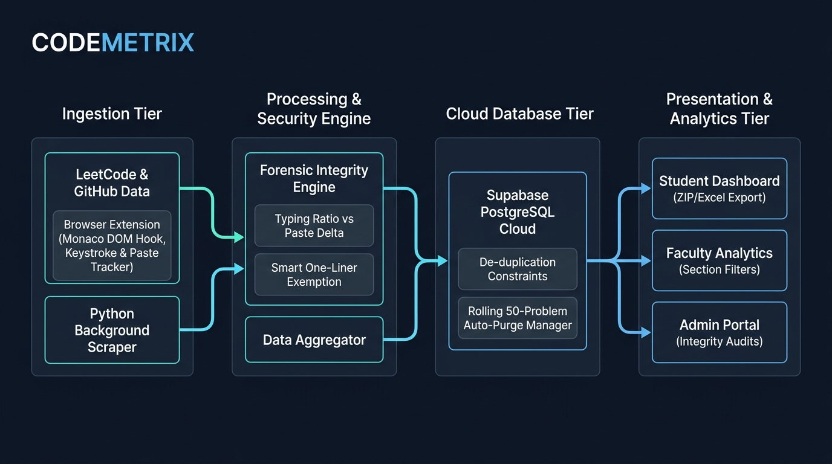
BLOCK DIAGRAM

Slide 7
WHAT IT DELIVERS
Key Features
Automated LeetCode & GitHub Tracking
Daily background scraping captures solved counts, streaks, and difficulty breakdowns automatically.
Section-wise Analysis
Instant filtering across sections with ranked leaderboards and detailed student modals.
Inactive Students Detection
Early identification of students with broken practice streaks for prompt academic mentoring.
Suspicious Solving Analysis
Extension tracks typing vs paste deltas to flag AI-pasted code while keeping short one-liners clean.
50-Problem Download & Auto-Purge
1-click ZIP and Excel archive of solved files with automatic database reset to maintain free cloud limits.
Duplicate Prevention
Re-submitted problems automatically replace older records, guaranteeing zero duplicate entries.
C O D E M E T R I X
06

Slide 8
WHAT SETS US APART
Innovation
Unified Coding Intelligence
Combines LeetCode + GitHub activity into one intelligence layer.
Real-Time Monitoring
Automated, real-time activity monitoring across platforms.
Pattern-Based Integrity Checks
Physical keystroke counting and smart one-liner tolerance (<=220 chars) eliminate false alarms.
Self-Pruning Cloud Architecture
Maintains perpetual free-tier operation via automated rolling 50-problem pruning and offline archives.
Data-Driven Reporting
Historical and section-wise data-driven reporting formatted for reviews.
Automated Delivery
Automatic report sending and email updates for class advisors.
C O D E M E T R I X
07

Slide 9
WHY IT MATTERS
Impact
Area | Before CodeMetrix | With CodeMetrix
Faculty Effort | 15+ hours/week on manual spreadsheet audits | 100% automated background sync and 1-click Excel reports
Integrity & Authenticity | Zero visibility into whether code was typed or pasted | Real-time classification (Clean, Suspicious, Flagged) based on keystroke data
Inactive Student Detection | Inactive students discovered late during exams | Early warning alerts identifying broken practice streaks within 24 hours
Storage & Infrastructure Cost | High risk of hitting database limits or paid tiers | $0 perpetual cost via rolling 50-problem limit and offline .ZIP export
Student Practice Habit | Irregular, last-minute bulk copy-pasting | Consistent daily coding habit driven by live section leaderboards
Consistent Practice Daily coding habit fostered across all students
Reduced Workload Automated monitoring saves 15+ faculty hours weekly
Early Intervention Inactive students identified quickly for counseling
Data-Driven Decisions Meaningful analytics for section-level performance reviews
Academic Integrity Unusual solving patterns and copy-paste dumps flagged
Storage Sustainability 50-problem auto-pruning enables perpetual zero-cost operation
Career Readiness Verified LeetCode + GitHub portfolios for placement drives
IMPACT RESULT
C O D E M E T R I X
08

Slide 10
<>
THANK YOU
CODEMETRIX • From Coding Activity to Actionable Performance Insights
C O D E M E T R I X
10

