Slide 1
TRACK 3 • OFFENSIVE SECURITY
VulnFix AI
VF
AI-Assisted Vulnerability Validation & Proof-of-Fix
A closed-loop security workflow for authorized local validation.
AUTHORIZED • LOCAL-ONLY • AUDITABLE
Demo target: 127.0.0.1:5000 | Dashboard: localhost:8502

Slide 2
01 • PROBLEM
Finding a vulnerability is not the same as proving the fix.
Security validation needs evidence across the full remediation loop.
1
Detect ≠ prove
2
Fix ≠ verify
3
Automation needs scope
A scanner result alone does not establish that a finding is reproducible or actionable.
A patch can be applied without demonstrating that the original weakness is no longer exploitable.
Security automation must enforce authorization and bounded behavior before probing a target.
VulnFix AI connects discovery, validation, remediation guidance and proof-of-fix in one controlled workflow.

Slide 3
02 • CORE IDEA
One closed loop: Find → Validate → Fix → Verify
FIND
VALIDATE
ASSESS
FIX
VERIFY
Discover endpoints
and inputs
Confirm behavior
with evidence
Risk + remediation
mapping
Apply guidance
and patch
Retest and prove
secure state
Output: evidence-backed findings + remediation + a repeatable proof-of-fix result

Slide 4
03 • ARCHITECTURE
Scope is the gate; evidence is the output.
Three vulnerability classes are validated and then individually retested for proof-of-fix.
AUTHORIZED TARGET
SCOPE CONTROLLER
DISCOVERY
DETECTION
VULNERABILITY VALIDATION
127.0.0.1:5000
loopback + ports
16 endpoints
9 inputs
3 classes
6 candidates
2/2 per class
SQLi
VALIDATION
PROOF-OF-FIX
Parameterized query
CWE-89
2/2 PASS
2/2 VERIFIED
Reflected XSS
VALIDATION
PROOF-OF-FIX
Entity encoding
CWE-79
2/2 PASS
2/2 VERIFIED
IDOR
VALIDATION
PROOF-OF-FIX
HTTP 403 boundary
CWE-639
2/2 PASS
2/2 VERIFIED
TOTAL: 6/6 validated • 6/6 FIXED_VERIFIED • 0 confirmed vulnerabilities after secure-state retest

Slide 5
04 • WHAT WE VALIDATE
Three vulnerability classes, validated against the lab.
SQLi
XSS
IDOR
CWE-89
CWE-79
CWE-639
Boolean / query behavior
Parameterized-query fix evidence
Reflected input behavior
Entity-encoding fix evidence
Cross-tenant object access
403 authorization evidence
Evidence-backed validation
Evidence-backed validation
Evidence-backed validation
The platform records what was tested, what was observed, and how the remediated state was verified.

Slide 6
05 • SECURITY CONTROLS
The platform is designed to fail closed.
LOOPBACK-ONLY
PORT WHITELIST
127.0.0.1 / ::1
Approved lab ports
REQUEST BOUND
AUDIT TRAIL
Rate / request limits
Scope + validation logs
NO DESTRUCTIVE ACTIONS
Controlled validation only
Adversarial scope checks cover cloud metadata, public IPs, file://, unapproved ports and request flooding.

Slide 7
06 • EVALUATION
Five defense cases — all passed.
01
02
03
04
05
Normal
Attack / Positive
Negative
Failure
Adversarial
PASS
PASS
PASS
PASS
PASS
verified case
verified case
verified case
verified case
verified case
5/5
99/99
6/6
evaluation cases passed
automated tests passed
findings FIXED_VERIFIED

Slide 8
07 • PROOF-OF-FIX
The key demo: vulnerable → remediated → verified secure.
BEFORE
REMEDIATE
AFTER RETEST
VULNERABLE
PATCH
GUIDANCE
SECURE
SQLi • XSS • IDOR
6/6 FIXED_VERIFIED
Example evidence: parameterized query • entity encoding • HTTP 403 authorization boundary

Slide 9
08 • RESULTS
A compact view of the validated lab run.
99/99
5/5
16
9
6/6
tests passed
evaluation cases
endpoints
controllable inputs
fixed verified
VALIDATION OUTPUT
FINAL STATE
6 vulnerability candidates validated
6/6 findings → FIXED_VERIFIED
SQLi • Reflected XSS • IDOR
Secure-state retest: 0 confirmed vulnerabilities

Slide 10
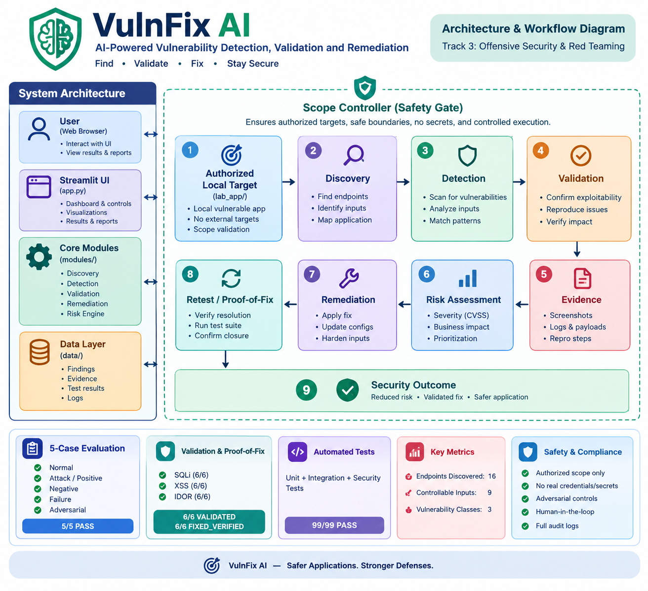
09 • DEMO & CLOSE
From authorized target to proof-of-fix in one workflow.
1
2
3
4
Authorize
Run pipeline
Review evidence
Retest
127.0.0.1:5000
Discover → Validate
Risk + remediation
FIXED_VERIFIED
VulnFix AI
Authorized • Local-only • Evidence-backed • Proof-of-fix
GitHub: github.com/sabari-moulish/VulnFix-AI • Dashboard: localhost:8502

