Slide 1
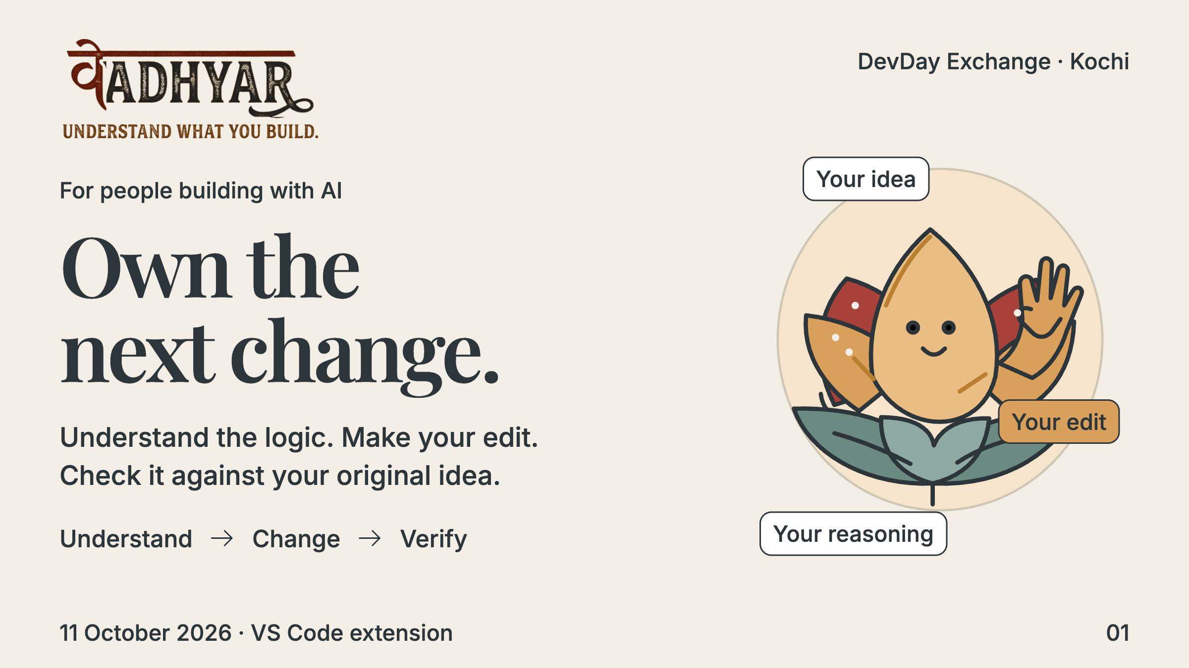
Notes:
AI helped me build this feature. Vadhyar helps me understand its decisions, make my next change, and check the result against my intent. It lives beside my actual project in VS Code.
Planned timing: 10 seconds

Slide 2
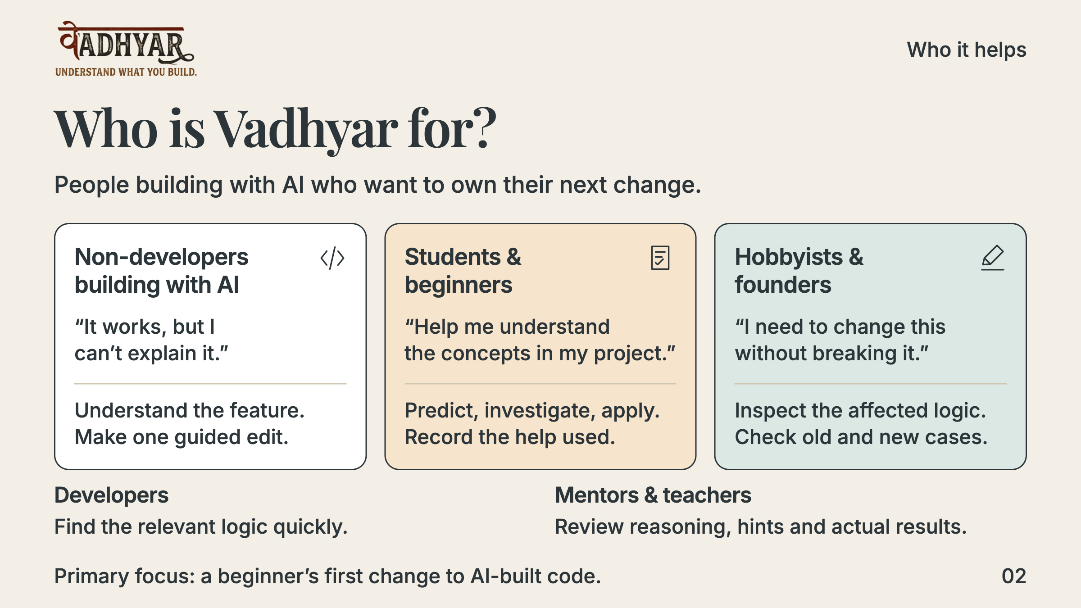
Notes:
These five intended audiences come from the builder’s supplied audience table, not validated market segmentation. Our first focus is a beginner taking ownership of one AI-built feature. A non-developer needs plain-language explanation, a short source path, a prediction, an observed case, a guided edit and checks, so they can locate and change a small part. Students and beginners select a requirement, learn the concept, predict and investigate, modify, try a related task with less help, and explain their result; the record preserves assistance, not a mastery score. Hobbyists and founders describe a new rule, inspect current source and checkpoint, find affected logic, edit, check old and new cases, and save the record. Developers can use compact source navigation, a counterexample or change target, an edit, verification and the diff; automatic experience-based adaptation is not claimed. Mentors and teachers can review the requirement, prediction, hints, diff and results, then ask a follow-up and observe another attempt; this is a use of the evidence record, not a dedicated teacher dashboard. Passing tests alone does not establish understanding. Intended outcomes must be validated with actual users.
Planned timing: 10 seconds

Slide 3
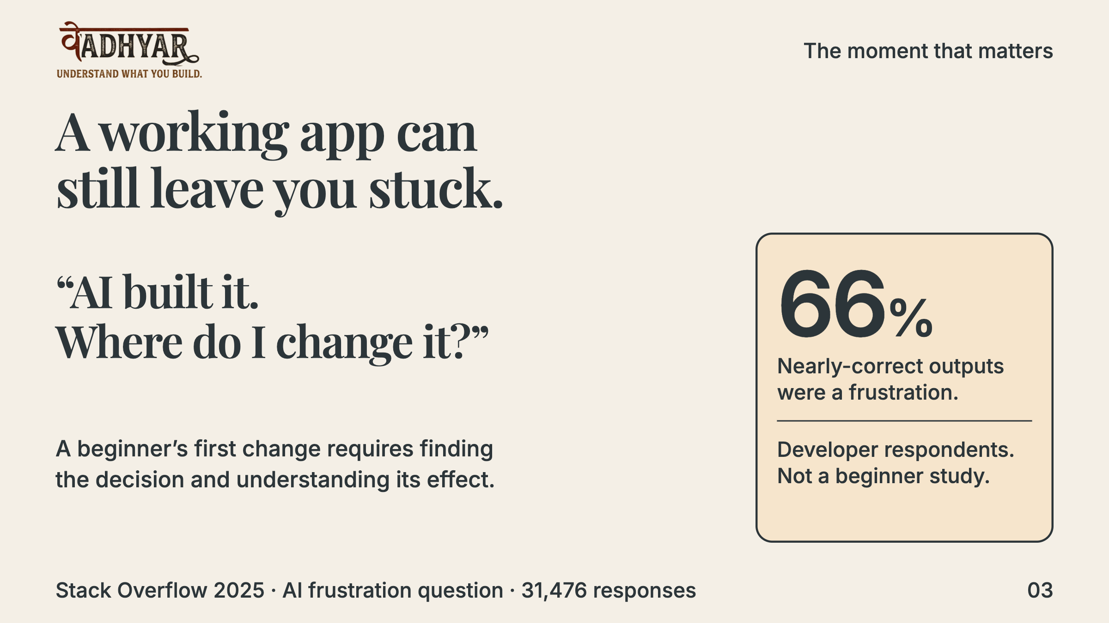
Notes:
A beginner can have a functioning AI-built feature without knowing where its rule lives. The 2025 Stack Overflow survey provides broader context: 66 percent reported frustration with nearly-correct AI output. It does not establish how many beginners lack understanding. Our specific product hypothesis is that the first change is a valuable moment for guided handover.
Planned timing: 10 seconds

Slide 4
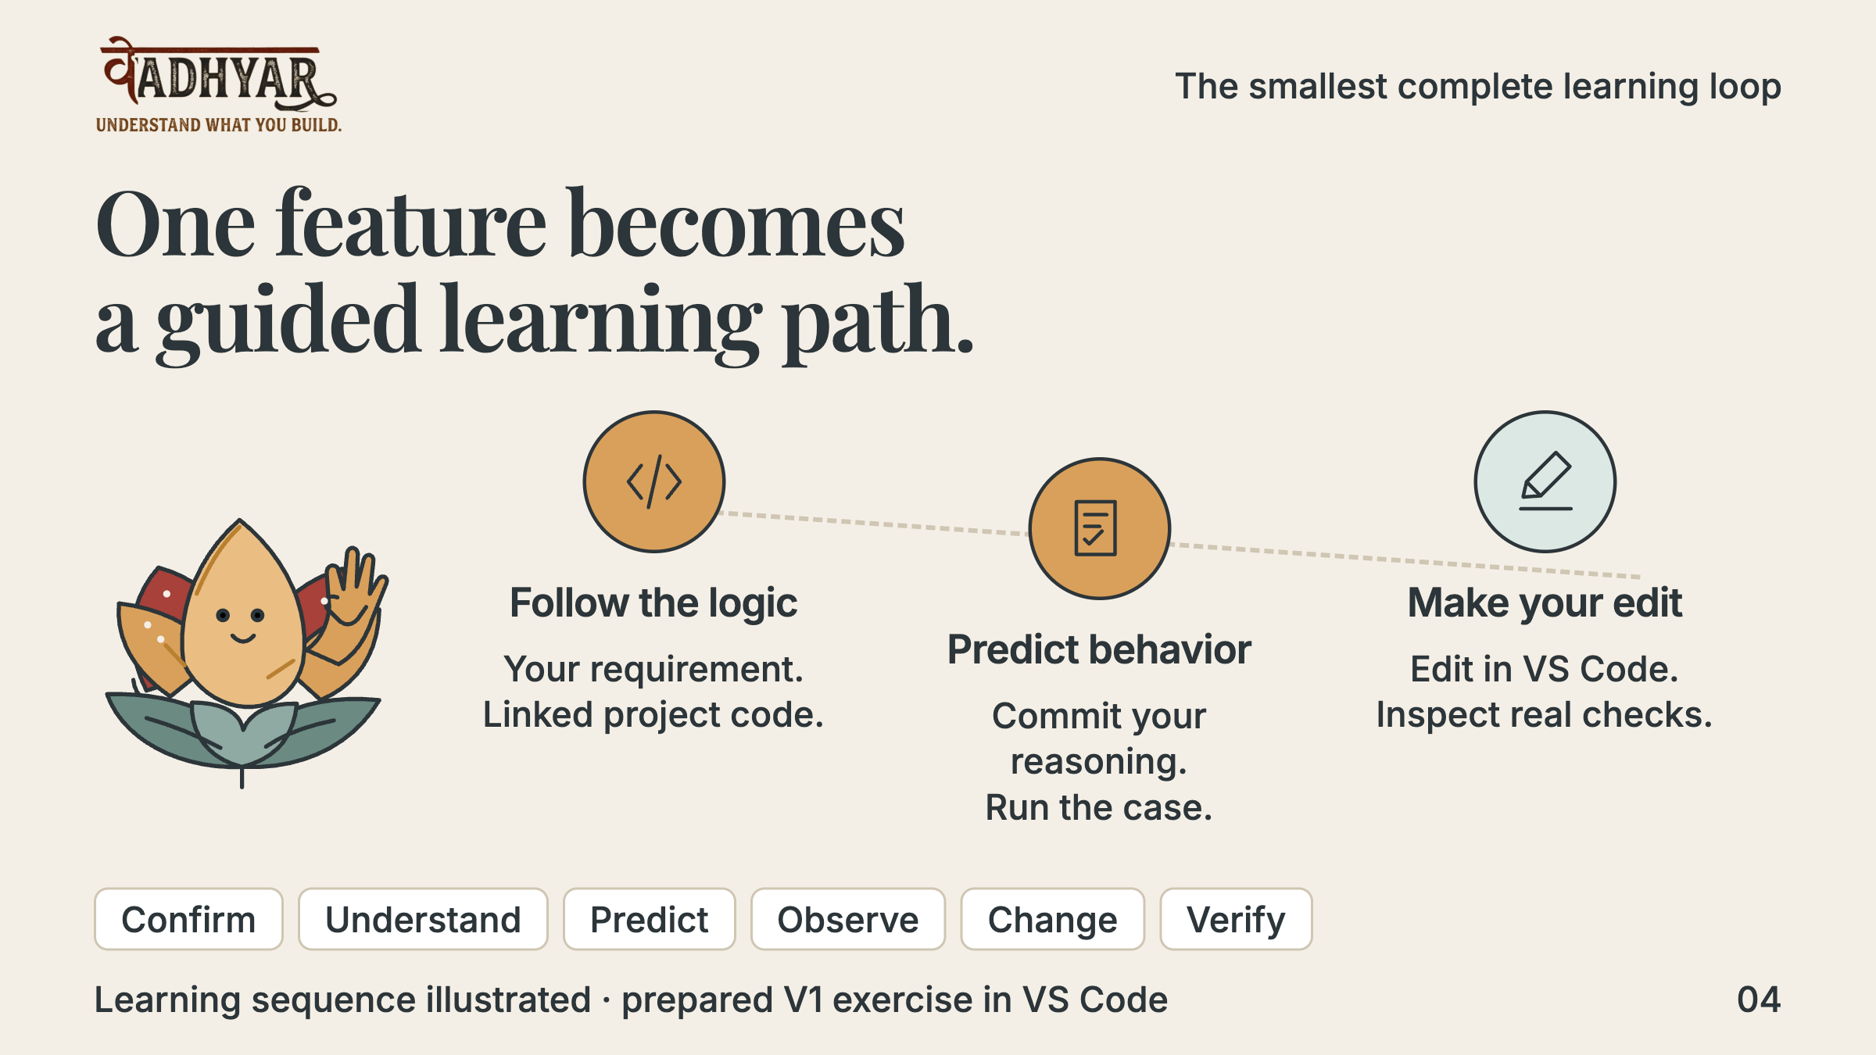
Notes:
Vadhyar guides a short sequence on the learner’s actual project: confirm the rule, follow linked source, predict, observe, edit and verify. The complete prepared NovaDesk loop now includes the archived follow-up; experimental Project Guide also tracks actual workspace intentions, changes and focused decisions, with distinct support limits. The drawing shows our learning sequence, not an accepted screenshot of the proposed v2 application interface.
Planned timing: 10 seconds

Slide 5
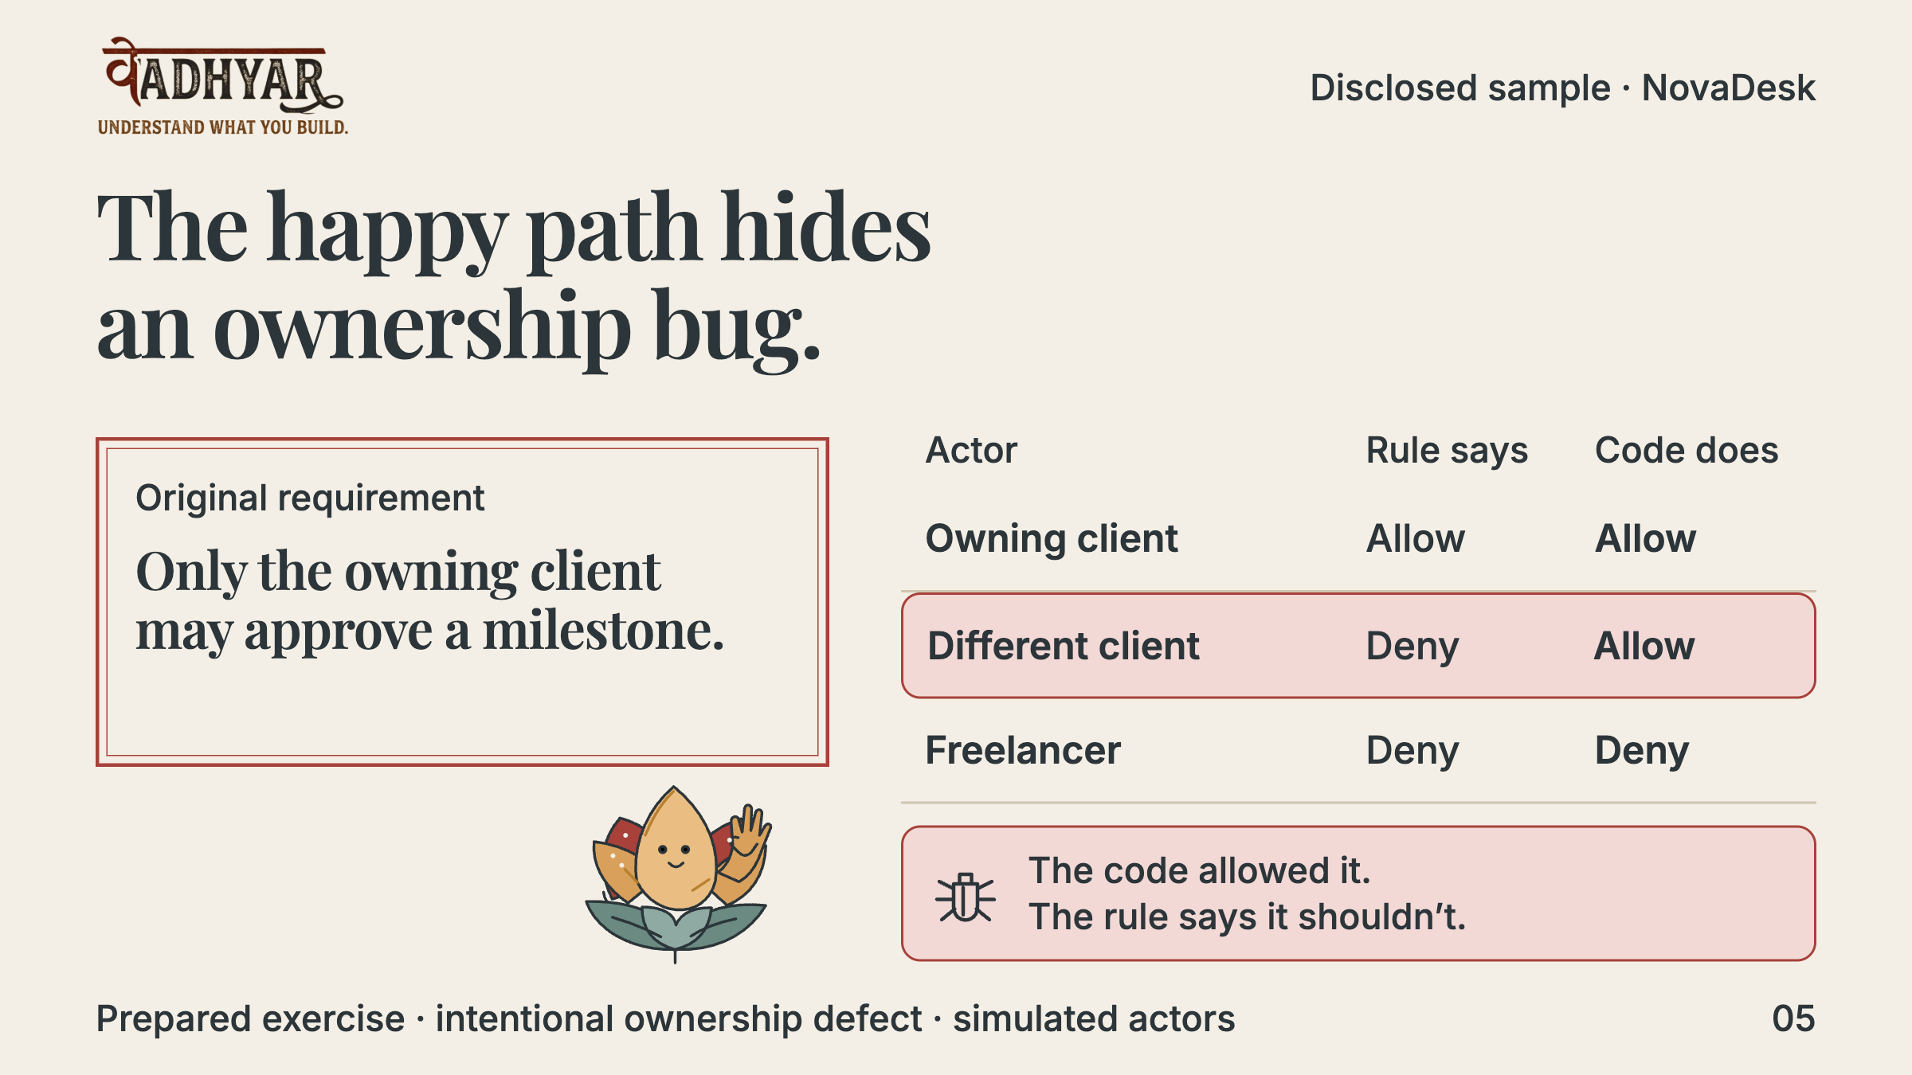
Notes:
This is a deliberately prepared NovaDesk exercise. The permission function checks client role but omits ownership. An owning client succeeds; a different client also succeeds, breaking the confirmed rule. Actors are simulated and the seeded bug is disclosed. This is a teaching example, not an undisclosed security finding.
Planned timing: 10 seconds

Slide 6
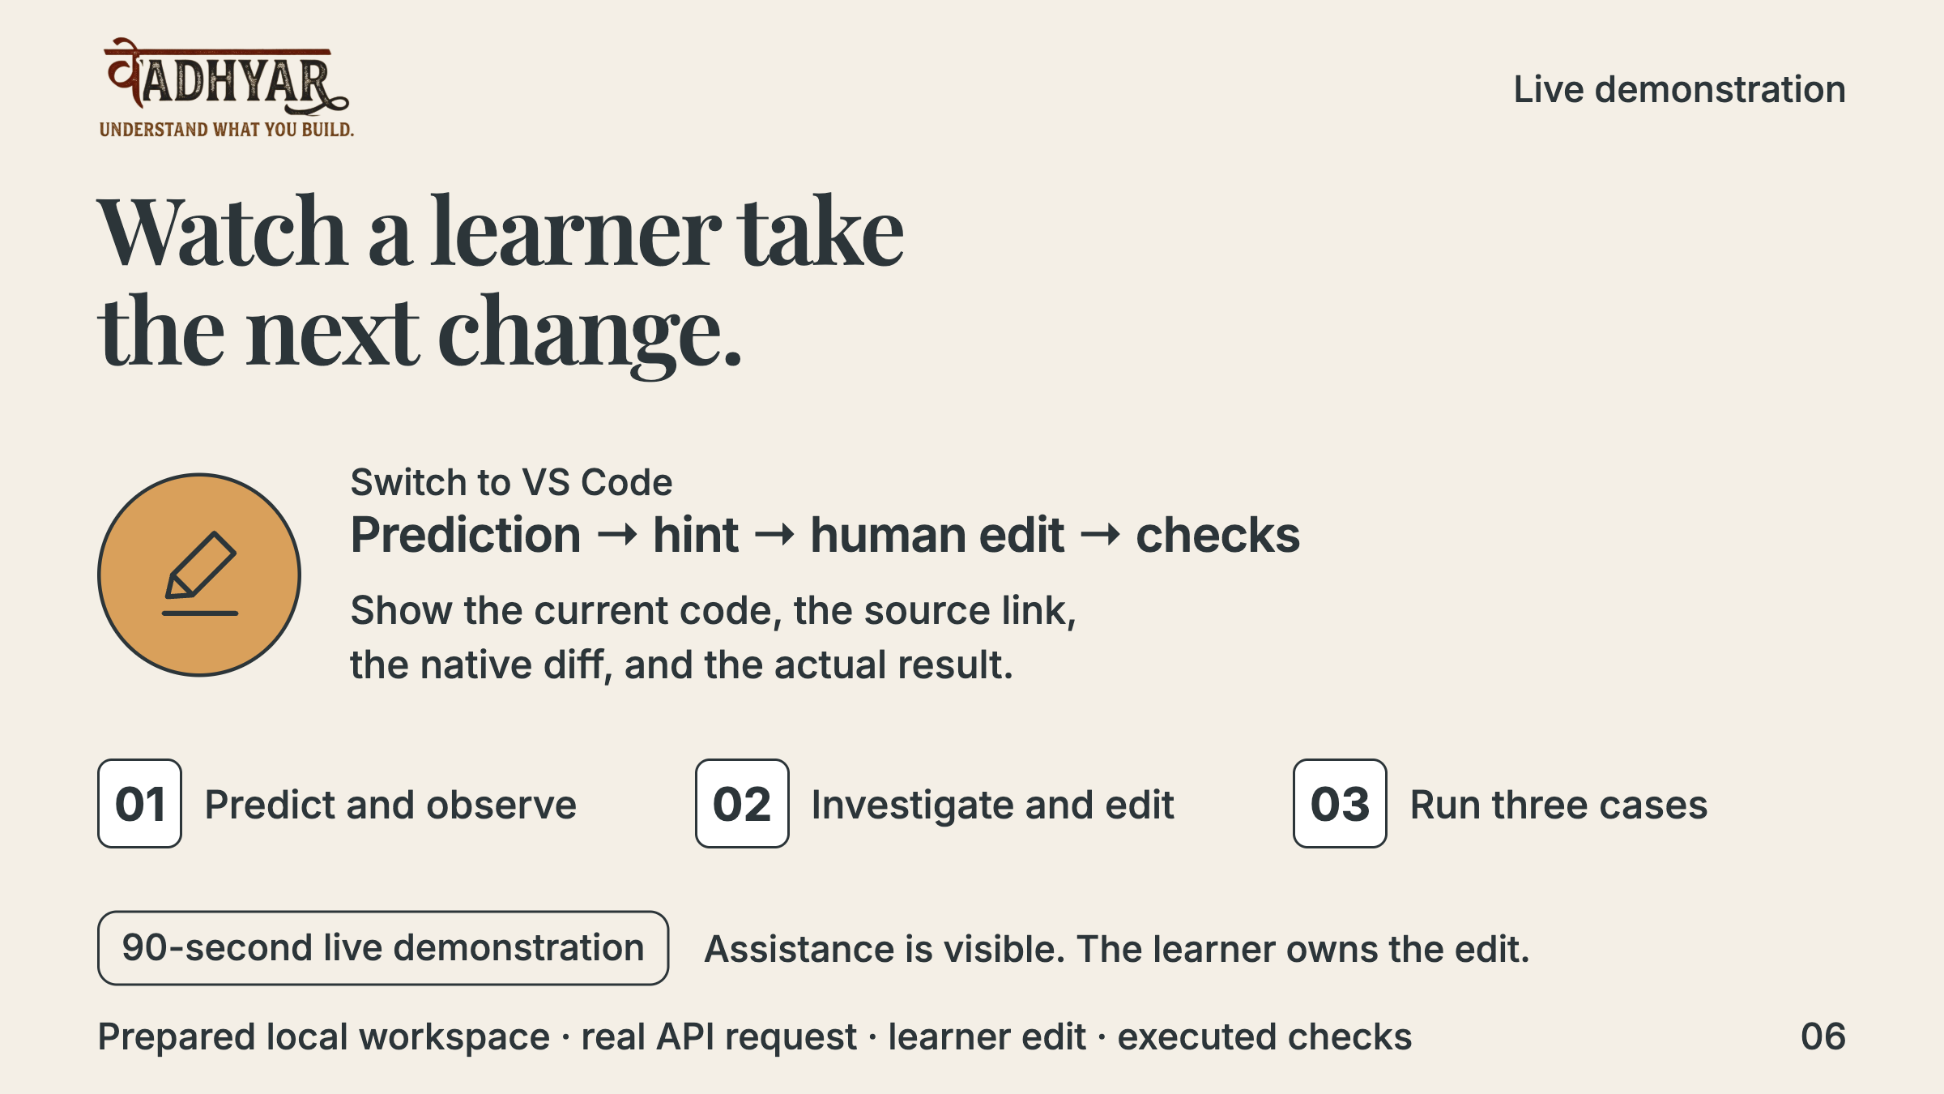
Notes:
Switch to a trusted disposable NovaDesk workspace. Save the prediction before running the different-client case. Show the surprising approval. Preview the context and request one live hint. Follow its source link, make and save the ownership edit, inspect the native diff, and run all three cases. Show actual results rather than the expected outcome. Disclose any additional assistance. If a live operation fails, identify it and use the labelled previously recorded evidence summary; the application release has a labelled edited still-frame native recap, not a continuous or new live recording. Show the archived follow-up as labelled recorded evidence if there is not time for another real edit and run.
Planned timing: 90 seconds

Slide 7
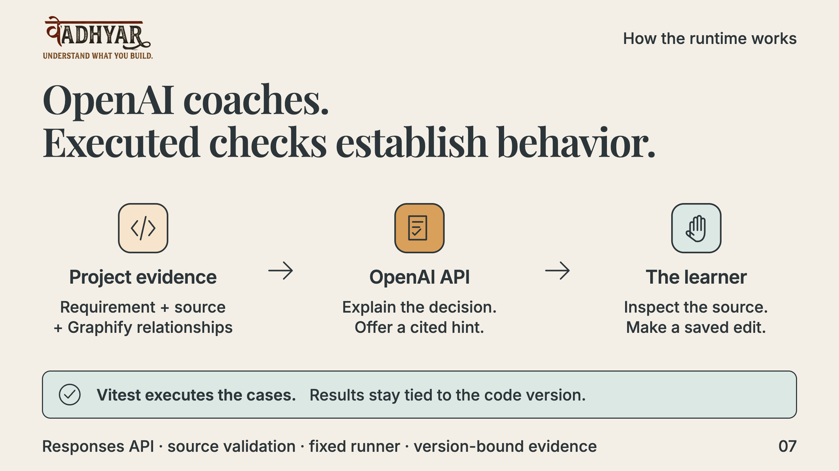
Notes:
The extension host supplies reviewed, bounded project evidence through the OpenAI Responses API for structured explanation and hints. It validates source references. The coaching workflow has no code-editing tool. The learner edits in VS Code; fixed Vitest cases execute the code and determine outcomes. A graph connection supplies context, not proof of runtime behavior.
Planned timing: 15 seconds

Slide 8
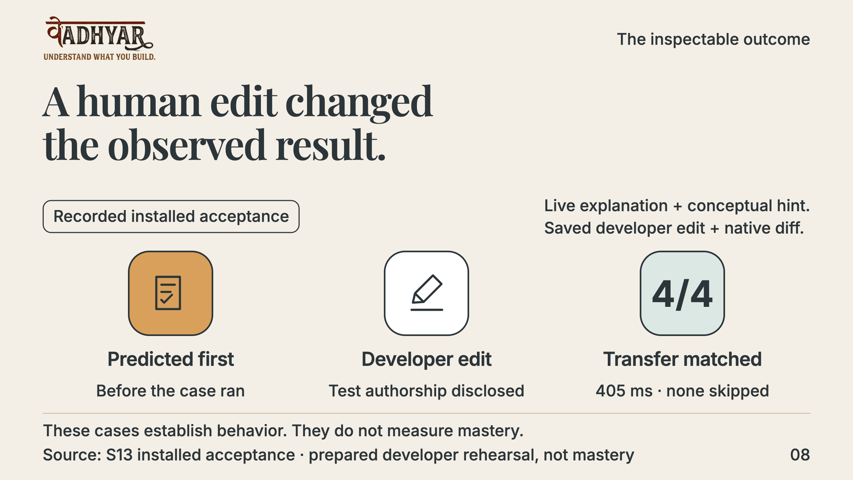
Notes:
S13 records a live explanation and concept hint, delegated developer edits, a three-case ownership pass and a four-case archived transfer pass (405 ms, zero skips). Fourteen evidence rows and exact Markdown export were checked, then the session resumed. H1 separately records a JavaScript project explanation, actual failed/passed check and installed resume. These are prepared developer demonstrations, not learner authorship or mastery. Earlier S7 retains a distinct user-performed edit; do not merge authorship across these records. The deck emblems are illustrations, not an implemented proof-sticker UI.
Planned timing: 15 seconds

Slide 9
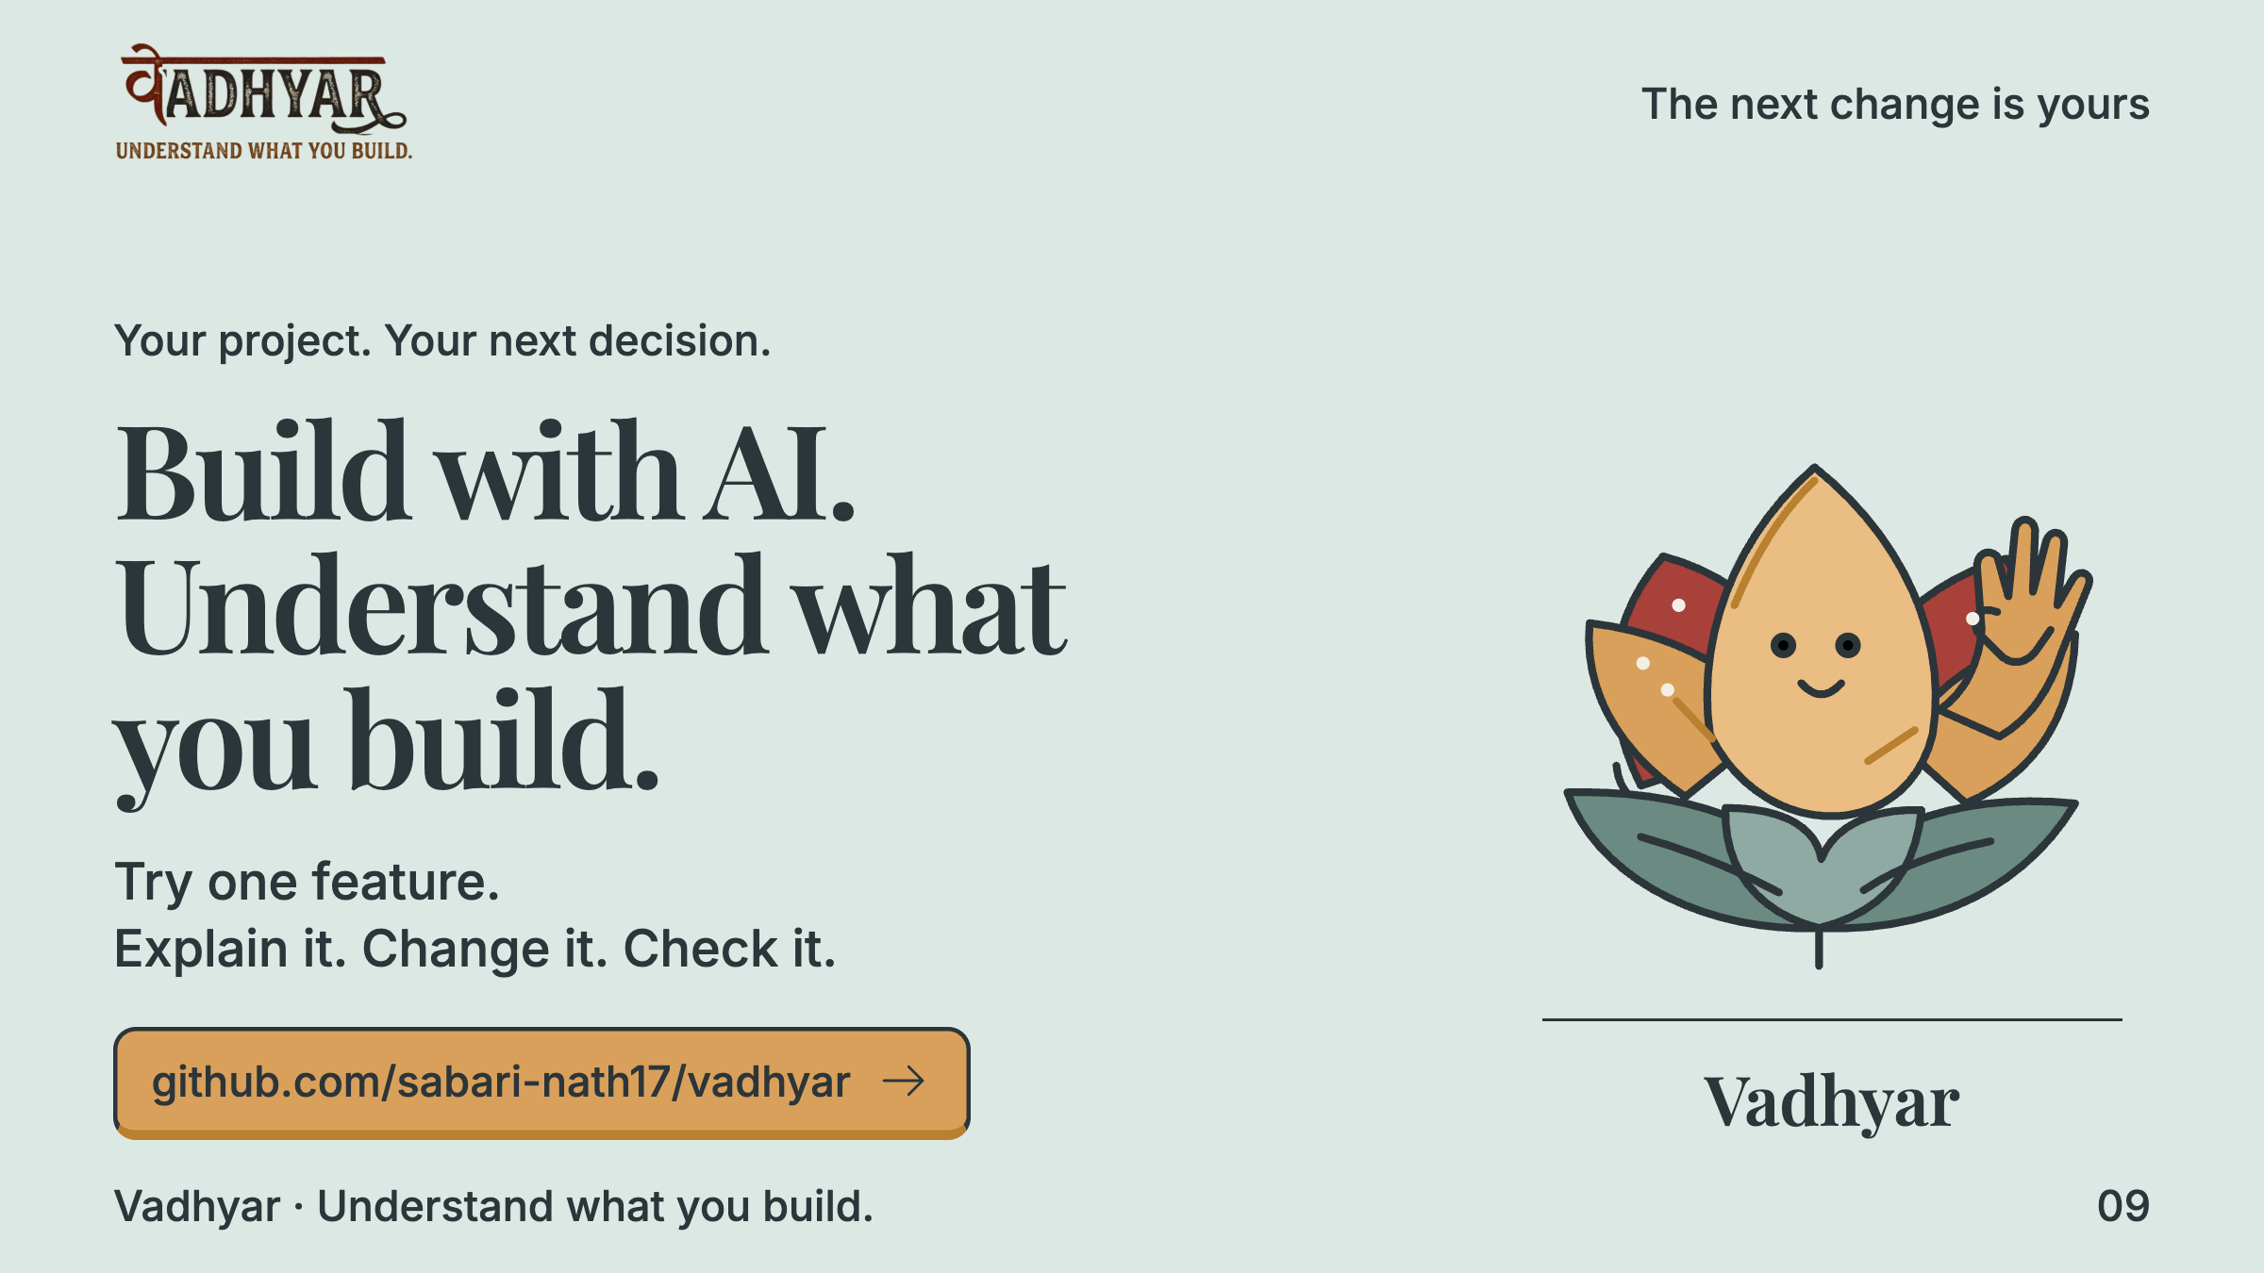
Notes:
Vadhyar turns an AI-built feature into something you can explain, change and check. The next validation is a beginner applying that reasoning to an unfamiliar change. Try one feature. Build with AI and understand what you build.
Planned timing: 10 seconds

Slide 10
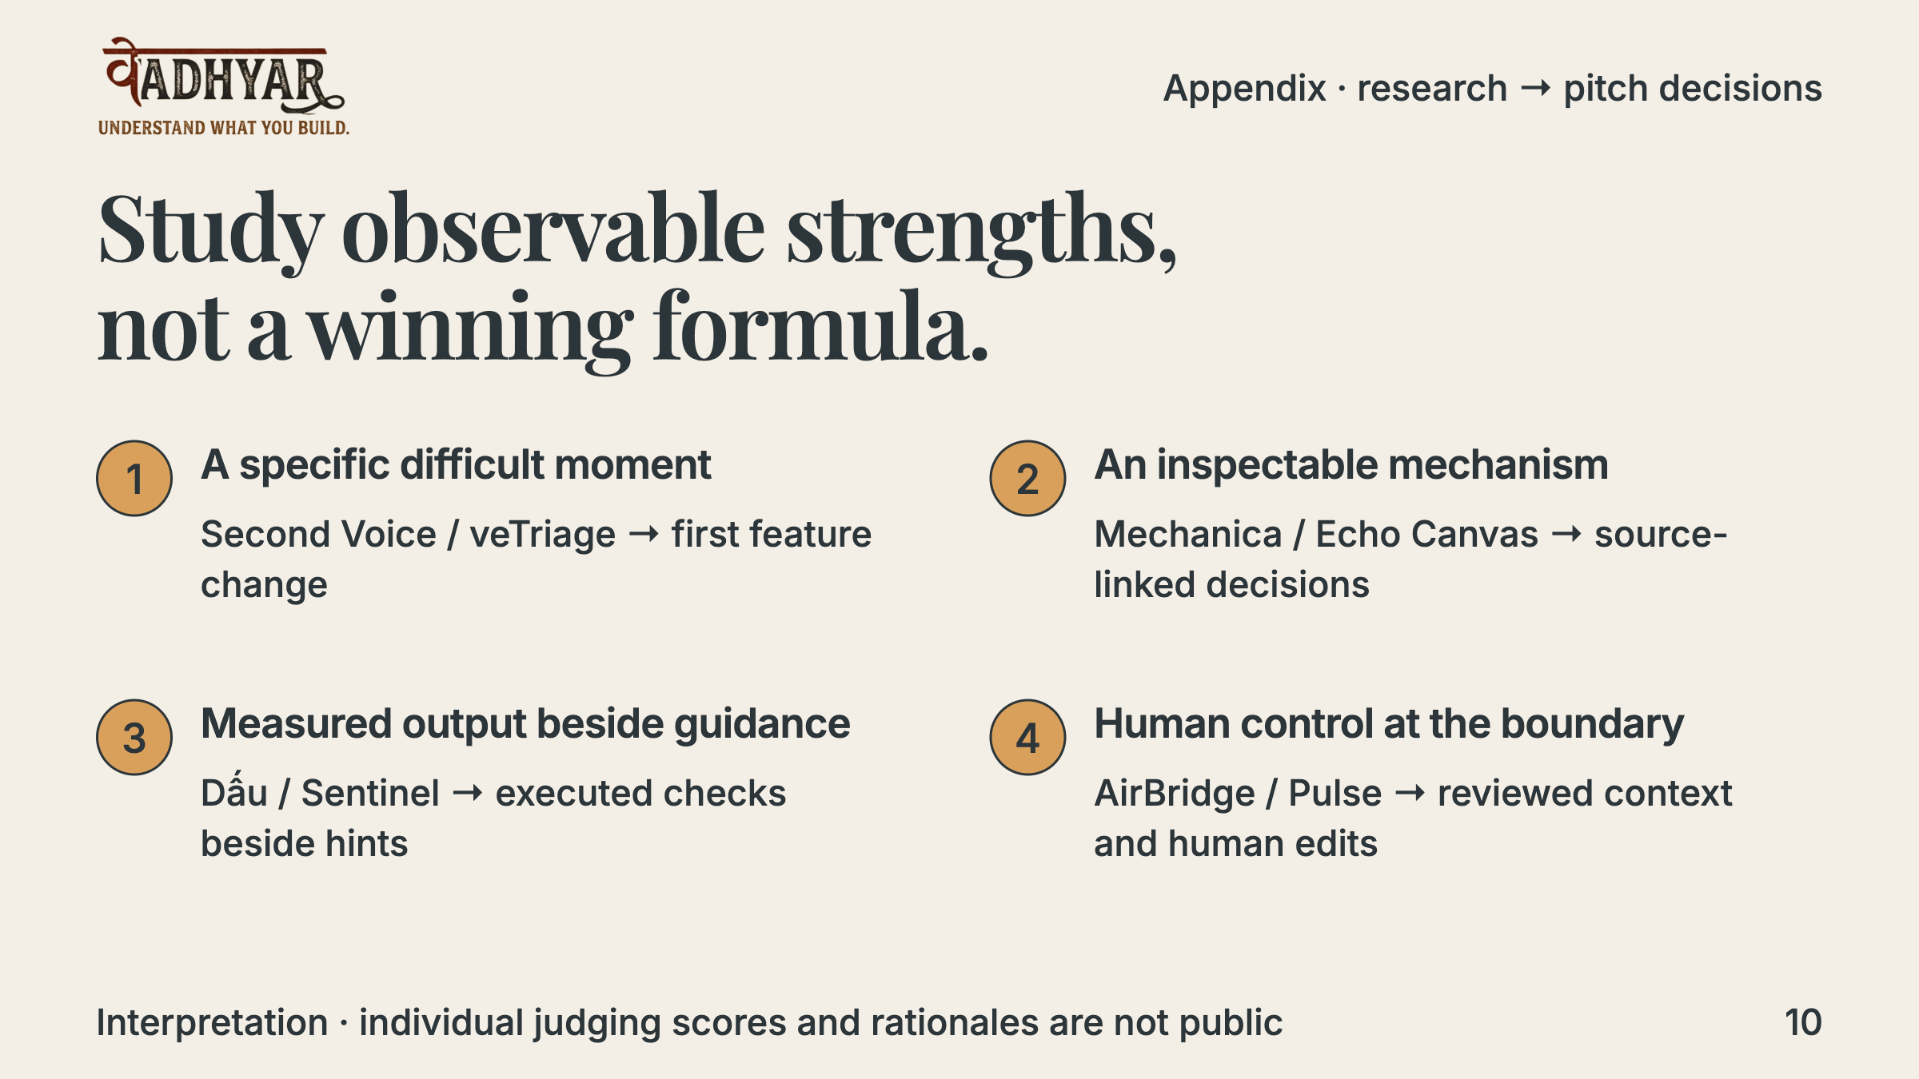
Notes:
These are design interpretations derived from the winners’ documented implementations, not private judging rationales. Build Week’s published criteria are equally weighted: technological implementation, design, potential impact and quality of the idea. That competition’s rubric is a useful lens, not a verified Kochi rubric. We cannot infer causal ranking factors from winners alone; losing submissions could share the same traits.
Planned timing: Judge appendix; outside the three-minute main pitch.

Slide 11
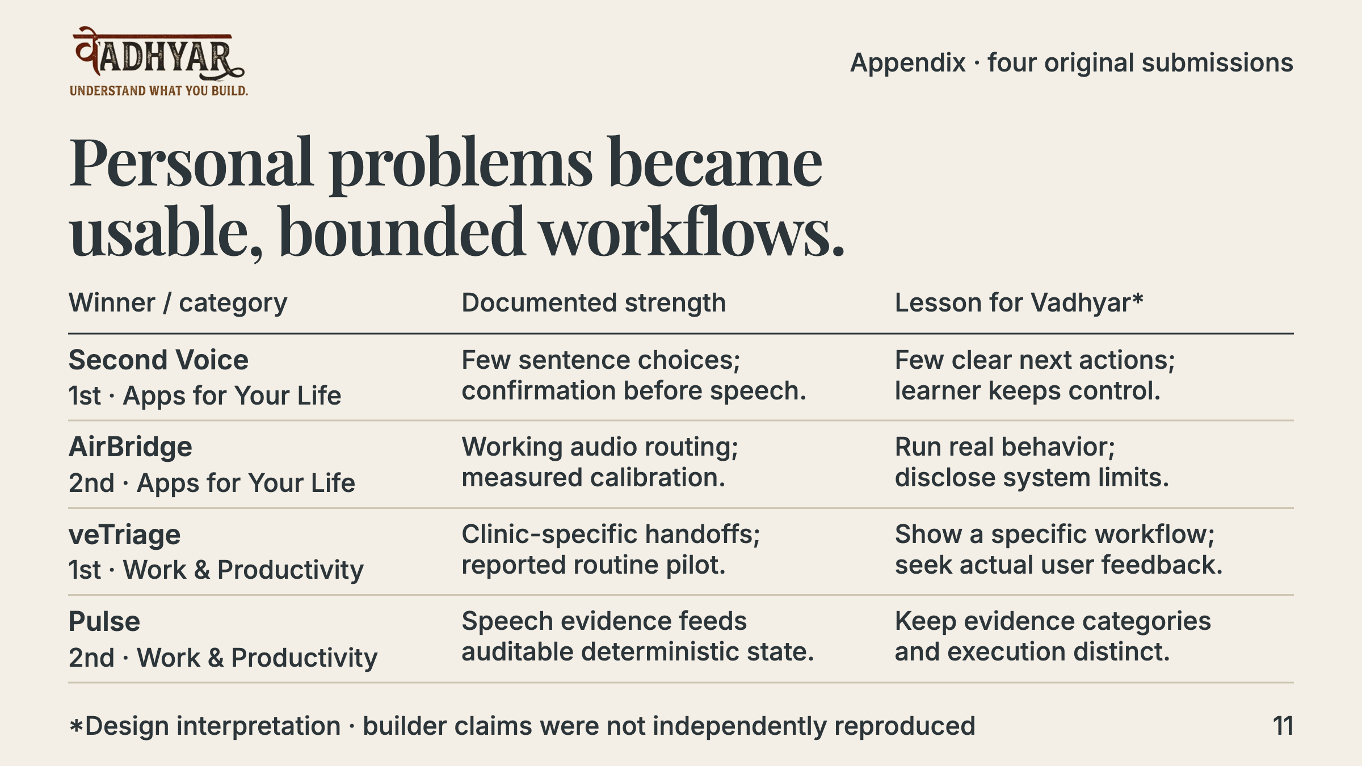
Notes:
Each name links to its original submission. Features and pilot use are reported by builders; we did not independently reproduce the products. The rightmost column is our interpretation of what Vadhyar can learn, not a statement of the judges’ reasoning.
Planned timing: Judge appendix; outside the three-minute main pitch.

Slide 12
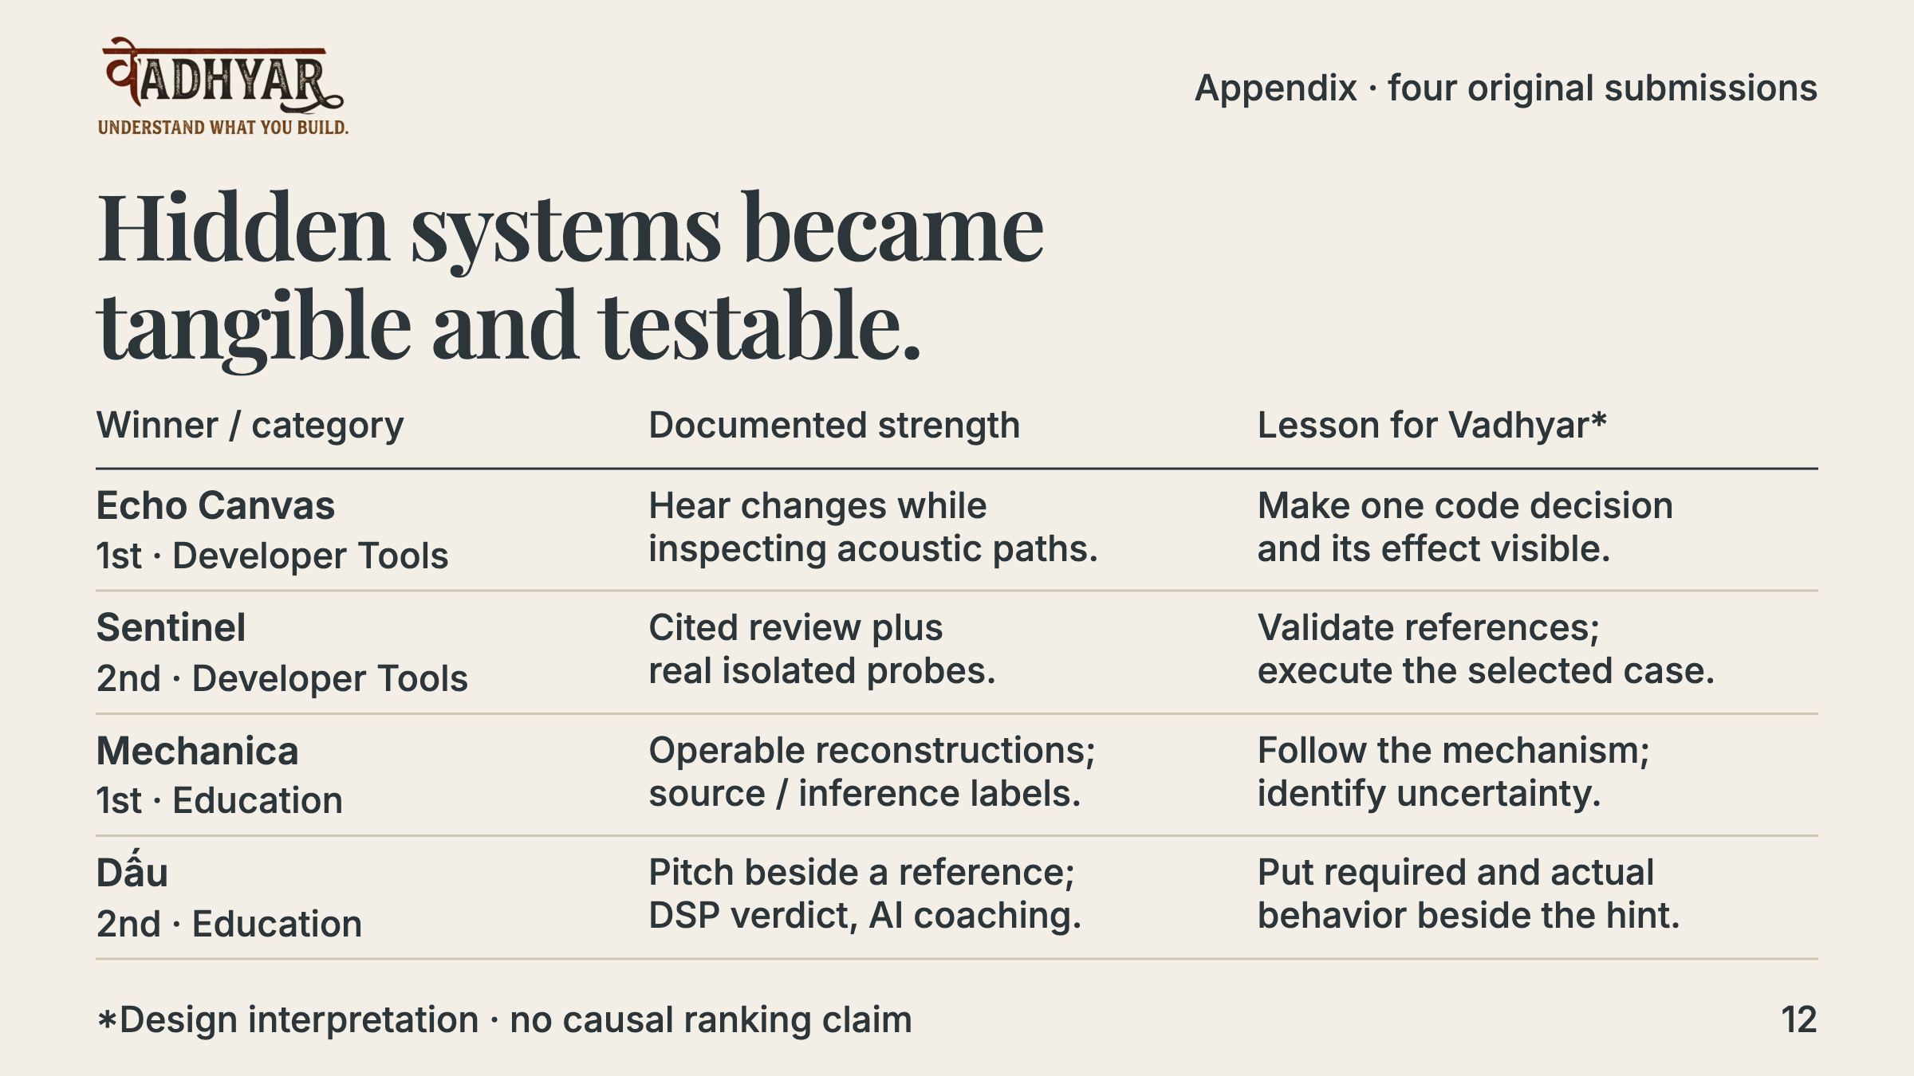
Notes:
These four documented designs are particularly relevant to the learning and verification loop. Their implementation descriptions support the comparison. The inference that these strengths made the entries persuasive is not proof that these factors caused their ranking.
Planned timing: Judge appendix; outside the three-minute main pitch.

Slide 13
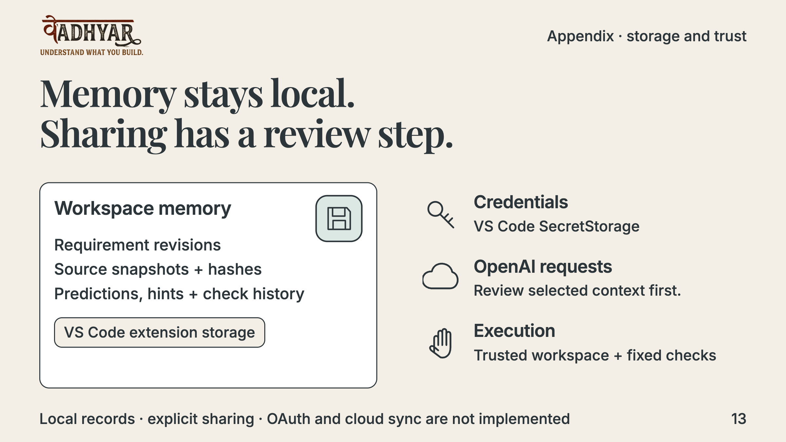
Notes:
Sessions and snapshots use workspace-scoped extension storage. Project Guide maintains separate project.json and content-addressed source files. API credentials remain in VS Code SecretStorage, outside the panel. Selected excerpts go to OpenAI after review. NovaDesk uses fixed cases; Project Guide uses an existing selected npm script with separate native confirmation. The current source suppresses implicit npm hooks and revalidates source after the dialog. Workspace Trust allows execution but is not a sandbox. OAuth and cloud memory are not implemented. Scoped NovaDesk memory clear requires separate native confirmation and preserves source, credentials and Project Guide records; it does not reset the seeded source.
Planned timing: Judge appendix; outside the three-minute main pitch.

Slide 14
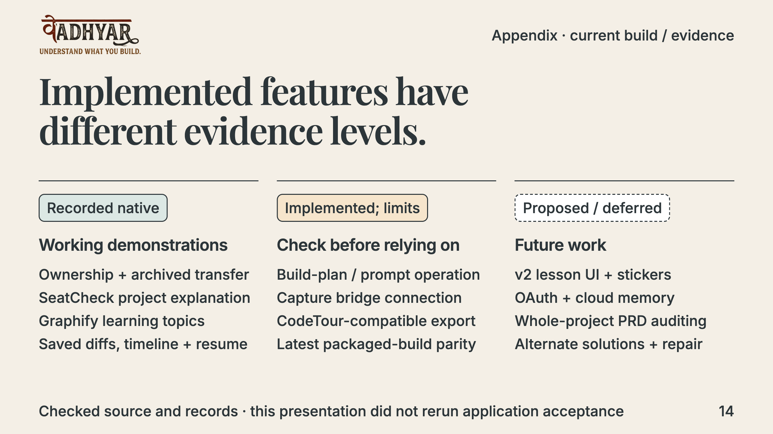
Notes:
Current source was inspected against S10–S13, H1, T1 and the red-team records. Transfer is implemented and natively recorded. SeatCheck has live explanation and actual checks. T1 has actual multi-file static Graphify extraction, live topic grouping and focused explanation in a Development Host. Build-plan/prompt code exists but live/native build-plan acceptance is absent; capture surfaces exist but no coding tool is connected. CodeTour export exists but native playback is unverified. S12 recorded native focus/keyboard and dark, light, high-contrast and high-contrast-light panel checks; T1 did not repeat a full new matrix. The proposed design-v2 lesson redesign is Phase 0, not an implemented migration. Current source, compiled T1 bundle, older local VSIX and public S7 installer are different artifacts.
Planned timing: Judge appendix; outside the three-minute main pitch.

Slide 15
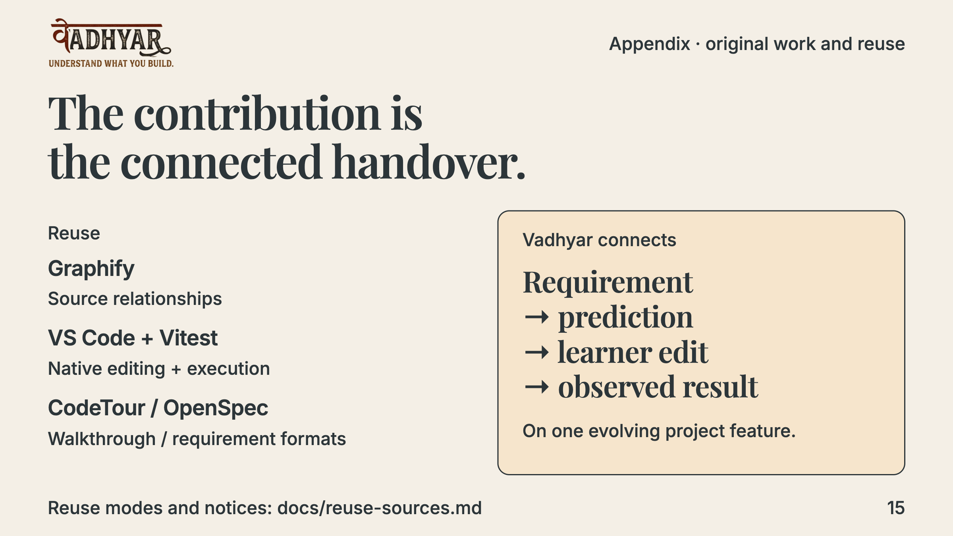
Notes:
Existing graph, editor and testing infrastructure supplies the building blocks. Vadhyar’s product hypothesis is a requirement-specific guided handover on the learner’s own project, with prediction, assistance, learner edit and executed evidence connected. We do not claim a novel graph parser, a test engine, or proven uniqueness against every competitor. An AI tutor with exercises is an established category; project-specific handover is the distinction to validate.
Planned timing: Judge appendix; outside the three-minute main pitch.

Slide 16
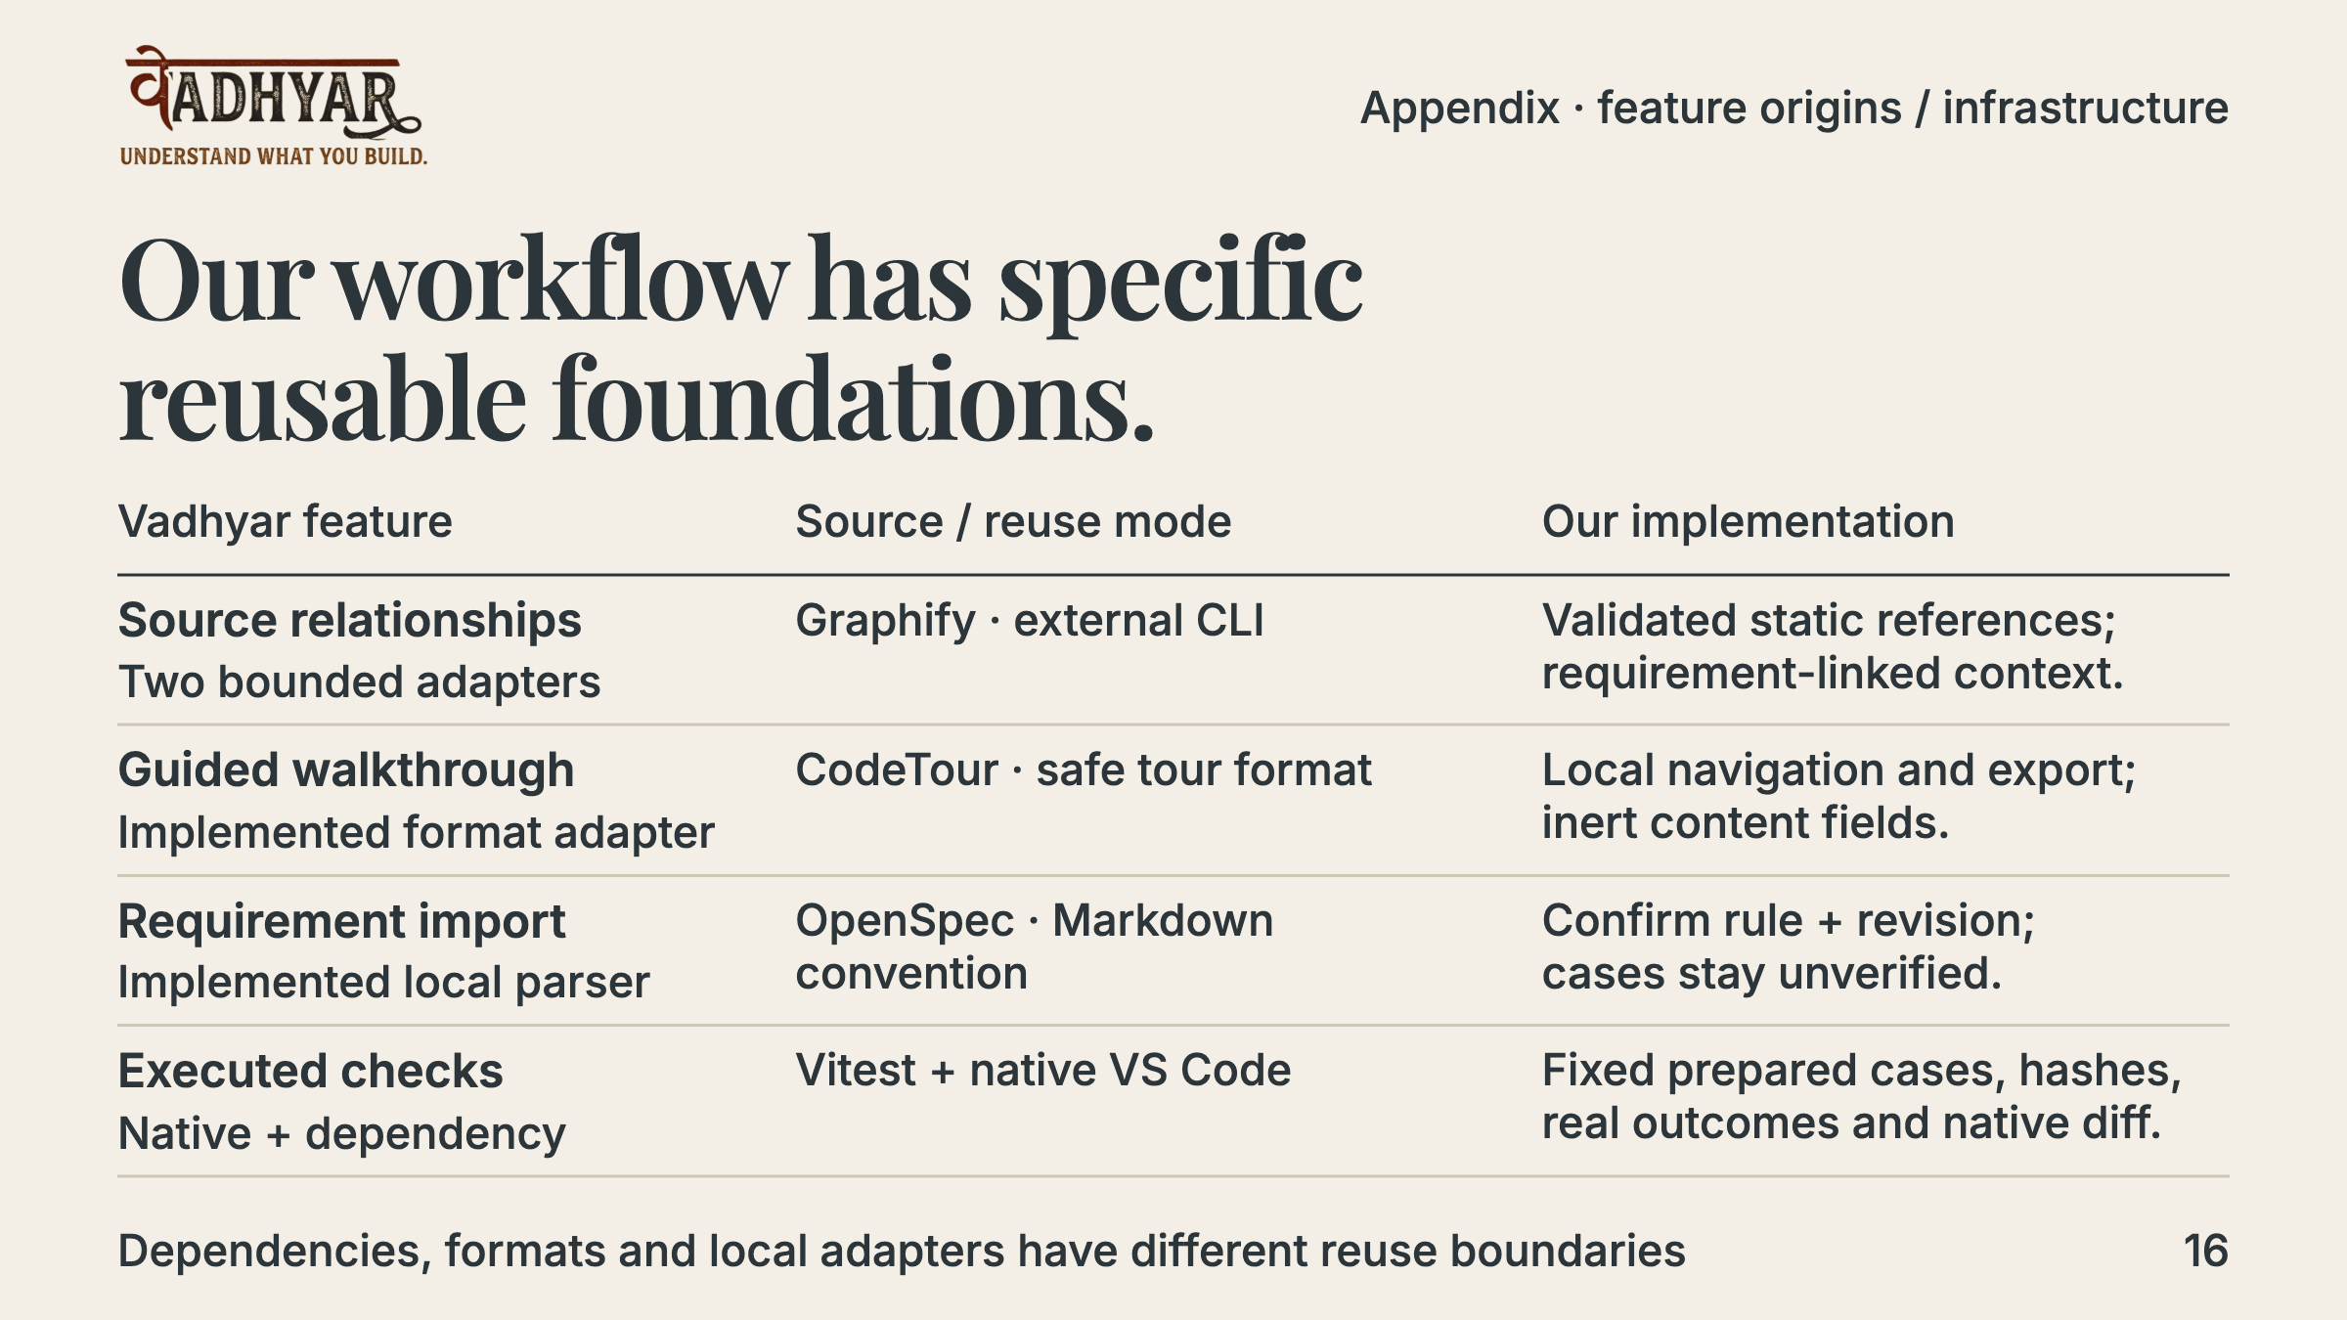
Notes:
Feature provenance was checked in docs/reuse-sources.md and docs/selective-reuse.md. Graphify is an external CLI; its parser was not copied. CodeTour is not installed as a runtime dependency: Vadhyar implements a safe format adapter and includes its unmodified schema as a compatibility fixture with MIT notice. OpenSpec supplies a Markdown convention, not its parser or CLI; imported scenarios have no automatic executable mapping. Vitest is a dependency, and VS Code supplies source selection, diffs, storage and dialogs. Requirement import has recorded native recovery; safe export has schema/automated evidence, while native CodeTour playback remains unverified. These records are not fresh native acceptance in this presentation task. See Feature-Origins.md for pinned sources and complete boundaries.
Planned timing: Judge appendix; outside the three-minute main pitch.

Slide 17
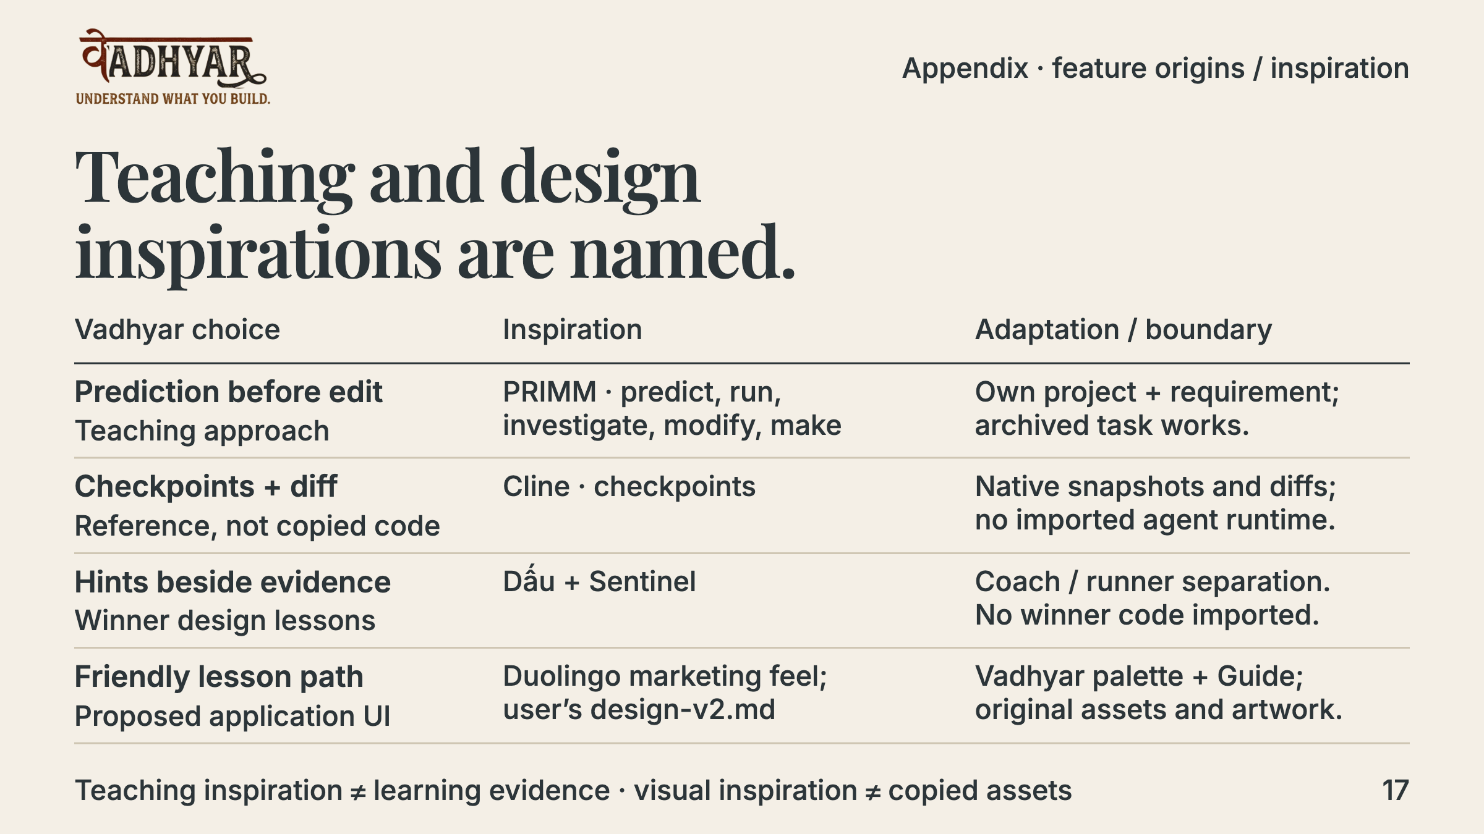
Notes:
PRIMM is an acknowledged teaching inspiration, not a claim of a new pedagogical method or proven learning impact; Vadhyar adapts it to an AI-built feature anchored to the learner’s requirement. Cline and Tour de Code AI are references, not copied runtime implementations. Dấu and Sentinel informed the distinction between coaching and measured outcomes; no source from these winners was imported. The user’s design-v2.md borrows Duolingo marketing feel and explicitly prohibits copying its characters, assets, fonts or exact green. The original deck Guide is presentation artwork; this does not establish that the proposed v2 lesson redesign is implemented. Existing S12 panel polish is separately recorded. Project Guide came from the user’s own Codex-assisted planning workflow; Snake was the user’s requested familiar arcade break, separate from learning evidence. Promptfoo supports development evaluation, not runtime coaching. Full feature mapping and source links: Feature-Origins.md.
Planned timing: Judge appendix; outside the three-minute main pitch.

Slide 18
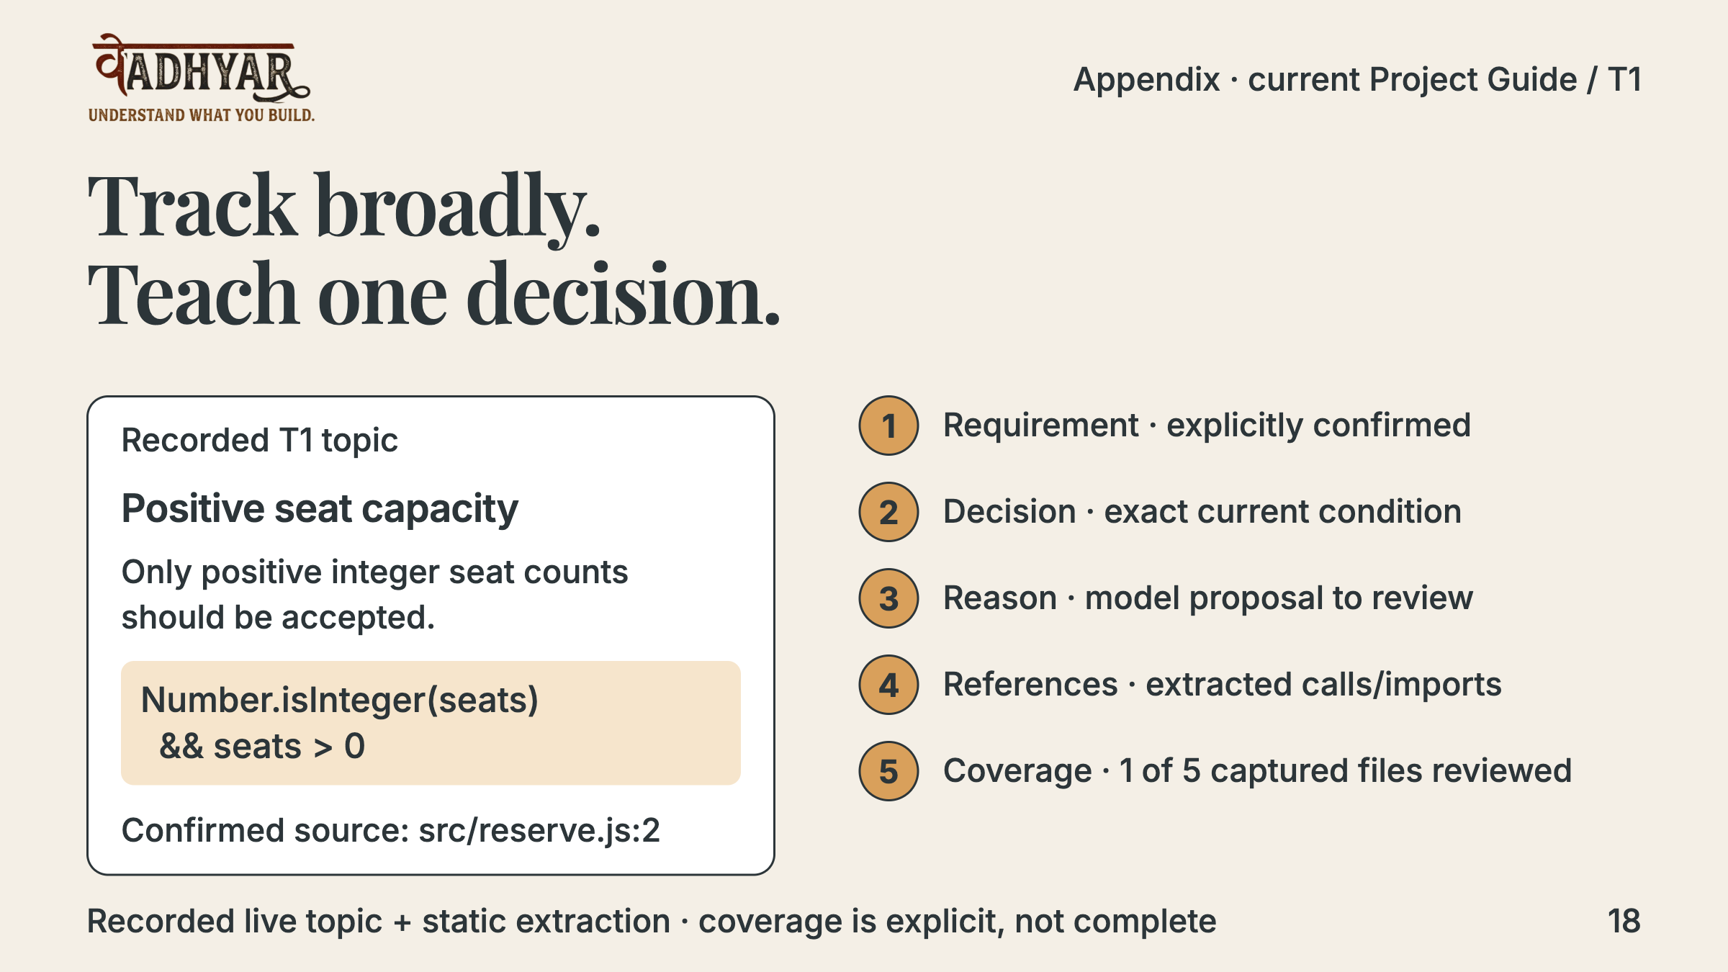
Notes:
T1 recorded a prepared five-file project in an actual Development Host: one live topic proposal and focused explanation, Graphify 0.9.84 with 10 nodes/9 edges and three extracted incoming static links, real decision/caller navigation, explicit requirement clarification and resume. The expression is reformatted for slide readability from the recorded line. Only one file’s contents were reviewed; other captured paths/static metadata were disclosed. Static links do not prove runtime execution of this condition or complete dependencies. Edits made old topics/navigation historical. T1 is not in the earlier local VSIX or public S7 installer.
Planned timing: Judge appendix; outside the three-minute main pitch.

Slide 19
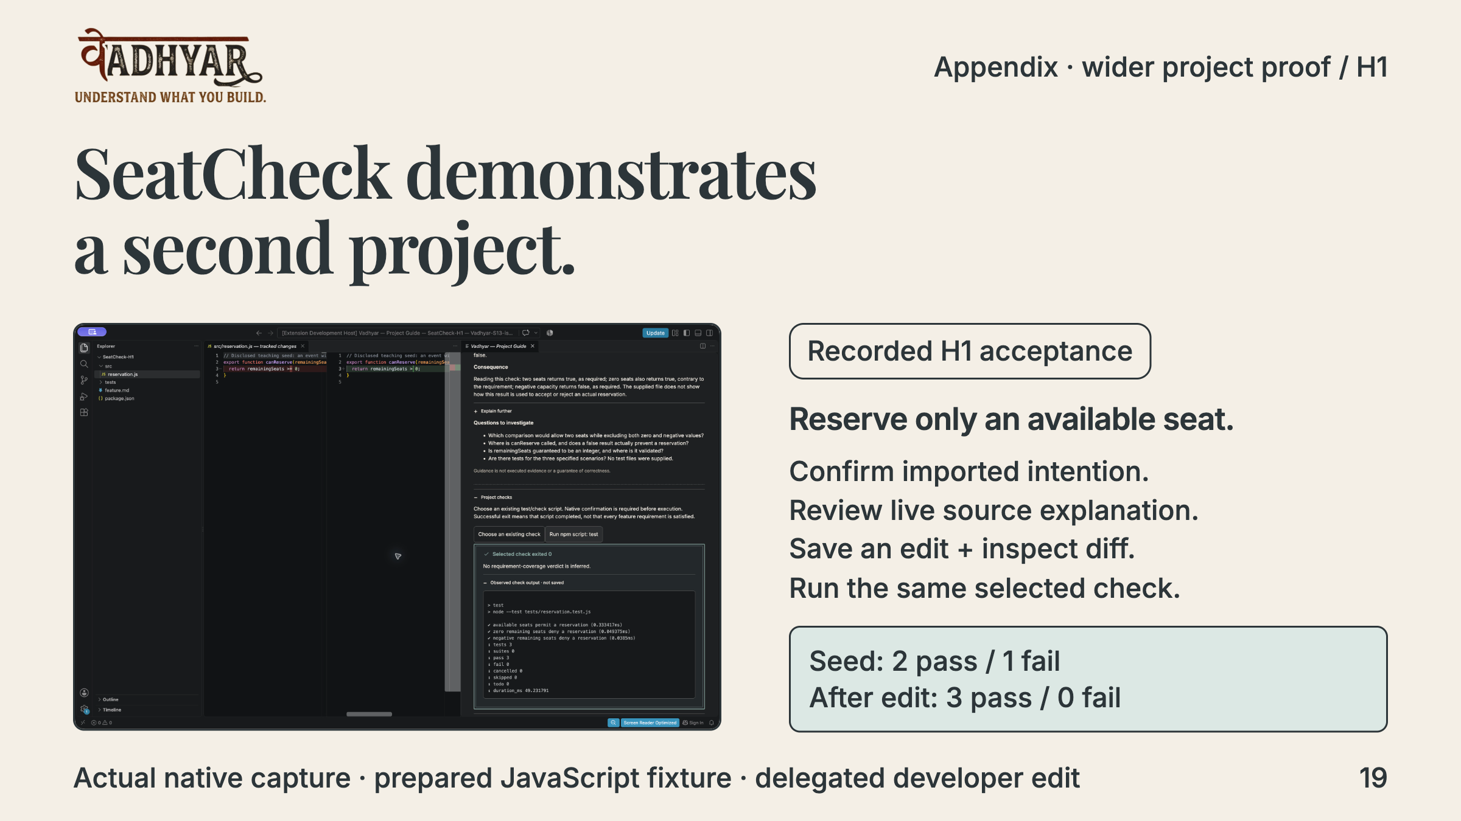
Notes:
This is an actual captured native image from H1, not a new live run or fabricated UI. SeatCheck is a disclosed prepared JavaScript fixture unrelated to NovaDesk. Its own imported requirement and selected source received a live validated explanation. The same existing npm test script failed at zero capacity, then passed three cases after a delegated developer edit; installed VSIX resume and an additional confirmed run were recorded. It proves a bounded second-project workflow, not universal repository support, automatic acceptance mapping or learner mastery. The API never supplied an applied patch.
Planned timing: Judge appendix; outside the three-minute main pitch.

Slide 20
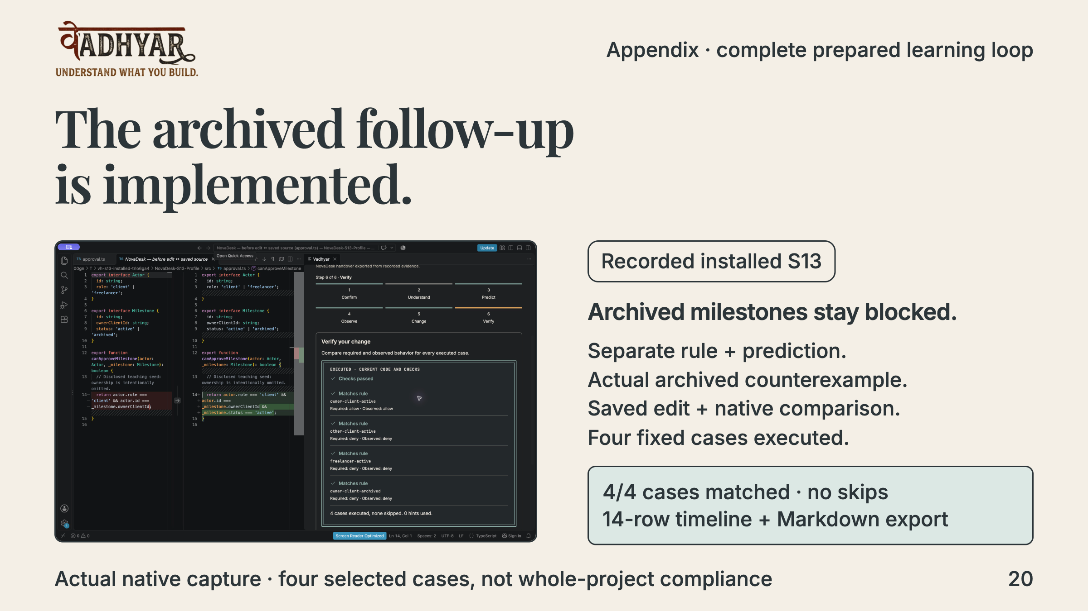
Notes:
S10–S13 implemented and recorded the archived milestone follow-up. The original owning-client positive case is retained; different client, freelancer and archived owner are denied. The actual native capture shows the lifecycle edit and four executed matches. S13 recorded a 405 ms transfer suite, separate requirement/prediction and 14 evidence rows with an exact production Markdown handover; close/reopen and extension-host restart preserved the record. The developer test edit is disclosed. This is functional transfer-workflow evidence, not an independent learner transfer study.
Planned timing: Judge appendix; outside the three-minute main pitch.

Slide 21
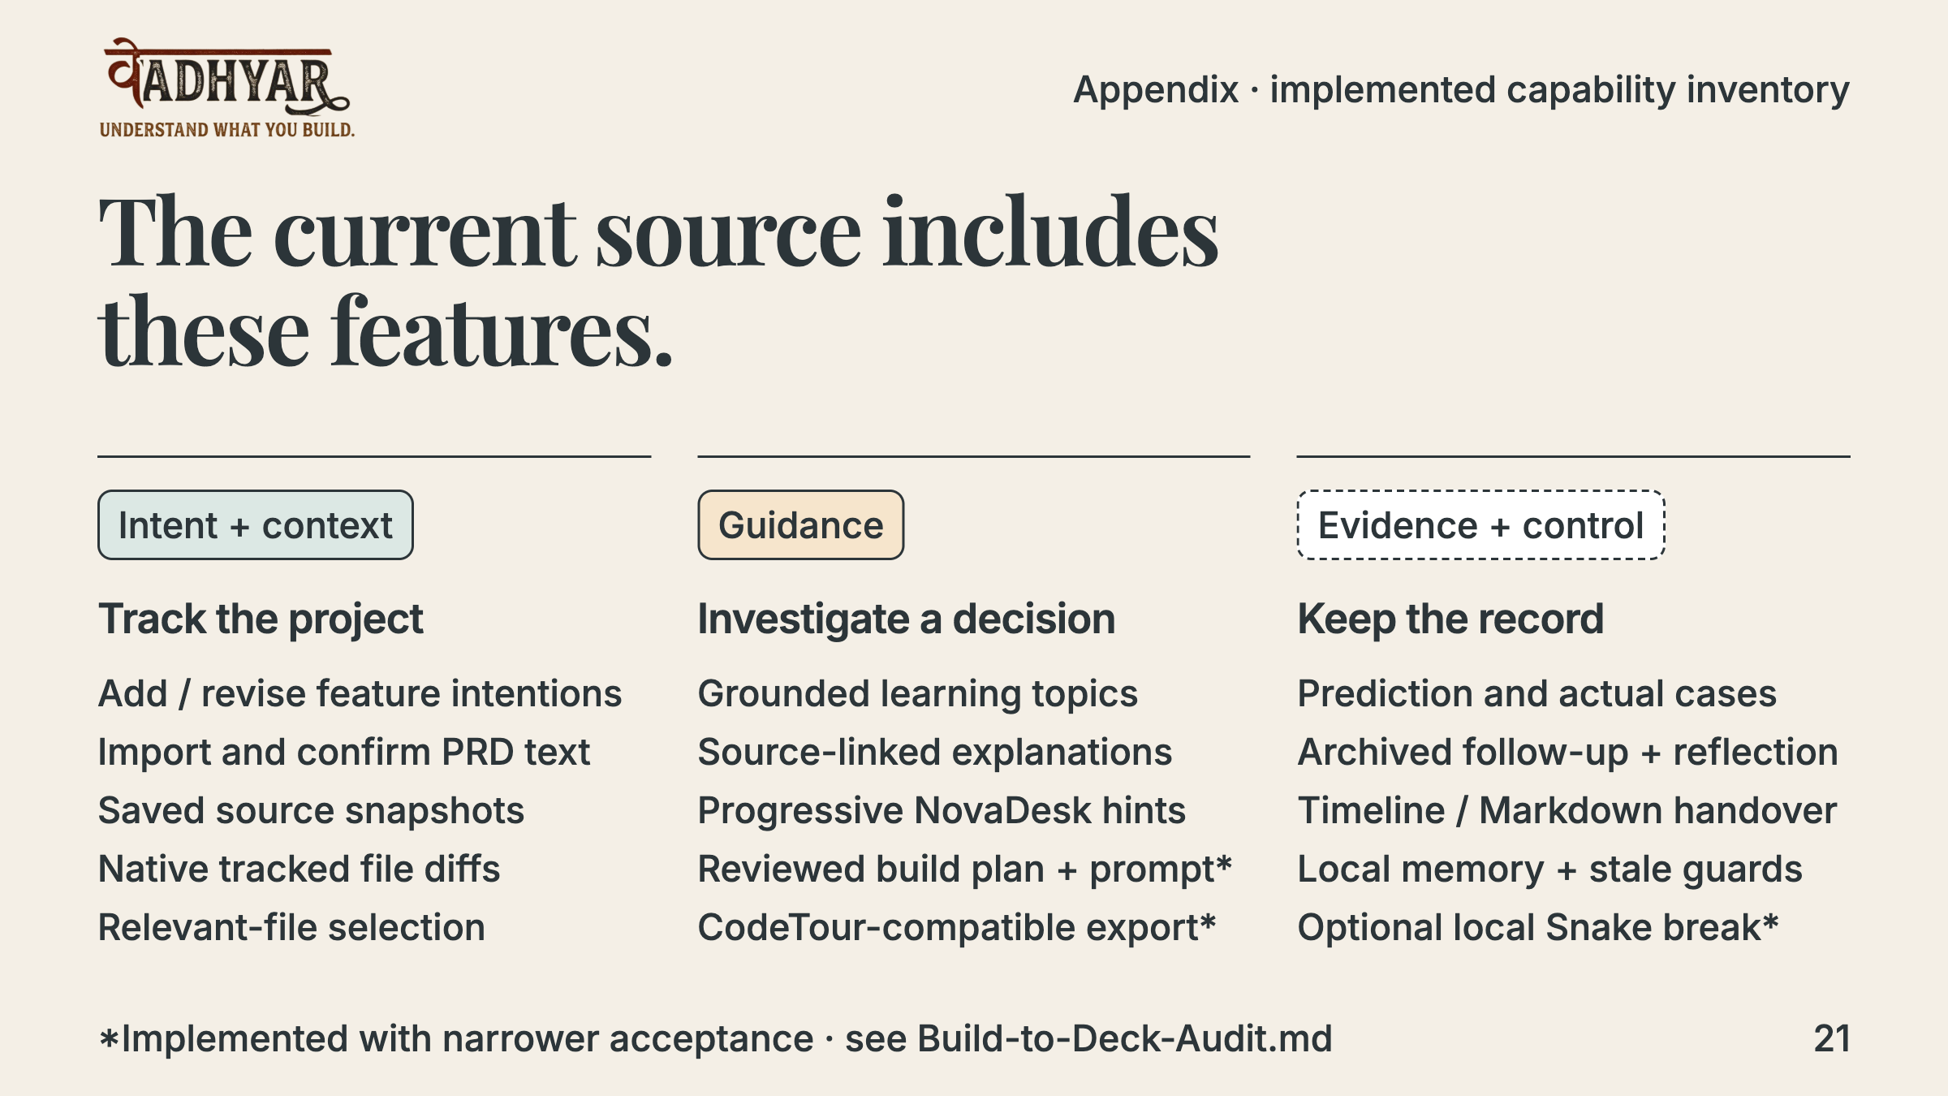
Notes:
The current source includes all listed controls. The deck distinguishes implementation from acceptance: build-plan/prompt is implemented with mocked/automated boundaries but not live/native acceptance; CodeTour-compatible export exists but native playback is unverified; Snake has logic and mock-host browser checks, not actual game-host acceptance. Local reflection is user-written and saved, not an implemented model Reflect operation. Existing-script Project Guide checks, capture integration surfaces, context review, secure key setup and confirmation boundaries are detailed in the Build-to-Deck-Audit. The opt-in capture command and intent-event helper retain incoming requests as unconfirmed local intentions; they do not intercept coding-product chats. Optional capture is not a connected coding-product integration.
Planned timing: Judge appendix; outside the three-minute main pitch.

Slide 22
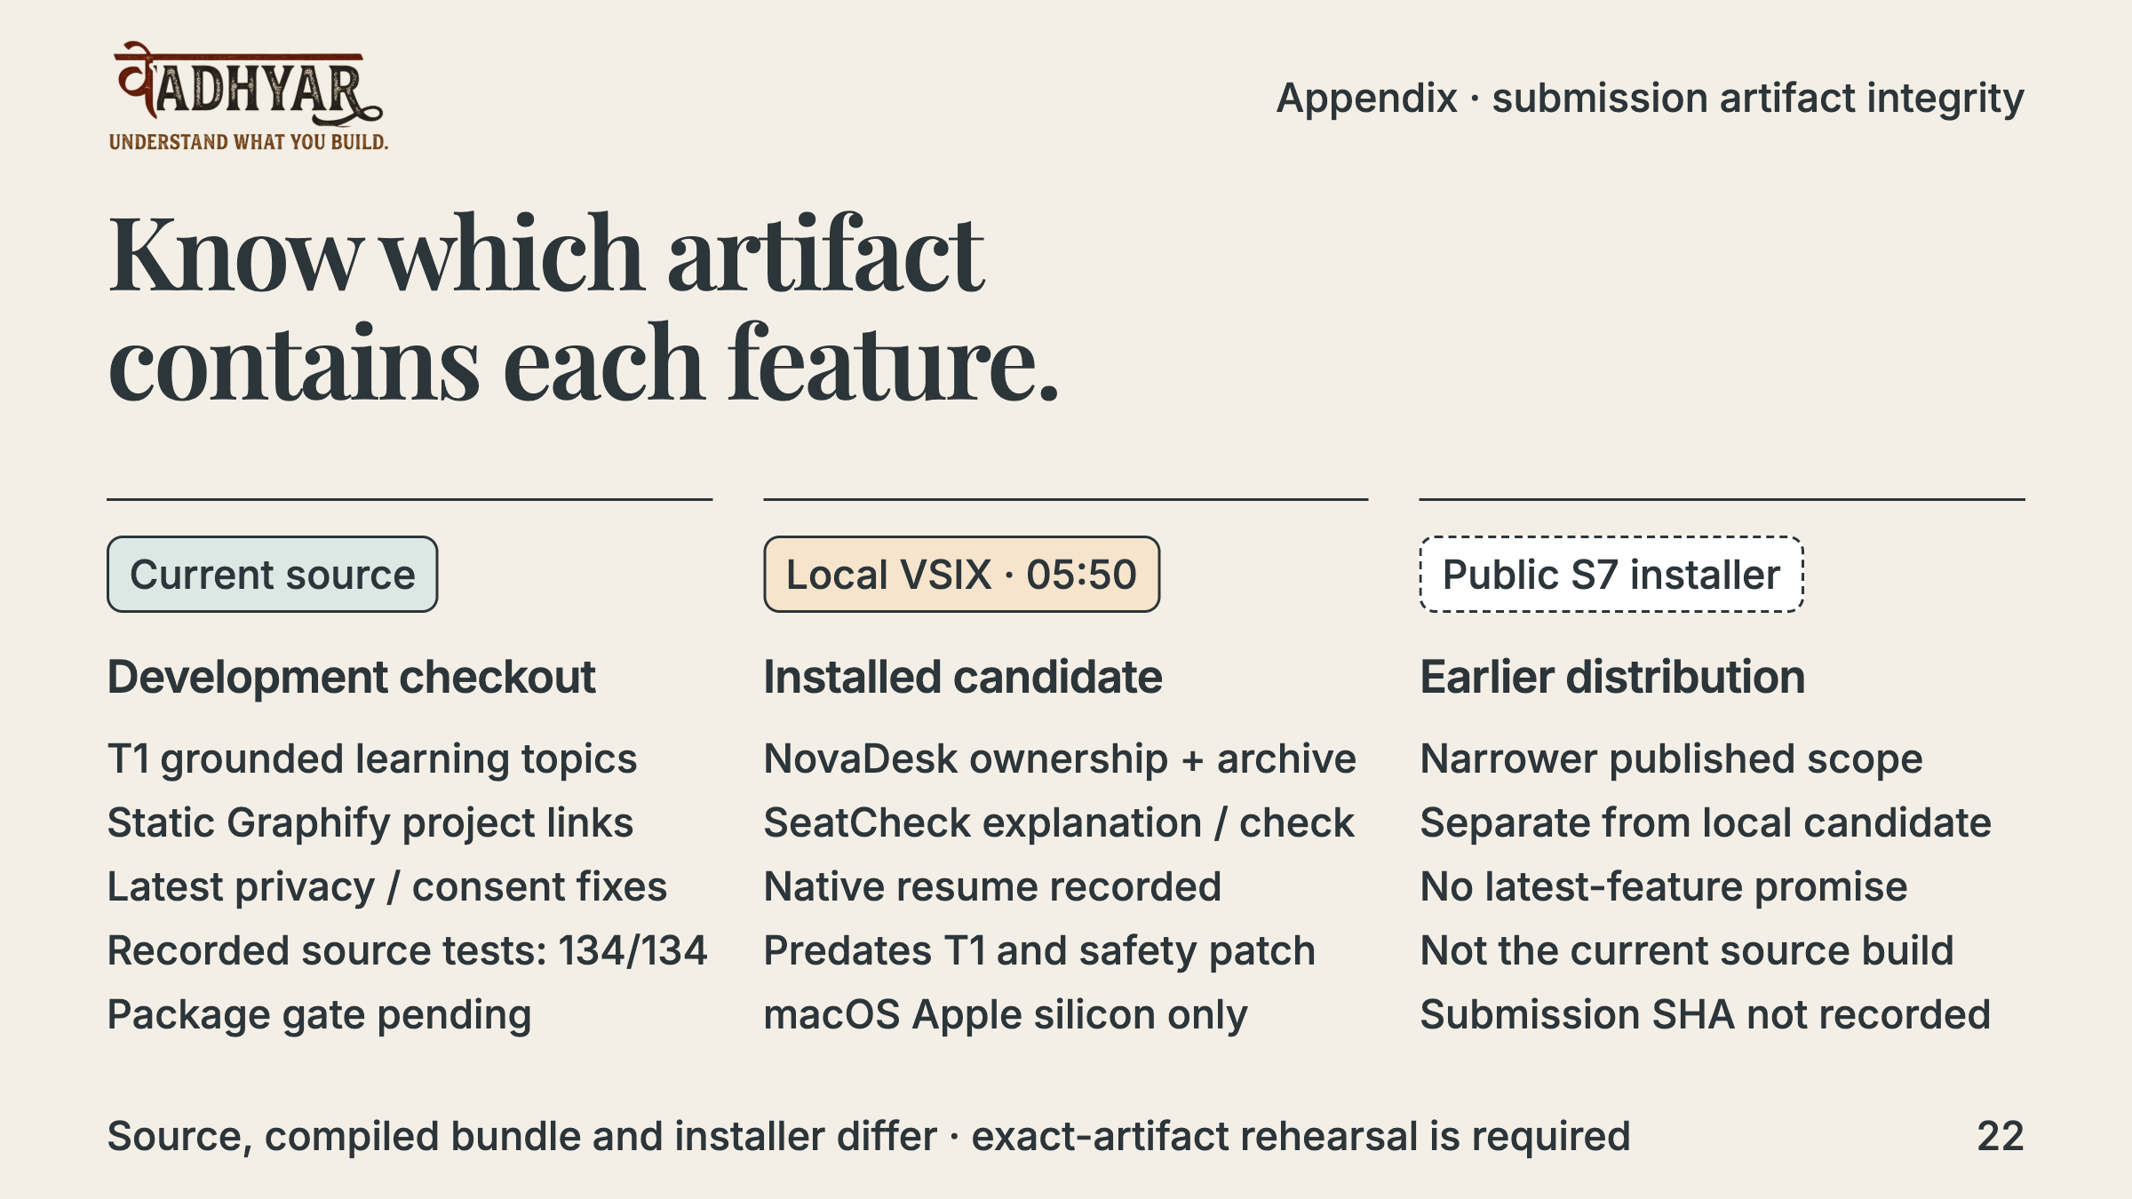
Notes:
This is a critical source/artifact distinction. Read-only inspection verified the 05:50 IST VSIX hash against its manifest and ZIP integrity. The checkout’s extension.cjs and panel.js differ from that package; CSS and lock match. The current compiled bundle matches T1’s recorded hashes, while later red-team source fixes were not rebuilt into checkout dist. No newer installer exists in the inspected release record. The deck does not claim that every current feature is in an installable final artifact. Before demonstrating or submitting, the implementation owner must build/package/rehearse one exact artifact. This presentation does not mutate the app or package.
Planned timing: Judge appendix; outside the three-minute main pitch.

Slide 23
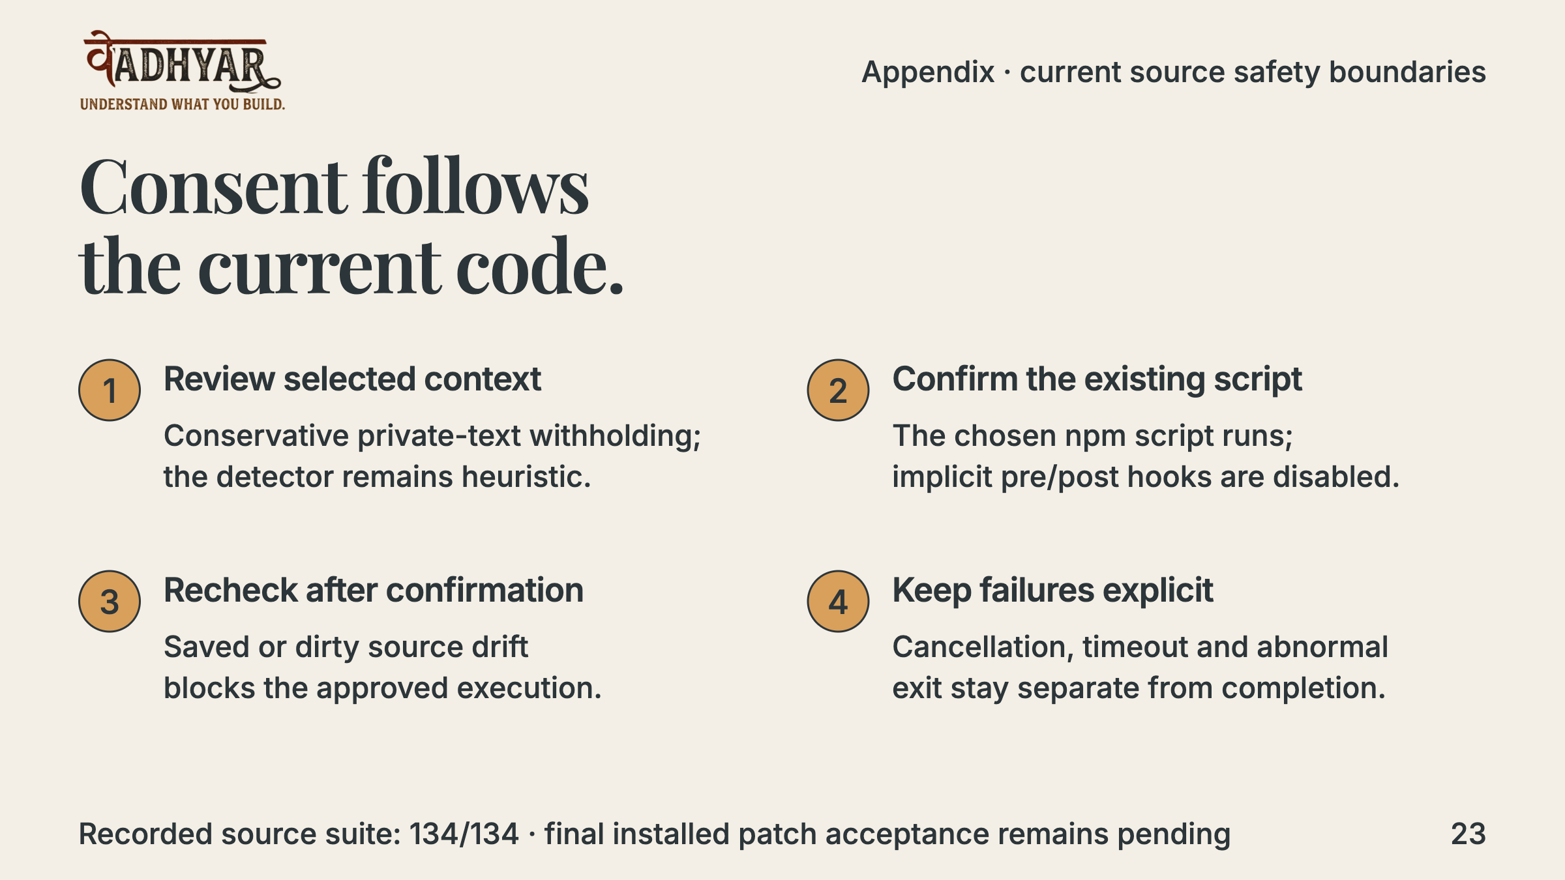
Notes:
The applied red-team source patch records 134/134 tests in 29 files, typecheck and lint on the checkout; build and six offline validators were run in an isolated copy. Current dist, installed package and concurrent panel-v2 migration were not rebuilt/rehearsed by that patch. The fixes cover serialized private fields, source drift during consent, implicit npm hooks, cancelled starts and null exits. Workspace Trust is not a sandbox: an explicitly selected project script can modify files or call commands. None of these checks proves teaching quality, full secret detection or whole-PRD compliance.
Planned timing: Judge appendix; outside the three-minute main pitch.

Slide 24
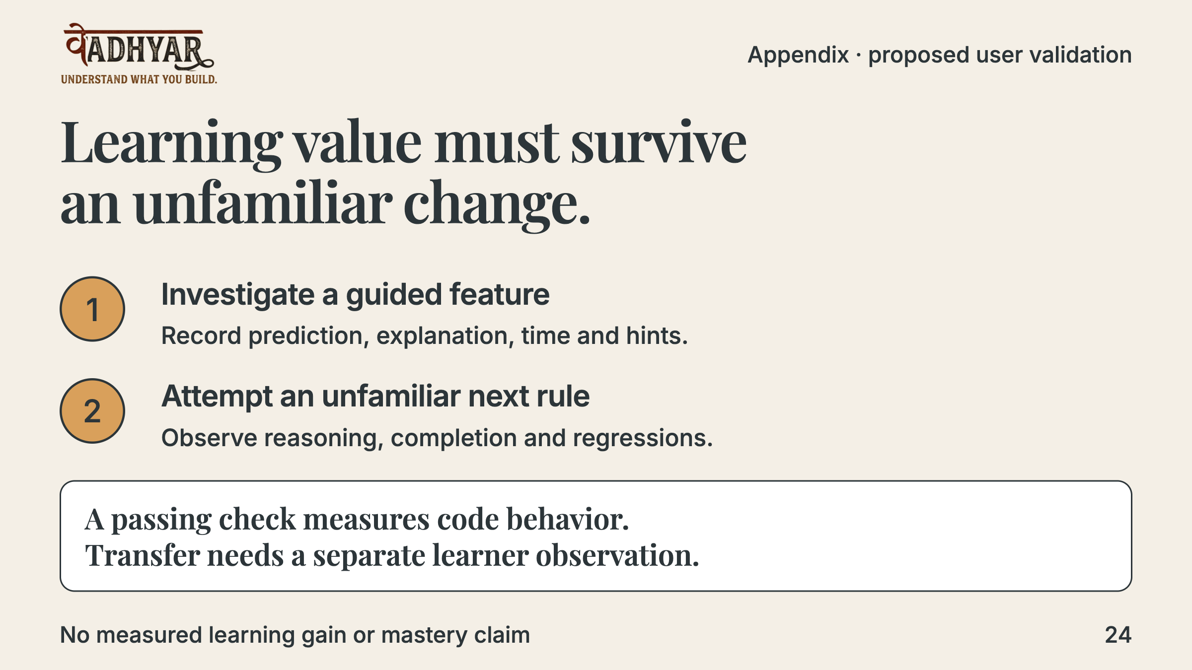
Notes:
This is a proposed validation, not a completed study. Observe beginners doing a guided feature investigation and then an unfamiliar change. Track task completion, reasoning, assistance, time and regressions. Begin with small usability observations before making comparative learning claims. No adoption, educational effect or mastery score is invented.
Planned timing: Judge appendix; outside the three-minute main pitch.

Slide 25
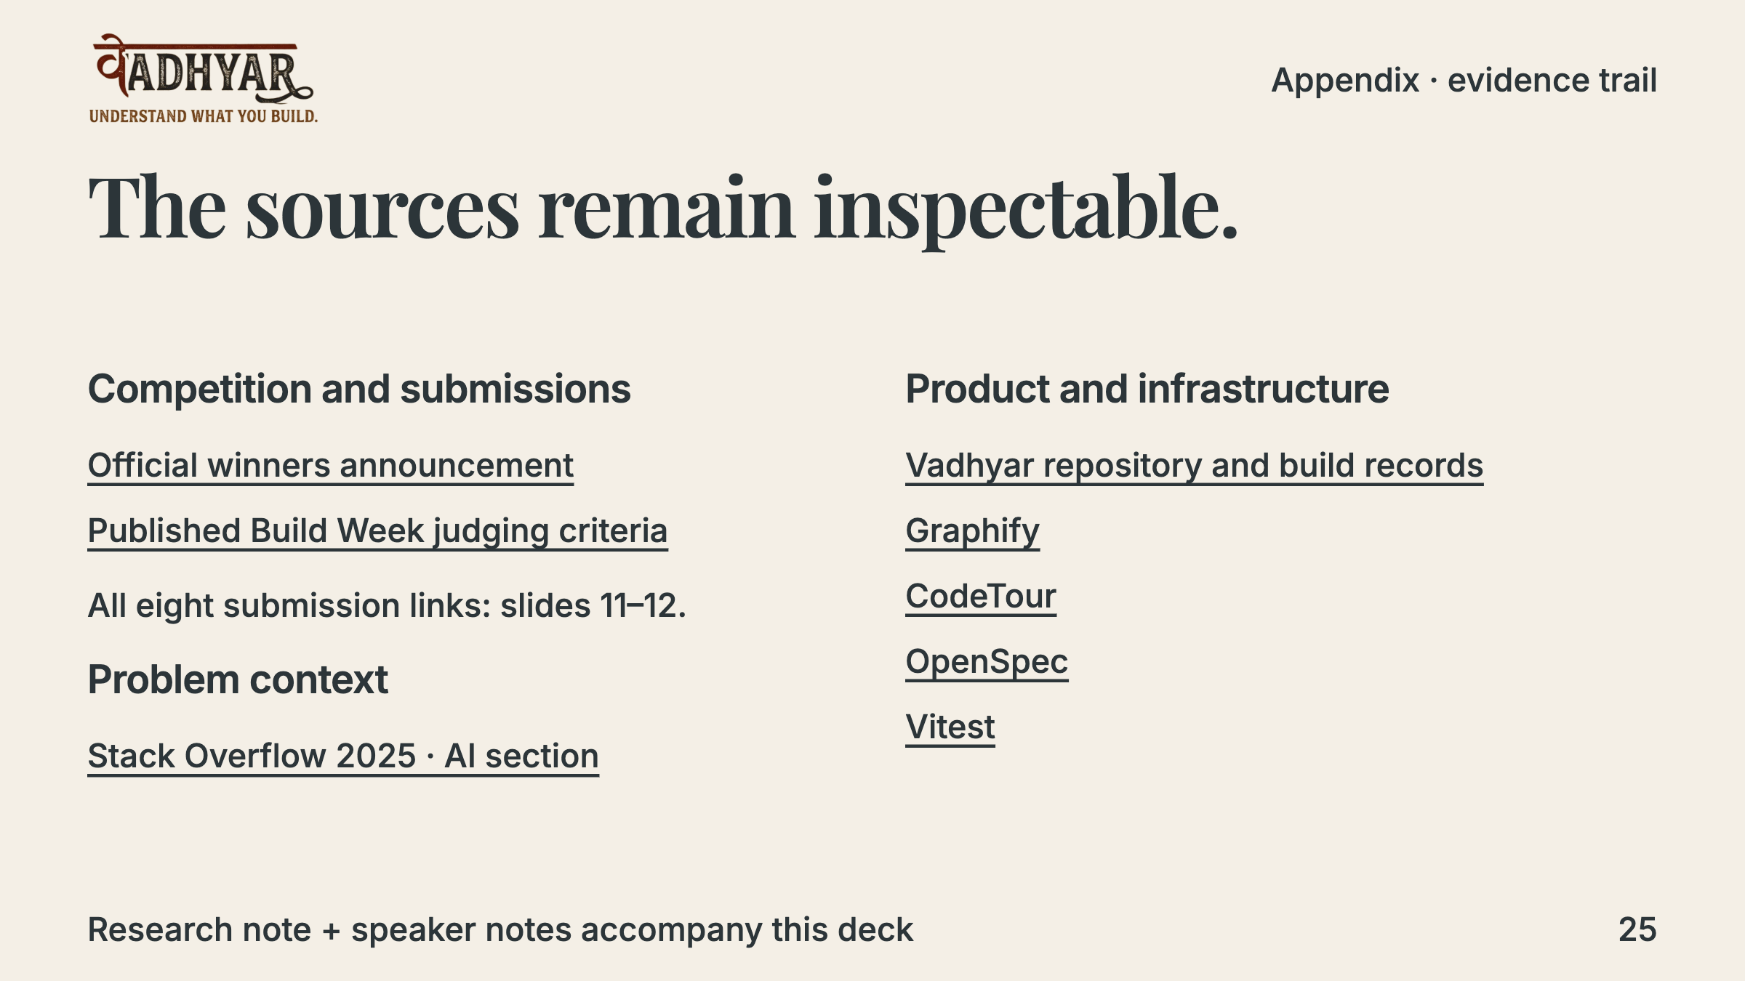
Notes:
The research note explains facts versus interpretations for every winner. Product claims were refreshed against current source and the S10–S13, H1, T1 and red-team records. The presentation refresh did not rerun native acceptance or API operations. Public sources were read on 11 October 2026. Linked demo videos were discovered but not watched or technically reproduced during this research.
Planned timing: Judge appendix; outside the three-minute main pitch.

