Slide 1
A Comparative Study of Transfer Learning Models for Weed and Crop Classification Using Deep Learning
TEAM
Gaduputi Kotlo Vijaya
Srisabari Prahadeshwar G
Mikhil Sai Doddi
Jaivishanth N C
Pritesh Jain

Slide 2



Introduction
Project Overview
Problem
Solution
Why It Matters
Weeds reduce crop yield by competing for essential resources like nutrients, water, and sunlight. Manual detection is slow and inefficient, while excessive herbicide use causes environmental damage.
This project proposes an AI-based approach using deep learning and transfer learning to automatically classify plant images into crops and weeds with high accuracy.
The system enables precision agriculture by reducing chemical usage, improving efficiency, and supporting sustainable farming practices.
2

Slide 3
Introduction
Project Objective
Main Goal
To develop an accurate and efficient deep learning model for automatic weed and crop classification using transfer learning techniques.
Supporting Objectives
Compare performance of MobileNetV1, MobileNetV2, and EfficientNetB0
Apply preprocessing techniques like resizing and normalization
Use data augmentation to improve model generalization
Evaluate models using accuracy, precision, recall, and F1-score
Identify the most suitable model for real-world agricultural applications
Expected Outcome
Achieve high classification accuracy
Reduce manual effort in weed detection
Enable efficient and sustainable farming practices
3

Slide 4
Background Research
Literature Survey
Deep learning techniques have shown superior performance over traditional image processing methods in plant classification
Transfer learning using pretrained CNN models improves accuracy and reduces training time
Models such as MobileNet, ResNet, and DenseNet are widely used for weed and crop detection
Major challenges include:
Visual similarity between crops and weeds
Class imbalance in datasets
Variations in lighting and background
Existing studies lack a direct comparison of lightweight models under identical conditions
4

Slide 5
data collection
Dataset & Preprocessing
Dataset used: Plant Seedlings Dataset (V2) containing 12 plant classes
Includes both crop and weed species
Images are resized and normalized for model input
Data augmentation techniques applied:
Flipping (horizontal & vertical)
Rotation (up to 30°)
Zoom variations
Dataset split:
70% Training
20% Validation
10% Testing
5

Slide 6
model selection
Models Used
Model Selection
MobileNetV1 & V2
EfficientNetB0
Training Approach
Selected lightweight deep learning models
Suitable for real-time agricultural applications
Efficient and low computational cost
Uses depthwise separable convolutions
Suitable for mobile/embedded devices
Uses compound scaling (depth, width, resolution)
Provides higher accuracy with efficiency
Better feature extraction capability
Pretrained on ImageNet
Two-phase training:
Train classification head
Fine-tune entire model

Slide 7
Concept Development
Methodology
Research → Data Collection
Prototyping → Model Training
Final Build → Evaluation
Collected Plant Seedlings Dataset (12 classes)
Includes crop and weed images
Applied transfer learning models
Trained using pretrained ImageNet weights
Tested on unseen data
Evaluated using:
Accuracy , Precision , Recall , F1-score
Ideation → Preprocessing
Feedback & Revisions → Fine-Tuning
Image resizing and normalization
Data augmentation:
Flip, rotate, zoom
Two-phase training:
Train classification head
Fine-tune full model
Improved model performance
7

Slide 8
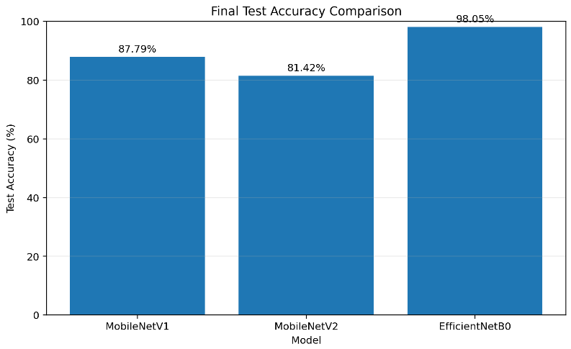
PERFORMANCE ANALYSIS
Results & Performance
Model performance comparison on test dataset:
MobileNetV1 – 87.79% accuracy
MobileNetV2 – 81.42% accuracy
EfficientNetB0 – 98.05% accuracy
EfficientNetB0 achieved the highest accuracy with lowest loss
MobileNet models are efficient but less accurate
Confusion matrix shows better classification performance for EfficientNetB0
8

Slide 9
FINAL INSIGHTS
Conclusion
This study demonstrates that transfer learning is an effective approach for weed and crop classification. Among the evaluated models, EfficientNetB0 achieved the highest accuracy of 98.05%, outperforming MobileNetV1 and MobileNetV2. While MobileNet models are suitable for low-resource environments due to their efficiency, EfficientNetB0 provides superior performance for accuracy-critical applications. Overall, the proposed system can support precision agriculture by enabling accurate weed detection, reducing manual effort, and improving farming efficiency.
9

Slide 10
The End
TEAM
Gaduputi Kotlo Vijaya
Srisabari Prahadeshwar G
Mikhil Sai Doddi
Jaivishanth N C
Pritesh Jain

