Slide 1
Customer Churn Analysis
Telco Customer Churn — End-to-End Analytics
Built by Sabari A S | linkedin.com/in/sabari3299

Slide 2
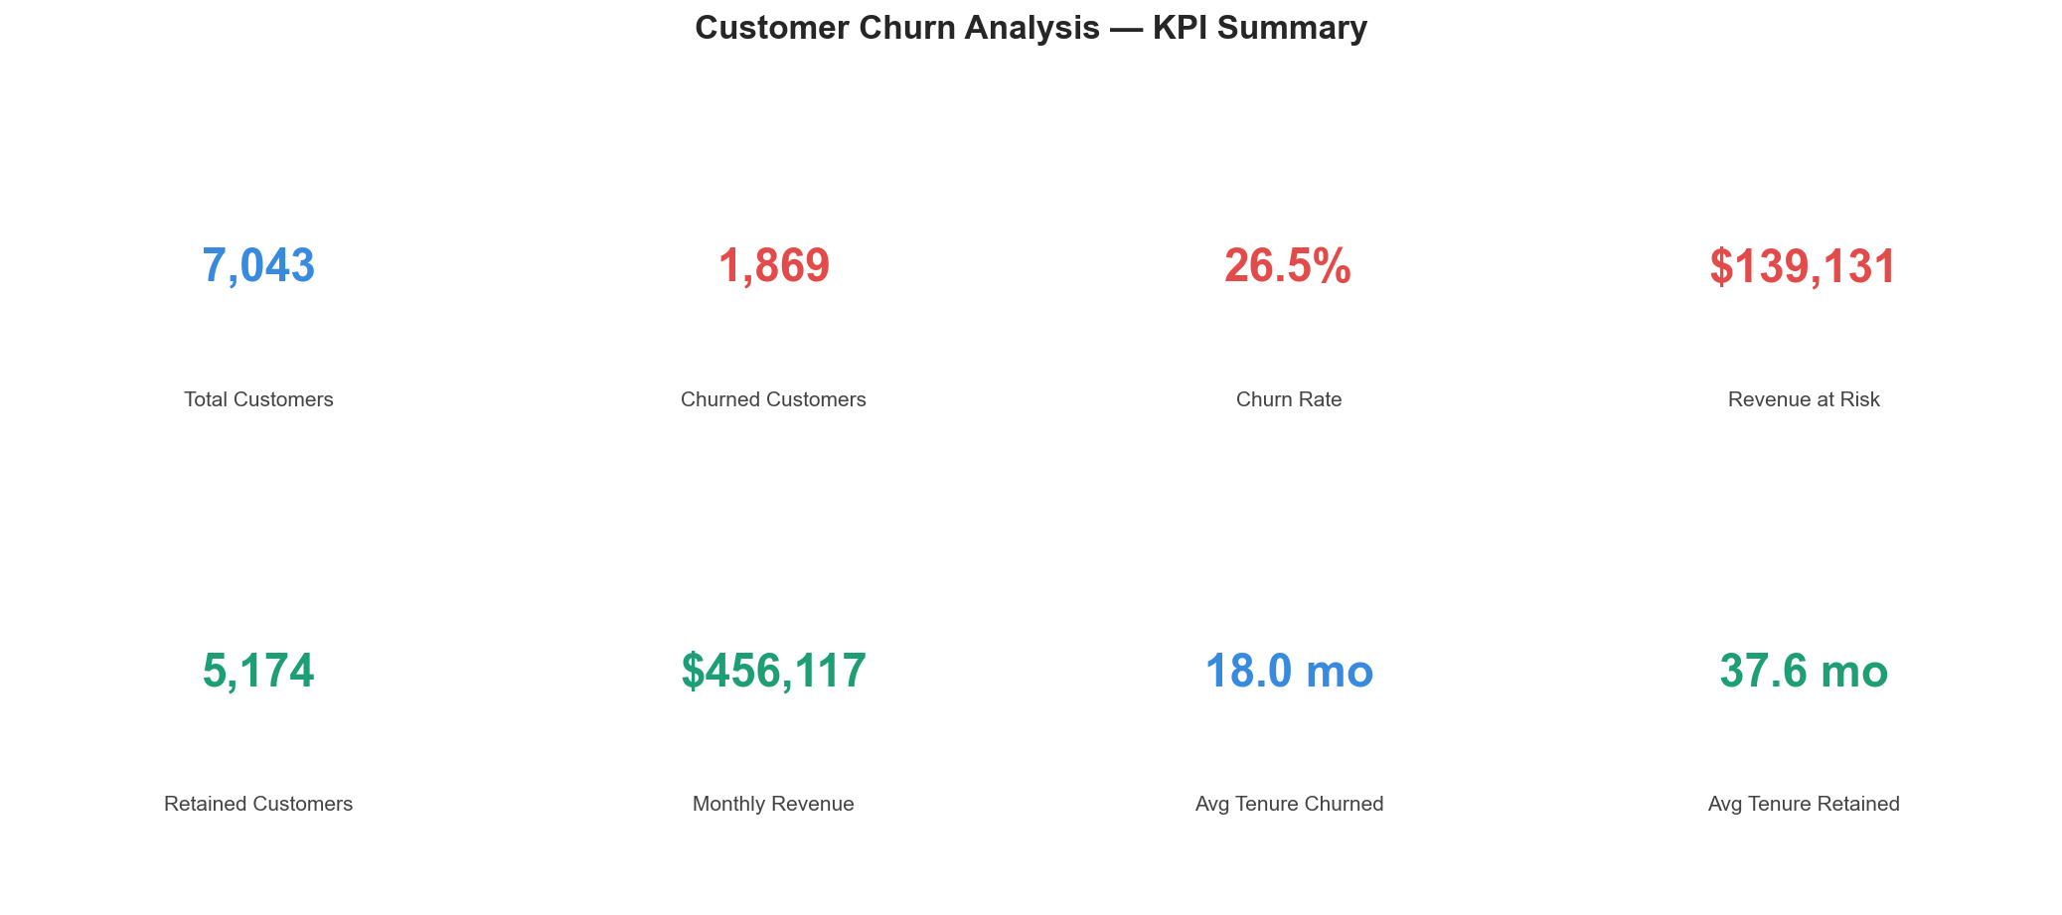
Executive KPI Summary

Slide 3
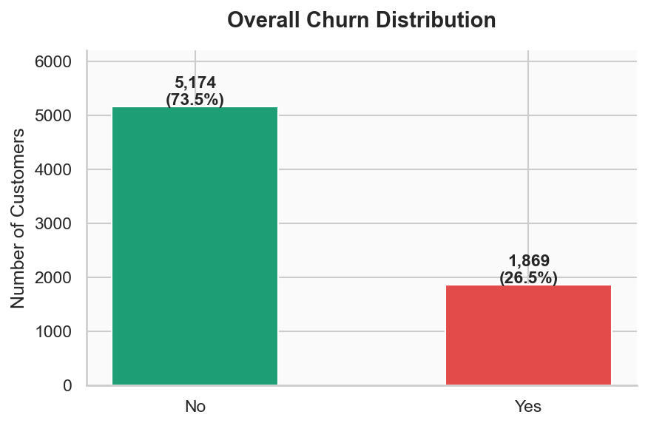
Overall Churn Distribution
Key Insight
26.5% of customers churned 1 in 4 customers is leaving Retaining customers costs 5x less than acquiring new ones

Slide 4
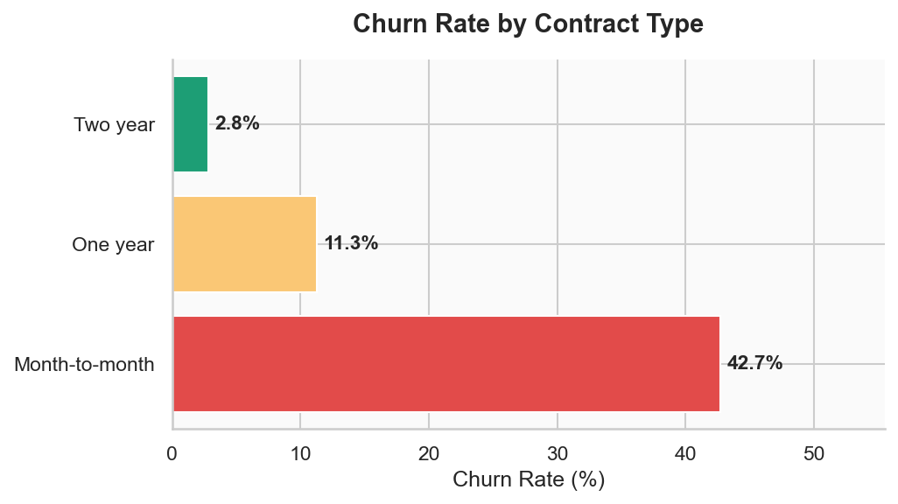
Churn by Contract Type
Key Insight
Month-to-month: 42.7% churn One-year: 11.3% churn Two-year: 2.8% churn Action: Incentivise customers to upgrade to longer contracts

Slide 5
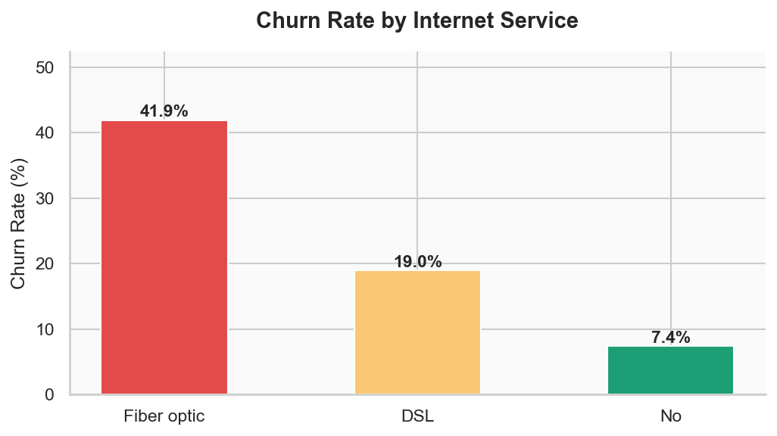
Churn by Internet Service
Key Insight
Fiber Optic: 41.9% churn DSL: 19.0% churn No Internet: 7.4% churn Action: Audit Fiber Optic complaints and benchmark competitor pricing

Slide 6
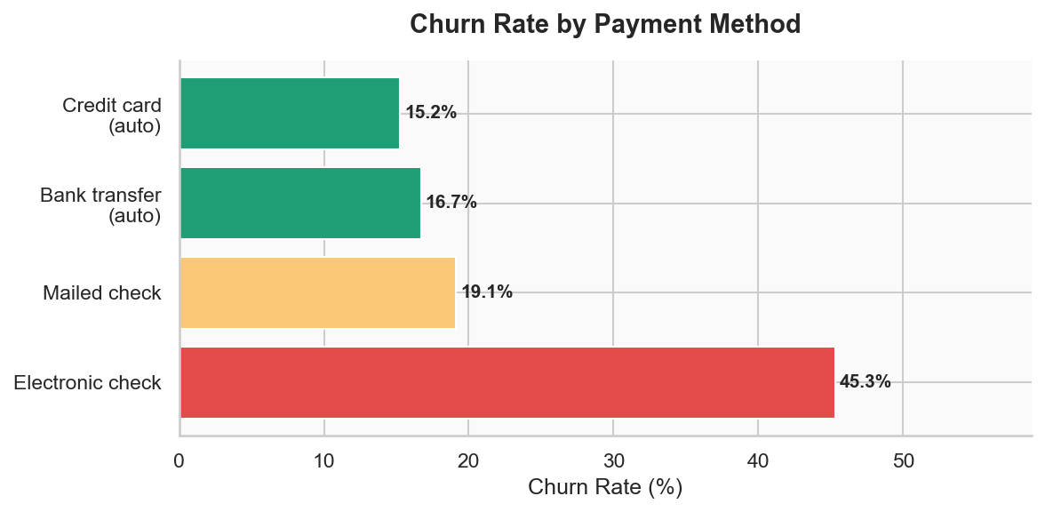
Churn by Payment Method
Key Insight
Electronic Check: 45.3% churn Mailed Check: 19.1% churn Auto-pay: 15-17% churn Action: Migrate customers to auto-pay

Slide 7
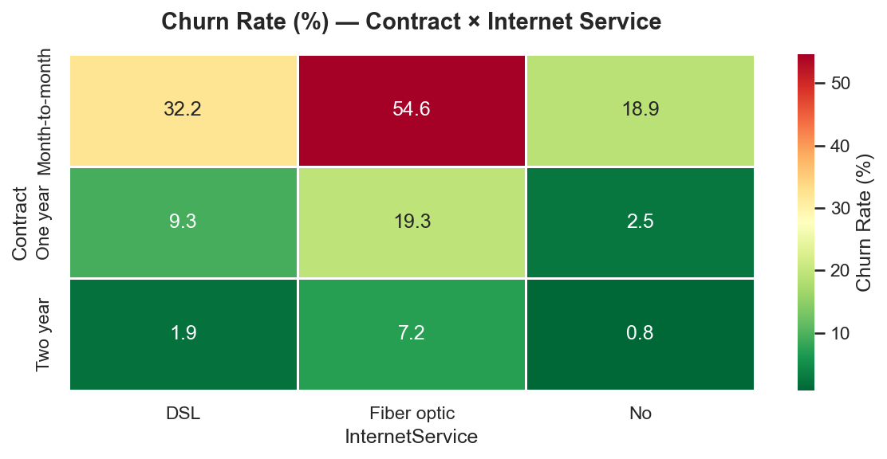
Churn Heatmap — Contract × Internet Service

Slide 8
Business Recommendations
1
Target month-to-month customers
Offer discounts to upgrade — churn drops from 42.7% to 2.8%
2
Investigate Fiber Optic
41.9% churn — audit complaints and benchmark competitors
3
Migrate to auto-pay
Electronic check 45.3% churn → auto-pay reduces to 15%
4
Year 1 onboarding program
Most churn happens in first 12 months — intervene early
5
Bundle Tech Support
Customers without tech support churn significantly more
6
Senior citizen retention program
40% churn vs 22% non-senior — dedicated support needed

