Slide 1
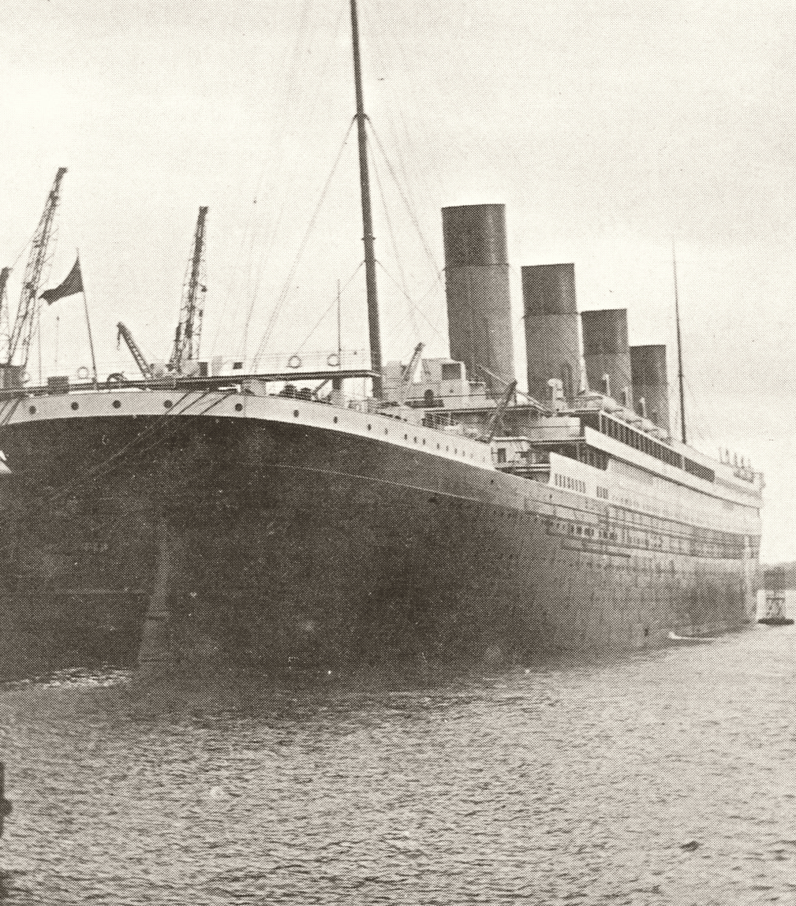
CAN DATA
PREDICT HUMAN
FATE?
A survival investigation in the Titanic training data
EXPLORATORY DATA ANALYSIS · 1912 / KAGGLE
01
Notes:
Open with the question: if survival were random in this passenger sample, would outcomes look the same across groups? The image shows Titanic at Southampton before its maiden voyage. Image source: Wikimedia Commons, “RMS Titanic in Southampton, April 9th of 1912,” CC0 / public domain, https://commons.wikimedia.org/wiki/File:RMS_Titanic_in_Southampton,_April_9th_of_1912.jpg.
Source: Kaggle, Titanic: Machine Learning from Disaster, training data (train.csv), https://www.kaggle.com/competitions/titanic/data.

Slide 2
891 passenger records, one stark outcome
The training file records 342 survivors and 549 non-survivors.
38.4%
recorded as survived
38.4%
The file is a subset of passengers with known outcomes, not a full manifest.
TITANIC SURVIVAL ANALYSIS
02
Notes:
The Kaggle training file has 891 rows and 12 columns. 342 rows have Survived=1 (38.4%); 549 have Survived=0. Frame the sample carefully: outcomes are supplied only for the training subset.
Source: Kaggle, Titanic: Machine Learning from Disaster, training data (train.csv), https://www.kaggle.com/competitions/titanic/data.

Slide 3
Before the clues: inspect the gaps
Most missingness is concentrated in cabin identifiers.
MISSING VALUES
687
cabin values missing
177 ages missing
2 embarkation values missing
0 exact duplicate rows
TITANIC SURVIVAL ANALYSIS
03
Notes:
The training file contains 891 rows and 12 columns. Missing values: Cabin 687; Age 177; Embarked 2. No exact duplicate records were found. The cabin field is too incomplete for a broad comparison.
Source: Kaggle, Titanic: Machine Learning from Disaster, training data (train.csv), https://www.kaggle.com/competitions/titanic/data.

Slide 4
Keep the analysis honest
Each comparison uses the records that contain the fields it needs.
01
Keep rows for the overall outcome and class counts.
02
Use observed ages only; age comparisons include 714 people.
03
Leave Cabin out of group analysis because 77% is missing.
No missing values were filled in for the comparisons shown.
TITANIC SURVIVAL ANALYSIS
04
Notes:
Describe the data handling rather than implying that every field was cleaned and made complete. The analysis does not impute age or cabin; it uses available values for each relevant comparison.
Source: Kaggle, Titanic: Machine Learning from Disaster, training data (train.csv), https://www.kaggle.com/competitions/titanic/data.

Slide 5
The survival gap by recorded sex was large
Observed survival: 233 of 314 women and 109 of 577 men.
55.3 percentage points
TITANIC SURVIVAL ANALYSIS
05
Notes:
Women: 233/314 = 74.2%. Men: 109/577 = 18.9%. The field in this dataset is Sex and contains female/male categories. These are sample associations, not a causal estimate.
Source: Kaggle, Titanic: Machine Learning from Disaster, training data (train.csv), https://www.kaggle.com/competitions/titanic/data.

Slide 6
Survival rates fell with ticket class
Each bar uses all passengers in that class as its denominator.
136/216 · 87/184 · 119/491
TITANIC SURVIVAL ANALYSIS
06
Notes:
First class: 136/216 (63.0%); second class: 87/184 (47.3%); third class: 119/491 (24.2%). Ticket class and survival are associated in this file. Do not read ticket class as a direct measure of every passenger's resources or access.
Source: Kaggle, Titanic: Machine Learning from Disaster, training data (train.csv), https://www.kaggle.com/competitions/titanic/data.

Slide 7
Higher fares lined up with higher survival
Fare quartiles are based on all 891 passengers in the training file.
Lowest: n=223 · Lower-middle: n=224 · Upper-middle: n=222 · Highest: n=222
Cut points: $7.91 · $14.45 · $31.00
TITANIC SURVIVAL ANALYSIS
07
Notes:
Fare quartiles use linear sample quantiles with cut points $7.9104, $14.4542, and $31.00. Rates: Lowest 44/223 (19.7%); Lower-middle 68/224 (30.4%); Upper-middle 101/222 (45.5%); Highest 129/222 (58.1%). This describes an association in the sample; fare alone is not a direct measure of wealth or of access to lifeboats.
Source: Kaggle, Titanic: Machine Learning from Disaster, training data (train.csv), https://www.kaggle.com/competitions/titanic/data.

Slide 8
Class and survival were statistically associated
Pearson chi-square test of independence · all 891 records
H₀
χ²(2)
102.89
Passenger class and recorded survival are independent.
p = 4.55e-23
Reject H₀ at α = 0.05
A significant association does not explain why it occurred.
TITANIC SURVIVAL ANALYSIS
08
Notes:
Chi-square test of independence on the 3 × 2 Pclass by Survived contingency table: χ²(2)=102.889, p=4.549e-23. Null hypothesis: passenger class and recorded survival are independent. The test rejects independence in this sample. The result is associational and does not identify the causal mechanism. Expected cell counts exceed 5.
Source: Kaggle, Titanic: Machine Learning from Disaster, training data (train.csv), https://www.kaggle.com/competitions/titanic/data.

Slide 9
The sex gap appears within every class
The rate differs by sex even when ticket class is held fixed.
Within-class denominators
1st class: 94 women · 122 men / 2nd class: 76 women · 108 men / 3rd class: 144 women · 347 men
TITANIC SURVIVAL ANALYSIS
09
Notes:
1st class: women 96.8% (n=94); men 36.9% (n=122).
2nd class: women 92.1% (n=76); men 15.7% (n=108).
3rd class: women 50.0% (n=144); men 13.5% (n=347). The within-class pattern is descriptive; it does not adjust for age, family structure, cabin location, or other factors.
Source: Kaggle, Titanic: Machine Learning from Disaster, training data (train.csv), https://www.kaggle.com/competitions/titanic/data.

Slide 10
Patterns are clear; causes are not
The clearest differences in this sample track recorded sex and ticket class.
The passenger file can reveal patterns in outcomes. It cannot tell us, by itself, which rescue decisions caused them.
CASE NOTES
Sample: Kaggle training subset · Method: exploratory comparisons · Claim: association, not causation
TITANIC SURVIVAL ANALYSIS
10
Notes:
Conclude with measured language: recorded survival was uneven across groups in this training file, especially by sex and passenger class. The data do not include the complete manifest or the full sequence of rescue decisions, and the exploratory comparisons do not establish causation.
Source: Kaggle, Titanic: Machine Learning from Disaster, training data (train.csv), https://www.kaggle.com/competitions/titanic/data.

Slide 11
Appendix · Fields in the training file
The outcome is known for 891 observations; the test file has no survival labels.
PassengerId
Integer · record identifier
SibSp
Integer · siblings / spouses aboard
Survived
Binary integer · outcome (0 / 1)
Parch
Integer · parents / children aboard
Pclass
Ordinal code · class (1, 2, 3)
Ticket
Text · ticket identifier
Name
Text · passenger name
Fare
Numeric · listed fare
Sex
Category · female / male labels
Cabin
Text · cabin identifier (687 missing)
Age
Numeric · years (177 missing)
Embarked
Category · port (2 missing)
TITANIC SURVIVAL ANALYSIS
11
Notes:
Field descriptions follow Kaggle’s competition data page. The analyzed file has 12 fields: PassengerId, Survived, Pclass, Name, Sex, Age, SibSp, Parch, Ticket, Fare, Cabin, Embarked.
Source: Kaggle, Titanic: Machine Learning from Disaster, training data (train.csv), https://www.kaggle.com/competitions/titanic/data.

Slide 12
Appendix · Age bands
Age was reported for 714 of 891 passengers; these comparisons use complete ages.
0–12: 40/69 · 13–18: 30/70 · 19–40: 165/425 · 41+: 55/148
Mean age: 28.3 among survivors · 30.6 among non-survivors
TITANIC SURVIVAL ANALYSIS
12
Notes:
Age is missing for 177 passengers; age-band rates therefore use n=714. Age bands: 0–12, 13–18, 19–40, and 41+. Rates: 0–12 40/69 (58.0%); 13–18 30/70 (42.9%); 19–40 165/425 (38.8%); 41+ 55/148 (37.2%). Mean age was 28.3 among recorded survivors (n=290) and 30.6 among non-survivors (n=424). Boundaries are descriptive choices, not historical categories.
Source: Kaggle, Titanic: Machine Learning from Disaster, training data (train.csv), https://www.kaggle.com/competitions/titanic/data.

Slide 13
Appendix · Summary statistics
Age and fare are continuous measures; count fields are not shown here.
Measure | Age (years) | Fare
Observed n | 714 | 891
Mean | 29.70 | 32.20
Median | 28.00 | 14.45
Mode | 24 | 8.05
Sample variance | 211.02 | 2469.44
Standard deviation | 14.53 | 49.69
Coefficient of variation | 48.9% | 154.3%
Pairwise sample covariance, Age × Fare: 73.85 (n = 714)
TITANIC SURVIVAL ANALYSIS
13
Notes:
Statistics use observed records. Age n=714; fare n=891. Variance uses the sample denominator (n−1); standard deviation is its square root; coefficient of variation is SD / mean × 100. The mode shown is the most frequent observed value (smallest value if tied). Pairwise sample covariance for age and fare uses 714 complete pairs. Covariance is scale-dependent and does not establish a relationship by itself.
Source: Kaggle, Titanic: Machine Learning from Disaster, training data (train.csv), https://www.kaggle.com/competitions/titanic/data.

Slide 14
Appendix · Test, source and limits
HYPOTHESIS TEST
χ²(2) = 102.89 · p = 4.55e-23
Passenger class × recorded survival
DATA
Kaggle · Titanic: Machine Learning from Disaster · train.csv
kaggle.com/competitions/titanic/data
LIMITS
Training subset, 891 records · observational data · association does not prove cause
Cover image: Wikimedia Commons · CC0 / public domain
TITANIC SURVIVAL ANALYSIS
14
Notes:
Dataset: Kaggle Titanic competition, https://www.kaggle.com/competitions/titanic/data. Cover image: Wikimedia Commons, “RMS Titanic in Southampton, April 9th of 1912,” https://commons.wikimedia.org/wiki/File:RMS_Titanic_in_Southampton,_April_9th_of_1912.jpg, CC0 / public domain. The uploaded file used here is a public mirror of Kaggle's standard training CSV; values are computed from the standard 891-row training sample. The dataset is historical, incomplete, observational, and not a causal record of rescue decisions.
Source: Kaggle, Titanic: Machine Learning from Disaster, training data (train.csv), https://www.kaggle.com/competitions/titanic/data.

