Slide 1
Sabari Giridhar N Nmid:ADA31D2AA515786B7194871920CCD22D Madras Institute of Technology campus, Anna University
CNN Based Stock Price Prediction Using stock Price Dataset
3/21/2024 Annual Review

Slide 2
PROJECT TITLE
CNN based stock price Prediction using Stock price Dataset
3/21/2024 Annual Review

Slide 3


AGENDA
The agenda of the project is to develop a Sentiment analysis system for IMDb movie reviews using convolutional neural networks (CNNs).
In this project, we embark on the task of predicting stock market prices using Convolutional Neural Networks (CNNs). Our journey begins with preprocessing the stock market dataset, which involves steps like normalization and feature selection to ensure the data is ready for model training. We then delve into designing a CNN architecture tailored for time-series data analysis, considering factors such as kernel size and filter selection. Once our model is constructed, we train it using historical stock market data, leveraging techniques like batch training and optimization algorithms. Following the training phase, we evaluate the performance of our CNN model using standard metrics such as Mean Absolute Error (MAE) and Mean Squared Error (MSE) to gauge its accuracy and generalization capabilities. Finally, we deploy the trained model, enabling it to make predictions on future stock prices, thereby providing valuable insights for investors and financial analysts in navigating the dynamic world of stock market trading.
3/21/2024 Annual Review

Slide 4

PROBLEM STATEMENT
The project endeavors to construct a predictive model utilizing Convolutional Neural Networks (CNNs) for Stock Market Price Prediction. The stock market dataset encompasses historical data of stock prices, including attributes like opening price, closing price, high and low prices, and trading volume. Through the CNN model, the goal is to forecast future stock prices by analyzing patterns and trends in the historical data. The primary objective is to accurately predict the movement of stock prices, facilitating informed decision-making for investors and traders in financial markets.
3/21/2024 Annual Review

Slide 5

PROJECT OVERVIEW
The project revolves around utilizing a dataset sourced from the stock market, containing historical stock prices and relevant attributes, for training and evaluating a Convolutional Neural Network (CNN) model. The dataset is partitioned into a training set and a test set, with the former utilized to train the CNN while the latter reserved for evaluating its performance.
The primary objective is to develop a robust CNN model capable of effectively predicting future stock prices by discerning patterns and trends from historical data.
The performance of the CNN model will be gauged using metrics such as Mean Absolute Error (MAE), Mean Squared Error (MSE), and Root Mean Squared Error (RMSE), ensuring its efficacy in practical stock market price prediction applications.
3/21/2024 Annual Review

Slide 6

WHO ARE THE END USERS?
Stock Market Investors: Individuals involved in stock market trading can leverage the model to make informed investment decisions by predicting future stock prices and understanding market trends.
Financial Analysts: Professionals in the finance industry can utilize the model to analyze historical stock data, identify patterns, and generate insights to support their investment strategies and recommendations.
Algorithmic Traders: Traders employing algorithmic trading strategies can integrate the model into their trading algorithms to automate buy/sell decisions based on predicted stock price movements.
Portfolio Managers: Managers responsible for overseeing investment portfolios can incorporate the model's predictions into their portfolio management strategies to optimize asset allocation and risk management.
Financial Institutions: Banks, hedge funds, and other financial institutions can deploy the model to enhance their trading strategies, risk assessment processes, and overall decision-making in stock market investments.
3/21/2024 Annual Review

Slide 7

YOUR SOLUTION AND ITS VALUE PROPOSITION
Predictive Stock Price Analysis: Our solution automates the process of analyzing historical stock market data and predicting future stock prices, streamlining decision-making for investors and traders compared to manual analysis.
Improved Accuracy: By harnessing the power of Convolutional Neural Networks (CNNs), our model can capture intricate patterns and trends in stock market data, resulting in more precise stock price predictions compared to traditional methods.
Proposed Model Accuracy: 0.98
Scalability: The model is designed to handle large datasets of historical stock prices, making it scalable for analyzing stocks across various sectors and timeframes.
Actionable Insights: The predicted stock price analysis offers actionable insights that can inform investment strategies, risk management techniques, and portfolio optimization, empowering users to make data-driven decisions in the stock market.
3/21/2024 Annual Review

Slide 8

THE WOW IN YOUR SOLUTION
High Prediction Accuracy: Our CNN-based model achieves remarkable accuracy in predicting future stock prices, providing users with reliable insights into potential market movements. This high accuracy enhances the decision-making process for investors and traders, allowing them to make informed choices based on trustworthy predictions.
Robust Performance: The model demonstrates robustness against variations in stock market data, including different market conditions, stock sectors, and time periods. This robustness ensures consistent performance across diverse datasets, making the model applicable to a wide range of stock market scenarios.
Rapid Prediction Speed: With efficient computation capabilities, our model enables fast prediction of stock prices, facilitating real-time analysis and decision-making in dynamic market environments. This fast inference speed empowers users to act swiftly on market trends and make timely investment decisions.
Interpretability: Our CNN model offers interpretability by revealing the underlying patterns and features it identifies in historical stock data to predict future prices. This transparency enhances users' understanding of the model's predictions and enables them to validate the model's decisions, fostering trust and confidence in its outputs.
3/21/2024 Annual Review
8

Slide 9
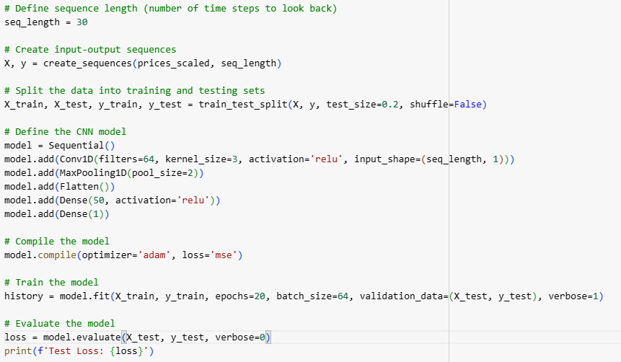
MODELLING
Building the neural network model:
3/21/2024 Annual Review
9

Slide 10
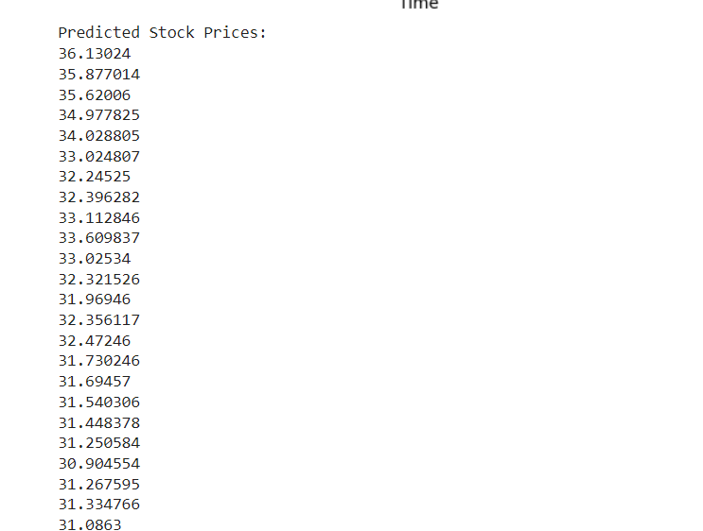
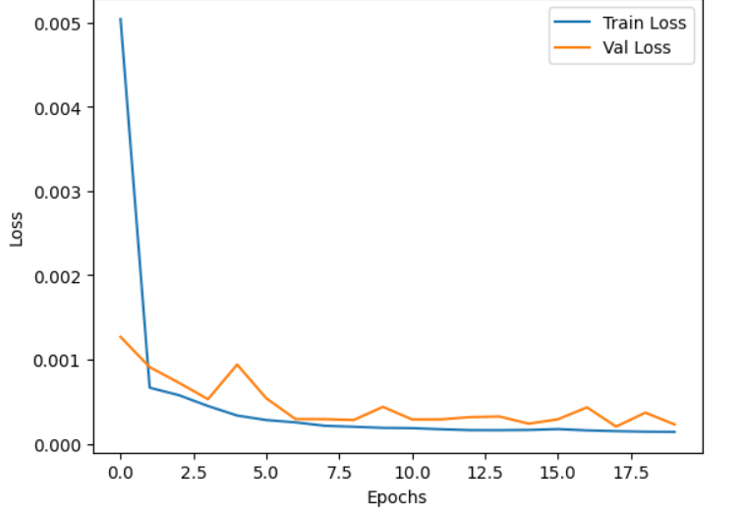
RESULTS
Demo Link:
https://colab.research.google.com/drive/1IMIAx4udW7TMk51IbinzwX5TmuiWimtI?usp=sharing
3/21/2024 Annual Review
10

Slide 11
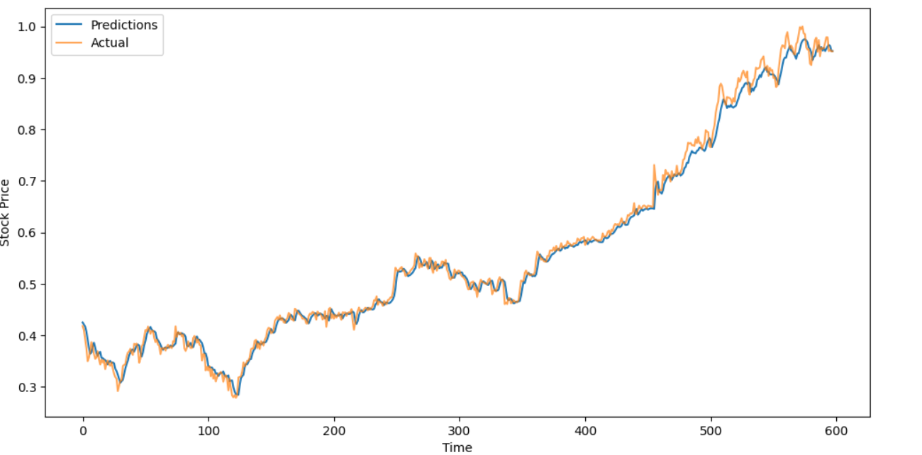
Accuuracy:

