Slide 1
Patient Deterioration Prediction
NEWS2-based
Stage Transition
Prediction
Mathematical ML Problem Formulation
EWS Ward Monitor | Foqal CareOS
Sabari Krishna | July 3, 2026

Slide 2
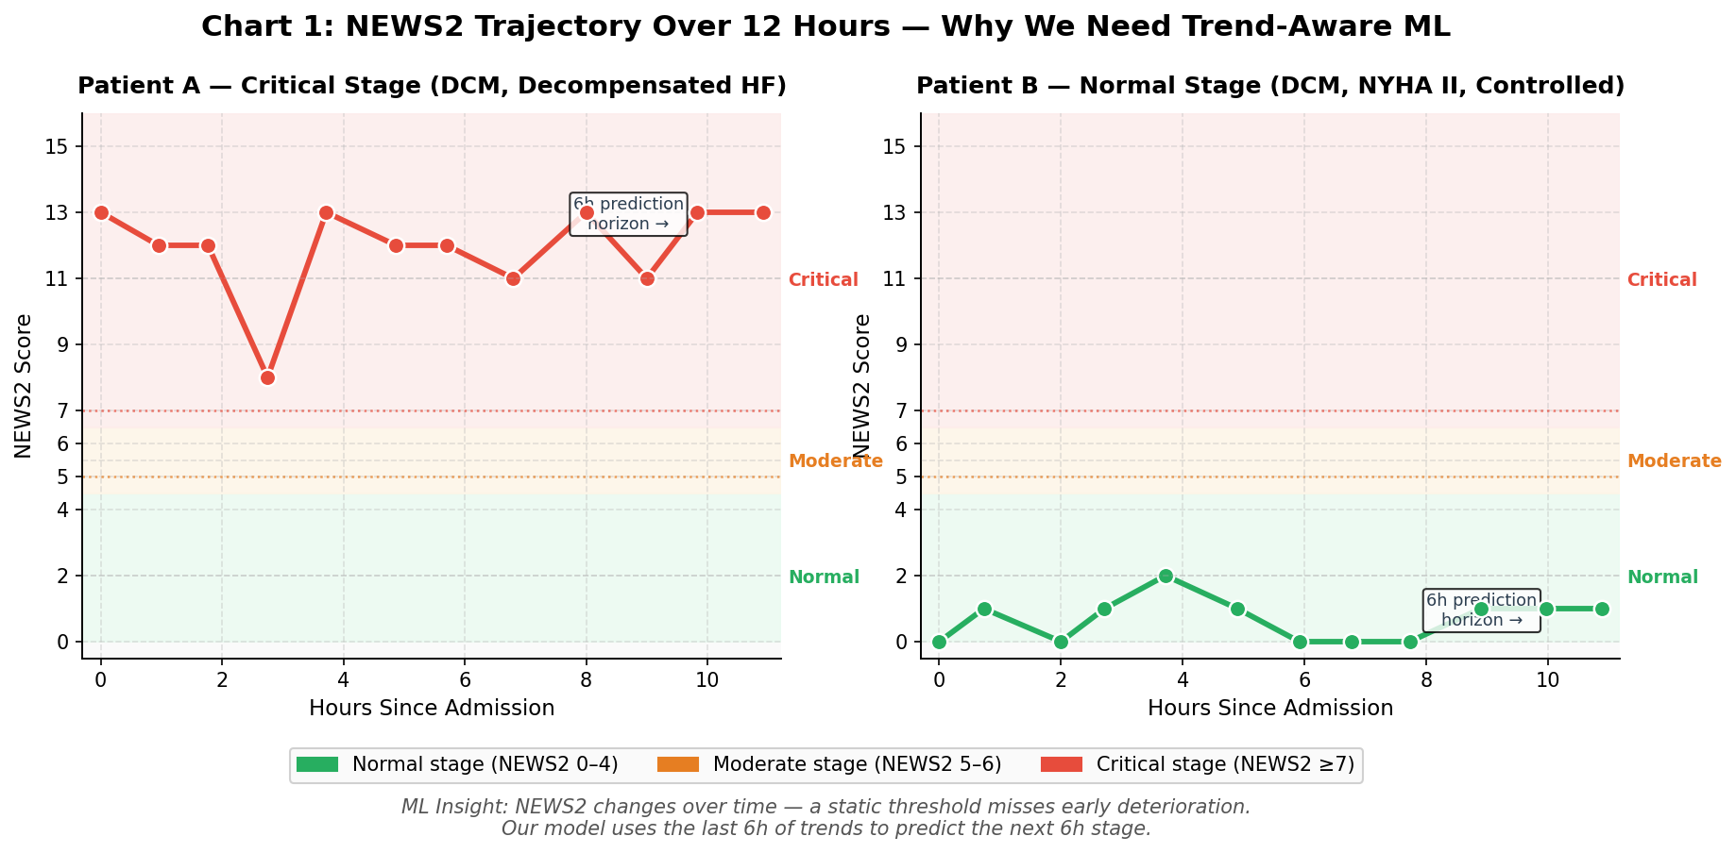
Why ML? The Gap NEWS2 Cannot Fill
- Current system: NEWS2 scores from live vitals
Threshold rule: score >=7 = Critical alert
- Problems with rule-based approach:
No trend - rising HR looks same as stable HR
No vital interactions (HR + low BP = worse)
No probability - just red/amber/green labels
NEWS2 AUROC: 0.67 - 0.85 (published literature)
- ML learns what rules cannot:
Trend: HR rising 10 bpm/h is dangerous
Output: P(deterioration in 6h) = 0.82
- Best-in-class: eCARTv5 AUROC = 0.895
- Our target: AUROC >= 0.80

Slide 3
The Prediction Task - One Sentence
Given the last 6 hours of a CCU patient's vital signs,
predict whether their clinical stage will worsen in the next 6 hours.
Binary Classification
Regression
Survival Analysis
CHOSEN [primary]
Not Used
Not Used
Output: P(deterioration) in [0,1]
Industry standard: eCARTv5, Epic DI,
NHS CIRCEWS all use this
Clinicians want a single risk score
Output: continuous NEWS2 value
Stage boundaries matter more
than the exact score number
Rejected: less clinically useful
Output: time-to-event distribution
Dynamic-DeepHit / DeepSurv
Noisy MIMIC event timestamps
Clinicians want a score, not a curve
H = 6 hours primary | Also test H = 24 hours

Slide 4
What Is 'Deterioration'? The Label - NYHA Analogy
Stage 0 - Normal
Stage 1 - Moderate
Stage 2 - Critical
NEWS2 Score: 0 - 4
Routine monitoring
NEWS2 Score: 5 - 6
Urgent review needed
NEWS2 Score: >= 7
Emergency response
->
->
NYHA Class 1-2:
no significant limitation
NYHA Class 2-3:
marked limitation on exertion
NYHA Class 3-4:
symptoms at rest
y_p(t) = 1 if stage( NEWS2_p(t+6h) ) > stage( NEWS2_p(t) )
y_p(t) = 0 otherwise (H = 6 hours primary | also test H = 24h)
Stage-transition advantages: computable from vitals ALONE (no external event records needed)
Captures early warning BEFORE the crisis | directly matches deployed staging UI in EWS dashboard

Slide 5
Mathematical Formulation - The Core
Notation
Prediction Task
p
Patient (identified by hadm_id)
yhat_p(t) = f_theta( X_p(t) ) in [0, 1]
t
Prediction time (discrete, hourly)
~ P( deterioration in (t, t+H] | X_p(t) )
x_p(t)
Feature vector at time t
Label Construction
X_p(t)
Feature matrix over [t - W, t]
y_p(t) = 1 if stage( NEWS2_p(t+H) ) > stage( NEWS2_p(t) )
W = 6h
Lookback window (how far back we look)
y_p(t) = 0 otherwise
H = 6h
Prediction horizon (how far ahead)
stage: Normal (0-4) < Moderate (5-6) < Critical (>=7)
y_p(t)
Binary label - did deterioration occur?
Focal Loss Function
f_theta
ML model with parameters theta
L_focal = -(1/N) * sum_i [ alpha * (1 - yhat_i)^gamma * log(yhat_i) ]
yhat_p(t)
Predicted probability in [0, 1]
alpha = 0.75 (minority class weight) gamma = 2.0 (focus on hard examples)
Why focal loss: event rate ~10-20% | SMOTE worsens calibration (JAMIA 2022, n=24 studies)

Slide 6
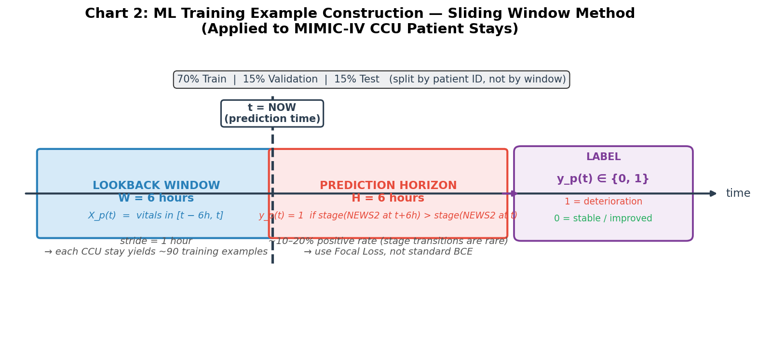
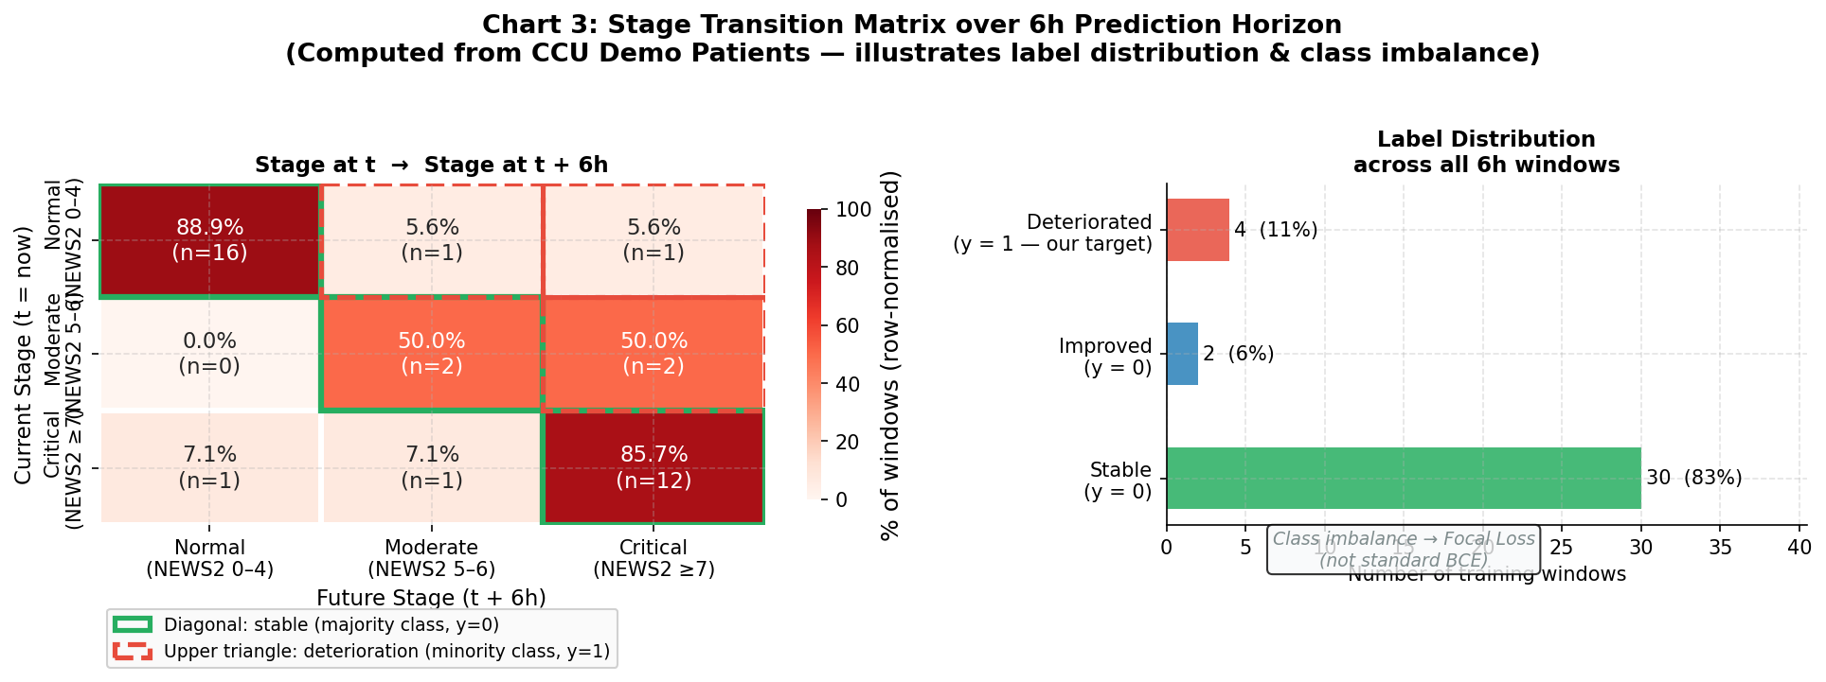
Dataset Construction - Sliding Window over MIMIC-IV
MIMIC-IV CCU stays
Training windows
Event rate
W = 6h | H = 6h
Split
~8,000 - 15,000
~600K - 1.2M
~10 - 20%
Stride = 1h
70 / 15 / 15
CRITICAL: Split by subject_id (patient), NOT by window - prevents data leakage and inflated metrics

Slide 7
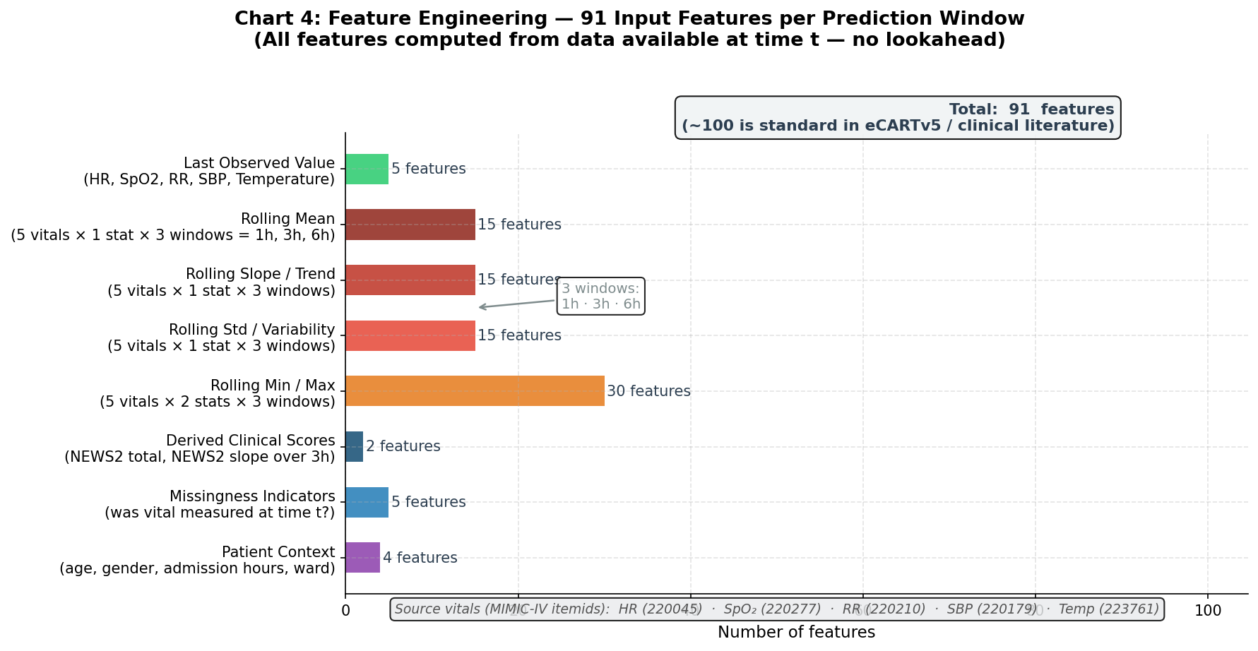
Feature Engineering - 91 Features from a 6-Hour Vital Sign Window

Slide 8
Model Architecture - XGBoost Primary, LSTM Secondary
Training Pipeline
Why XGBoost (Primary)
1
MIMIC-IV chartevents
Raw vitals: HR, SpO2, RR, SBP, Temp
eCARTv5 (AUROC 0.895, SOTA) uses gradient boosted trees
MIMIC-IV 2024 benchmark: XGBoost matches LSTM on tabular data
Built-in missing value handling (critical for EHR data)
SHAP feature importance - interpretable to clinicians
2
Resample to 1-hour bins
Forward-fill; max gap 4h
3
Extract features
Rolling stats x 3 windows = 91 features
4
Assign labels
y_p(t) = stage transition in next 6h
Why LSTM (Secondary)
Captures temporal dependencies beyond rolling stats
Input: X_p(t) in R^{6 x 20} (timesteps x features)
2-layer LSTM (128 units) -> Dense(64, ReLU) -> sigmoid
Slower - establish XGBoost baseline first
5
Patient-level split
70 / 15 / 15 by subject_id
6
XGBoost training
scale_pos_weight = N_neg / N_pos
7
Evaluate
AUROC, AUPRC, Sensitivity@90Spec
Class imbalance ~10-20% -> focal loss (alpha=0.75, gamma=2.0) | NOT SMOTE

Slide 9
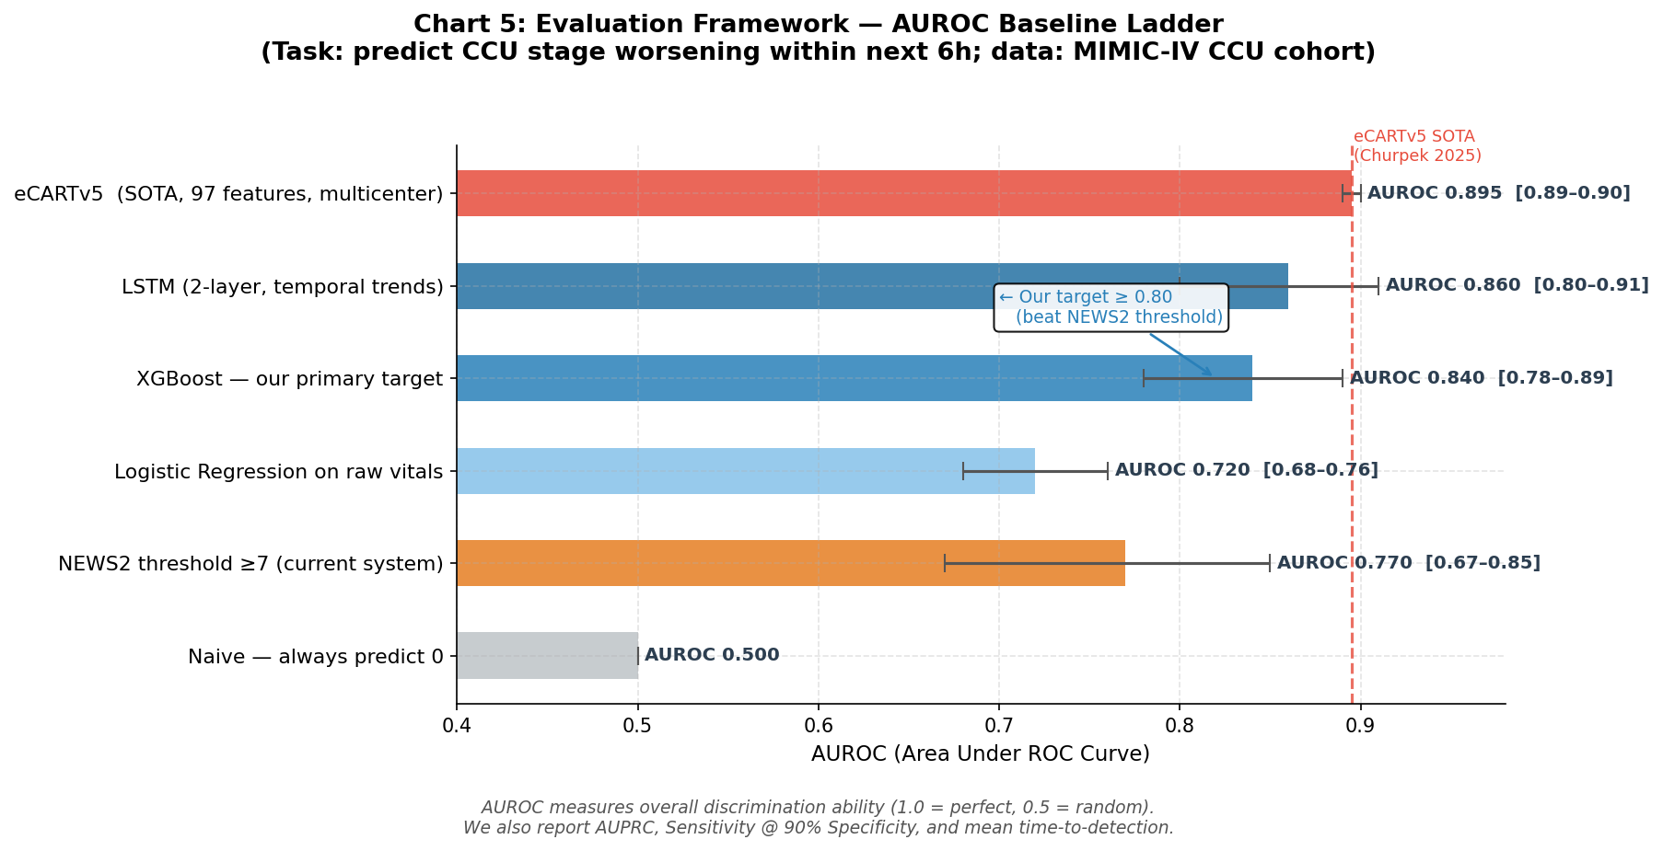
Evaluation Framework - How We Measure Success
Metrics We Report
AUROC
Overall discrimination (primary, literature-comparable)
AUPRC
Precision-recall area (better for rare events <10%)
Sensitivity@90%Spec
Catch X% of deteriorations at 10% false alarm rate
Time-to-Detection
Hours before event that model first fires alarm
Calibration (ECE)
P=0.7 should mean 70% actually deteriorate
Alert burden
Alerts / patient / day (alarm fatigue metric)
Target: Beat NEWS2 baseline (AUROC 0.67-0.85) | Aim for AUROC >= 0.80

Slide 10
Next Steps - 5-Phase Roadmap to Production ML
Phase 1
Formulation complete. Slack post today. Professor review Thursday.
Now (Jul 2-3)
Phase 2
MIMIC-IV cohort extraction. Sliding window dataset. Label assignment.
Week 2 (Jul 7)
Phase 3
XGBoost baseline. SHAP feature importance. First AUROC on held-out set.
Week 3 (Jul 14)
Phase 4
LSTM secondary model. Ablation study. Live dashboard ml_risk integration.
Week 4 (Jul 21)
Phase 5
Gautam final review. Demo on live EWS. Comparison to eCARTv5 benchmark.
Week 5 (Jul 28)
Integration: ml_risk field exists in main.py:742 - ML model will replace the placeholder probability

