Slide 1
IN-UNIT CLINICAL DETERIORATION EARLY WARNING SYSTEM
Reducing False Alarms in a Coronary Care Unit
Measurement discipline, alerting behaviour, and target design
MIMIC-IV Coronary Care Unit • 7,860 admissions • 298,679 hourly predictions • patient-level data split
Discrete-time hazard survival model • seven prediction horizons • isotonic-calibrated probabilities

Slide 2
CLINICAL DETERIORATION EARLY WARNING SYSTEM
Executive Summary
WHAT THE MODEL PREDICTS
For every patient, every hour: the calibrated probability of crossing NEWS2 ≥ 7 sustained for at least two consecutive hours, within the next 2 / 4 / 6 / 9 / 12 / 18 / 24 hours.
How the alert threshold is set: on a held-out calibration split, take the score below which only 20% of true events fall — capturing 80% of them — then freeze that value and apply it unchanged to the test split. The resulting out-of-sample sensitivity is 81.1%.
DETECTION
96.7%
Patient recall
967 of every 1,000 deteriorating patients are flagged at least once before their event.
AUROC 0.812
AUPRC 0.398
no-skill floor 0.120 → 3.31×
C-index 0.786
95% CI [0.767 – 0.806]
Brier score 0.088
PRECISION
0.331
Episode PPV at 12 hours
Of every 100 alarms raised, 33 are followed by a real deterioration inside the horizon. Computed per ALARM, not per hour.
After alarm consolidation and
the hysteresis latch:
0.410 at 12 hours
0.500 at 24 hours
Lift 2.75× → 3.41×
ALARM LOAD
2,069 → 1,551
Alert episodes
A 25% reduction in the number of distinct alarms across the test population.
Achieved with no loss of detection:
recall 0.967 → 0.975
Median warning time
7.0 h → 8.0 h
CALIBRATION
1.007
Calibration slope
A slope of 1.0 means a predicted risk of 30% corresponds to an observed event rate of 30% — the probabilities can be read at face value rather than only as a ranking.
Expected calibration error
0.013
Mean absolute gap between predicted and observed frequency across probability deciles.
Notes:
The threshold method appears on this slide deliberately, so the operating point is never mistaken for a result. 80% sensitivity is a CHOSEN point; the evidence is what precision, lift and recall do at that point.

Slide 3
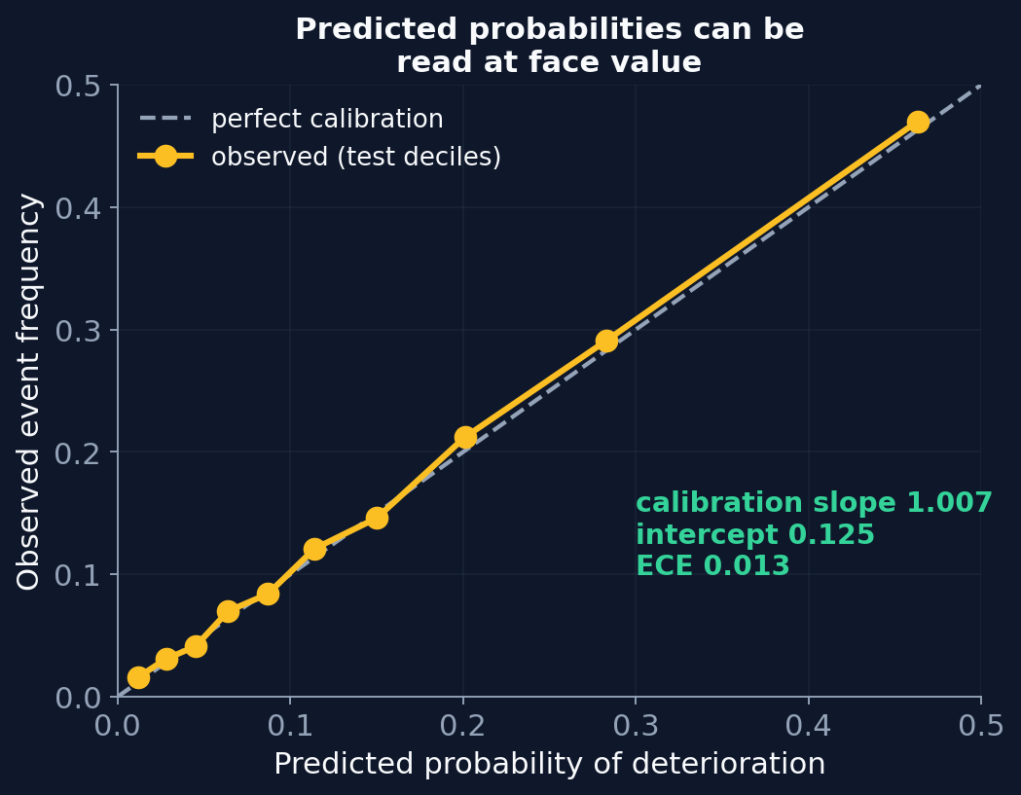
CLINICAL DETERIORATION EARLY WARNING SYSTEM
Model Formulation, Outputs, and Probability Calibration
DISCRETE-TIME HAZARD SURVIVAL MODEL
Time is divided into ordered intervals ending at 2, 4, 6, 9, 12, 18 and 24 hours. One gradient-boosted classifier per interval estimates the conditional hazard — the probability of the event occurring inside that interval, given the patient is still at risk when it begins:
h_j = P( event in interval j | still at risk at its start )
The survival curve is the running product of the complements:
S(c_j) = S(c_j−1) × (1 − h_j) P(T ≤ c_j) = 1 − S(c_j)
Because every hazard lies between 0 and 1, the survival curve can only decrease. Monotonicity holds by construction and no correction is applied afterwards.
Censoring is handled per interval: a patient discharged partway through an interval contributes no row for that interval or any later one, since their outcome there is unknowable. Stable patients contribute a negative row to every interval they survive, so they are used as training signal rather than discarded.
THREE OUTPUTS PER PATIENT-HOUR
1. Seven calibrated probabilities, one per horizon. This is the primary output and the quantity the alert threshold is applied to.
2. A conditional expected time to the event, used to order the worklist by urgency.
3. The shape of the hazard curve across intervals, used as an additional severity signal — described on a later slide.
PROBABILITY CALIBRATION
Each interval's raw score is mapped to a probability by an isotonic regression fitted on the calibration split.
Isotonic regression fits a monotone step function minimising squared error against the observed outcome. Being non-parametric it corrects any shape of miscalibration; being monotone it cannot reverse the ordering of patients, so discrimination — and therefore AUROC — is preserved exactly while the numbers become interpretable as probabilities.

Slide 4
CLINICAL DETERIORATION EARLY WARNING SYSTEM
How an Alarm Is Defined, and How Precision Is Computed
THE ALARM EPISODE
A patient whose risk remains above threshold for five consecutive hours produces one alarm that a clinician responds to, not five. The unit of evaluation is therefore the alarm EPISODE: a maximal run of consecutive alerting hours for a single patient.
Successive alerting hours belong to the same episode when they are no more than two hours apart. The comparison is made on timestamps, so a gap in charting cannot split one clinical episode into two.
HOW EPISODE PRECISION IS COMPUTED
An episode counts as TRUE when the patient's deterioration occurs within the prediction horizon of any hour inside that episode.
Episode PPV = true episodes ÷ all episodes
At the 12-hour horizon: 685 ÷ 2,069 = 0.331
HOW DETECTION IS COMPUTED
Patient recall = deteriorating patients with at least one alerting hour inside the horizon before their event ÷ all deteriorating patients
At the 12-hour horizon: 621 ÷ 642 = 0.967
HOW LIFT IS COMPUTED
Lift = episode PPV ÷ base rate. A value of 1.0 means an alarm carries no more information than selecting a patient at random. At 12 hours: 0.331 ÷ 0.120 = 2.75×.
THREE UNITS OF EVALUATION, AND WHAT EACH ANSWERS
Prediction row — 39,046 in the test set
One patient at one hour. This is the unit the model scores, and the unit over which AUROC, AUPRC and calibration are computed. It answers: how well does the model rank risk?
Alarm episode — 2,069 in the test set
One continuous run of alerting. This is the unit a clinician actually experiences, and the unit precision is reported in. It answers: when the system raises an alarm, how often is it right?
Patient — 1,236 admissions in the test set
One coronary care admission. This is the unit detection is reported in. It answers: was this deteriorating patient warned about at all?
WHY THE DISTINCTION IS ENFORCED
The three units have different denominators, so a ratio formed from two of them has no interpretation. Throughout this work every precision figure is episode-level, every detection figure is patient-level, and the two are never combined into a single ratio.
Reporting precision per prediction row would make a stable patient with 60 charted hours weigh 60 times as heavily as a patient who deteriorates after three — which is why the episode is used instead.

Slide 5
CLINICAL DETERIORATION EARLY WARNING SYSTEM
Composition of the False Alarms, and the Refined Event Definition
WHAT THE 1,384 FALSE EPISODES AT 12 HOURS ACTUALLY ARE
REFINED EVENT DEFINITION
Original: NEWS2 ≥ 7 for two CONSECUTIVE hours.
Refined — the earliest time at which any of four rules is satisfied:
(a) NEWS2 ≥ 7 for two consecutive hours, as before
(b) at least two hours at NEWS2 ≥ 7 within any four-hour window
(c) one hour at NEWS2 ≥ 7 followed by death within six hours
(d) one hour at NEWS2 ≥ 7 with the record ending under two hours later, so the two-hour rule could not physically be satisfied
Rule (a) is retained as a candidate, so the refined definition is a strict superset of the original: it can only move an event earlier, and can never remove one.
EFFECT ON THE FALSE-ALARM BURDEN
Rule (b) reclassifies 515 of the 2,019 transient patients as genuine events. Of those remaining, 1,008 recorded exactly one high hour in the entire admission — a pattern indistinguishable from a single artefactual reading, which is precisely what a two-reading requirement exists to filter. Recovering them would exchange one form of label noise for another.
Measured at 12 hours:
Episode PPV 0.331 → 0.345
False episodes 1,384 → 1,209
Episodes on transient patients 700 → 584
The patient's NEWS2 record | Episodes | Share
Never reached NEWS2 ≥ 7 at any point in the stay | 360 | 26.0%
Reached NEWS2 ≥ 7, never for two consecutive hours | 700 | 50.6%
Sustained NEWS2 ≥ 7, outside this horizon | 324 | 23.4%
Only 26% of alarms fire on a patient who shows no critical deterioration at any point during the admission.
Half fire on patients who did cross the critical threshold, but whose crossing was not sustained for two consecutive hours — so the original event definition recorded them as never having deteriorated.
This locates a substantial share of the apparent false-alarm burden in the event definition rather than in the model, and motivates the refinement opposite.
An alternating pattern such as 8, 6, 9, 6, 8 spends three hours in the critical band yet satisfies no two-consecutive-hour rule, because each hour below threshold resets the count.

Slide 6
CLINICAL DETERIORATION EARLY WARNING SYSTEM
Validating the Refined Definition: Better Signal, or Harder Task?
THE AMBIGUITY THAT HAS TO BE RESOLVED
A broader event definition admits harder cases, so the prediction task itself becomes harder. Precision rises because prevalence rises, while lift falls because the added events are intrinsically less predictable. Neither movement on its own distinguishes a better training signal from a harder target.
THE RESOLUTION — cross the TRAINING definition against the EVALUATION definition, on the same 261,436 prediction rows
 | Evaluated against the original definition | Evaluated against the refined definition
Trained on the original definition | AUROC 0.7956 AUPRC 0.3086 | AUROC 0.7948 AUPRC 0.3783
Trained on the refined definition | AUROC 0.7982 AUPRC 0.3208 | AUROC 0.7968 AUPRC 0.3845
The model trained on the refined definition performs better even when judged against the ORIGINAL definition, which it was never trained for: AUROC +0.0026 and AUPRC +4.0% relative.
The refined definition is therefore a better training signal, and the fall in headline lift is attributable entirely to the harder target rather than to a degraded label.
Sizing this honestly: the AUROC gain of +0.0026 lies inside the confidence interval and should not be presented as decisive on its own. The AUPRC gain is the more credible of the two, because AUPRC is not inflated by the large true-negative pool that a rare outcome produces. The comparison is valid only because split assignment is a deterministic function of patient identifier, so the same patient is a test patient under both definitions and the two models are scored on identical people.

Slide 7
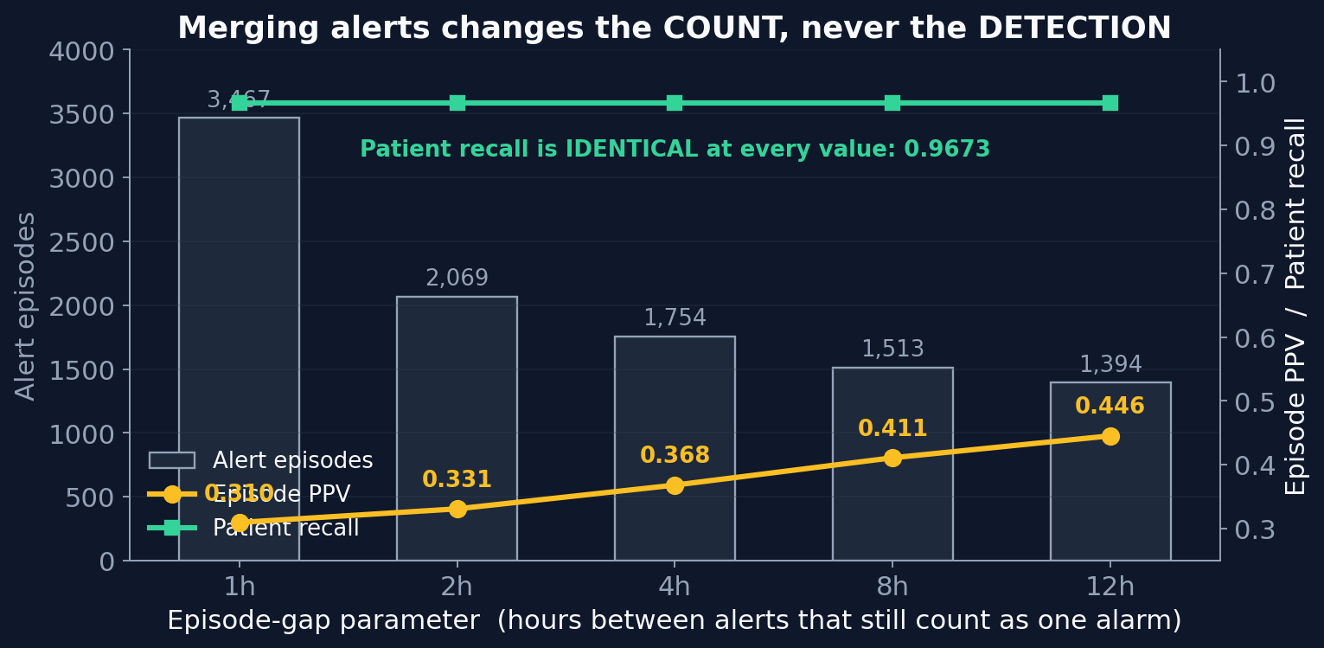
CLINICAL DETERIORATION EARLY WARNING SYSTEM
Alarm Consolidation: the Episode-Gap Parameter
WHAT THE PARAMETER IS
The maximum interval between two alerting hours for them to be counted as one alarm rather than two.
PUBLISHED PRECEDENT
Alarm consolidation is standard practice in deployed early-warning systems. Reported windows:
4 hours MEWS++, Mount Sinai
6 hours DETERIO, UC San Diego —
declared explicitly as an
end-user clinical response
policy rather than a model
property
8 hours MC-EWS, Mayo Clinic
4–48 hrs range reported across the
fourteen systems in the
JAMIA 2024 review
WHY TWO HOURS WAS SELECTED
Patient recall is identical at every setting, so this parameter affects only how alarms are counted and never how many patients are detected.
A twelve-hour window would report precision of 0.446 rather than 0.331 with no change to the model. Two hours is the shortest window that consolidates a single-hour dip below threshold, and nothing beyond that.

Slide 8
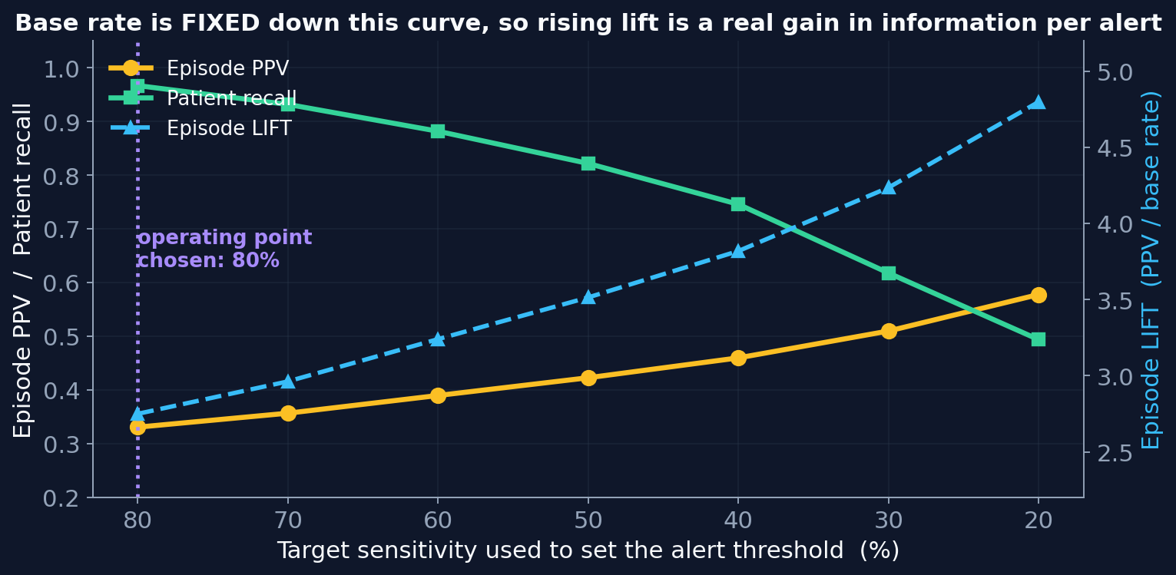
CLINICAL DETERIORATION EARLY WARNING SYSTEM
The Operating Point: Where the Alert Threshold Is Set
HOW THE THRESHOLD IS SET
On the calibration split, take the score below which only a chosen fraction of true events fall. Freeze that value. Apply it unchanged to the test split.
At a target of 80%, the out-of-sample sensitivity is 81.1%. The small discrepancy confirms the score distribution transfers between splits; a large one would indicate distribution shift.
WHY LIFT IS THE HONEST METRIC
Lift = episode PPV ÷ base rate
A value of 1.0 means an alarm carries no more information than selecting a patient at random; the ceiling is one divided by the base rate. Because the base rate is constant along this curve, rising lift represents a real increase in the information each alarm carries.
THE TRADE, QUANTIFIED
Lowering the sensitivity target raises precision monotonically from 0.331 at 80% to 0.578 at 20%, and raises lift from 2.75× to 4.80×. The cost is detection: patient recall falls from 0.967 to 0.494.
Deployed systems in the reviewed literature operate between 25% and 63% sensitivity, chosen to match the alarm volume a ward can absorb.

Slide 9
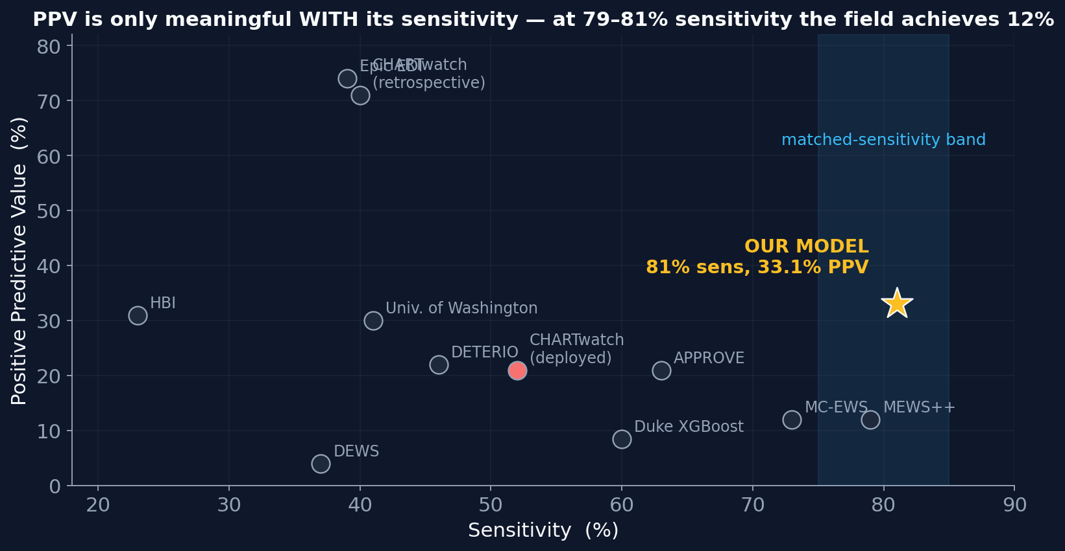
JAMIA 2024 SYSTEMATIC REVIEW — FOURTEEN SYSTEMS — PLUS DETERIO, UC SAN DIEGO
Comparison Against Published Deterioration Systems
System | Model family | Vars | Sens | PPV | AUROC
OUR MODEL, 12h | Discrete-time hazard | 55 | 81% | 33.1% | 0.812
MEWS++, Mount Sinai | Random forest | 36 | 79% | 12% | 0.88
MC-EWS, Mayo | Gradient boosting | 59 | 73% | 12% | 0.91–0.94
eCART, Chicago | Logistic regression | 27–33 | 60–77% | — | 0.88
APPROVE, Mayo | Random forest | 36 | 63% | 21% | 0.87
Duke | XGBoost | 57 | 60% | 8–9% | 0.87
DETERIO, UC San Diego | Neural network | 229 | 46% | 22% | 0.775
Univ. of Washington | Logistic regression | 36 | 41% | 30% | 0.73
CHARTwatch, Toronto | Ensemble | 526 | 40% | 71% → 21% | 0.95 → 0.63
Epic Deterioration Index | Logistic regression | >125 | 39% | 74% | 0.79
DEWS, Korea | LSTM | 4–7 | 37% | 4% | 0.85
HBI Solutions | Random forest | 349 | 23% | 31% | 0.88
eCARTv2 | Logistic regression | — | — | 8.2% | —
Precision and sensitivity trade against one another, so neither figure is interpretable alone. At a matched sensitivity of 79–81%, the published systems achieve 12% precision.
The two systems reporting precision above 70% operate near 40% sensitivity — roughly half of ours — and one of them lost two-thirds of that precision on deployment.
Interpretive caveat: our event definition is derived from the same vital signs used as model inputs, whereas most reviewed systems predict an independent outcome such as intensive-care transfer or death. The comparison is favourable but not exact, and Part 2 addresses this directly.
CHARTwatch is shown with retrospective figures followed by deployed figures. Precision fell from 71% to 21% and AUROC from 0.95 to 0.63 on live data — the largest degradation among the reviewed systems, and the one using the most variables. Every system reporting both stages degraded.

Slide 10
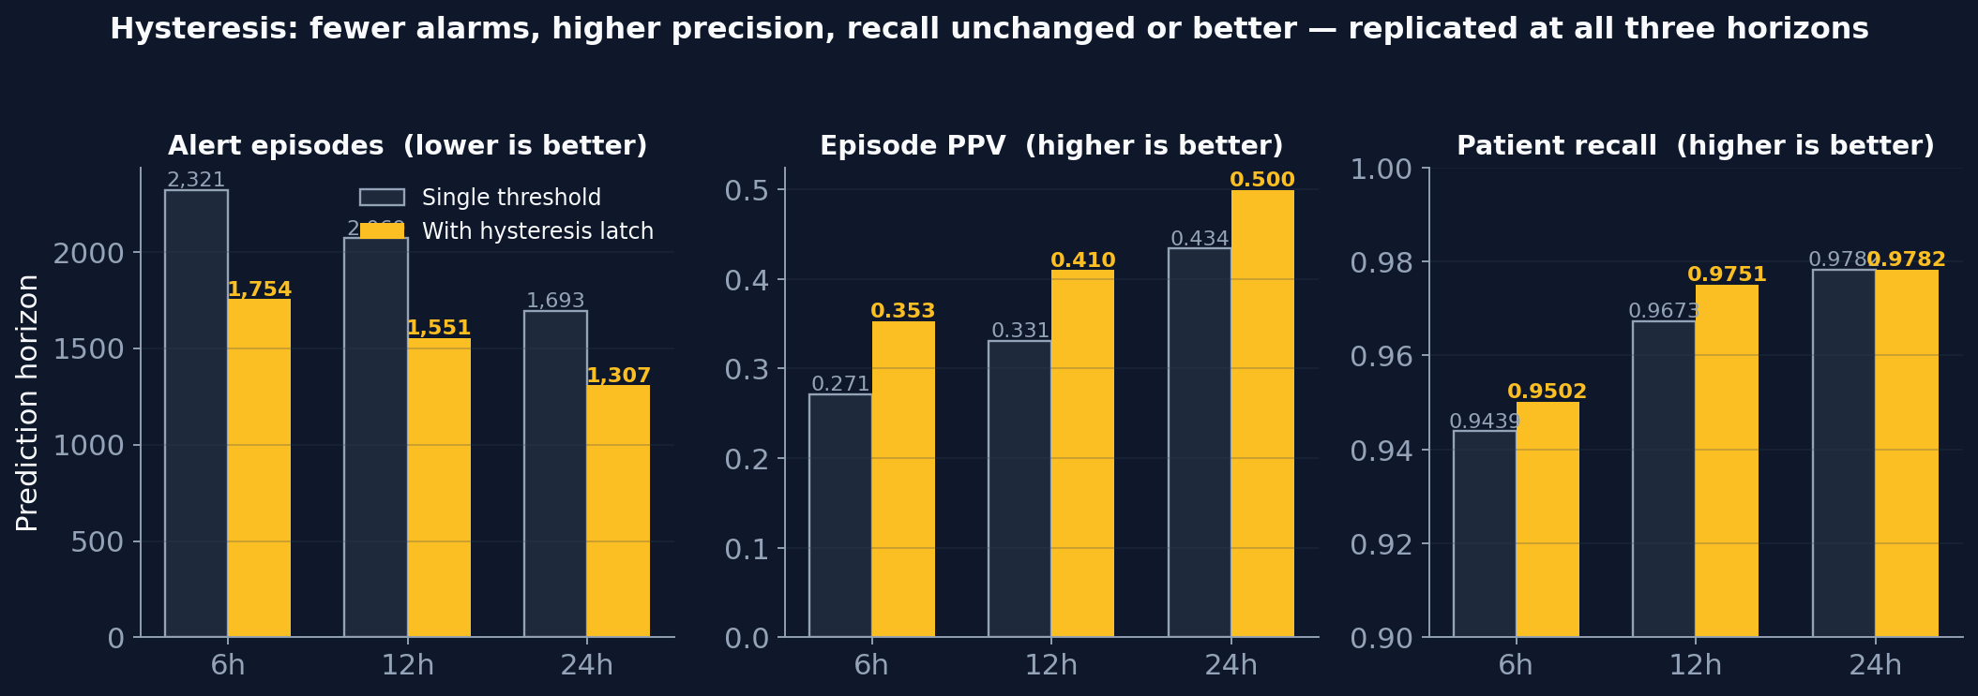
CLINICAL DETERIORATION EARLY WARNING SYSTEM
Hysteresis: a Dual-Threshold Alerting Rule
THE PROBLEM WITH A SINGLE THRESHOLD
A single threshold raises the alert when risk rises above it and clears the alert when risk falls below it. A patient whose risk hovers near that line therefore alternates on and off, producing several separate alarms from measurement noise rather than from any change in the patient's condition.
THE RULE
Raise the alert when risk exceeds τ_high. Keep it raised until risk falls below a LOWER release threshold τ_low, set here to 50% of τ_high. Between the two thresholds the alert holds whatever state it is already in. This is a Schmitt trigger — the same mechanism that prevents a thermostat from cycling continuously around its set point.
MEASURED EFFECT AT 12 HOURS
Alert episodes 2,069 → 1,551
Episode PPV 0.331 → 0.410
Episode lift 2.75× → 3.41×
Patient recall 0.967 → 0.975
Median warning 7.0 h → 8.0 h
WHY PRECISION IMPROVES
False alarms are predominantly brief excursions across the threshold, while true alarms are sustained. Holding the alert through the deadband therefore consolidates the brief excursions preferentially. Across the test set, false episodes fell by 34% while true episodes fell by only 7%.
WHY DETECTION IS PRESERVED
The condition for RAISING an alert is unchanged; only the condition for clearing it is altered. The first alert on any patient can therefore never be delayed or lost, so recall is preserved by construction. It rises slightly because a patient whose risk dips briefly remains under alert when their event arrives.

Slide 11
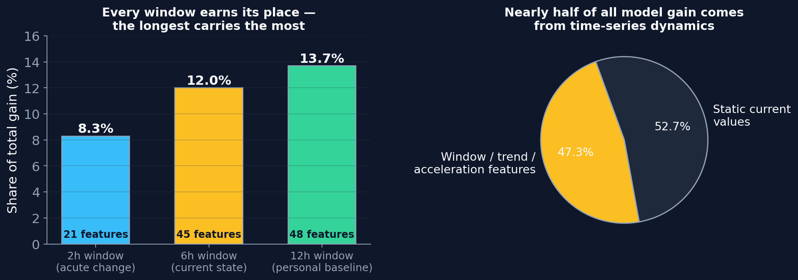
CLINICAL DETERIORATION EARLY WARNING SYSTEM
Multi-Window Time-Series Dynamics: Construction and Contribution
HOW THE FEATURES ARE CONSTRUCTED
Each physiological variable is summarised over three overlapping look-back windows, all ending at the prediction hour:
2 hours acute change, high temporal resolution
6 hours the patient's current state
12 hours the patient's own recent baseline
Within each window, three statistics are computed: the mean (level), the standard deviation (volatility), and the slope (velocity).
TREND-ACCELERATION FEATURES
trend_2h_vs_12h = mean over 2 h − mean over 12 h
A heart rate of 100 with a twelve-hour mean of 100 describes a stably elevated patient. A heart rate of 100 with a twelve-hour mean of 70 describes a patient accelerating into crisis. The two require different responses, yet they are indistinguishable from any single window.
Supplying the difference explicitly matters because decision trees split on one variable at a time. Separating those two patients from the two means independently requires a staircase of many splits, and at a maximum tree depth of four a single such boundary would consume the entire tree. The explicit difference reduces it to one split.
TWO FURTHER FEATURE CLASSES
Deviation from the patient's own twelve-hour baseline, so that an abnormal value is judged against that individual rather than a population norm; and the time elapsed since each variable was last measured, which captures that clinical teams measure more frequently when concerned.
CONTRIBUTION TO FALSE-ALARM REDUCTION
Window, trend and acceleration features account for 47.3% of total model gain. Each window contributes independently, and the twelve-hour baseline contributes most of the three — evidence that the model is separating acute deterioration from stable elevation. That distinction is precisely what a single-window model resolves as a false alarm, which is the mechanism by which the multi-window construction reduces them.

Slide 12
CLINICAL DETERIORATION EARLY WARNING SYSTEM
False-Alarm Reduction: Complete Method Inventory
Reducing false alarms means three structurally different things. Separating them is what makes each claim interpretable: one category changes how alarms are counted, one changes how the alerting system behaves, and one changes the precision–detection trade itself. Each row below states its mechanism and its cost.
Category | Method | Mechanism | Cost to detection | Measured result
ORDERING | Worklist ranked by predicted severity | Every alarm is displayed; the most urgent are presented first | None — nothing is withheld | Precision on the leading 10% of alarms rises from 0.19 to 0.57
BEHAVIOUR | Hysteresis dual-threshold latch | The alert holds through a deadband instead of clearing at a single line | None — the raise condition is unchanged | Episodes 2,069 → 1,551; PPV 0.331 → 0.410; recall 0.967 → 0.975
TRADE | Operating point: sensitivity and horizon | Moves the threshold along the precision–detection curve | Real, and quantified on the curve | PPV 0.331 → 0.578 as sensitivity falls from 80% to 20%
TRADE | Conformal abstention, three-tier output | Low-confidence hours are routed to a review list rather than paged | Real; the abstention rate is chosen explicitly | Paged-tier lift 2.88× → 3.45× at α = 0.20
COUNTING | Episode consolidation, gap parameter | Defines how many alerting hours constitute one alarm | None — recall is invariant at every setting | A reporting convention; the full curve is always shown
DEFINITION | Refined event definition | Recognises non-consecutive critical excursions as events | Improves — recall rises | False episodes 1,384 → 1,209; validated as a better training signal
The ORDERING and BEHAVIOUR categories improve the clinician's experience at no cost to detection, so they are adopted unconditionally. The TRADE category is where genuine precision is purchased and the price is stated alongside. The COUNTING category is reported as a curve rather than a single value, so the convention chosen is visible rather than embedded.

Slide 13
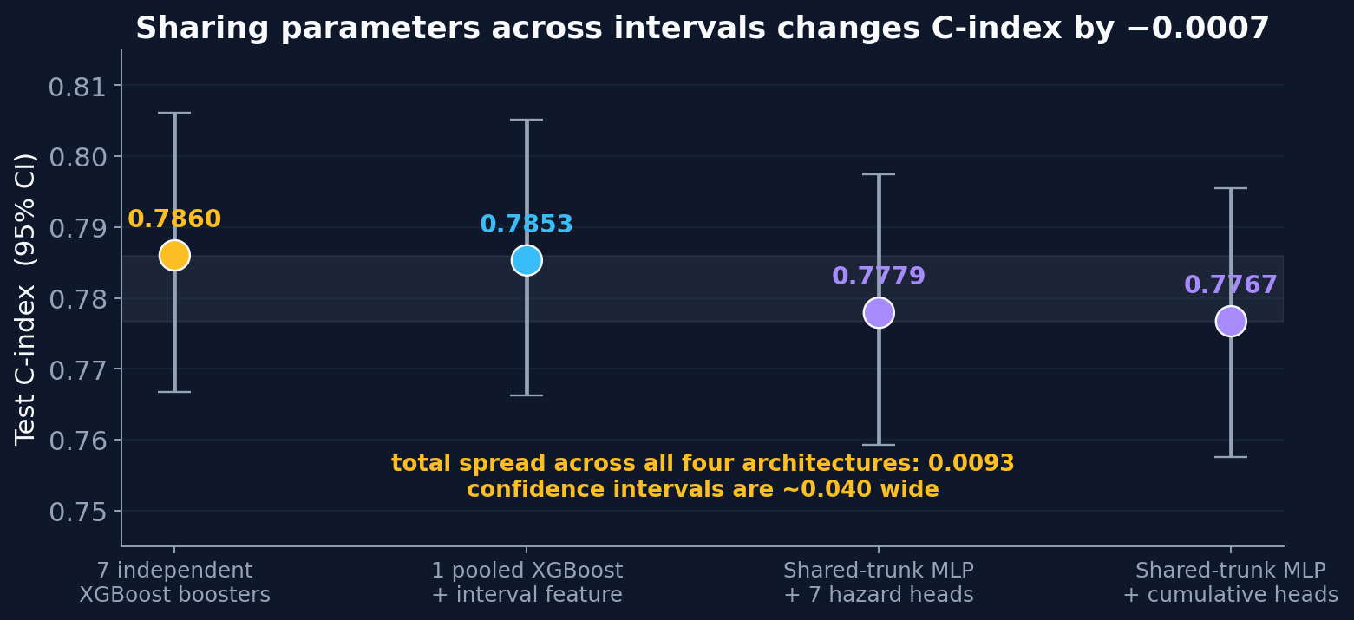
CLINICAL DETERIORATION EARLY WARNING SYSTEM
Architecture Comparison: Gradient-Boosted Trees and Neural Networks
THE QUESTION
The baseline trains seven independent classifiers, one per interval, sharing no parameters. An alternative is a single network with a shared representation and one output head per interval, trained on a combined loss so that gradient from every interval updates the same trunk — allowing the intervals to inform one another.
Moving directly between those designs changes both the parameter sharing and the base learner simultaneously. Four configurations were therefore trained so that each change can be attributed separately.
THE FOUR CONFIGURATIONS
1. Seven independent gradient-boosted classifiers — 0.7860
2. One pooled classifier taking the interval index as an input feature, so all parameters are shared while the base learner is held fixed — 0.7853
3. Shared-trunk network, 55 → 128 → 64, with seven hazard heads trained on a masked cross-entropy loss — 0.7779
4. Shared-trunk network with monotone cumulative heads — 0.7767
FINDINGS
Parameter sharing in isolation changes the C-index by −0.0007. The total spread across all four architectures is 0.0093, against confidence intervals approximately 0.040 wide — the four are statistically indistinguishable.
Sharing behaves as theory predicts in detail: it improves the data-poor late intervals, from 0.7387 to 0.7455 at twelve hours, and degrades the data-rich early one, from 0.8707 to 0.8645 at two hours. The two effects cancel. Parameter sharing benefits a task starved of data, and the smallest interval here still holds 105,416 training rows.
A search across eight network configurations spanned only 0.7% of validation loss, indicating the neural result reflects the architecture rather than insufficient tuning.
CALIBRATION APPLIED IDENTICALLY ACROSS ALL FOUR
Each interval's raw score is mapped to a probability by an isotonic regression fitted on the calibration split. Isotonic regression fits a monotone step function minimising squared error against the observed outcome. Being non-parametric it corrects any shape of miscalibration; being monotone it cannot alter the ordering of patients, and therefore leaves AUROC exactly unchanged.
Applying the identical calibration procedure to every configuration ensures the architecture comparison measures the hazard estimate itself, rather than differences in how the scores were post-processed. Resulting calibration slope 1.007, expected calibration error 0.013.

Slide 14
PART 2 — THE ESCALATION-OF-CARE MODEL
Part 2: Redefining the Prediction Target
PREVALENCE OF THE CURRENT TARGET
NEWS2 ≥ 7 sustained for two hours occurs in 50.3% of coronary care admissions.
Published prevalence of the outcomes used by deployed deterioration systems:
Intensive care settings 11.3% – 32.8%
Non-intensive settings 2.1% – 22.7%
The current target lies above the entire published intensive-care range.
WHY THIS CONSTRAINS PRECISION
Precision is bounded by prevalence. When an outcome occurs in half of all admissions, an alarm indicating that outcome cannot carry much information, because the alarm state and the ordinary state of the unit are nearly the same condition.
This is a property of the target, not of the model, and no change to the model can remove it.
WHY THE PREVALENCE IS SO HIGH
Under national protocol, NEWS2 ≥ 7 mandates an emergency response, continuous monitoring, and escalation to intensive-care-level care.
Patients in a coronary care unit already receive all three.
The response the score exists to trigger is therefore already in place. For this population the threshold describes a routine state rather than an exceptional one — which is both why half the unit reaches it, and why an alarm based on it does not identify a decision that still needs to be taken.
WHAT DEPLOYED SYSTEMS PREDICT INSTEAD
All fourteen systems in the JAMIA 2024 review predict transfer to intensive care, escalation of treatment, cardiac arrest, or death. None predicts a vital-sign score threshold.
An outcome that is actionable within the unit is required — one where the alarm identifies a clinical decision not yet made.

Slide 15
PART 2 — THE ESCALATION-OF-CARE MODEL
The Escalation-of-Care Target: Full Definition
EVENT DEFINITION
The first occurrence, more than two hours after unit admission, of any escalation of organ support, of death, or of sustained circulatory collapse. All three are timestamped clinical facts rather than derived scores.
COHORT RESTRICTION
Admissions whose event occurs within the first two hours are excluded from the modelling population. Median time from admission to first escalation in this unit is 1.07 hours, so for those patients the event is concurrent with or precedes the first available observation and there is nothing to forecast. They are covered instead by an admission rule that alerts immediately, so no patient is left unmonitored.
CONSTITUENT EVENTS, BY THE TRACK THAT FIRED FIRST
Event track | Events | New
Vasopressor or inotrope initiation | 696
Death without prior escalation | 424
Mechanical ventilation initiation | 350
Renal replacement therapy initiation | 164
Intubation, pericardiocentesis, pacing | 127 | yes
Sustained circulatory collapse | 116 | yes
Cardiac arrest or defibrillation | 97 | yes
IABP, Impella, or ECMO | 60 | yes
Cohort construction | Admissions
All coronary care admissions | 10,775
Excluded: event within the first two hours | − 2,965
Excluded: stay shorter than two hours | − 53
Modelling population | 7,757
Sustained circulatory collapse is defined as a mean arterial pressure below 55 mmHg together with a shock index — heart rate divided by systolic pressure — of at least 1.1, persisting two hours or longer. It captures patients in unambiguous physiological collapse who are nonetheless not escalated, for instance under a treatment-limitation order, and who would otherwise be recorded as having no event at all.
The four tracks marked new contribute 400 of the 2,034 events. Mechanical circulatory support is the definitive rescue for cardiogenic shock in this population and had not previously been represented.
2,034 events ÷ 7,757 admissions = 26.2% prevalence
Inside the published intensive-care range of 11.3% – 32.8%, and derived from clinical actions rather than from the vital signs used as model inputs — so the target is independent of the feature set.

Slide 16
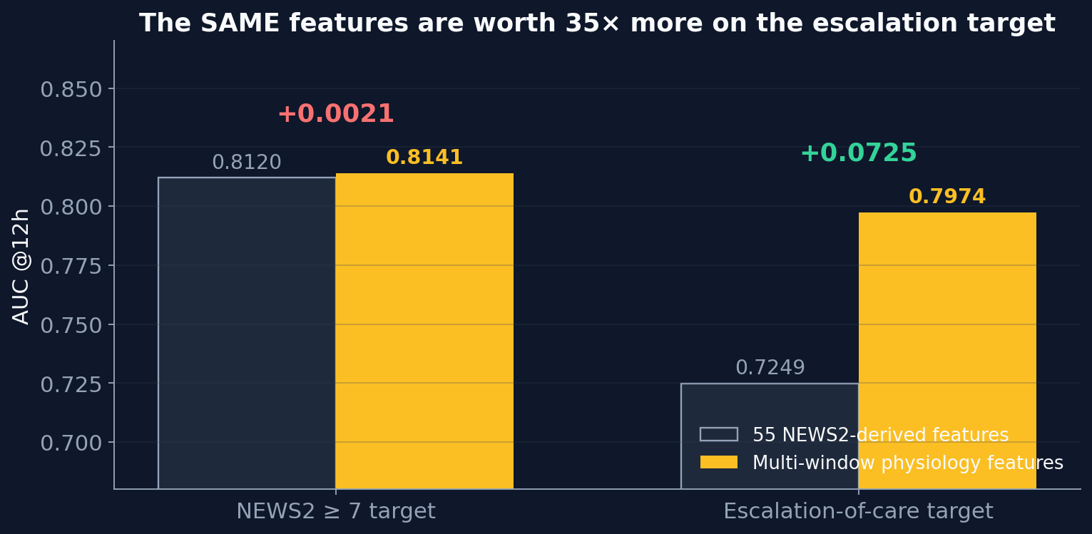
PART 2 — THE ESCALATION-OF-CARE MODEL
Escalation Model: Results, and the Effect of the Feature Set
DOES THE FEATURE SET MATTER, AND ON WHICH TARGET?
ESCALATION MODEL PERFORMANCE
Metric | Value
Prevalence, admission level | 26.2%
Base rate at 12 h, row level | 0.0465
AUROC at 12 h | 0.797
AUPRC at 12 h | 0.214
AUPRC ÷ no-skill floor | 4.59×
C-index | 0.771 [0.736 – 0.806]
Episode PPV at 12 h | 0.134
Episode lift at 12 h | 2.88×
Patient recall at 12 h | 0.944
Features retained after pruning | 80
READING THE PRECISION FIGURE
Episode PPV of 0.134 is lower than the NEWS2 model's 0.331, on a base rate that is 2.6 times lower. Precision is bounded by prevalence, so the two figures are not directly comparable.
Lift divides prevalence out and is comparable across targets: 2.88× for the escalation model against 2.75× for the NEWS2 model — equivalent discrimination on an outcome that is actionable within the unit.
The following three slides show how precision is raised from this baseline without changing the model.
The identical feature set improves the escalation target by 0.0725 AUROC and the NEWS2 target by 0.0021.
NEWS2 is computed deterministically from seven vital signs. Anion gap, mean arterial pressure, lactate and infusion titration therefore cannot improve a prediction of NEWS2: they do not enter its formula, and can act only through their eventual effect on those same seven vitals, which the vital features already represent.
Against escalation of care, where metabolic acidosis and hypoperfusion are direct causal mechanisms, the same features carry substantial information.

Slide 17
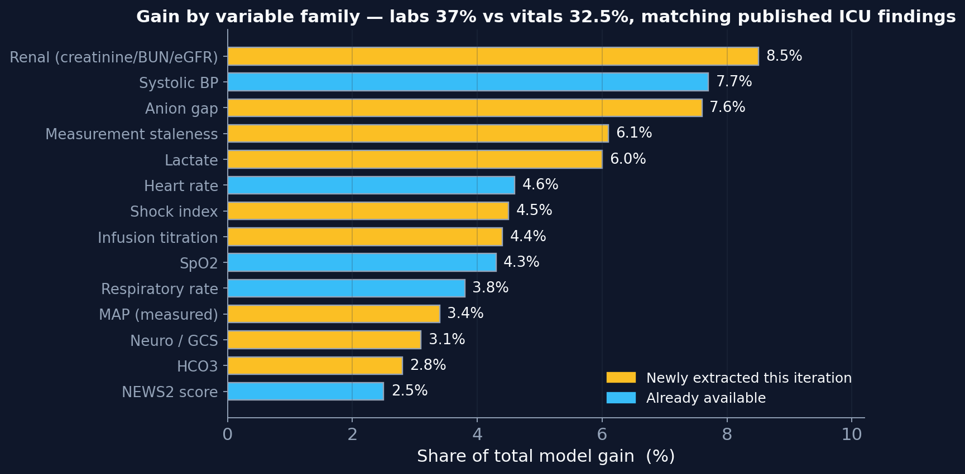
PART 2 — THE ESCALATION-OF-CARE MODEL
Which Physiology Drives the Prediction
METABOLIC ACIDOSIS LEADS
Anion gap occupies the first, second, third and fifth positions among individual features. It measures the accumulation of unmeasured acids from anaerobic metabolism, and it rises while heart rate and blood pressure remain within acceptable limits — identifying the patient who is deteriorating before the vital signs reflect it.
Renal markers form the largest single family, consistent with renal replacement therapy being a constituent event and with renal hypoperfusion preceding overt circulatory failure.
VITAL SIGNS REMAIN CENTRAL
Systolic pressure, heart rate, shock index, oxygen saturation, respiratory rate, mean arterial pressure, temperature and diastolic pressure together account for 32.5% of total gain — the largest block in the model.
Individual vital features appear lower in a ranked list because each variable is represented by roughly nineteen window-and-statistic combinations, which divides its importance among them, whereas anion gap is represented by twelve. Importance is therefore aggregated by variable family — the only comparison that is valid when variables have unequal feature counts.
AGREEMENT WITH PUBLISHED FINDINGS
Laboratory and organ-function markers account for 37% of gain against 32.5% for vital signs. Published intensive-care work reports the same ordering, and identifies anion gap, lactate, bicarbonate, urea and pH specifically among the strongest predictors of deterioration — an independent corroboration of this feature profile.

Slide 18
PART 2 — THE ESCALATION-OF-CARE MODEL
How Precision and False Positives Are Determined
THE IDENTITY
Precision = ( sensitivity × prevalence ) ÷ [ ( sensitivity × prevalence ) + ( false-positive rate × ( 1 − prevalence ) ) ]
Precision therefore depends on three quantities: the sensitivity chosen, the prevalence of the outcome, and the model's false-positive rate. Only the third is a property of the model.
Horizon | Prevalence | Specificity required for precision 0.30 at 80% sensitivity | Specificity achieved | What that would require
12 hours | 0.0465 | 0.909 | 0.610 | removing 77% of current false positives while retaining every true positive
24 hours | 0.0948 | 0.805 | 0.561 | removing 55% of current false positives while retaining every true positive
Precision at high sensitivity is constrained by prevalence rather than by model quality.
The three levers that do move it, all applied in this system:
1. A longer prediction horizon. The twenty-four-hour horizon has twice the prevalence of the twelve-hour horizon, which raises the ceiling itself rather than trading along the existing curve — and simultaneously increases the available warning time.
2. The alerting rule. The hysteresis latch consolidates brief threshold excursions, which are disproportionately false, without altering the condition for raising an alert.
3. The presentation order. Ranking the alarms already raised concentrates true events at the top of the worklist without withholding anything from the clinician.
Six independent modelling directions — additional laboratory features, an alternative survival formulation, parameter sharing, two neural architectures, and an alternative input representation — each changed AUROC by less than 0.01. That is the evidence that the constraint is not a modelling one.

Slide 19
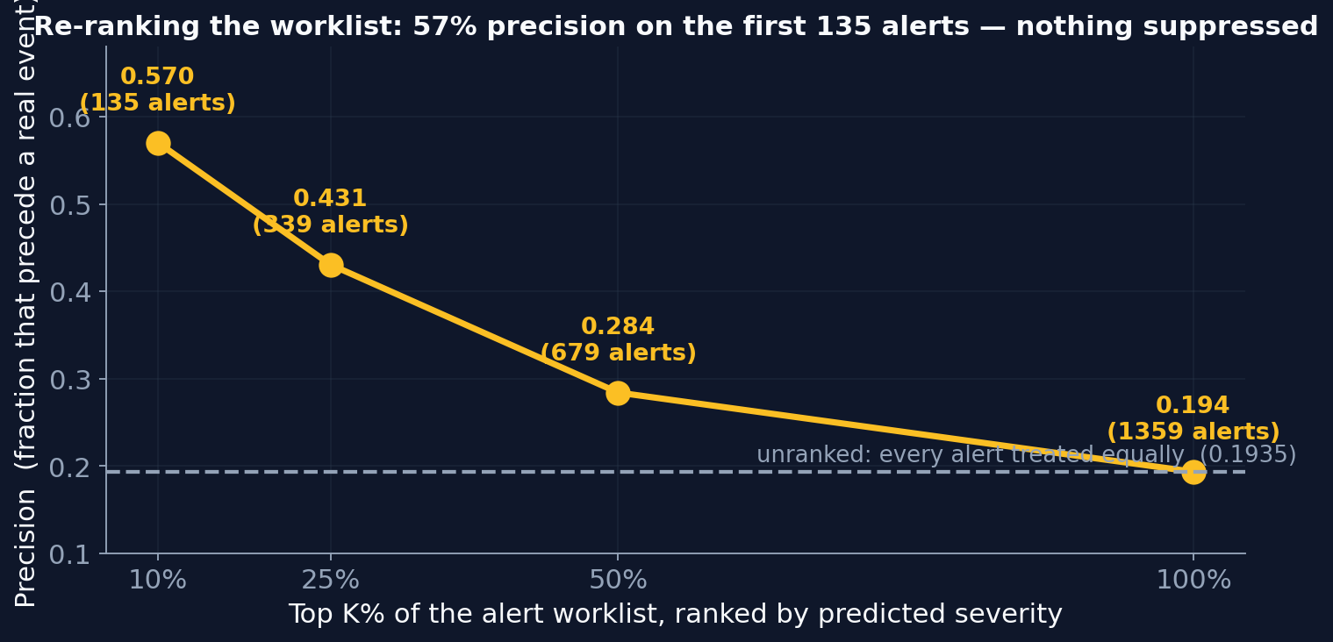
PART 2 — THE ESCALATION-OF-CARE MODEL
Raising Precision by Ordering the Worklist
THE METHOD
Every alarm continues to be displayed. They are ordered by a severity score derived from the model's own hazard curve, so that the alarms most likely to precede a real escalation are presented first.
THE SEVERITY SCORE
Two quantities are combined, both taken from the hazard curve the model already produces:
Cumulative hazard, Λ(t) = −log S(t). Unlike a probability this is unbounded and additive, so differences between patients remain meaningful across the whole range rather than being compressed near zero.
Hazard-curve shape. The seven interval hazards are estimated independently, so the profile across them carries information that the single cumulative probability discards. A concentrated profile indicates risk focused in a specific interval; a flat profile indicates a stable patient. Measured across profile deciles, precision ranges from 0.08 to 0.36.
RESULT
Of the leading 135 alarms, 57% precede a real escalation, against 19% across all 1,359. Precision on the leading quarter is 43%.
This is the only method available that raises precision at no cost to detection, because it changes the order in which alarms are presented rather than which alarms exist.

Slide 20
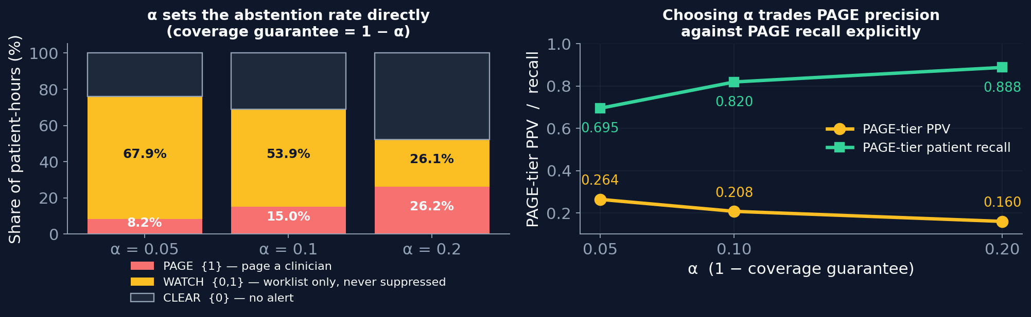
PART 2 — THE ESCALATION-OF-CARE MODEL
Three-Tier Alerting With a Statistical Confidence Guarantee
THE PRINCIPLE
A binary alert forces a decision at every patient-hour, including those where the model has no real basis for one. A three-tier output allows the system to decline: page when the evidence supports an alert, clear when it supports no alert, and refer to a review list otherwise.
HOW THE TIERS ARE DERIVED
Conformal prediction, computed on a held-out half of the calibration split. For each true event a nonconformity score of 1 − p is recorded; for each non-event, p. The (1 − α) quantile of each set becomes a threshold, and for a new patient-hour each label is admitted into the output set if its score falls below the corresponding threshold.
{ 1 } only PAGE a clinician is notified
{ 0 } only CLEAR no alert is raised
{ 0, 1 } both WATCH review list, no notification
{ } neither WATCH the observation is unlike anything
seen in calibration
WHY THIS RATHER THAN A CONFIDENCE CUT-OFF
The single parameter α sets the abstention rate directly and carries a distribution-free guarantee: the true label is contained in the emitted set at least (1 − α) of the time, whatever the underlying distribution. An arbitrary confidence cut-off offers no such guarantee — on this data a fixed cut-off would have abstained on 0.5% of alerts, an effectively inert rule.
The calibration split is halved by patient, so the quantiles are computed on data the probability calibration never saw. That separation is what makes the guarantee valid.
INTERPRETING THE SETTING
At α = 0.20, one quarter of patient-hours are paged with precision 0.160 and lift 3.45×, against 2.88× for the unfiltered baseline. 89% of deteriorating patients are still paged, and the remaining 20% of events appear on the review list rather than being discarded — nothing is suppressed.
Lowering α raises the precision of the paged tier and increases the proportion of events routed to review. The choice of α is a clinical judgement about how the review list will be used in practice, and the guarantee makes that trade explicit rather than leaving it implicit in a threshold.

Slide 21
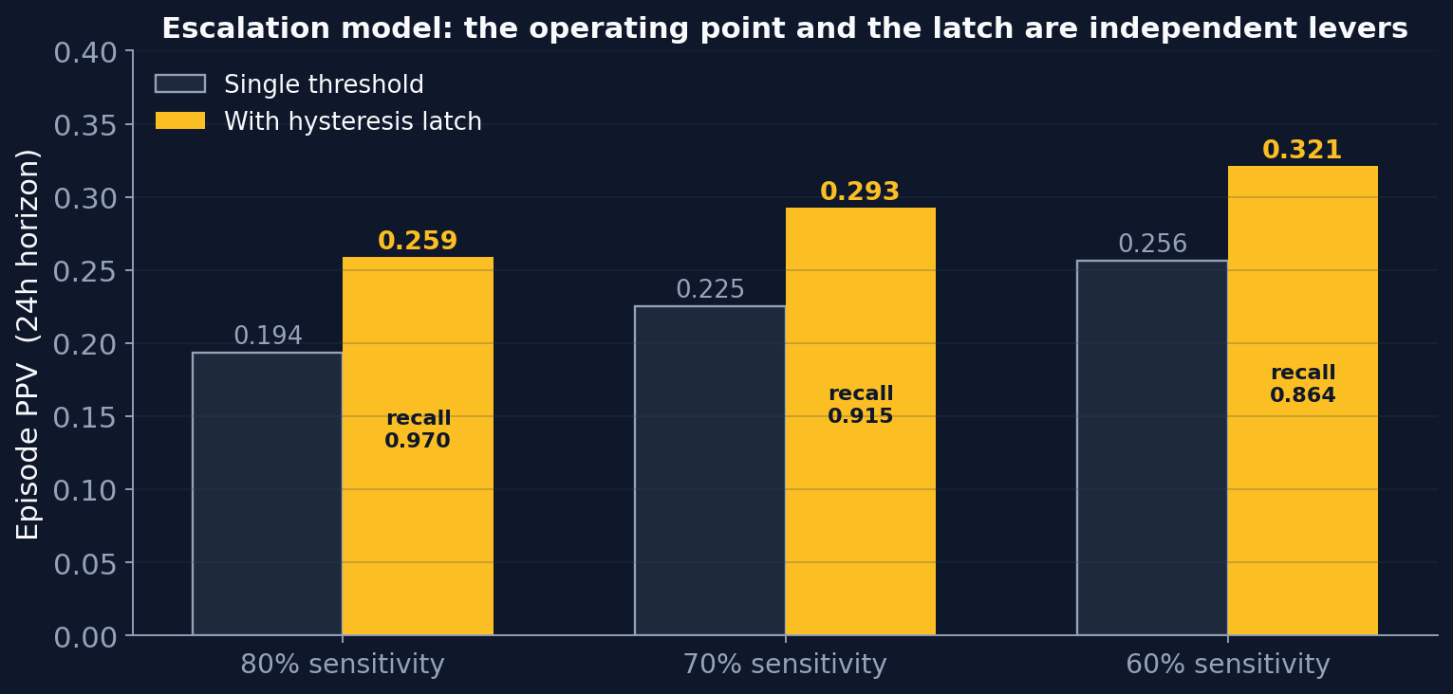
PART 2 — RECOMMENDATION
Recommended Configuration
ESCALATION TARGET • 24-HOUR HORIZON • HYSTERESIS LATCH • RANKED WORKLIST
ALTERNATIVE OPERATING POINTS
Measure | NEWS2 model, 12 h | Recommended
Episode lift | 2.75× | 2.73×
Patient recall | 0.967 | 0.970
Alert episodes | 2,069 | 912
Median warning time | 7.0 hours | 11.0 hours
Episode PPV, all alarms | 0.331 | 0.259
Episode PPV, leading 10% | — | 0.570
Actionable within the unit | no | yes
If a higher precision figure is required, reducing the sensitivity target to 60% yields episode PPV 0.321 and lift 3.39× — 23% above the NEWS2 model — with 8.7 hours of warning and patient recall 0.864.
The operating point and the alerting rule are independent levers and they compose: the latch improves precision at every sensitivity setting without affecting detection.
Selecting between these points is a clinical decision about the acceptable balance between missed events and alarm volume, and is presented as a curve rather than a single recommendation.
At equivalent lift and equivalent detection, the recommended configuration produces 56% fewer distinct alarms and 57% more warning time, on an outcome that identifies a decision not yet taken.
Precision across all alarms is lower because prevalence is 2.4 times lower. Lift is the quantity that is comparable across targets, and it is equivalent.
Precision on the leading tenth of the worklist — the alarms a clinician addresses first — is 0.570.

Slide 22
CLINICAL DETERIORATION EARLY WARNING SYSTEM
Limitations and Validation Status
VALIDATION STATUS
Single institution, single unit type, single era from 2008 to 2019. No external validation on an independent cohort. Under TRIPOD and PROBAST reporting standards this constitutes model development rather than validated performance.
No prospective or silent-mode evaluation has been performed. Every reviewed system that reported both retrospective and live performance showed degradation, in one case from 0.95 to 0.63 AUROC.
No human-factors evaluation, no defined clinical override protocol, and no regulatory assessment.
STRUCTURAL COVERAGE LIMIT
1,516 patients deteriorate a median of sixteen minutes after admission. Two vital-sign readings cannot exist before their event at any look-back setting, so they lie outside the reach of an hourly model entirely. The limiting factor is observation frequency rather than model design, and addressing it requires continuous monitoring data that the source dataset does not provide.
STATISTICAL LIMITS
The escalation model shows a train-to-test C-index gap of 0.056 on 1,475 event-positive admissions. Reducing the feature count from 371 to 80 closed only 18% of that gap, indicating the binding constraint is sample size rather than model complexity; it is unlikely to fall below approximately 0.05 on a cohort of this size.
Confidence intervals on the C-index are approximately 0.040 wide, so differences smaller than that are described as indistinguishable rather than as improvements.
DEPENDENCE ON CLINICAL PRACTICE
The timing of an escalation partly reflects clinician judgement, so the target is not purely physiological. Death and renal replacement therapy are less discretionary than the timing of vasopressor initiation, and NEWS2 performance is reported alongside as a secondary outcome to keep the comparison balanced.
The safety of the review tier depends on the review list being examined in practice. That is an operational assumption which has not been evaluated, and it should be tested before the three-tier output is used clinically.

