Slide 1

Face recognition using FireFly algorithm in Machine Learning
Capstone Project
Team 11
CH.EN.U4AIE21141 - Sabarinath
CH.EN.U4AIE21149 - Shyam Ganesh
CH.EN.U4AIE21150 - Sidesh Sundar
CH.EN.U4AIE21160 - Sasank Sami
CH.EN.U4AIE21165 - Bharadwaj

Slide 2
OVERVIEW
We are going to detect face using firefly algorithm.
The suggested method is unique because it combines the benefits of RBFNN and the evolutionary firefly algorithm to adaptively evolve the number and centres of hidden neurons.
The fast convergence, enhanced face recognition performance, decreased feature selection overhead, and algorithm stability of the suggested technique are its strengths.
Benchmark face databases are used to validate the suggested approach like namely ORL, Yale, AR and LFW.

Slide 3
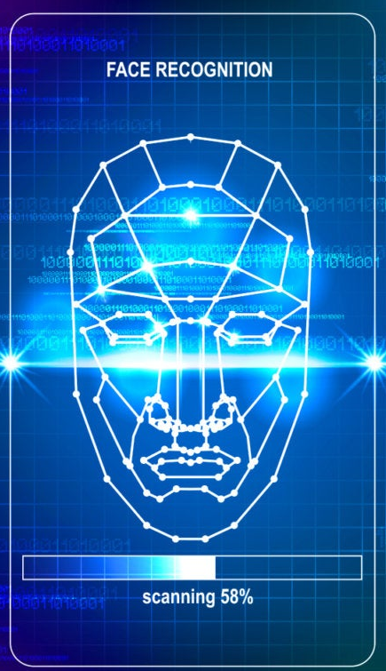
Introduction
Face Recognition:
A method of recognising or verifying a person's identification using their face is facial recognition. People can be recognised using facial recognition technology in real-time or in still images and videos.
History and creation of python face module:
Adam Geitgey created a Python library for face recognition. This library gives us one of the simplest and most straightforward ways to identify and recognise faces.

Slide 4
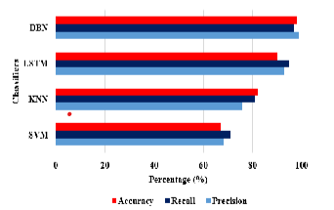
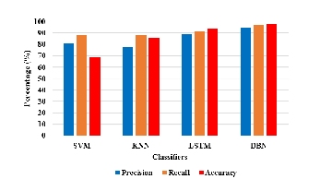
AIM AND OBJECTIVE
The main aim of the project is detect the face from a picture using fire fly algorithm.The graph shows the accuracy recoil ans precision of various methods.So we can conclude that the best algorithm for detecting face is DNN and DBN.With the help of firefly algorithm we can increase the matching pattern as it uses intensity only so it will be more precise.

Slide 5
EXISTING WORKS
Histogram Of Oriented Gradients:
The histogram of oriented gradients (HOG) is a feature descriptor used in computer vision and image processing for the purpose of object detection. The technique counts occurrences of gradient orientation in localized portions of an image. Using this method for face recognition is convenient to perform and accurate, in current days usage of this specific method is popular among developers.
Viola-Jones Algorithm:
The Viola–Jones object detection framework is a machine learning object detection framework proposed in 2001 by Paul Viola and Michael Jones. The algorithm is efficient for its time, able to detect faces in 384 by 288 pixel images at 15 frames per second on a conventional 700 MHz Intel Pentium III. It is also robust, achieving high precision and recall. While it has lower accuracy than more modern methods such as convolutional neural network, its efficiency and compact size which means it is still used in cases with limited computational power.
R-CNN:

Slide 6
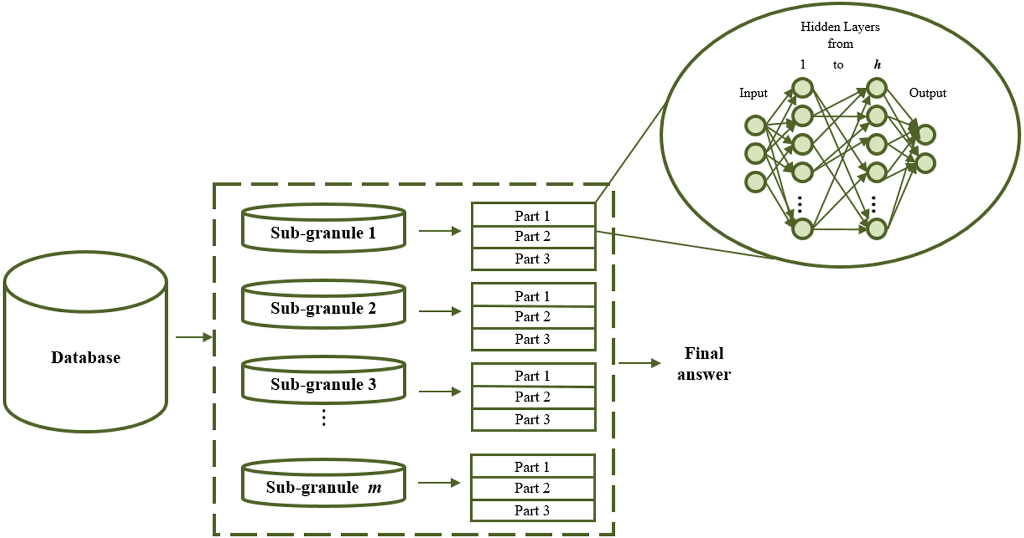
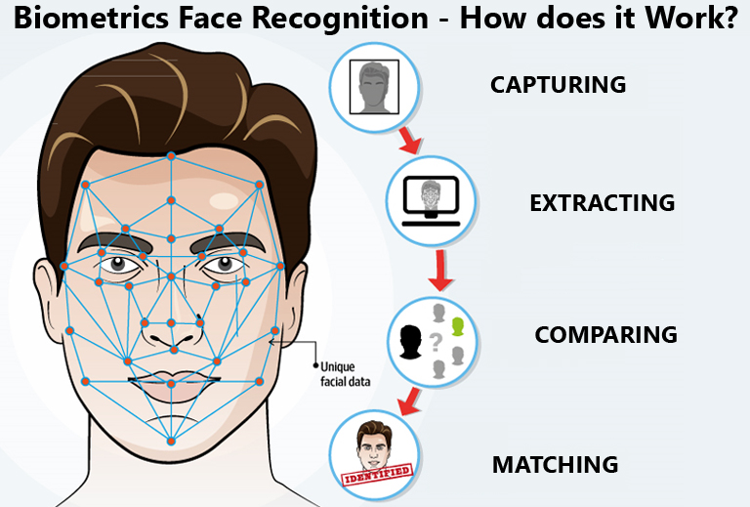
PROPOSED ALGORITHM

Slide 7
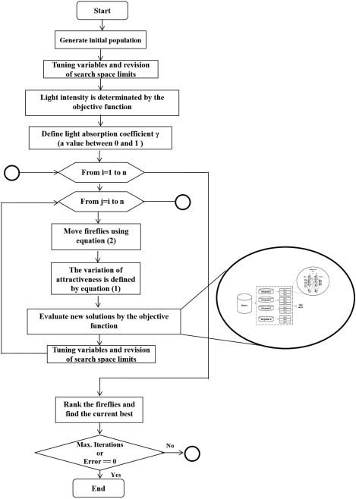
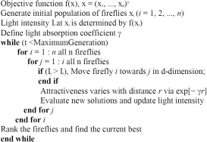
PROPOSED ARCHITECTURE

Slide 8
IMPLEMENTATION DETAILS
Import required python librarires.
Start webcam.
Click to capture take photo.
Read,Resize and Display the image
Now connect the image with the dataset availabe in the github.
Load the pre-trained face detection network model from disk.
Apply the fire fly algorithm to check the match using intensity.
Pass the blob through the neural network and obtain the detections and predictions.
Loop over the detections and draw boxes around the detected faces

Slide 9
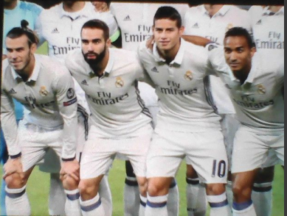
INPUT

Slide 10
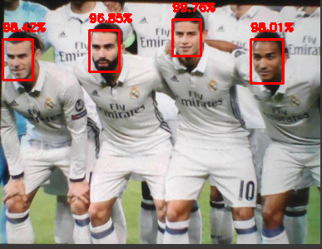
OUTPUT

Slide 11


