Slide 1

Frequency estimation
And its application using linear algebra
Team 11
Project review

Slide 2
Index
ABSTRACT
INTRODUCTION
DEFINITION
METHODOLIGY
COMPARITIVE STUDY
APPLICATION (code)
OUTPUTS
CONCLUSION
2

Slide 3
ABSTRACT :
Estimation of the frequency (f) has been one of the main problems in the field of signal processing and communications, due to its vast applications. For getting accurate and instant frequency estimation from we used an algorithm called non uniform fast Fourier transform [FFT].
Fourier Transform (FFT) is any efficient algorithm for calculating the DFT. And for comparative study with FFT, we have applied another method named Subspace method.
6

Slide 4
INTRODUCTION
Frequency estimation has fundamental, significant and wide relevance for many reasons.
First, any arbitrary signal may be modelled as a sum of frequencies. Hence, any signal estimation problem may be expressed in terms of frequency estimation problems.
Second, many parameter estimation applications may be mathematically expressed as a frequency estimation problem. An example is active noise and vibration control.
The problem of estimating the frequencies of sinusoidal components from a finite number of discrete-time measurements has attracted a great deal of attention and still is an active research area to date, because of its wide applications in science and engineering.
3
Notes:
3

Slide 5
definitions
DFT:
Discrete Fourier Transform (DFT) is the discrete version of the Fourier Transform (FT) that transforms a signal (or discrete sequence) from the time domain representation to its representation in the frequency domain
FFT:
Fast Fourier Transform (FFT) is any efficient algorithm for calculating the DFT. ● Computing a DFT of n n points by using only its definition, takes Θ(n^2) time , whereas an FFT can compute the same result in only Θ(n log n) steps.
SUBSPACE METHOD:
The concept of the subspace method is derived from the observation that patterns belonging to a class form a compact cluster in high-dimensional vector space.
Let’s Dive In
4

Slide 6

THEORY OF ALGORITHMS
ALGORITHMS
ALGORITHM - 1: DFT
The DFT can transform a sequence of evenly spaced signals to the information about the frequency of all the sine waves needed to sum to obtain the time-domain signal. It is defined as
N = number of samples
n = current sample
k = current frequency, where
k∈[0,N−1]
xn = the sine value at sample n
Xk = the DFT that includes information of both amplitude and phase
5

Slide 7
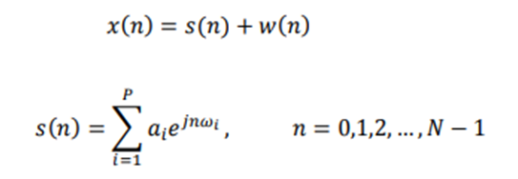
ALGORITHM - 2: SUBSPACE METHOD
The key idea of the subspace method is to convert the complex valued autocorrelation matrix in Hankel-like shape into a real valued data matrix with the same dimension. The resultant real valued matrix will be used to extract the noise and/or the signal subspace instead of the original complex one.
For example, consider a signal, x (n), consisting of a sum of P complex exponentials in the presence of white noise, w (n). This may be represented as:
6

Slide 8
Comparative study :
Application - 1:In the first application we can see that the estimated frequency (noisy signal) by Algorithm - 1 [FFT] which is more accurate and more close when compared to Algorithm - 2 [subspace method].
Estimated frequency by Algorithm - 1: 123.0469 Hz
Estimated frequency by Algorithm - 2: 123.82 Hz
In the second application we can see that the estimated frequency (noisy signal) by Algorithm - 1 [FFT] which is more accurate and more close when compared to Algorithm - 2 [subspace method].
Estimated frequency by Algorithm - 1: f1 = 0.4 Hzf2 = 0.425 Hz
Estimated frequency by Algorithm - 2: f1 = 0.4 Hzf2 = 0.437 Hz
LOOKING AHEAD
9

Slide 9
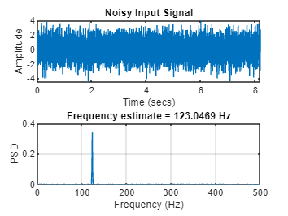
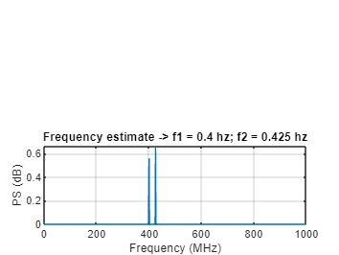
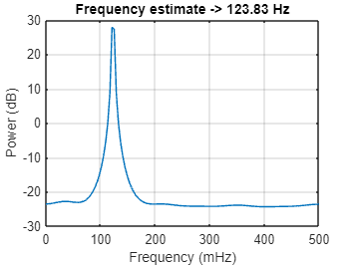
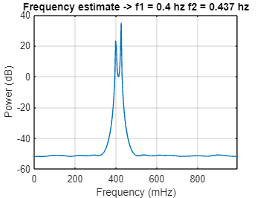
Outputs
Application-2
Application-1
FFT :
Subspace
Method :
8
Notes:
8

Slide 10
Conclusion:
Through this project we have got to know about many different applications of frequency estimations. As we summarized the implementation process with linear algebra, it is even more understandable. And we have got to know about many methods and techniques like Fourier transform, Fast Fourier transform, discrete Fourier transform, subspace method and many more as applications for estimation.
10

Slide 11
Future scope
Though this concept of estimation is outdated and isn’t enhanced enough to be used there are some drawbacks in terms of time complexity and implementation of algorithms which is not in the level of comparison with respect to the current quantum computing methodologies. So, this estimation theory can be enhanced even better on existing applications itself and can be applied in apt environment with less computation speed and power. The methods and algorithms can be used on many different applications.
12

Slide 12
THANK YOU

