Slide 1

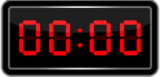
DIGITAL STOPWATCH
GROUP-5
TEAM MEMBERS :
POORANI AYSWARIYA PS_21134
PRANAV RAJ _21135
P YAGNITHA_21138
SARRVESH _ 21148
SIDESH SUNDAR_21150

Slide 2

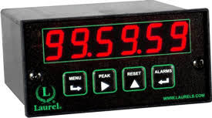
STOPWATCH
A stopwatch is a timepiece designed to measure the amount of time that elapses between its activation and deactivation.

Slide 3
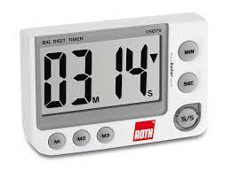
TIMER
Timer is a specialized type of clock used for measuring specific time intervals.

Slide 4
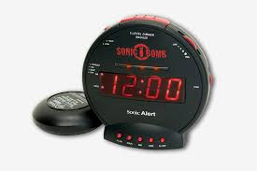
ALARM
The most common types include an alarm clock that sounds an alarm at a pre-set time, often used to wake a person up or remind them of an event.

Slide 5
C
O
M
P
O
N
E
N
T
S
ArduINo
LCD
Piezo
7-Segment Display
breadboard
Resistor
pushbutton
Slide switch
U
S
E
D

Slide 6
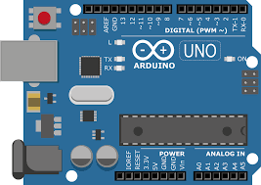
Arduino
Arduino is an open-source electronics platform based on easy-to-use hardware and software.
Arduino boards are able to read inputs - light on a sensor, a finger on a button, or a Twitter message - and turn it into an output - activating a motor, turning on an LED, publishing something online.

Slide 7
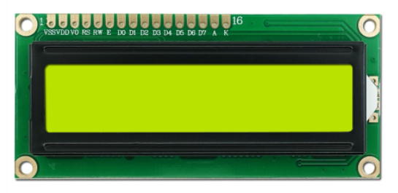
LCD
LCDs are commonly used for portable electronic games, as viewfinders for digital cameras and camcorders, in video projection systems, for electronic billboards, as monitors for computers, and in flat-panel televisions.

Slide 8
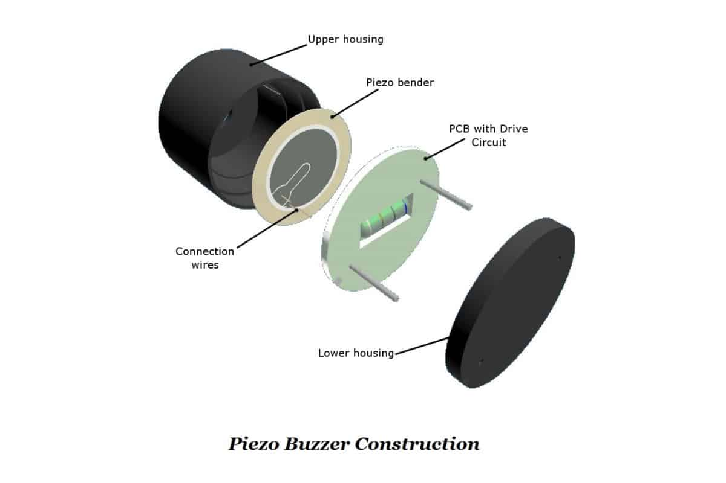
Piezo
A piezoelectric microphone is used in these devices to detect pressure variations in sound waves, which can then be converted to an electrical signal for processing.
One of the simplest applications for piezoelectricity is the electric cigarette lighter.

Slide 9
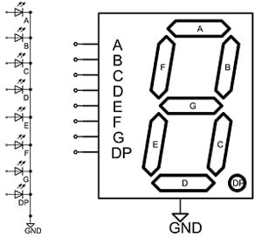
7-Segment Display
A seven-segment display is a form of electronic display device for displaying decimal numerals that is an alternative to the more complex dot matrix displays.
Seven-segment displays are widely used in digital clocks, electronic meters, basic calculators, and other electronic devices that display numerical information.

Slide 10
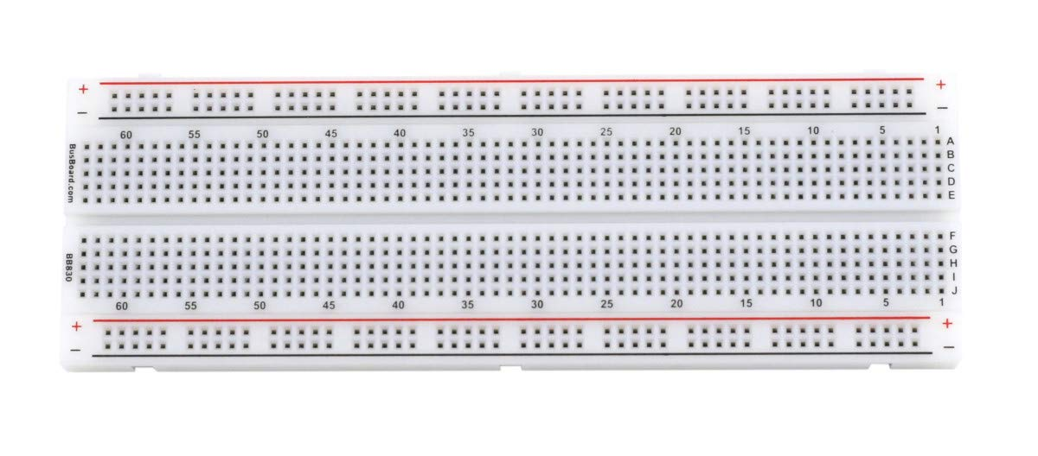
Breadboard
A breadboard is used to build and test circuits quickly before finalizing any circuit design.
The breadboard has many holes into which circuit components like ICs and resistors can be inserted.

Slide 11
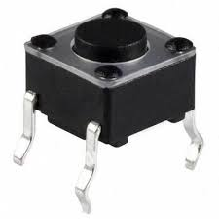
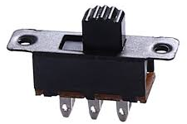
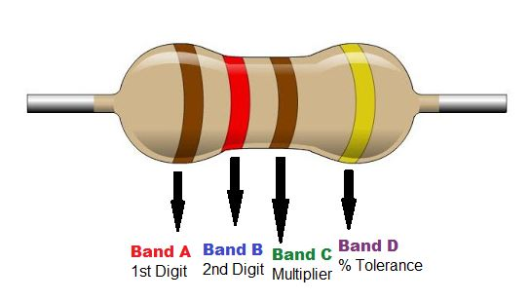
Pushbutton | Slideswitch | Resistor
They are common features within the home and workplace, and are also referred to as pushbutton switches or push switches. | A slide switch is a mechanical switch that slides from the open (off) position to the closed (on) position and allows control of a circuit's current flow without having to manually splice or cut wire. | A resistor is a passive electrical component with the primary function to limit the flow of electric current.

Slide 12
STOPWATCH

Slide 13

Components used
Arduino
16×2 LCD
1K Ohm Resistor
4 Pushbuttons

Slide 14

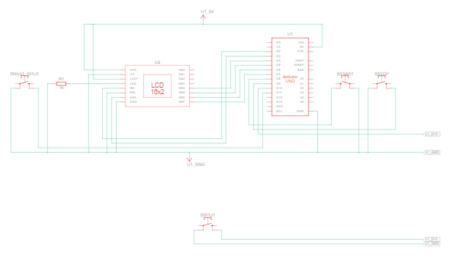
Schematic Model:

Slide 15
Principle:
This is done by using a 555 Timer IC (LCD) connected in a stable mode to produce the clock pulses of 1 second interval each.
While the first counter counts from 0 to 9, the second counter starts its counting operation every time the count value of first counter reaches 9.

Slide 16
Working:
we use arduino uno connected to 16 by two lcd using four data pins :
Enable pin
Register select pin
Read write pin
v node pin connected to ground vcc

Slide 17
Ground of the lcd connected to 5 volts and ground of arduino the backlight led connected to positive negative through 1 kilo ohm resistor
4 push buttons to make the stopwatch functions start post split
Next split connected to pins without resistors through the ull up input function.
The next process is to include the lcd and start by defining the constants and the variables and start simulation.

Slide 18
Then we have to initialize the pin modes and initializing the lcd this is the chronometer function and thus scrolling through the four partial split counting function that’s the pose function .
Now we can start the simulation here when we press start button counting will start we can press pause then we can continue we can take split time .
The old one as top we can make up to four plit time lapse arduino stores up to 4 split time partial split one two three four and then we can start again .

Slide 19
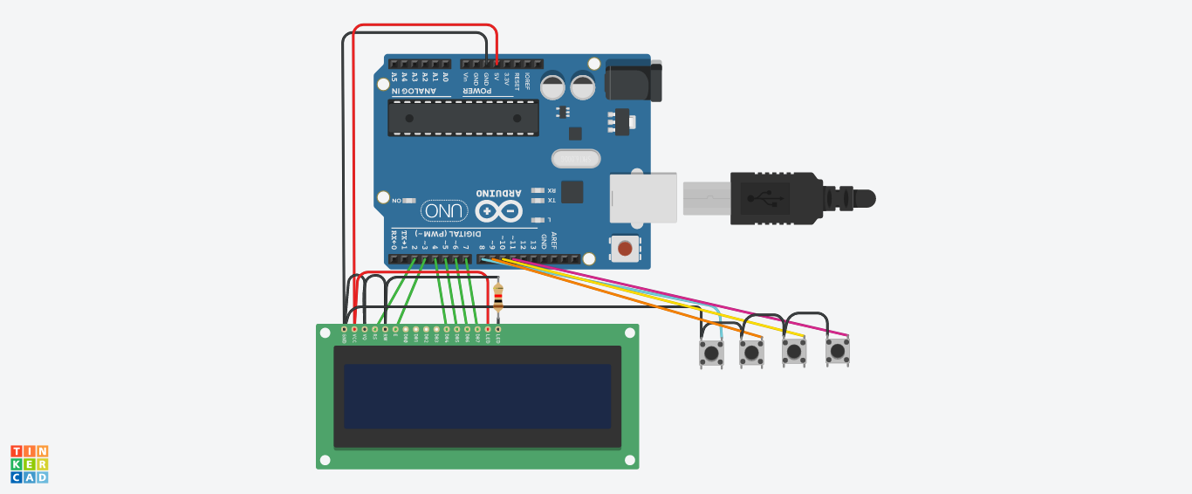
Model:
https://www.tinkercad.com/things/8m1kr3g5tBW-stopwatch/editel

Slide 20
Advantages
Usually a stopwatch is used to measure the time interval of each second.
Accuracy
Precision

Slide 21
ALARM

Slide 22
Components used
Arduino
LCD
Piezo
Breadboard

Slide 23
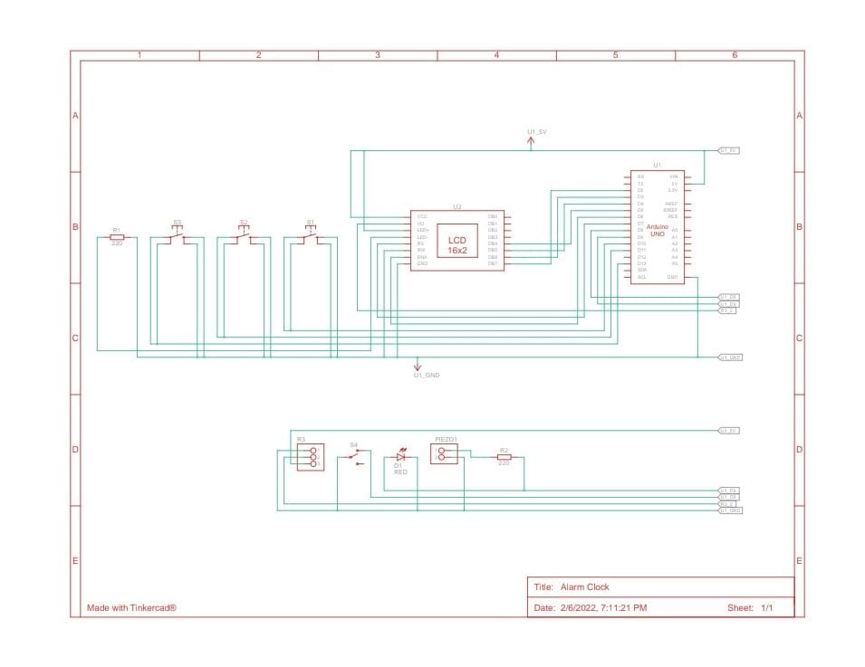
Schematic Model:

Slide 24
Principle:
Digital clocks use what's known as a "counter" and, of course, the clock uses an LED or LCD face to display the numbers rather than hands and a painted surface.
For the alarm mechanism itself, digital clocks make use of either a radio or a recording of an alarm sound, which usually rings or pulses.

Slide 25
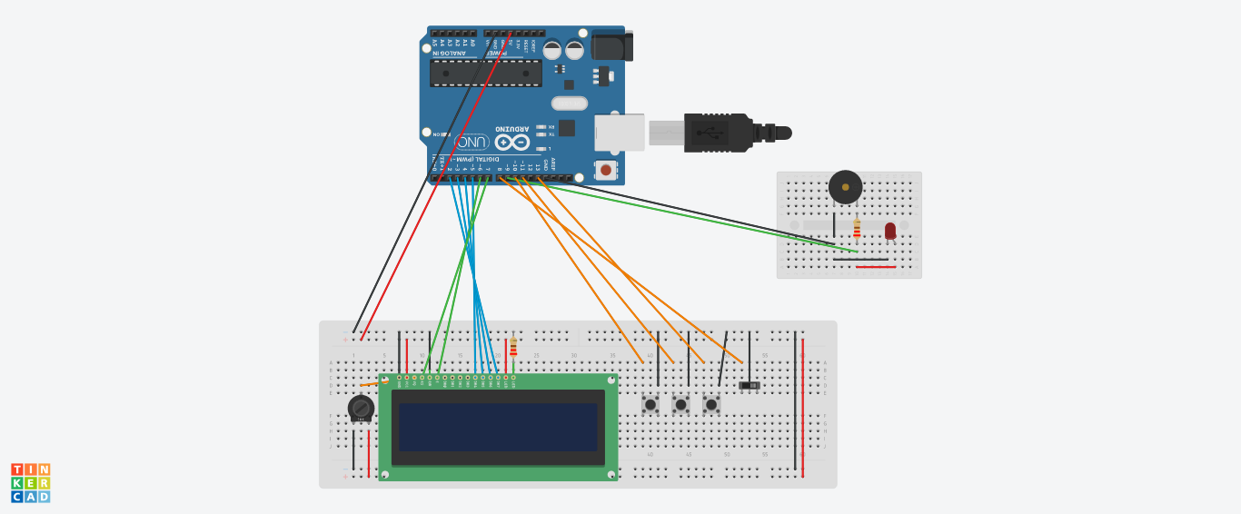
Model:
https://www.tinkercad.com/things/78CYeD8XcU7-alarm-clock/editel

Slide 26
TIMER

Slide 27
Components used
Arduino
7-Segment Display
Piezo
Breadboard

Slide 28
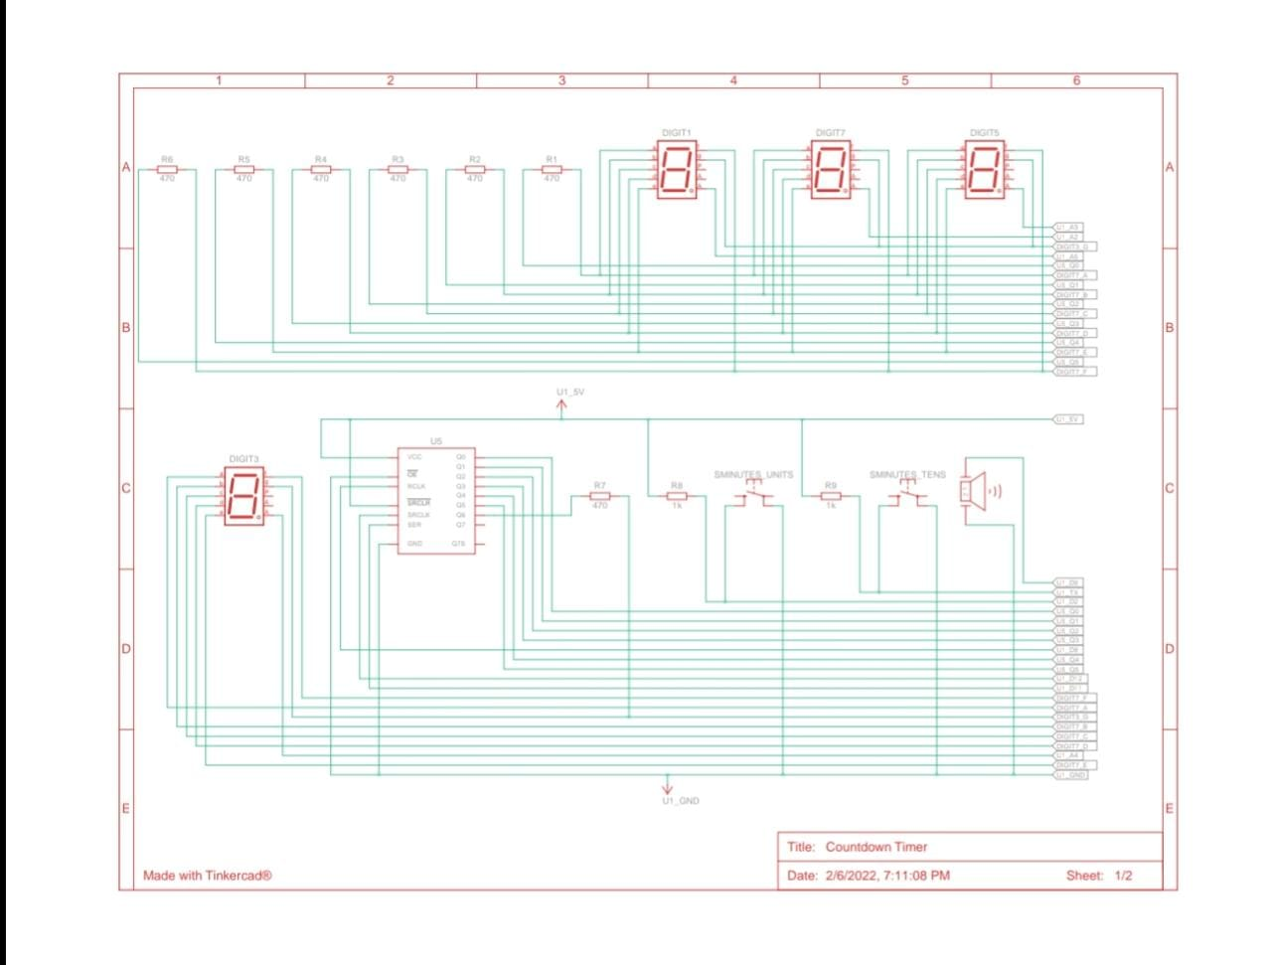
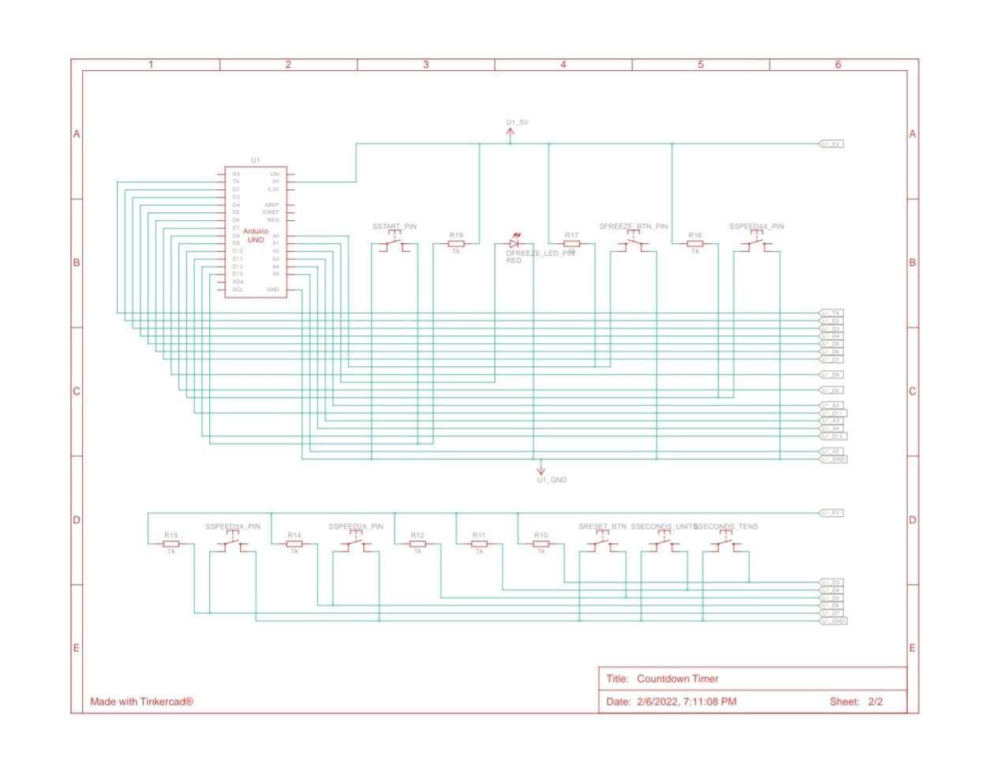
Schematic Model:
Other simple components used are:
Pushbutton
Resistor

Slide 29
Principle:
The working principle of the digital timer is, it uses the power source and different electronic components for a time like hours, minutes and seconds.
The power source of this timer is either a battery otherwise a power cable connection or the clock gearing controlled by the counter. Finally, it displays the time either on LED or LCD screen.

Slide 30
Working:
We use arduino uno connected to 7 segment disply using four data pins :
Enable pin
Register select pin
Read and write pin

Slide 31
There the time function, range, of the desired time have to be set through pushbutton
This information for the timer is to start the operation and it is called the ‘start impulse’ or the ‘trigger’.
Now the timer operates.
When the selected time delay is complete,.
The buzzer device will help you to give an alert to the user.

Slide 32
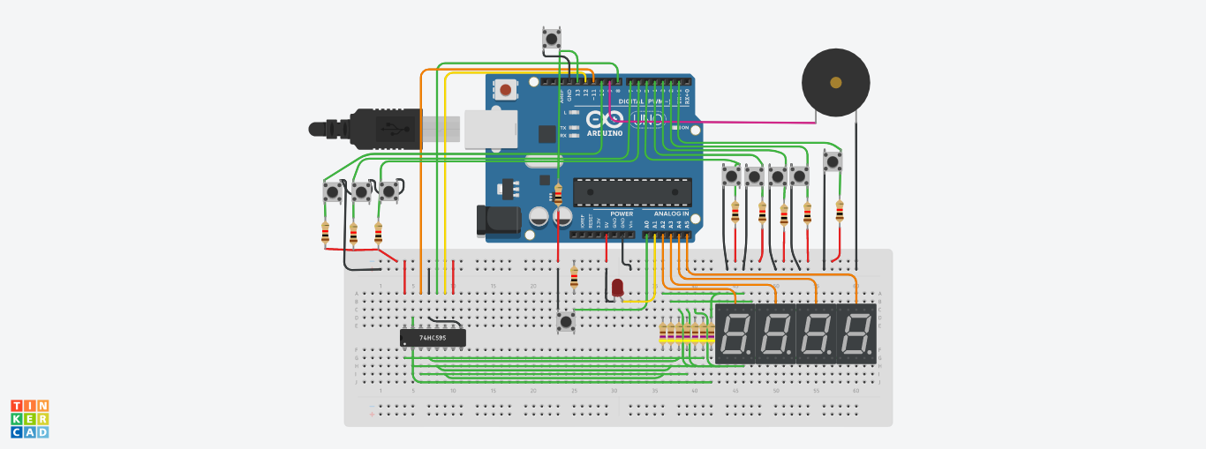
Model:
https://www.tinkercad.com/things/dIw5qTKL6TC-countdown-timer/editel

Slide 33
Advantages
Timer switch will allow us to save unnecessary energy which is being wasted .

Slide 34


