Slide 1
Digital Portfolio
STUDENT NAME: N.SABARINATHAN
REGISTER NO AND NMID: 24132011802521086 &
asanm20124132011802521086
DEPARTMENT: BSC COMPUTER SCIENCE-E/M(SHIFT-1)
COLLEGE: ARIGNAR ANNA GOVT ARTS COLLEGE

Slide 2
PROJECT TITTLE:PERSONAL PORTFOLIO WEBSITE

Slide 3


AGENDA
Problem Statement
Project Overview
End Users
Tools and Technologies
Portfolio design and Layout
Features and Functionality
Results and Screenshots
Conclusion
Github Link
3/21/2024 Annual Review

Slide 4

PROBLEM STATEMENT
I.In today's competitive job market, having a strong online presence is essential for developers and designers to showcase their skills, projects, and experience.
II. Many aspiring professionals lack a personalized digital space to present themselves effectively to potential clients or employer.
Notes:
In today’s competitive digital world, students and professionals need a personal platform to showcase their profile, skills, education, and projects. Traditional resumes are static and cannot fully highlight an individual’s creativity or interactive work. Therefore, there is a need for a responsive portfolio website that presents all personal and professional details in an attractive, user-friendly, and accessible manner.

Slide 5

PROJECT OVERVIEW
1.The Personal Portfolio Website is a responsive and modern web application designed to showcase the personal brand, skills, and projects of N. Sabarinathan, a front-end developer and computer science student.
2.The website serves as a digital resume that highlights his technical abilities, previous work, and ways to get in touch

Slide 6

WHO ARE THE END USERS?
1.DEVELOPER
2.DESIGNER

Slide 7

TOOLS AND TECHNIQUES
1.Responsive Web Design – using grid layouts and flexible styling for mobile-friendliness.
2.Component-Based Layout – organizing code into sections like header, nav, about, skills, projects, and contact for better readability and structure .
3.Form Handling (JavaScript) – basic front-end form submission with feedback alert.

Slide 8
Portfolio design and lay out:
Color Scheme
Background: #f8f9fa (light gray)
Header: #2f1a14 (dark brown)
Accent: Light pinks (#ffe5dc) and white cards
Consistent Typography: Clear hierarchy using font weights and sizes.
Font & Style: Uses Google Fonts

Slide 9
FEATURES AND FUNCTIONALITY
Navigation Bar
Allows smooth scrolling to #about, #skills, #projects, and #contact.
About Section
Personal introduction with educational background and passion for web development.
Skills Section
Lists core competencies like HTML, CSS, JavaScript, UI/UX Design, etc.
Uses a responsive grid layout.
Projects Section
Two featured projects:
Portfolio Website
Landing Page
Each project is shown as a card with an image, title, and description.
Contact Form
Users can enter name, email, and message.
JavaScript captures the data and displays an alert (Thank you {name}! Your message has been sent.).
Form is reset after submission.

Slide 10
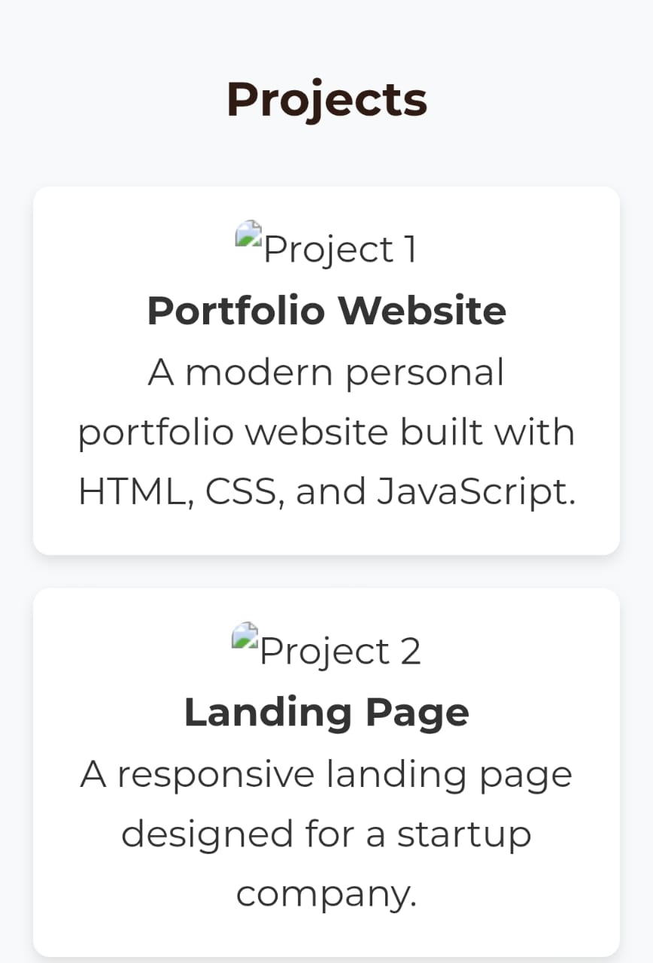
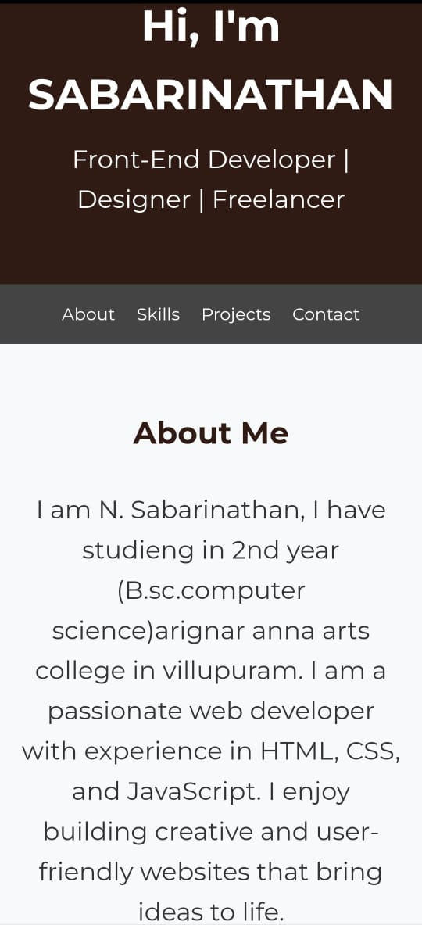

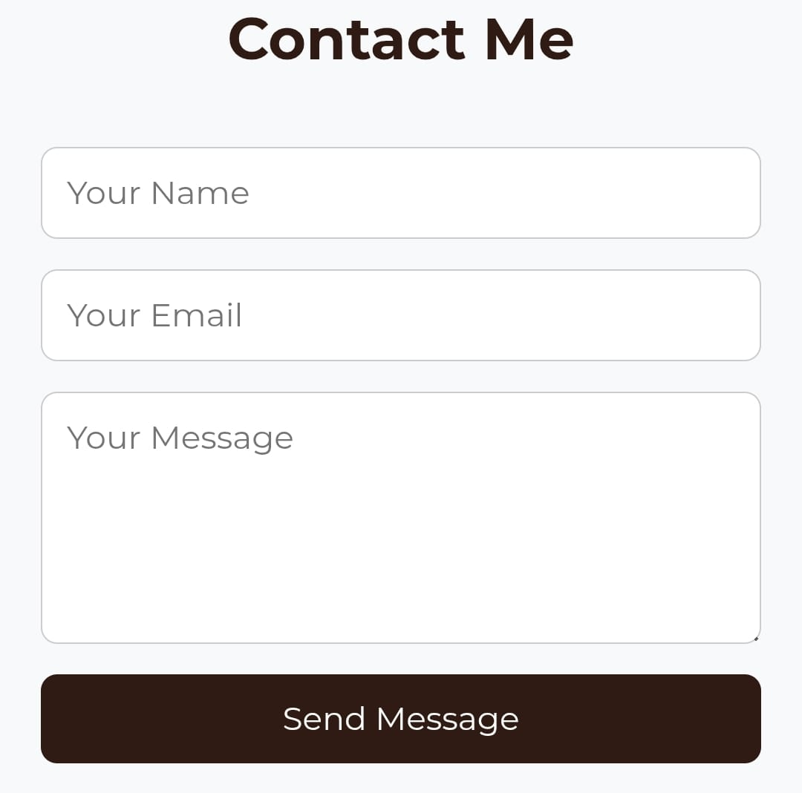

RESULTS AND SCREENSHOTS
The Personal Portfolio Website was successfully designed and developed using HTML, CSS, and JavaScript. The project fulfills its intended purpose by showcasing personal details, skills, and projects in a professional and user-friendly layout. The website is fully responsive and functions smoothly across different devices and screen sizes.
3/21/2024 Annual Review
10

Slide 11
CONCLUSION;
This portfolio is a great starting point — simple, professional, and easy to customize. With a few personal touches (real images, working contact form, social links), it can serve as a strong showcase of your ss.kill
11

