Slide 1
Digital Design of a Synthetic Ramp & Patterns Generation Unit for High-Speed Communication CMOS-Image-Sensor Applications
Mid Semester Presentation
Students: Oded Sabari and Margarita Kouzmine
Supervisor: Vered Antebi

Slide 2
Table of contents
Background
Project definition and goals
Alternative solutions 1
Alternative solutions 2
Architectural design of the selected solution
Status and schedule for the remaining part

Slide 3
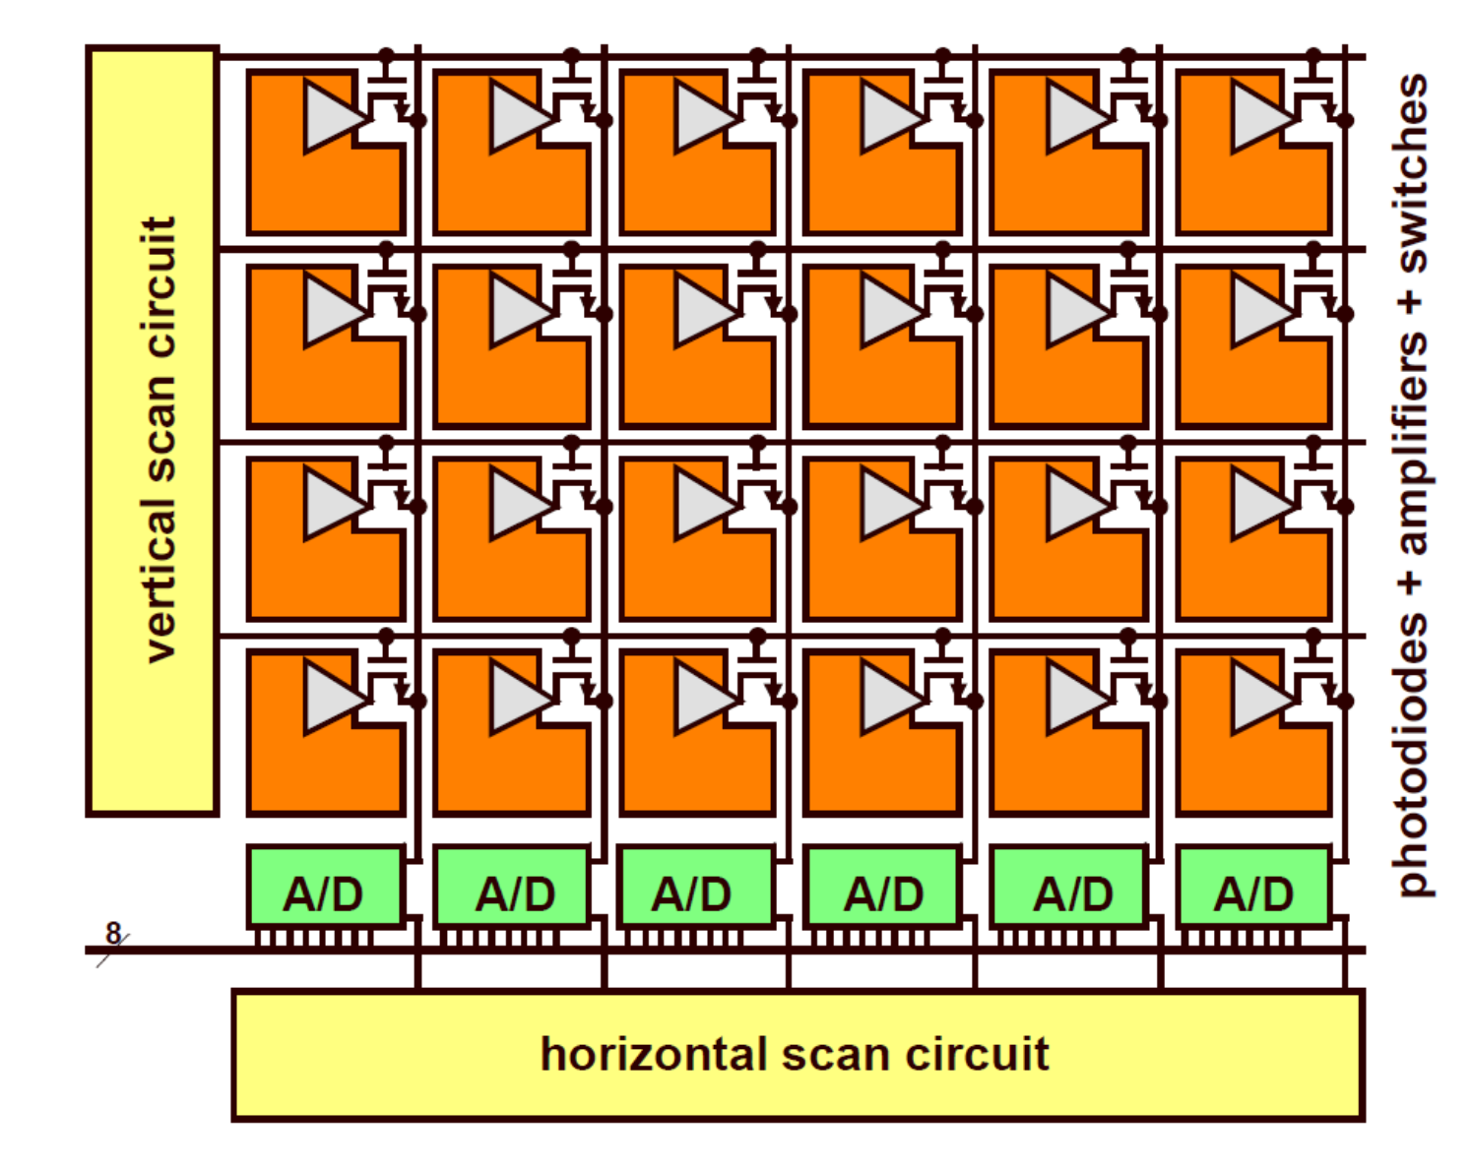
Background
Tower Semiconductors manufactures CMOS image sensors that capture light using an array of pixels. The light intensity at each pixel is converted from an analog voltage to a 12-bit digital signal through an analog-to-digital converter and is then organized into frames. The goal of this project is to design the digital component of the camera's analog-to-digital converter.

Slide 4
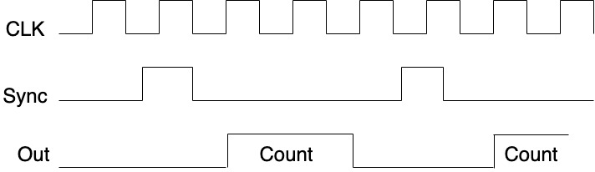
Project definition and goals
The digital part of the A/D converter has two modes of operation:
1.Regular mode, when the module receives the first sync signal, it begins counting in Gray code to minimize errors. The count restarts with each subsequent sync signal and continues until the 24th sync signal, indicating the end of the frame.

Slide 5
Project definition and goals
2.Test mode, the unit bypasses the pixel array and generates synthetic configurable values as outputs. The camera output includes:
A constant value provided by the user.
A checkerboard pattern, configurable as a 1x1 or 2x2 grid, with either a white or black start.
A matrix pattern with column increments of 0, 1, 4, or 8 and row increments of 0, 1, 16, or 1290.
The project aims to deliver optimal real-time performance while minimizing power consumption and area.

Slide 6
Alternative solutions 1
Our initial alternative solution was to create independent modules for each work and test mode, with the control block determining which module to use.
This approach was soon discarded due to its inefficiency and redundancy. It led to significant duplication, as each module required the same components, such as individual counters, resulting in unnecessary waste and complexity.

Slide 7
Rst
Clk
Gray
Counter
[11:0]val
00
Sync
Clk
Constant
f_Sync
Rst
clk
Control
rst
[2:0]Tsig
Mux
[0:11]Cnt
[2:0]Mode
Rst
Checkerboard
Clk
11
Sel
[1:0]x
Extracting
ramp
[1:0]y
clk
[1:0]OutSel

Slide 8
Alternative solutions 2
The second alternative involved developing global counters: one to track when a count ends, another to signal the end of a frame, and a third to manage the output.
We also created a module called FirstVal to calculate the initial value for each line. When a count ends, the output counter receives a load signal, which updates it with the output from FirstVal, and the count begins at the required value based on the work mode.
The increment for each row is set by the FirstVal module, while the increment for each column is controlled by the Xmode input of the output counter.
This approach was also discarded due to its inefficiency.

Slide 9
reset
test
clk
12bit
Counter
NewLine
EndLine
reset
EndFrame
5bit
Counter
reset
clk
clk
NewLine
Binary_or_Gray
Sync
f_Sync
[2:0]mode
Control
[1:0]X
[2:0]Xmode
Binary2Gray
[1:0]Y
reset
[11:0]val
clk
mux
[0:11]Cnt
Counter
[11:0]s_Val
Update
NewLine
Load
[1:0]Ymode
[11:0]LoadVal
reset
FirstVal
clk

Slide 10
Architectural design of the selected solution
The final solution also uses global counters, but with a different approach. In this setup, the output counter calculates the sum of the X row increment and LoadVal inputs.
The LoadVal input is connected to a multiplexer with various inputs depending on the work mode and the Ramp module is responsible for calculating the row increments.
We also added enable inputs to various blocks to save power when they are not needed
Additionally, this new approach allowed us to reduce the size of our state machine, enhancing overall efficiency.

Slide 11
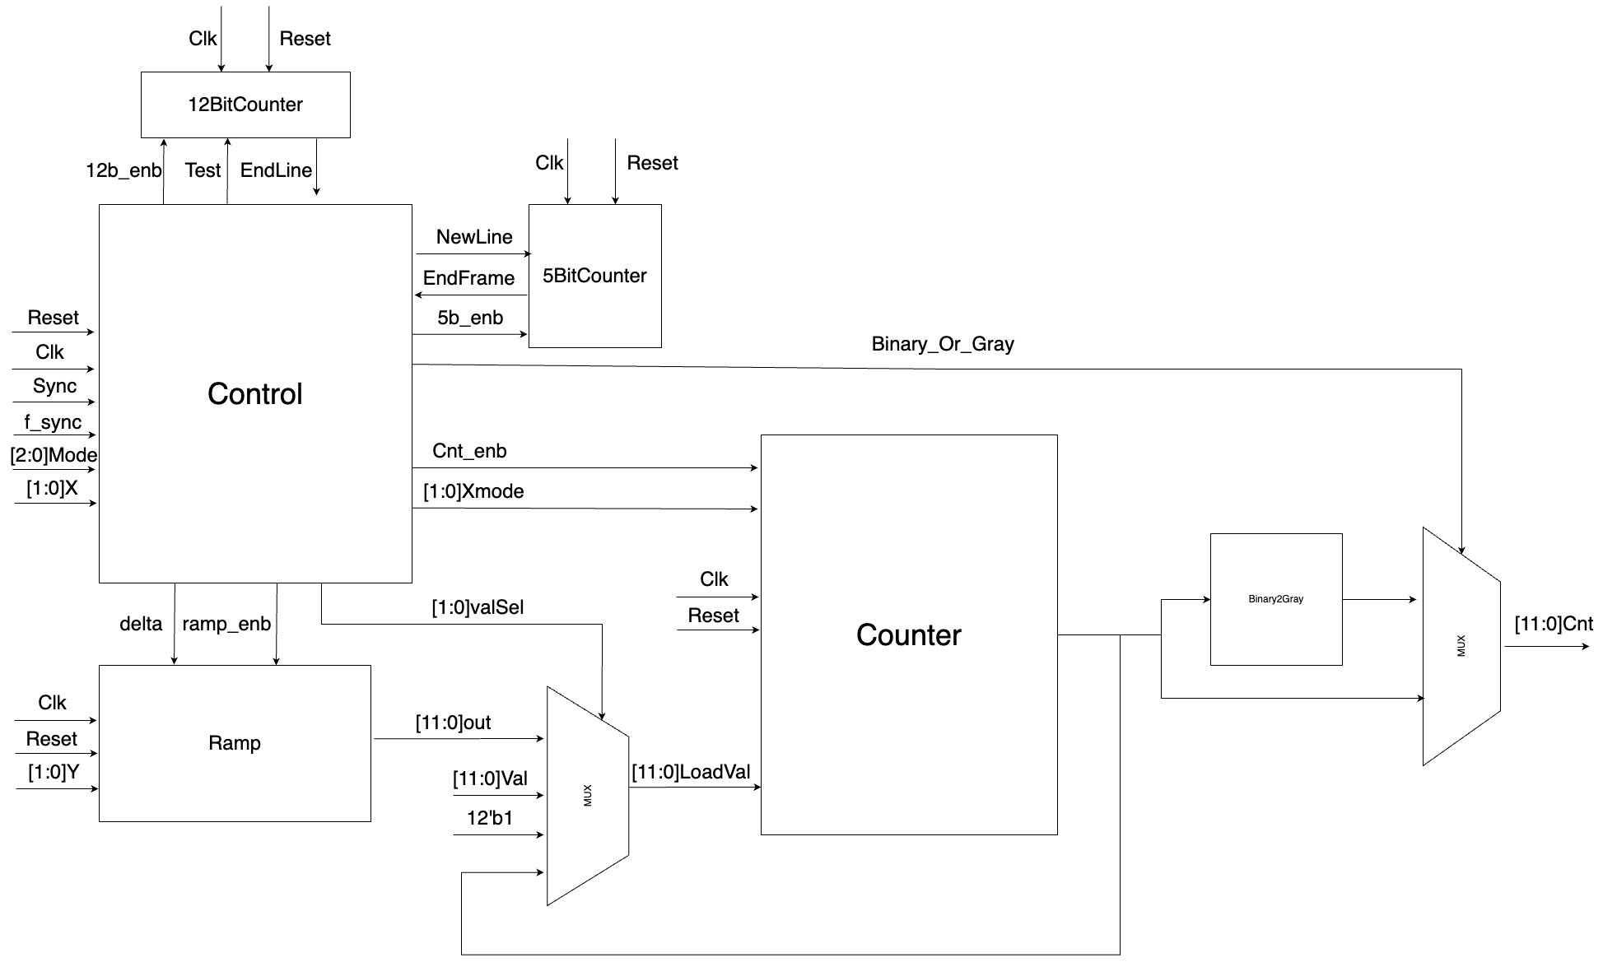

Slide 12
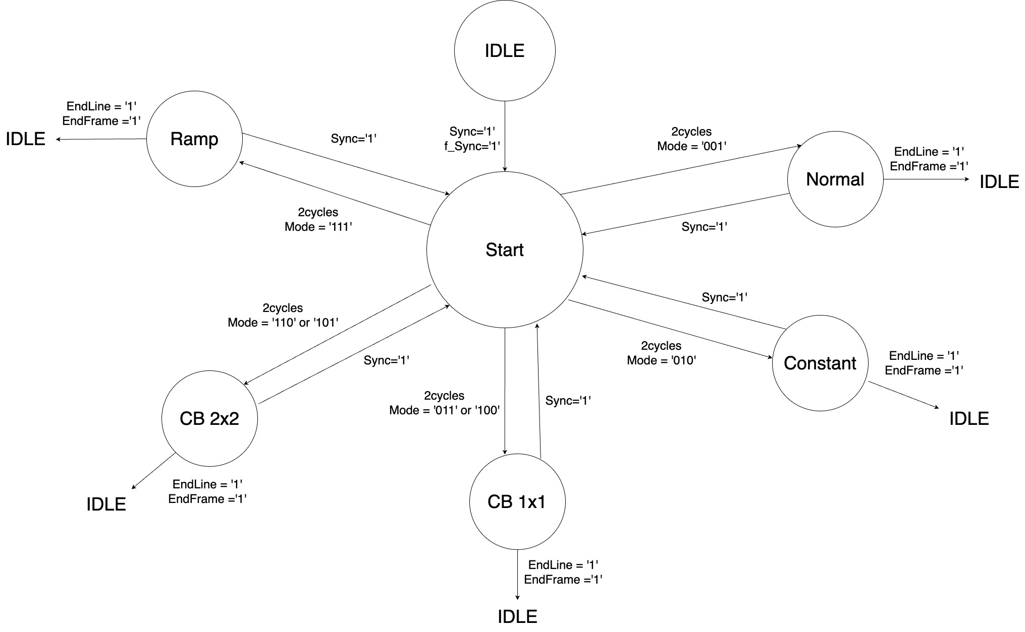

Slide 13
Status and schedule for the remaining part
The following stages have been completed:
Architectural and Logic Design
HDL Implementation using Verilog
The remaining tasks are:
Verification (to be completed by the last week of August)
Synthesis (to be completed by the last week of September)
Layout Design (to be completed by the first week of October)
Final Report (to be completed by the third week of October)

