Slide 1
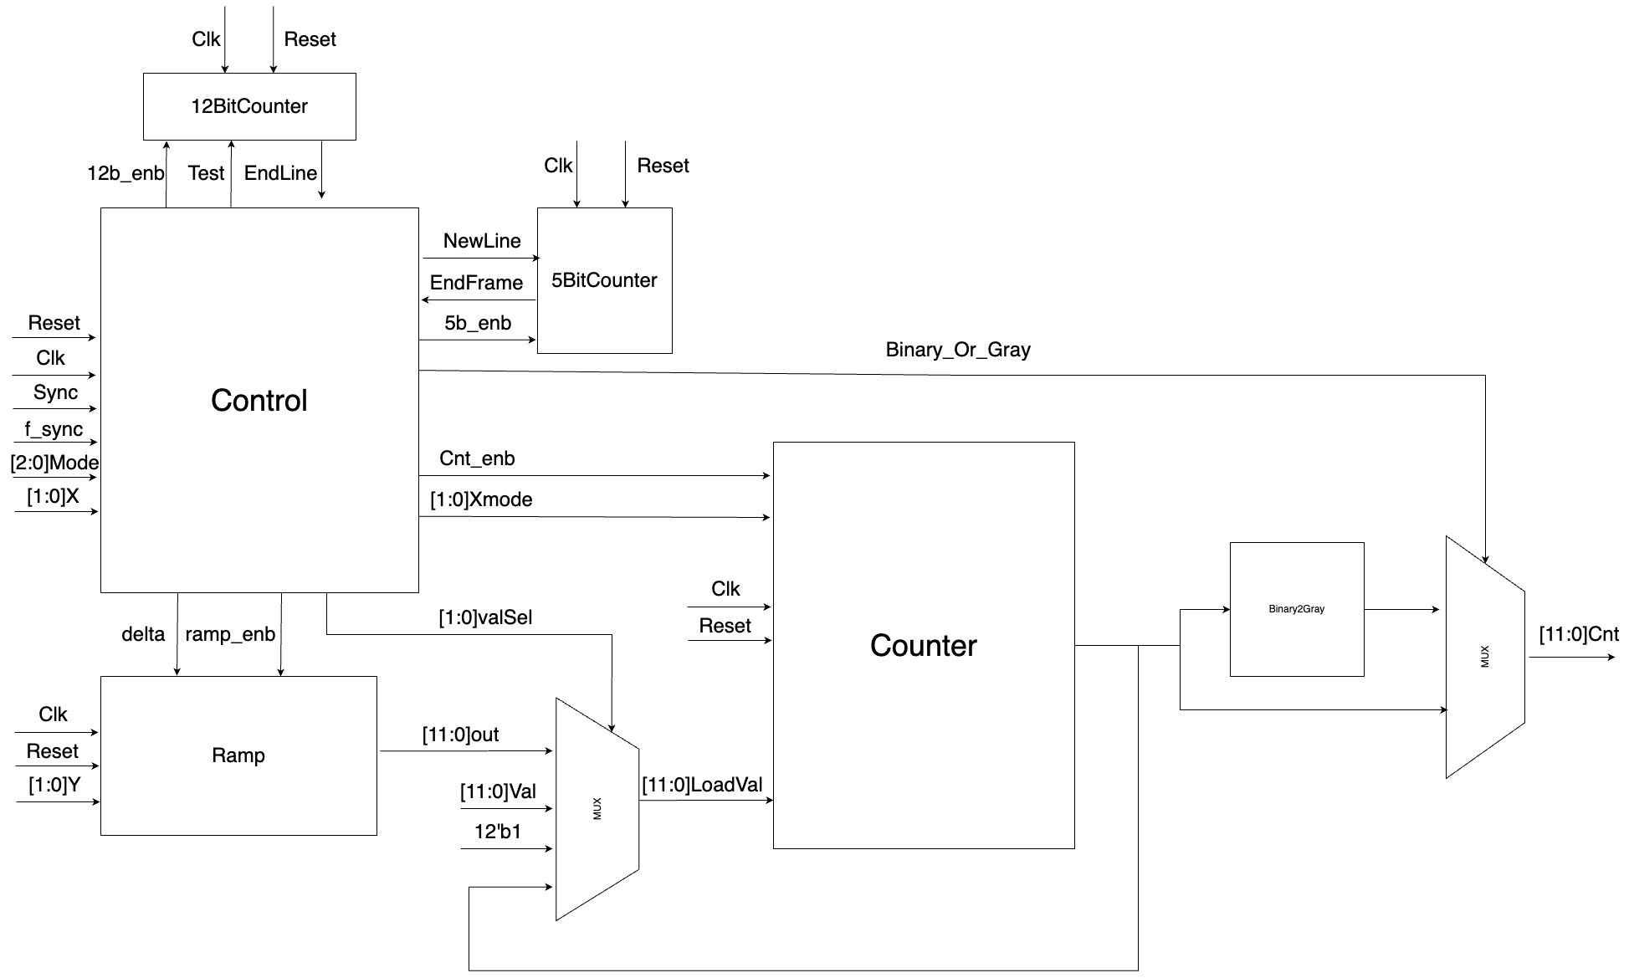

Slide 2
Control – Inputs
Inputs:
Clk – The system clock.
Reset – Active low asynchronous reset.
[2:0]Mode – The current work mode.
Sync – New line signal.
f_Sync – Start the normal mode counter.
EndFrame – The frame has ended once the 5bitCounter counted 24 lines.
EndLine – The line has ended once the 12bit counter counter either 1290 in test mode or 4096 in normal mode.
[1:0]X - Choose gap between numbers at the same row .

Slide 3
Control - Outputs
The possible output values:
NewLine – Send a signal to the 5bitCounter when a new line has started.
Binary_or_Gray – Choose whether the output will be in Gray code or Binary code. ‘1’ for Gray and ’0’ for Binary.
[1:0]Xmode - The gap between numbers at the same row for the Counter :
’00’: The gap between numbers at the same row will be 0.
‘01’: The gap between numbers at the same row will be 1.
‘10’: The gap between numbers at the same row will be 4.
‘11’: The gap between numbers at the same row will be 8.
Test – ‘0’ for the 12bitcounter to count to 4095 and ‘1’ for the 12bitCounter to count to 1289
5b_enb – ‘1’ active, ‘0’ inactive with ‘0’ at all outputs
12b_enb - ‘1’ active, ‘0’ inactive with ‘0’ at all outputs
Cnt_enb - ‘1’ active, ‘0’ inactive with ‘0’ at all outputs
ramp_enb - ‘1’ active, ‘0’ inactive with ‘0’ at all outputs
Delta – ‘1’ to add deltaY to the count
[1:0]ValSel – ’00’ for FV, ‘01’ for [11:0]Val, ’10’ for 12’b1 and ’11’ for the last output.

Slide 4
Counter
Inputs:
Clk – The system clock.
Reset – Active low asynchronous reset.
Cnt_enb – ‘1’ for active, ’0’ for inactive.
[11:0]LoadVal – The value that needs to be added to delta X.
[1:0]Xmode – The delta X, Choose gap between numbers at the same row .
’00’: The gap between numbers at the same row will be 0.
‘01’: The gap between numbers at the same row will be 1.
‘10’: The gap between numbers at the same row will be 4.
‘11’: The gap between numbers at the same row will be 8.
Output:
[11:0]Cnt – The value of LoadVal + deltaX

Slide 5
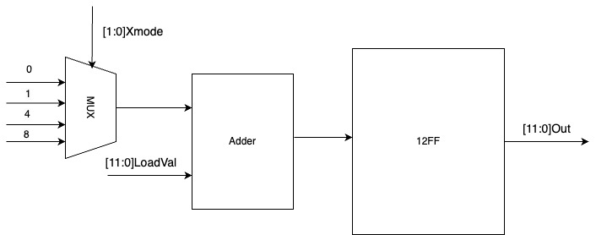
Counter - design

Slide 6
Ramp
Inputs:
Clk – The system clock.
Reset – Active low asynchronous reset.
ramp_enb – ‘1’ for active, ’0’ for inactive.
delta – Add delta Y to the output
[1:0]Ymode – The delta Y
’00’: deltaY = 0
‘01’: deltaY = 1
‘10’: deltaY = 16
‘11’: deltaY = 1290
Output:
[11:0]Out = deltaY*(number of delta signals)

Slide 7
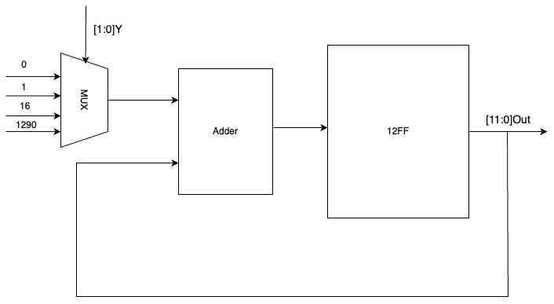
Ramp - design

Slide 8
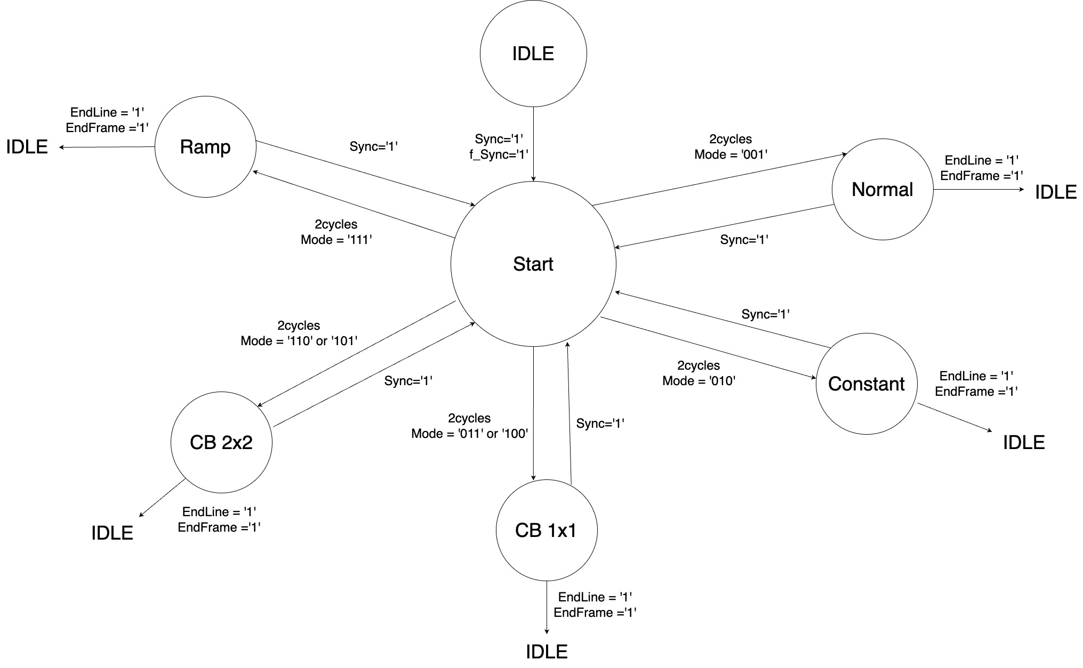

Slide 9
Normal work mode – [2:0]Mode = ‘001’
READY
[2:0]Mode == ‘001’ :
5b_enb =‘1’
Test = ‘0’
Binary_Or_Gray=’1’
ramp_enb =’0’
[1:0]ValSel = ‘00’
Xmode= ‘000’
Cnt_enb=‘1’
NewLine =‘1’(2d clock)
2 clock
Normal:
Input:
EndLine=’0’:
Output:
Xmode= ‘01’
Cnt_enb=‘1’
12b_enb = ‘1’
[1:0]ValSel = ‘11’
Input:
EndLine=’1’:
Output:
Cnt_enb=‘0’
12b_enb = ‘0’
IDLE
EndLine=‘1’
EndFrame=‘1’
Sync=‘1’

Slide 10
Constant test mode – [2:0]Mode = ‘010’
READY
[2:0]Mode == ‘010’ :
5b_enb =‘1’
Test = ‘1’
Binary_Or_Gray=’0’
ramp_enb =’0’
[1:0]ValSel = ‘01’(2d clk)
Cnt_enb=‘1’(2d clk)
NewLine =‘1’(2d clk)
2 clock
Normal:
Input:
EndLine=’0’:
Output:
Xmode= ‘00’
Cnt_enb=‘1’
12b_enb = ‘1’
Input:
EndLine=’1’:
Output:
Cnt_enb=‘0’
12b_enb = ‘0’
IDLE
EndLine=‘1’
EndFrame=‘1’
Sync=‘1’

Slide 11
Checkerboard 1x1’white’– [2:0]Mode = ‘011’
READY
[2:0]Mode == ‘011’ :
5b_enb =‘1’
Test = ‘1’
Binary_Or_Gray=’0’
ramp_enb =’0’
NewLine =‘1’(2d clk)
Cnt_enb=‘1’(2d clk)
Input: Flag = ‘0’:
Output: [1:0]ValSel = ‘00’
Input: Flag = ‘1’:
Output: [1:0]ValSel = ‘10’
2 clock
CB 1x1:
Input:
EndLine=’0’:
Output:
Xmode= ‘00’
Cnt_enb=‘1’
12b_enb = ‘1’
ValSel[1]=~ValSel[1]
Flag = ~Flag(1clk)
Input:
EndLine=’1’:
Output:
Cnt_enb=‘0’
12b_enb = ‘0’
IDLE
EndLine=‘1’
EndFrame=‘1’
Sync=‘1’

Slide 12
Checkerboard 1x1’black’– [2:0]Mode = ‘100’
READY
[2:0]Mode == ‘100’ :
5b_enb =‘1’
Test = ‘1’
Binary_Or_Gray=’0’
ramp_enb =’0’
NewLine =‘1’(2d clk)
Cnt_enb=‘1’(2d clk)
Input: Flag = ‘0’:
Output: [1:0]ValSel = ‘10’
Input: Flag = ‘1’:
Output: [1:0]ValSel = ‘00’
2 clock
CB 1x1:
Input:
EndLine=’0’:
Output:
Xmode= ‘00’
Cnt_enb=‘1’
12b_enb = ‘1’
ValSel[1]=~ValSel[1]
Flag = ~Flag(1clk)
Input:
EndLine=’1’:
Output:
Cnt_enb=‘0’
12b_enb = ‘0’
IDLE
EndLine=‘1’
EndFrame=‘1’
Sync=‘1’

Slide 13
Checkerboard 2x2 ’white’– [2:0]Mode = ‘101’
READY
[2:0]Mode == ‘101’ :
5b_enb =‘1’
Test = ‘1’
Binary_Or_Gray=’0’
ramp_enb =’0’
NewLine =‘1’(2d clk)
Cnt_enb=‘1’(2d clk)
Input: Flag = ‘00’ or ‘01’:
Output: [1:0]ValSel = ‘00’
Input: Flag = ’10’ or ‘11’:
Output: [1:0]ValSel = ‘10’
2 clock
CB 2x2:
Input:
EndLine=’0’:
Output:
Xmode= ’00’
Cnt_enb=‘1’
12b_enb = ‘1’
Flag = Flag+1(1clk)
Every 2 clks:
ValSel[1]=~ValSel[1]
Input:
EndLine=’1’:
Output:
Cnt_enb=‘0’
12b_enb = ‘0’
IDLE
EndLine=‘1’
EndFrame=‘1’
Sync=‘1’

Slide 14
Checkerboard 2x2’black’– [2:0]Mode = ‘110’
READY
[2:0]Mode == ‘110’ :
5b_enb =‘1’
Test = ‘1’
Binary_Or_Gray=’0’
ramp_enb =’0’
NewLine =‘1’(2d clk)
Cnt_enb=‘1’(2d clk)
Input: Flag = ‘00’ or ‘01’:
Output: [1:0]ValSel = ‘10’
Input: Flag = ‘10’ or ‘11’:
Output: [1:0]ValSel = ‘00’
2 clock
CB 2x2:
Input:
EndLine=’0’:
Output:
Xmode= ’00’
Cnt_enb=‘1’
12b_enb = ‘1’
Flag = Flag+1(1clk)
Every 2 clks:
ValSel[1]=~ValSel[1]
Input:
EndLine=’1’:
Output:
Cnt_enb=‘0’
12b_enb = ‘0’
IDLE
EndLine=‘1’
EndFrame=‘1’
Sync=‘1’

Slide 15
Extracting Ramp - [2:0]Mode = ‘111’
READY
[2:0]Mode == ‘111’ :
5b_enb =‘1’
Test = ‘1’
Binary_Or_Gray=’0’
ramp_enb =’1’
[1:0]ValSel = ‘00’
delta = ’0’
NewLine =‘1’(2d clock)
Cnt_enb=‘1’(2d clk)
2 clock
Ramp
Input:
EndLine=’0’:
Output:
Xmode= x[1:0]
Cnt_enb=‘1’
12b_enb = ‘1’
[1:0]ValSel = ‘11’
delta = ’1’(1clk)
Input:
EndLine=’1’:
Output:
Cnt_enb=‘0’
12b_enb = ‘0’
IDLE
Flag = 0
EndLine=‘1’
EndFrame=‘1’
Sync=‘1’

