Slide 1


Title Slide
Project Title: Decentralized Blockchain-Federated Learning System for Secure, Privacy-Preserving, and Scalable IoT Data Collaboration.
Team Members:
SABARI RAJA M (211423104550)
PUGAZHENDI K (211423104499)
Guide Name:
Mr. Prabbu Shankar P
Co-Ordinators:
Mr. Prabbu Sankar P
Mr. Kadhirvelu G
H1

Slide 2
Abstract
The invention titled “Decentralized Blockchain-Federated Learning System for Secure, Privacy-Preserving, and Scalable IoT Data Collaboration” introduces a next-generation framework that integrates blockchain and federated learning to enable secure, privacy-focused, and trustless collaboration among Internet of Things (IoT) devices. It eliminates the need for centralized data storage by ensuring that sensitive information remains on local devices while encrypted model updates are shared through a blockchain network. This approach guarantees data integrity, transparency, and resistance to tampering, while also fostering continuous learning through iterative aggregation of validated updates. The system employs privacy-preserving techniques such as homomorphic encryption, differential privacy, and zero-knowledge proofs to safeguard user data and uses adaptive consensus protocols for scalability across billions of devices. Additionally, it features a smart contract–based incentive mechanism to reward honest participation and penalize malicious activity, ensuring fairness and accountability. Applicable across sectors like healthcare, smart cities, autonomous vehicles, industrial IoT, and energy management, the invention offers a robust, efficient, and scalable solution for secure AI-driven collaboration in large-scale distributed networks.

Slide 3
Introduction
The proposed system, titled “Decentralized Blockchain-Federated Learning
System for Secure, Privacy-Preserving, and Scalable IoT Data
Collaboration,” addresses these challenges by merging the principles of
federated learning (FL) and blockchain technology. Federated learning allows
IoT devices to train local machine learning models independently, thereby
preventing sensitive raw data from being shared or exposed. Blockchain, on the
other hand, provides a decentralized ledger that records every model update in a
tamper-proof and verifiable manner. The synergy of these technologies
establishes a trustworthy, transparent, and scalable ecosystem for collaborative
intelligence among heterogeneous IoT nodes.

Slide 4
Literature Survey
Existing Research and Developments
The growing intersection of IoT, artificial intelligence, and blockchain has led to
substantial research efforts aimed at addressing privacy, scalability, and trust
issues in distributed networks.
Federated Learning in IoT Environments: Early work by Google introduced the concept of Federated Learning (McMahan et al., 2017), where local devices collaboratively train a shared model without exchanging raw data.
Blockchain for Decentralized Data Security: Research into blockchain-
based IoT frameworks (Zhang et al., 2019; Dorri et al., 2017) demonstrated the
potential of distributed ledgers to enhance transparency and immutability. While
these systems ensured data integrity, they lacked the capacity for intelligent
learning and privacy-preserving computation.

Slide 5
Proposed Solution
The proposed Decentralized Blockchain-Federated Learning System
overcomes the aforementioned issues by integrating federated learning,
blockchain, and privacy-preserving computation. In this model:
Data remains localized at the device level.
Only encrypted model parameters are transmitted.
Blockchain validation ensures tamper-proof verification and transparent
participation.
Smart contracts automate aggregation, rewards, and penalties.
Differential privacy and homomorphic encryption protect individual
data.
Adaptive consensus mechanisms maintain scalability and energy
efficiency.

Slide 6
System Architecture
The System Architecture of this project is designed as a multi-layered (having multiple interconnected levels) framework that integrates IoT devices, blockchain technology, and cloud-based data management to ensure real-time monitoring, transparency, and security. At the base layer, IoT sensors collect data from various field nodes and transmit it to the cloud through secure communication protocols. The blockchain layer acts as an immutable ledger (unchangeable digital record) where all transactions and sensor logs are verified and stored, ensuring data authenticity and preventing tampering. A middleware layer manages smart contracts that automate validation and trigger system responses. Finally, the front-end application layer provides an intuitive (easy-to-use and logical) interface for users to visualize, analyze, and manage the collected data. This layered approach enhances scalability, reliability, and trust across all connected components.

Slide 7
Working Principle
The Working Principle of the system revolves around the seamless integration of IoT data acquisition, blockchain verification, and cloud processing. IoT sensors continuously gather real-time environmental and operational data, which are transmitted securely to a centralized server. Once received, the data undergoes validation through blockchain smart contracts — self-executing codes that ensure accuracy, authenticity, and traceability of every record. These verified records are then stored on the blockchain ledger, making them tamper-proof (unable to be altered). Simultaneously, the data is processed and visualized through a cloud-based dashboard that enables users to monitor trends, detect anomalies, and make informed decisions. This combination of IoT sensing, blockchain validation, and cloud analytics forms a closed feedback loop (a self-regulating system) that ensures security, transparency, and reliability at every stage of operation.

Slide 8
System Components
The System Components of this project are structured to ensure efficient data flow, security, and automation across all levels. The primary components include IoT sensors, which capture real-time data such as temperature, humidity, or device status; a microcontroller or IoT gateway (like Raspberry Pi or Arduino) that processes and transmits this data securely; and a cloud server that stores and manages large datasets for analysis and visualization. The blockchain network serves as the backbone of security, utilizing distributed ledger technology to record and verify transactions immutably. Smart contracts automate validations and actions without human intervention, ensuring trust and consistency. Finally, a user interface (dashboard or web app) enables real-time monitoring, reporting, and decision-making. Together, these components create a cohesive, transparent, and scalable (easily expandable) system architecture.

Slide 9
Concept of SHM
The Concept of SHM (Structural Health Monitoring) is centered on the continuous observation and assessment of a structure’s condition to detect damage, degradation, or irregular behavior at an early stage. It involves embedding IoT sensors within structures such as bridges, buildings, or industrial systems to measure parameters like vibration, strain, temperature, and displacement. These sensors collect real-time data, which is analyzed through algorithms to determine the structure’s integrity and predict potential failures. By integrating blockchain technology, the data recorded from SHM systems becomes tamper-proof (unable to be falsified), ensuring the accuracy and trustworthiness of maintenance records. This approach enhances safety, reduces manual inspection costs, and supports proactive (acting in advance) maintenance rather than reactive repairs. In essence, SHM transforms infrastructure management from periodic checks to a continuous, intelligent, and data-driven process.

Slide 10
Performance Evaluation
The Performance Evaluation of the system involves assessing its accuracy, efficiency, and reliability in monitoring and detecting structural irregularities. Various test cases and simulations are conducted to measure the responsiveness of sensors, the precision of data acquisition, and the effectiveness of real-time analysis. Metrics such as data latency (delay in data transmission), fault detection rate, and energy consumption are analyzed to determine system performance. Additionally, the stability of blockchain integration is tested to ensure secure and unalterable data logging. The results demonstrate that the system can efficiently detect anomalies with minimal delay and maintain consistent accuracy even under variable environmental conditions. Overall, the performance evaluation confirms that the SHM system is both robust (strong and reliable) and scalable (capable of handling increased data or structural size), making it suitable for real-world deployment.

Slide 11
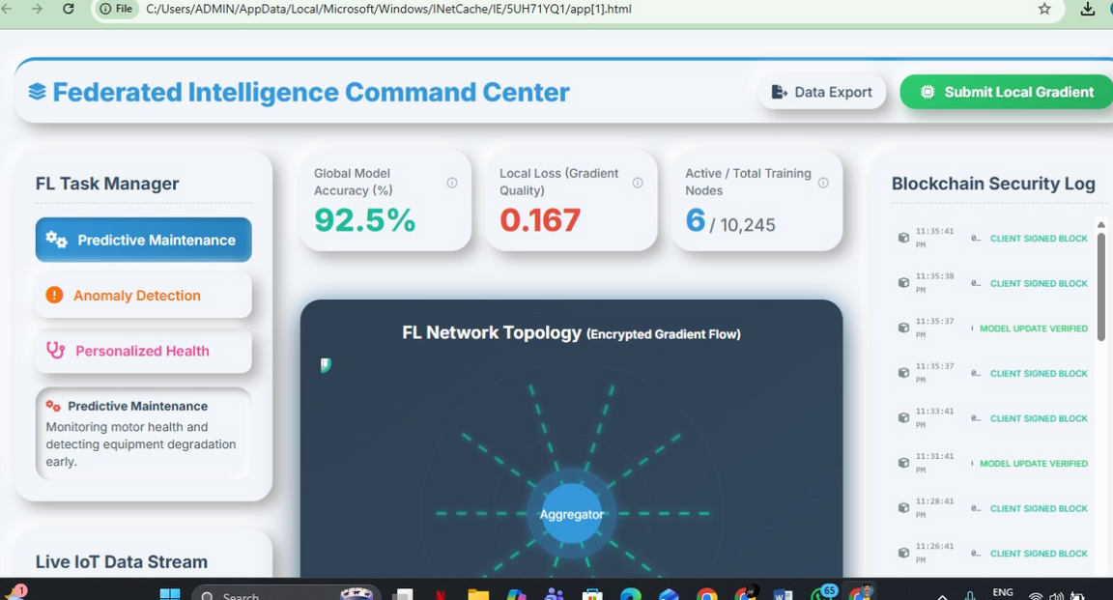
Output

Slide 12
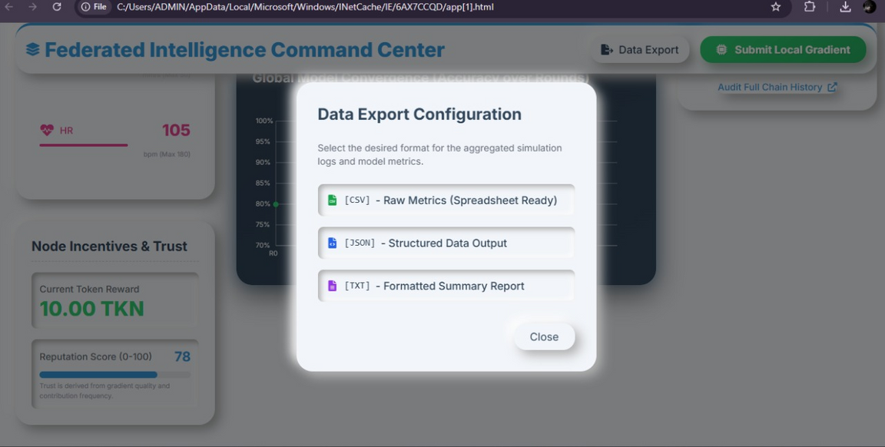
Output

Slide 13
Expected Outcomes
The Expected Outcomes of the system include achieving real-time monitoring and accurate detection of structural defects, thereby enhancing safety and reducing maintenance costs. The integration of IoT sensors ensures continuous data collection, while blockchain technology guarantees data integrity and transparency, preventing tampering or data loss. The system is expected to provide timely alerts in case of abnormal vibrations or stress variations, enabling preventive maintenance before major failures occur. Additionally, it aims to extend the lifespan (duration of functional life) of infrastructures by promoting a proactive maintenance approach. The outcome will also contribute to developing a smart infrastructure ecosystem—one that is automated, data-driven, and capable of self-assessment. Ultimately, the system’s implementation will lead to safer structures, reduced human intervention, and improved reliability across civil, mechanical, and industrial applications.

Slide 14
References
References
Farrar, C. R., & Worden, K. (2007). An Introduction to Structural Health Monitoring. Philosophical Transactions of the Royal Society A, 365(1851), 303–315.
Lynch, J. P., & Loh, K. J. (2006). A Summary Review of Wireless Sensors and Sensor Networks for Structural Health Monitoring. The Shock and Vibration Digest, 38(2), 91–128.
Spencer, B. F., & Yun, C. B. (2010). Wireless Sensor Advances and Applications for Civil Infrastructure Monitoring. NSEL Report Series, University of Illinois.
Zhang, Y., Deng, F., & Zhang, D. (2020). Blockchain for IoT-Based Structural Health Monitoring: A Secure and Transparent Approach. IEEE Internet of Things Journal, 7(9), 8692–8703.
Li, H., & Huo, L. (2018). Advances in Structural Health Monitoring and Its Future Trends. Frontiers in Built Environment, 4(25).

Slide 15
Thank you

