Slide 1


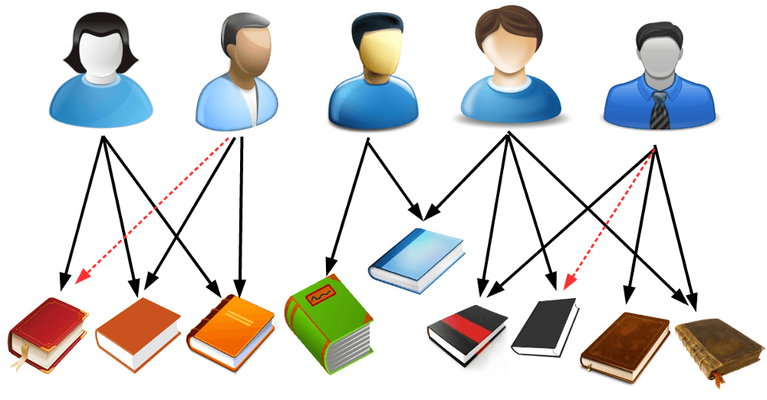
Recommender Systems
Sabarish Gopalakrishnan Advised by: Dr. Raymond Ptucha
Machine Intelligence Laboratory, Computer Engineering
Rochester Institute of Technology
Abstract
Recommender systems are used by companies like Amazon, Netflix and Google to nudge customers into consuming products based on their behaviour. This project describes 2 methods used to build a Collaborative Filter: i) user based and ii) item based collaborative filtering. The user based technique recommends a new product to a user based on their similarity to users already using the product. The item based filtering finds a relation between products and suggests a new product to an existing user basis their current consumption. The similarity between two users or products can be measured by using covariance, cosine similarity or the Euclidian distance between them.
Calculation
A sample problem for a User Based Filtering is worked out below. The same technique can be used for a Item Based Filtering method.
The existing data on the ratings provided by some users on items is Table. 1. The ratings range from 1 to 5 where 5 represents the best rating. The blanks in the table indicates that the user has not used the corresponding item.
 | Item A | Item B | Item C | Item D | Item E
User 1 | 5 | 3 | 4 | 4
User 2 |  | 1 | 2 | 3 | 3
User 3 | 4 | 3 |  | 3 | 5
User 4 | 3 | 3 | 1 | 5 | 4
User 5 | 1 | 5 | 5 |  | 1
i) User Based
Flow Diagram
In this method, the similarity between two users is used to recommend if an existing user will use a new or unused product based on the user’s history. It calculates the similarity metric between all the pairs of users in the data and is quite computationally expensive.
Item A
User 1
Similar
User 2
Item A
This example uses the Pearson correlation to calculate the similarity between two users. The correlation between the users is indicated in Table 2.
Item B
Item B
ii) Item Based
 | User 1 | User 2 | Uesr 3 | User 4 | User 5
User 1 | 1 | 0.87 | 0.87 | 0 | -0.87
User 2 | 0.87 | 1 | 0.50 | 0.56 | -0.87
User 3 | 0.87 | 0.50 | 1 | -0.09 | -0.87
User 4 | 0 | 0.56 | -0.09 | 1 | -0.69
User 5 | -0.87 | -0.87 | -0.87 | -0.69 | 1
It is same as the user based filtering technique but the difference is that the similarity between two items or products is used as a metric to gauge if an existing user will use a new or unused product based on the user’s history. It calculates the similarity metric between all the pairs of items.
Item C
Item D
Item used by User
Recommended Item
For a k^{th} user, we recommend an unused item for if :
a) User Based Recommender System
Similarity Metric
User 1
User 2
There are several ways in which one can measure the similarity between 2 users or items:
Pearson Correlation: Calculates the correlation between the 2 users or items and ranges from -1 to 1.
Cosine Similarity: The users or items are represented as vectors. The cosine of the angle between the vector is used as a similarity metric. Closer the 2 vectors, smaller is the angle between them and the higher is the cosine value. It also ranges from -1 to 1.
r_{i} – Similarity measure: Here it is the Pearson correlation between i^{th} user and k^{th} user
X_{i} – Rating for the item given by i^{th} user
(Average Rating)_{k}– Average Rating to all products rated by k^{th} user
Item A
Similar
Item B
Item used by User
For Item E and User 1 –
Recommended Item
?
b) Item Based Recommender System
Acknowledgements
Knowledge-Based Systems - Haifeng Liu Beijing University of Posts and Telecommunications, China
Similarity and recommender systems - Hiroshi Shimodaira, School of Informatics, University of Edinburgh
Item E won’t be recommended to User 1
Notes:
36pt font
40in by 32in
MILPET pictures
Encoder pictures
Encoder and kalman filters
Particle filters
Choice of encoder, how it works, oscilloscope screenshot
Localization
Encoders
An encoder is a device used to measure distance traveled, speed and direction. Typically, the device consists of an encoder wheel and the sensor. The wheel can be equally divided into black and white wedges so the sensor detects either reflected light off of the white wedges or an absence of light absorbed by the black wedges. Other types of wheels are dotted with equally spaced slits along the circumference. In this case the sensor detects whether or not light passes through a slit. In both cases, the encoder sensor consists of an infrared light emitting a beam onto the disk and a transistor detecting the light. The transistor returns a high or low reading depending on the position of the wheel and whether or not it detects light. Transitions between high and low are used to measure the angular rotation of the wheel.
A quadrature encoder is a method of detecting the direction in which the wheel is turning. On a black and white encoder wheel, there are two tracks of wedges 90 degrees out of phase. Each track is followed by an individual sensor. The resulting waveforms are 90 degrees out of phase. By looking at whether the second waveform is high or low on the rising edge of the first sensor, The direction of the wheel can be concluded by looking at whether the second waveform is high or low on the rising edge of the first sensor.
MILPET
The repurposed Quickie S-11 medical electrical wheelchair, MILPET (Machine Intelligence Laboratory Personal Electronic Transporter), has been implemented with encoders on the motor of each wheel to track its motion as it roams through hallways. Additionally, an omnicamera attached to the robot gives imaging feedback of the surrounding environment.
Dead Reckoning
The process of commanding a movement to a robot and using that movement and knowledge of the original position to determine location is called dead reckoning. However, the location becomes less certain as the agent continues to move. Movement comes with uncertainty – did the robot undershoot or overshoot its movement? Did a wheel slip and not go anywhere? Did it collide with something and turn in a different direction?
Kalman Filters
To resolve the uncertainty of dead reckoning, measurements of the environment are folded into the movement of the robot to more precisely localize with the process of Kalman Filters. These filters incorporate probability functions to predict the robot’s location as it moves and reduce uncertainty of with each prediction. Kalman Filters are a process of movement and sensing – the encoder tracks movement information and other sensors, such as lasar range finders or SONAR, take measurements of the environment.

