Slide 1
CYBER Security
Project
Password Cracking
Using USB Rubber Ducky

Slide 2
USB RUBBER DUCKY
Introduction:
USB Rubber Ducky is a powerful and versatile tool that can be used to automate tasks, gain access to computers, and even penetrate networks.
It is a small device that looks like a regular USB flash drive, but acts like a keyboard when plugged into a computer.
The Rubber Ducky contains a powerful scripting language which allows it to rapidly send keystrokes to a target machine, allowing it to quickly execute pre-programmed tasks.
With its fast and reliable performance, the USB Rubber Ducky is an ideal choice for anyone looking to automate tasks, gain access to systems, or test security protocols.

Slide 3
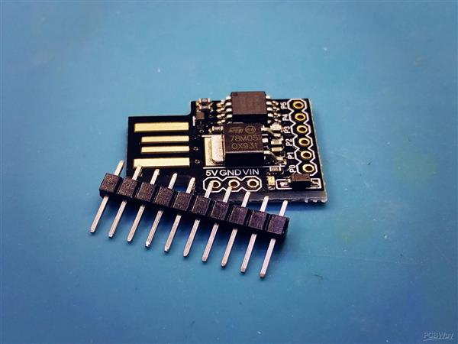
Arduino IDE
In this project we Use Arduino IDE to Inject the code into device
Arduino IDE:
First in Arduino IDE we install the Digispark Drivers
Add Reference link of Digistump drivers in IDE.
Select the Digispark Board and insert the script code
To Function.
Rubber Ducky Payloads :
Payloads are converted to C++
script in through converters and placed in IDE.
Digispark:
The Digispark will start working According to given
delay.
Very reliable not Even computer don't try stop
because it is a HID Device .

Slide 4
01
Android pin cracker
For 4 digit pin

Slide 5
SELECT
01
SCRIPT
02
VERIFY
03
INSERT
04
PIN CRACK
05
Select the Digispark board in anduino IDE
Write the script that you are working to insert
Verify this script code is correct and working
Insert the code in the digispark board
The digispark will start working to crack the pin

Slide 6
02
WI-FI PASSWORD GRABBER
WI-FI passwords are send to Attacker

Slide 7
THE SAVED WIFI PASSWORDS ARE SEND TO ATTACKER
SAVED PASSWORDS
Saved passwords Data sailed in the device or Collected
RECEIVER DBS
Receiver will get the Data and store’s in DataBase

Slide 8
INTERNET AROUND THE WORLD
RECEIVER
Attacker will receive the passwords to his server

Slide 9
ABOUT THIS TOPIC
The USB Rubber Ducky is often used in cybersecurity demonstrations and training exercises to show how easy it is for an attacker to gain access to a computer if the user is not careful about the devices they connect to their system.
devices are popular among security professionals and ethical hackers because they can be used to automate tasks and test the security of systems in a quick and stealthy manner.

Slide 10
TEAM MEMBERS
1ST SABARISH
2ND JAYASWI
3RD GOUSE
4TH VARMA
AP20110010832
AP20110010783
AP20110010647
AP20110010650

