Slide 1
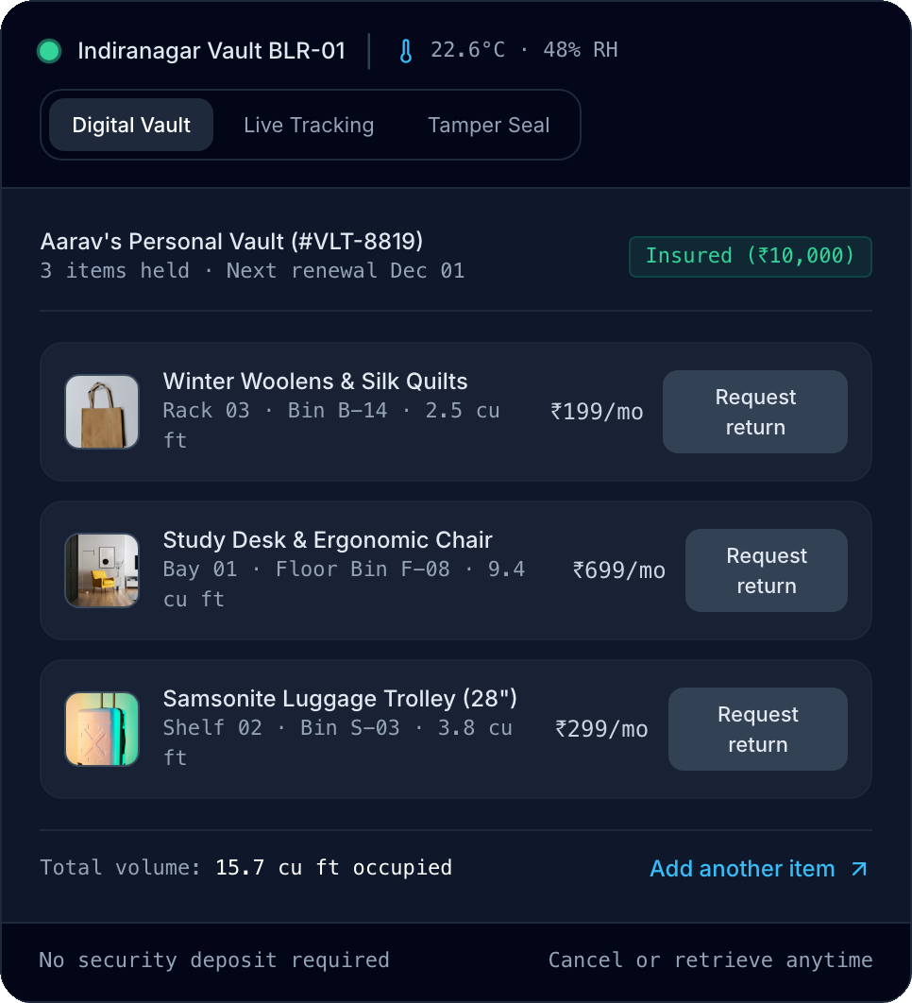
LU
Loot Up Space
BENGALURU · MUMBAI · CHENNAI
LIVE DIGITAL VAULT INTERFACE
HACKATHON PROJECT PITCH
Your space, back.
Your stuff, safe.
An Amazon-style doorstep personal storage platform & PWA built for space-constrained Indian metro apartments. Photograph belongings, get instant 18% GST volumetric quotes, hand over boxes via 4-digit OTP, and retrieve any single barcoded carton within 24–48 hours.
From ₹199/mo
4 RBAC Portals
14 / 14 Tests
Volumetric tiers from 2 cu ft
Customer · Driver · Hub · Admin
Full TS + React + Express + Prisma
Live: lootupspace.vercel.app | GitHub: sabarishyuvasri8-del/lootupspace

Slide 2
01 / PROBLEM STATEMENT
Indian metro apartments are too expensive to act as storage closets
Residents waste expensive per-sq-ft living area on seasonal gear, while legacy godowns force truck rentals and blind whole-unit lock-ins.
01
Metro Rent Squeeze
METRO LIVING SPACE COST BENCHMARKS
Typical apartment rent per sq ft / month
Apartments in Indiranagar, Bandra & OMR cost ₹55–₹180/sq ft/month. Winter quilts, 28" suitcases, bikes, and spare desks silently consume 25–45 sq ft of livable space.
Mumbai (BKC / Powai)
₹120 – ₹180
Bengaluru (Indiranagar / HSR)
₹80 – ₹110
02
Outskirts Self-Storage Friction
Chennai (OMR / Anna Nagar)
₹55 – ₹85
Legacy warehouses require you to buy cartons, pack heavy boxes, hire a local tempo, haggle with movers, and travel 25–35 km through traffic to industrial outskirts.
SPACE RECOVERY MODEL
35 sq ft reclaimed = ₹2,975/mo rent value
03
Zero Item-Level Visibility
Traditional storage treats everything as one locked room. Retrieving one jacket or tax folder forces unpacking everything on-site without digital catalogs or insurance.
Default bundle: 2 winter boxes (8 sq ft) + 2 suitcases (9 sq ft) + study desk/chair (18 sq ft) at ₹85/sq ft vs ₹1,495/mo storage.
Net value unlocked: ~₹1,480 / mo
Loot Up Space (Lootupspace) | On-Demand Doorstep Storage & Vault Logistics
lootupspace.vercel.app
02 / 10

Slide 3
02 / SOLUTION WORKFLOW
An Amazon-style doorstep storage loop with item-level custody
From smartphone photos to barcoded shelving and 24–48 hour partial return delivery.
01
02
03
04
05
Photo & Estimate
Doorstep Handover
Vault Intake & Bin
Digital Vault App
Single-Item Return
Upload 2–8 photos and dimensions (cm/in/ft) or box count for instant tier & 18% GST quote.
Captain arrives in a 2-hr slot, seals cartons with tamper QR tape, verifies 4-digit pickup OTP.
Hub scans barcode, logs cargo condition & weight, assigns smart Zone-Aisle-Rack-Bin coordinate.
Customers inspect photos, shelf locations, and insurance status anytime from web or phone.
Need just 1 winter coat or book carton? Request 1-tap doorstep delivery within 24–48 hours.
Free cartons on request
Serialized security seal
24/7 CCTV & <55% RH
Live vault visibility
4-digit delivery OTP
DIMENSION
LOOT UP SPACE (DOORSTEP CUSTODY)
TRADITIONAL OUTSKIRTS SELF-STORAGE
Packing & Transport
+ 5-ply cartons + captain pickup included in 2-hr slot
- Self-pack, hire local tempos, haggle & navigate traffic
Single-Item Retrieval
+ Click any QR-tagged item in app -> delivered in 24–48h
- Drive 30 km to godown and unpack entire locked unit
Protection & Custody
+ <55% RH climate vault + 24/7 CCTV + ₹10k free cover
- Industrial corrugated sheds; dampness risk; owner liability
Loot Up Space (Lootupspace) | On-Demand Doorstep Storage & Vault Logistics
lootupspace.vercel.app
03 / 10

Slide 4
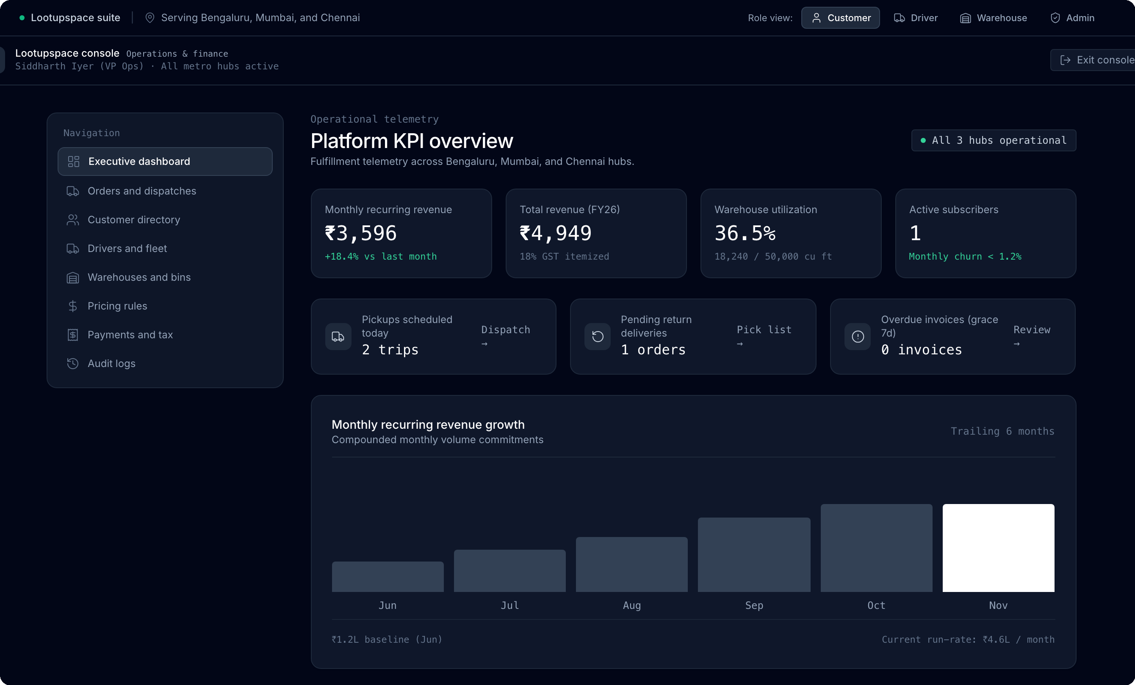
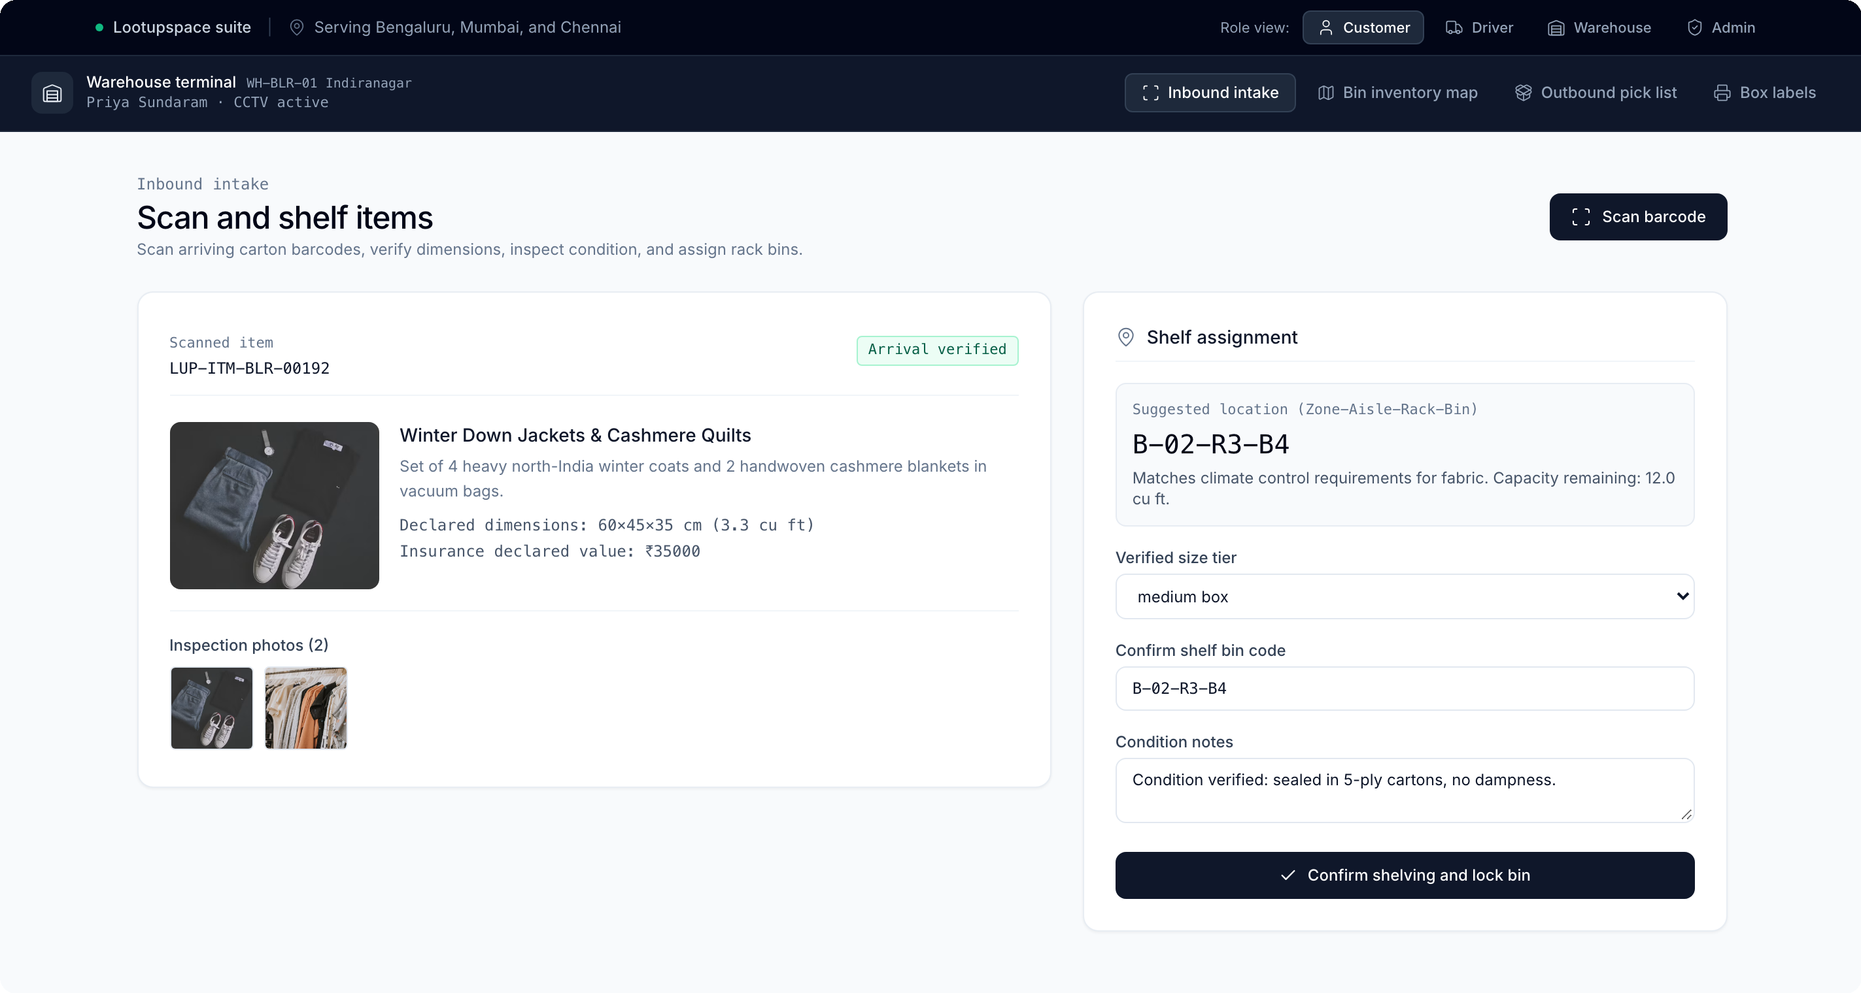
03 / LIVE PRODUCT SURFACES
Real operational consoles: QR intake terminal & executive KPI cockpit
Captured directly from the production build running across Bengaluru, Mumbai & Chennai mock/PostgreSQL hubs.
/warehouse · INBOUND QR INTAKE
Smart Bin: B-02-R3-B4
/admin · OPS & FINANCE CONSOLE
3 Hubs · Audit Ledger
Staff scan sealed carton barcodes, verify volumetric size tier & photos against declaration, and lock items directly into climate rack coordinates.
Executive cockpit tracks MRR growth, FY revenue, warehouse cubic-ft utilization, active dispatches, overdue grace monitoring, and immutable audit logs.
Loot Up Space (Lootupspace) | On-Demand Doorstep Storage & Vault Logistics
lootupspace.vercel.app
04 / 10

Slide 5
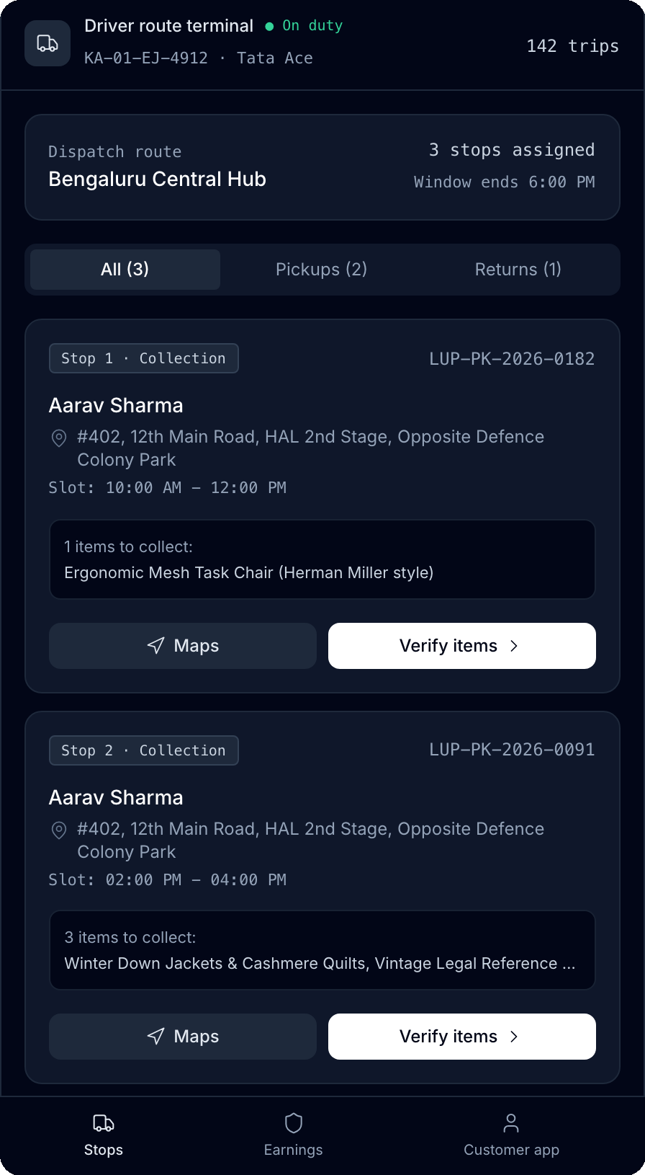
04 / FOUR-PERSONA RBAC SUITE
One shared state graph serving every stakeholder end-to-end
Pinned Role Switcher Banner lets evaluators jump cleanly across Customer, Driver PWA, Warehouse & Admin views.
DRIVER PWA LIVE CAPTURE
CUSTOMER PORTAL (/customer)
DRIVER FIELD PWA (/driver)
Aarav Sharma · +919876543210
Ramesh Kumar · Tata Ace KA-01-EJ-4912
30-pincode coverage check, 2–8 photo intake, volumetric cart checkout, QR digital vault, 1-click partial returns, and GST tax invoice printing.
Installable offline-resilient PWA (sw.js + offline.html), pickup route manifest, packing checklist, cargo proof upload & 4-digit OTP handover.
WAREHOUSE TERMINAL (/warehouse)
ADMIN OPS & FINANCE (/admin)
Priya Sundaram · Hub WH-BLR-01
Siddharth Iyer · All Metro Hubs
Barcode modal scanner, condition log verification, Zone-Aisle-Rack-Bin placement map, outbound return pick list & printable QR carton labels.
Multi-hub MRR & bin capacity analytics, driver fleet reassignment, live pricing rule overrides, CSV GST ledger export & full action audit log.
Demo OTP across all 4 seeded RBAC personas: 123456 | Single-click toggle via top Role Switcher bar
Loot Up Space (Lootupspace) | On-Demand Doorstep Storage & Vault Logistics
lootupspace.vercel.app
05 / 10

Slide 6
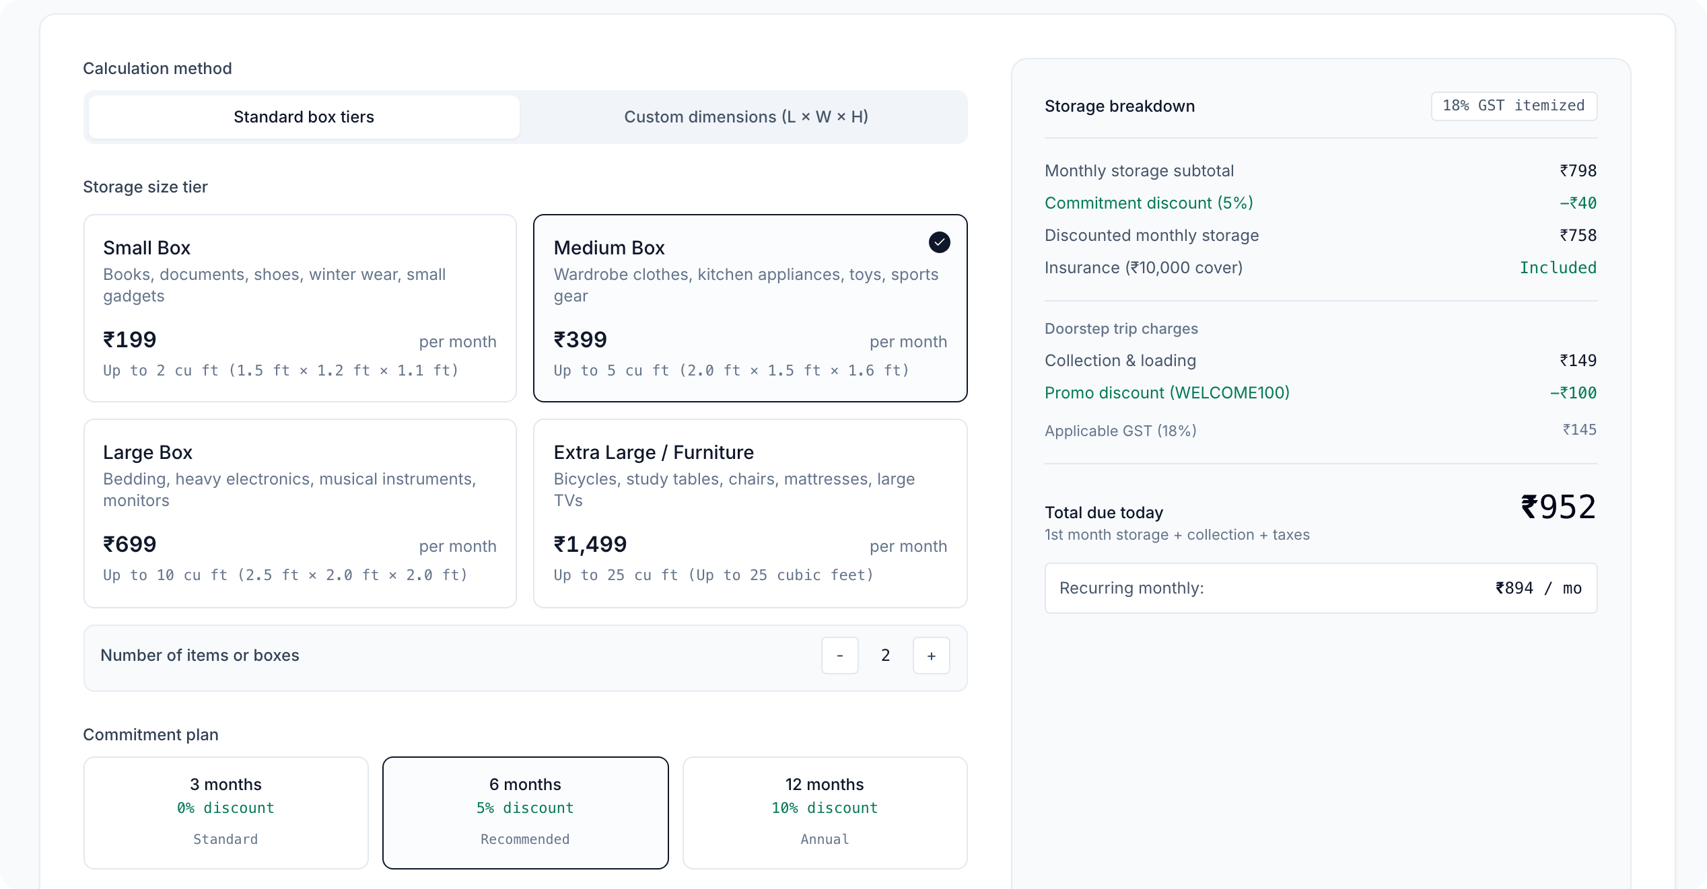
05 / PRICING & GST ENGINE
Pure volumetric pricing engine shared between frontend & backend
Deterministic TypeScript billing (@lootupspace/shared) handling box tiers, custom CM/IN/FT volumes, commitment discounts & 18% GST.
SIZE TIER
MAX VOLUME
RATE / MO
/pricing · LIVE VOLUMETRIC CALCULATOR
Small Box
Up to 2.0 cu ft
₹199
Medium Box
Up to 5.0 cu ft
₹399
Large Box
Up to 10.0 cu ft
₹699
Extra Large / Furniture
Up to 25.0 cu ft
₹1,499
Custom Bulk Storage
Dynamic cu ft
₹75 / cu ft
SURCHARGES, DISCOUNTS & TAX RULES
- Doorstep Pickup / Return: ₹149 base (5 km & 5 boxes) + ₹15/km + ₹35/extra box
- Commitment Plans: 3 mo (0%) | 6 mo (5% off) | 12 mo (10% off) · Coupons supported
- Insurance Tiers: ₹10k Free | ₹25k (₹99) | ₹50k (₹199) | ₹1L (₹349/mo)
- GST Compliance: 18% GST under SAC Code 996729 itemized for B2B ITC
Live Quote: 2 Medium Boxes · 6-mo (-5%) · WELCOME100 (-₹100) + 18% GST
Due today: ₹952 (1st mo + pickup + tax) | Recurring: ₹894 / mo
Loot Up Space (Lootupspace) | On-Demand Doorstep Storage & Vault Logistics
lootupspace.vercel.app
06 / 10

Slide 7
06 / SYSTEM ARCHITECTURE
Modular npm workspaces monorepo with dual-mode persistence
Engineered for zero-friction local/cloud evaluation and seamless production cutover to PostgreSQL + Redis.
apps/web
apps/api
packages/database
React 18 + Vite 8 + PWA
Express + TypeScript API
Dual-Mode Data Layer
- 35 routes lazy-loaded via React.lazy()
- Tailwind UI system & WCAG native <dialog>
- Offline Driver PWA (sw.js + offline.html)
- browser.ts alias strips server/Zod deps
- Vercel production build + SPA rewrites
- 10 controllers mounted under /api/v1/*
auth, items, pickups, returns, warehouse,
driver, payments, pricing, admin, tickets
- JWT + 4-role RBAC guard middleware
- OpenAPI 3.0 Swagger UI served at /docs
- QR barcode, Queue & Notif services
- Prisma schema with 12 domain enums
- Full warehouse, invoice & audit models
- Auto-uses stateful mockDb when
DATABASE_URL is unset (zero setup)
- Docker stack: PostgreSQL, Redis, API, Web
packages/shared · SINGLE SOURCE OF TRUTH
Pricing Engine (calculateStoragePrice, calculateCubicFeet, determineSizeTier) · Serviceable Pincodes · Enums · Zod Schemas
Cleanly split via packages/shared/src/browser.ts so client builds import pure domain math with 0 bytes of Zod/Node validation overhead.
Loot Up Space (Lootupspace) | On-Demand Doorstep Storage & Vault Logistics
lootupspace.vercel.app
07 / 10

Slide 8
07 / ENGINEERING & PERFORMANCE
Audited for Core Web Vitals, accessibility, and automated reliability
Every number below is directly measured on the production Vite bundle, Express test suite, and live Google Chrome.
509 ms
0 Bytes
35 / 35
14 / 14
Vite 8 Production Build
Zod / Prisma in Client
Routes Chrome-Audited
Automated Tests Pass
Full route + below-the-fold lazy code splitting keeps initial JS lean.
packages/shared/src/browser.ts Vite alias strips backend schemas cleanly.
0 console errors, 0 failed network requests, 0 CLS, 0 mobile overflow.
7 Pricing unit tests + 3 Auth tests + 4 E2E Booking integration tests in CI.
MODERN WEB PLATFORM & ACCESSIBILITY
CI/CD, TOOLING & PRODUCTION DEPLOY
- Native HTML Top Layer: <dialog> modals for QR scanner, item preview, and GST tax invoice printing.
- Zero-JS Accordion & Nav: Exclusive <details name="faq"> disclosures + keyboard WAI-ARIA tablists.
- Inclusive Motion & Focus: Skip links, visible focus rings, and strict prefers-reduced-motion rules.
- Render Deferral: content-visibility: auto (cv-auto) defers below-fold sections with zero CLS.
- Automated GitHub Actions: .github/workflows/ci.yml builds shared, generates Prisma, tests API & web.
- One-Command Local Dev: npm run dev boots Express API (:4000) & Vite Web (:3000) cleanly.
- Containerized Stack: infra/docker-compose.yml + Postman collection ready for API verification.
- Serverless Hosting Ready: Deployed on Vercel (SPA rewrites active; in-browser demo auth fallback).
Loot Up Space (Lootupspace) | On-Demand Doorstep Storage & Vault Logistics
lootupspace.vercel.app
08 / 10

Slide 9
08 / TRUST, CUSTODY & INDIAN COMPLIANCE
Designed from day one for physical security and Indian statutory law
Combining verifiable chain-of-custody workflows with DPDP Act 2023, Bailment law & SAC 996729 GST billing.
PHYSICAL & CHAIN-OF-CUSTODY SAFEGUARDS
INDIAN REGULATORY & TAX GOVERNANCE
Dual-Side 4-Digit Handover OTP
DPDP Act (2023) Data Governance
Neither pickup nor return closes without verifying the customer's live 4-digit OTP + proof photos.
Explicit consent workflows, encrypted KYC document verification & full account deletion endpoints.
Tamper-Evident QR Barcodes
Indian Contract Act (1872) Bailment
Serialized 3M security seals + waterproof barcodes track every carton to Zone-Aisle-Rack-Bin.
Dedicated /storage-agreement covering Chapter IX bailment, Sec 170 lien & 90-day default notices.
Biometric Hubs & <55% RH Climate
Automated Prohibited Items Gate
Closed to walk-in public; 24/7 CCTV with 90-day archive + active monsoon dehumidification.
Pre-checkout screening blocks perishables, flammables, firearms, live plants & loose cash > ₹50,000.
Tiered Transit & Vault Insurance
SAC 996729 GST & Audit Trail
Free ₹10,000 shield on all accounts; optional Silver (₹25k), Gold (₹50k), and Platinum (₹1,00,000).
18% CGST/SGST tax invoices downloadable for ITC; every Admin action logged immutably.
Loot Up Space (Lootupspace) | On-Demand Doorstep Storage & Vault Logistics
lootupspace.vercel.app
09 / 10

Slide 10
09 / WHAT'S NEXT & TRY IT LIVE
Scaling intelligent vault custody across Indian metros
Phase 2 roadmap and direct evaluation links for hackathon judges.
PHASE 2A · AI VOLUMETRIC SIZING
JUDGE EVALUATION & LINKS
Computer Vision Cubic-Ft Estimator
Try Loot Up Space Right Now
Auto-detect item category, estimated cubic-foot footprint, and fragility class directly from smartphone intake photos.
LIVE WEB APPLICATION (VERCEL)
https://lootupspace.vercel.app
PHASE 2B · RACK OPTIMIZATION
3D Tetris Bin-Packing Engine
GITHUB SOURCE REPOSITORY
Maximize hub rack utilization across Bengaluru, Mumbai & Chennai warehouses with automated 3D shelf-packing suggestions.
https://github.com/sabarishyuvasri8-del/lootupspace
LOCAL FULL-STACK BOOT
git clone ... && npm install && npm run dev
Web :3000 | API + Swagger Docs :4000/docs
PHASE 2C · RAILS & CIRCULARITY
Live Payments, WhatsApp & Resale
INSTANT DEMO CREDENTIALS
Connect production Razorpay Autopay, WhatsApp Business dispatch alerts, AWS S3 uploads & 1-click donate/resell.
Use pinned Role Switcher bar on top of screen
Demo OTP for all 4 roles: 123456
Loot Up Space (Lootupspace) | On-Demand Doorstep Storage & Vault Logistics
lootupspace.vercel.app
10 / 10

