Slide 1
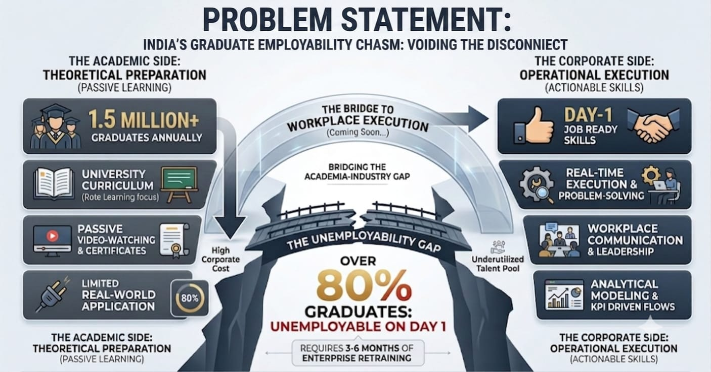
PROBLEM STATEMENT
CORE PROBLEM
India produces over 1.5 million graduates every year. Yet, over 80% are deemed unemployable on Day 1. Why? Because universities teach theory, while industry demands real-time execution, workplace communication, and cross-functional problem-solving.
PROBLEM ON CURRENT TECHNOLOGY
Current ed-tech relies on passive video watching and certificates with zero corporate accountability, leaving companies to spend months and millions retraining entry-level hires."

Slide 2
IDEA TITLE
IDEA
A Centralized Gamefied skill-development platform connecting students,acdemia and industries for skill mapping,internships and placements
AI style manager interaction
Real world project workspace
Placement cell module
Virtual corporate work place
virtual communication with collegous through chat,Email,video calls
PROBLEM RESOLUTION
Bridges the gap between academic learning and real-world corporate experience.
Develops technical, soft and professional skills through real-world tasks.
UNIQUE VALUE PROPOSITIONS
We transform students from job seekers into industry-ready professionals through AI-powered skill mapping, personalized learning, and realistic gamified workplace experiences.
Provides repeated, realistic mock interviews and personalized feedback to build confidence and help students face real interviews without fear.

Slide 3
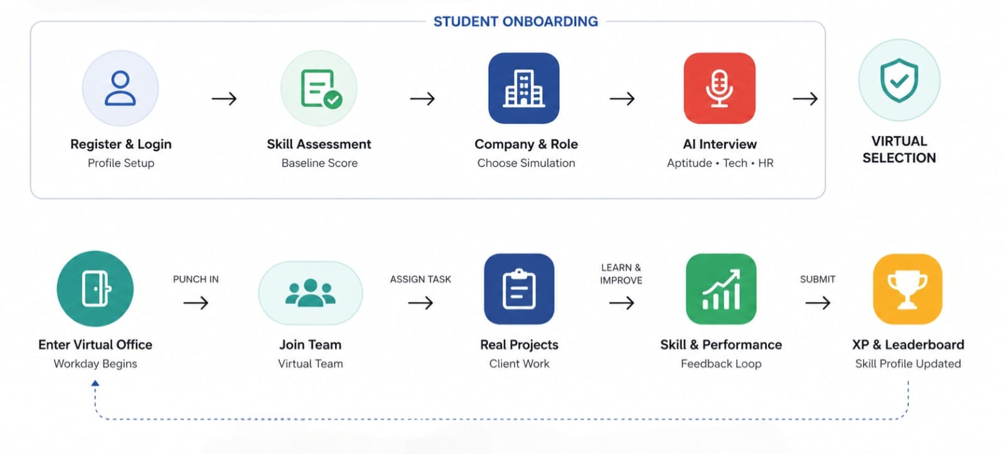
TECHNICAL APPROACH
Frontend
HTML5, CSS3, JavaScript
APPLICATION LOGIC
JavaScript – skill assessment, scoring, XP, leaderboard and skill-gap logic
BACKEND SERVER
Node.js + Express.js – APIs, authentication and data processing
DATABASE
MongoDB – student profiles, skills, assessments, projects and performance
ALGORITHMS
Skill Matching, Skill Gap Analysis, Scoring & Recommendation
AI INTEGRATION
AI-based Mock Interview & Personalized Learning (proposed/future implementation)
PROCESS FLOW
Product status
Product Status – 80% Completed
Core portal structure and key features have been developed.
Backend integration, testing, and final deployment are in progress.

Slide 4
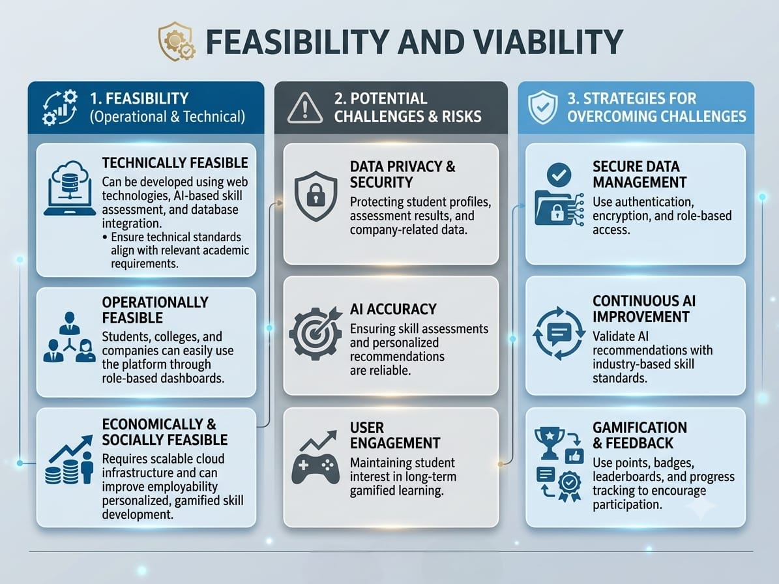

Slide 5
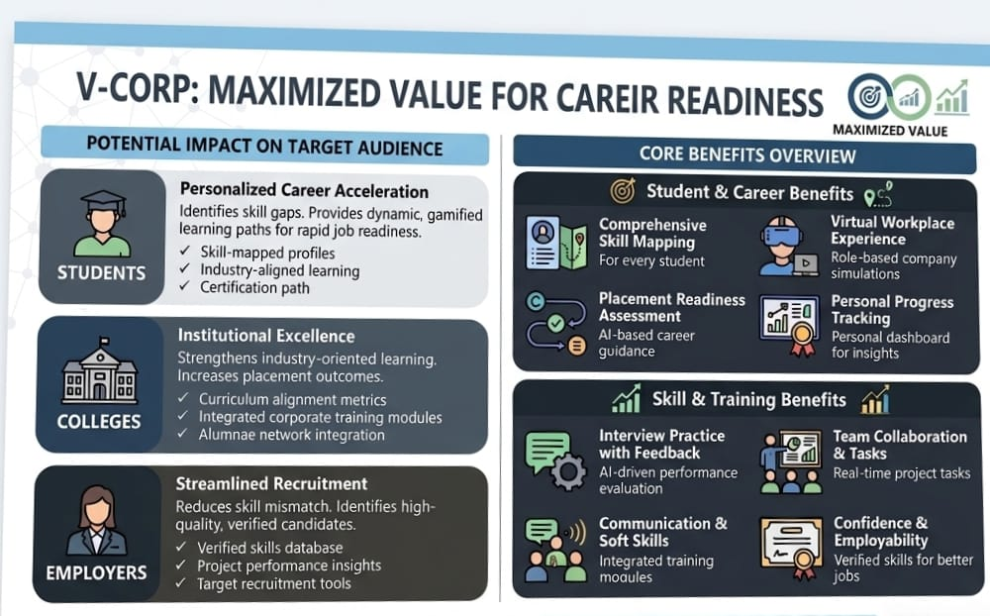

Slide 6
REVENUE MODEL
YEAR 1 INVESTMENT & COST BREAKDOWN
Cost Component | Description / Details | Year 1 Budget (INR)
Platform MVP Build | React, Node.js, Express, MongoDB, WebRTC | ₹4,50,000
AI LLM & Interview APIs | Dynamic interview simulation & evaluation inference | ₹1,80,000
Cloud Infrastructure | AWS / GCP, Atlas DB, Redis caching, CDN | ₹1,00,000
Campus Sales & Demos | Institutional marketing, pilot onboarding & training | ₹1,60,000
Security & Compliance | Data protection compliance (DPDP), QA testing | ₹60,000
TOTAL YEAR 1 INVESTMENT | All-inclusive initial capital & operations | ₹9,50,000
SCALE SCENARIO & FINANCIAL OUTLOOK
Scale Scenario | Target Adoption | Active Enrolled Students | Gross Annual Revenue (ARR) | Net Profit Margin
Pilot Stage | 3 Colleges | ~1,500 Students | ₹9,00,000 | Break-Even
Target Scale | 8 Colleges | ~4,800 Students | ₹33,60,000 | + ₹24,10,000 (71% margin)
Growth Scale | 15 Colleges | ~12,000 Students | ₹90,00,000 | —

