Slide 1
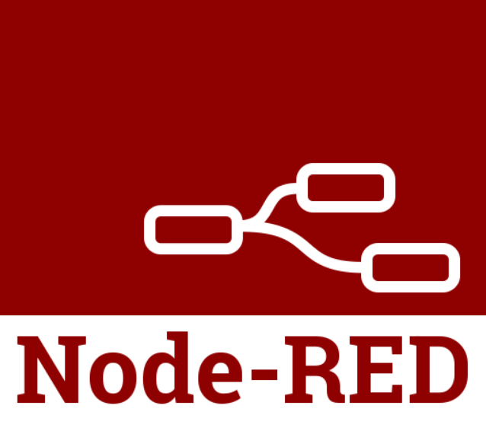


Node-Red in SAP Cloud Foundry

Slide 2
Deployment steps:
Create a package in SAP Business Application studio
Install “node-red”, “node-pre-gyp” packages in that folder
Login to CF account from your system
Deploy Node-Red Application to the CF environment
Create and Deploy your Node-Red API on SCP CF cloud

Slide 3
