Slide 1
Automated Cervical Spine Morphometry
Application positioning: screens for physician review
Architecture, deployment, and validation update

Slide 2
Table of contents
01
The Problem
02
Pipeline Architecture
03
Deployment Architecture
04
Validation
Manual baseline, bottlenecks, and design constraints
Segmentation, measurements, interpretation, and reporting
EEP + 2 IEPs on AWS EKS with Grafana monitoring
What is validated, what is partial, and what is still planned

Slide 3
01
The Problem

Slide 4
Manual reads are slow.

Slide 5
And agreement is inconsistent.

Slide 6
And honest re-validation matters.

Slide 7
02
The Solution

Slide 8
Why automate
2.7-3.8 min manual baseline
Backlogs scale poorly
Manual agreement collapses: cord ICC 0.66, compression 0.35-0.56, Pfirrmann-cervical kappa 0.265, mixed-reader Cobb about 0.55
The pipeline must be cited, reproducible, healthy-anchored, and honest about uncertainty

Slide 9
Project objective
Build an application-grade cervical MRI pipeline that turns one sagittal T2 exam into structured measurements, cited review flags, and a report-ready contract without pretending to diagnose disease.

Slide 10
Project output
Input: one sagittal T2 cervical MRI. Output: a structured contract with measurements, flags, interpretations, patient fields, and report fields that a front end can render into a clinical report and PDF export.

Slide 11
Project principles
Method
Clinical stance
Findings are flagged for physician review, never presented as a diagnosis.
Disease-agnostic, healthy-anchored measurement automation with cited thresholds and deterministic outputs.

Slide 12

One sagittal T2 MRI
drives the full pipeline
Segmentation feeds measurement groups G1-G6, which then flow into cited interpretation, a clinical report, impressions, and PDF export.

Slide 13
Pipeline Architecture

Slide 14
Core honesty line
"Findings are flagged for physician review, never a diagnosis."

Slide 15

Three segmentation
engines

Slide 16
Key numbers
3
250
Segmentation engines: TSS, SCT, and the SPINEPS Cobb add-on
MMCSD cohort cases, with 49 segmented in the current validation set
6
Measurement groups
from G1 vertebral to G6 interpretation

Slide 17
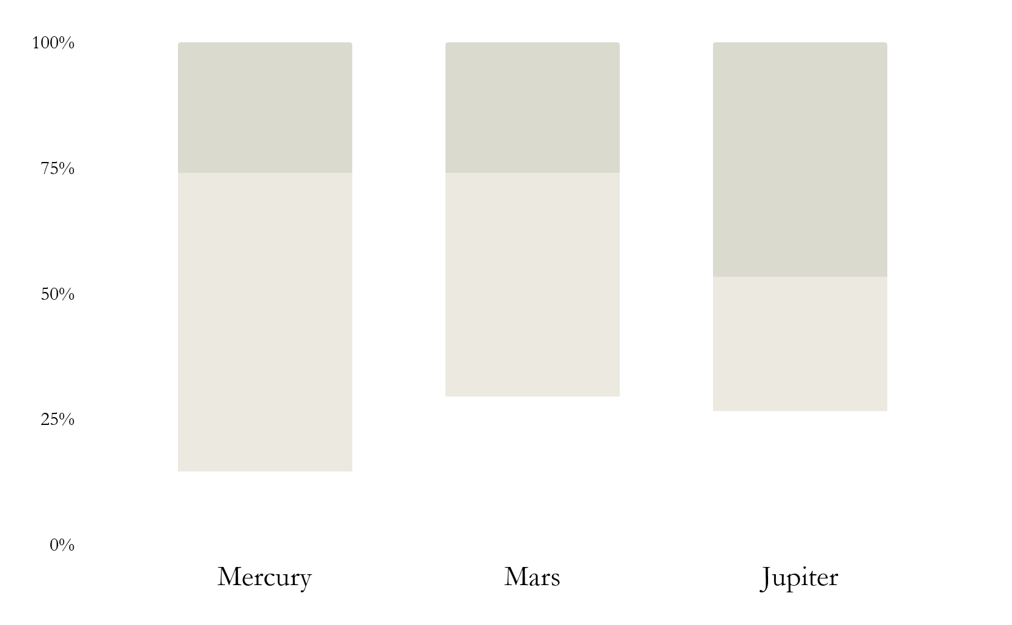
System composition
TSS
Primary labels
SCT
Cord + lesion CLI
SPINEPS
Cobb add-on only
Gotchas: TSS and SPINEPS require separate NumPy environments; SCT must be installed or G3 should fail gracefully.

Slide 18
Pipeline story
Input: one sagittal T2 cervical MRI
Segment vertebrae, discs, canal, cord, and Cobb endplates
Compute G1-G5 measurements and G6 interpretation outputs
Render measurements, flags, impressions, and PDF export

Slide 19
Stages in the pipeline
Phase 4
Segmentation: TSS primary, SCT for G3/G5.1, SPINEPS for Cobb
Runtime
Phase 6
Phase 3
Measurements: six groups and about 16 components
Input
Phase 2
Interpretation: cited thresholds, status bands, and review flags
Reporting: clinical report, impressions, and PDF export

Slide 20
Our process
01
03 Measure
01 Input
03
G1-G5 compute morphometry, discs, cord/canal, alignment, and screens
One sagittal T2 cervical MRI enters the pipeline
02
04 Report
02 Segment
04
G6 interpretation feeds a clinical report, impressions, and PDF export
TSS + SCT + SPINEPS produce the anatomical layers needed downstream

Slide 21
03
Technical Specification
Segmentation, measurements, interpretation, and reporting

Slide 22

Segmentation
Primary segmenter: TotalSpineSeg for vertebrae, discs, and canal. Spinal Cord Toolbox supports G3 diameters and G5.1 SCIseg lesion screening. SPINEPS is a narrow Cobb add-on because its endplate sheets outperform TSS corners on cervical alignment (C6-C7 SD 5.9 degrees vs 18.5 degrees, J12). Deployment gotcha: TSS and SPINEPS require separate environments, and SCT must be installed as a CLI.

Slide 23
Measurement groups
G1
G2
Vertebral morphometry and compression-screen geometry
Disc height, AP ratio, signal, and bulge features
G3
G4
Canal diameter, cord diameter, and SAC
Cobb and alignment metrics from endplate geometry

Slide 24
Measurement logic
G5
G6
Inputs
Outputs
Fracture and myelomalacia screens
Interpretation outputs: threshold bands and syndrome flags
Group dependencies, inputs, and outputs are tracked per group
About 16 components merge into measurements, flags, and interpretations

Slide 25
Interpretation & Reporting
Interpretation
Raw value to cited threshold band to status
Thresholds
within_reference / outside_reference / review_only with sex-specific dural-sac cut
Reporting
JSON contract drives the clinical report, impressions, and PDF export

Slide 26
AWS EKS
Deployed end-to-end as an application with EEP + 2 IEPs and Grafana monitoring.

Slide 27
2.7-3.8 min
ICC 0.66
kappa 0.265
manual read time per case
cord manual agreement
Pfirrmann-cervical agreement

Slide 28
Validation snapshot
57%
91%
62%
G5.1
G2
G4
G5.1 myelomalacia specificity
G2 disc ratio
partial discriminator
G4 alignment is not a discriminator

Slide 29
Completed validation
 | N / basis | Verdict | Key result | Claim | Use
G3 | 22 cases | STRONG | canal 11.7->8.6, SAC 4.7->2.3, cord 6.3->5.5 | p=.0001 / .0001 / .009 | Lead result
G2 | 49 cases | PARTIAL | ratio AUC 0.62; signal/bulge AUC 0.50 | p=.0018 | Frame carefully
G4 | 67 cases | NOT discrim. | d=0.28, AUC 0.57 | p=.32 | Do not overclaim
G1 | screen only | VALID screen | 0% healthy false-flag; null on spondylosis | fracture arm untested | Screen only
Use the revised 2026-06-08 group-status file as the single source of truth.

Slide 30
Deployment architecture
EEP
Measurements IEP
Reporting IEP
Public API and orchestration layer
Runs the measurement and interpretation stack
Produces the clinical report, impressions, and PDF export

Slide 31
Validation by group
G1
G2
G5.1
G3
G4
G6
Validated as a screen; abnormal fracture arm still untested
Partial only: ratio discriminates, signal and bulge do not
About 91% healthy specificity; sensitivity comes from the SCIseg paper
Strongest result: canal, cord, and SAC separate healthy vs symptomatic
Reads lordosis correctly, but not a disease discriminator
Built and wired end-to-end, but not yet clinically accuracy-tested

Slide 32
Caveats / honesty guards
No per-case GT
G4 is limited
G2 is partial
Clinical stance
Show distribution separation, not accuracy or sens/spec.
Do not present G4 as clinically validated.
Disc ratio helps; disc signal and bulge do not.
Outputs are screens for physician review, never diagnoses.

Slide 33
Next validation steps
G3 robustness on a random non-lesion-selected MMCSD draw
Compression-fracture arm still lacks a usable dataset
Per-case accuracy still needs an AUBMC radiologist read
Confirm the live deployment state with the infra chat before final delivery
Now
Gap
Clinical
Infra

Slide 34


Monitoring & operations
AWS EKS
Grafana
Application deployment target with EEP + 2 IEPs, Kubernetes assets, and cloud-first positioning
Monitoring layer for live service visibility; the infra chat owns the current runtime state

Slide 35

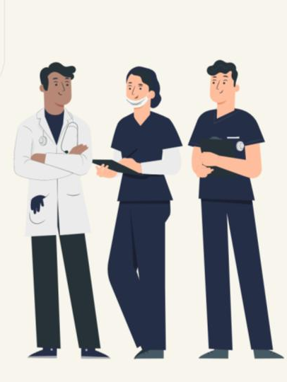
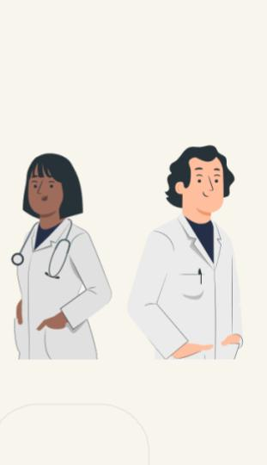
Report outputs
Clinical report + impressions + PDF export. The front end renders the JSON contract into a radiologist-facing report, and the appendix can cite the two radiologist PDFs plus the validation figures.

Slide 36
Thanks
Questions?
Application positioning: flagged for physician review, never a diagnosis.
Please keep this slide for attribution

Slide 37
Alternative resources
Here’s an assortment of alternatives resources within the same style of this template. Find more illustrations like these on Storyset

Slide 38
Resources
Did you like the resources on this template?
Get them for free at these websites:
Photos:
Crop ethnic medic measuring pressure
Medium shot doctor talking to patient
Side view doctor talking to patient
Side view doctor checking patient
Front view doctor working at clinic
Illustrations
Doctor
Medicine
World health day
Health professional team
Blood donation
Ffp2 face mask
Vaccine phases
Find more illustrations like these on Storyset

Slide 39
Instructions for use (free users)
In order to use this template, you must credit Slidesgo by keeping the Thanks slide.
You are allowed to:
Modify this template.
Use it for both personal and commercial purposes.
You are not allowed to:
Sublicense, sell or rent any of Slidesgo Content (or a modified version of Slidesgo Content).
Distribute this Slidesgo Template (or a modified version of this Slidesgo Template) or include it in a database or in any other product or service that offers downloadable images, icons or presentations that may be subject to distribution or resale.
Use any of the elements that are part of this Slidesgo Template in an isolated and separated way from this Template.
Delete the “Thanks” or “Credits” slide.
Register any of the elements that are part of this template as a trademark or logo, or register it as a work in an intellectual property registry or similar.
For more information about editing slides, please read our FAQs or visit Slidesgo School:
https://slidesgo.com/faqs and https://slidesgo.com/slidesgo-school

Slide 40
Instructions for use (premium users)
In order to use this template, you must be a Premium user on Slidesgo.
You are allowed to:
Modify this template.
Use it for both personal and commercial purposes.
Hide or delete the “Thanks” slide and the mention to Slidesgo in the credits.
Share this template in an editable format with people who are not part of your team.
You are not allowed to:
Sublicense, sell or rent this Slidesgo Template (or a modified version of this Slidesgo Template).
Distribute this Slidesgo Template (or a modified version of this Slidesgo Template) or include it in a database or in any other product or service that offers downloadable images, icons or presentations that may be subject to distribution or resale.
Use any of the elements that are part of this Slidesgo Template in an isolated and separated way from this Template.
Register any of the elements that are part of this template as a trademark or logo, or register it as a work in an intellectual property registry or similar.
For more information about editing slides, please read our FAQs or visit Slidesgo School:
https://slidesgo.com/faqs and https://slidesgo.com/slidesgo-school

Slide 41
Fonts & colors used
This presentation has been made using the following fonts:
Sora
(https://fonts.google.com/specimen/Sora)
Exo
(https://fonts.google.com/specimen/Exo)
#252e47
#ffffff
#f8f5ec
#ece9e1
#dadace

Slide 42
Storyset
Create your Story with our illustrated concepts. Choose the style you like the most, edit its colors, pick the background and layers you want to show and bring them to life with the animator panel! It will boost your presentation. Check out How it Works.
Pana
Amico
Bro
Rafiki
Cuate

Slide 43
Use our editable graphic resources...
You can easily resize these resources without losing quality. To change the color, just ungroup the resource and click on the object you want to change. Then, click on the paint bucket and select the color you want. Group the resource again when you’re done. You can also look for more infographics on Slidesgo.

Slide 46
JANUARY
FEBRUARY
MARCH
APRIL
MAY
JUNE
PHASE 1
Task 1
Task 2
PHASE 2
Task 1
Task 2
JANUARY
FEBRUARY
MARCH
APRIL
PHASE 1
Task 1
Task 2

Slide 49
Medical Infographics

Slide 52
...and our sets of editable icons
You can resize these icons without losing quality.
You can change the stroke and fill color; just select the icon and click on the paint bucket/pen.
In Google Slides, you can also use Flaticon’s extension, allowing you to customize and add even more icons.

Slide 53
Educational Icons
Medical Icons

Slide 54
Business Icons
Teamwork Icons

Slide 55
Help & Support Icons
Avatar Icons

Slide 56
Creative Process Icons
Performing Arts Icons

Slide 57
Nature Icons

Slide 58
SEO & Marketing Icons

Slide 59


