Slide 1
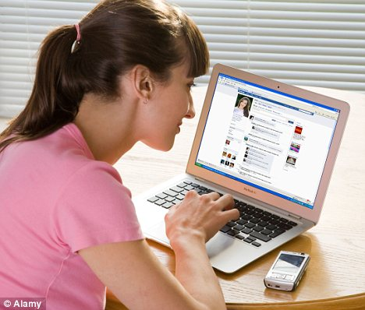
Involved in
Taking care of family and home.
Key Responsibilities
Home life is hectic for Alice as she has all the children and home responsibilities.
Alice Wonderland
Stay at home mom
Staying connected to friends and family
She tries to stay connected to friends and family through sharing posts and liking and commenting on their posts.
Going on vacations
They have a great home. But it would be just nice to afford a holiday. She wants to share her vacation photos on facebook.
IT/Technical Knowledge
Web/Social Media Usage
Language Editing
Eye for the Details
Video Development
Drivers
Tech Profile
High Mortgage
High Mortgage give little cash. Need to downsize and reduce mortgage. Sell property at a good price in a bad market. She needs to vent about her mortgage struggles with her friends on facebook sometimes.
Unthoughtful Comments and Unsolicited Advice
Sometimes she gets too many comments on her posts and some of them make her feel uncomfortable.
Frustrations

Slide 2
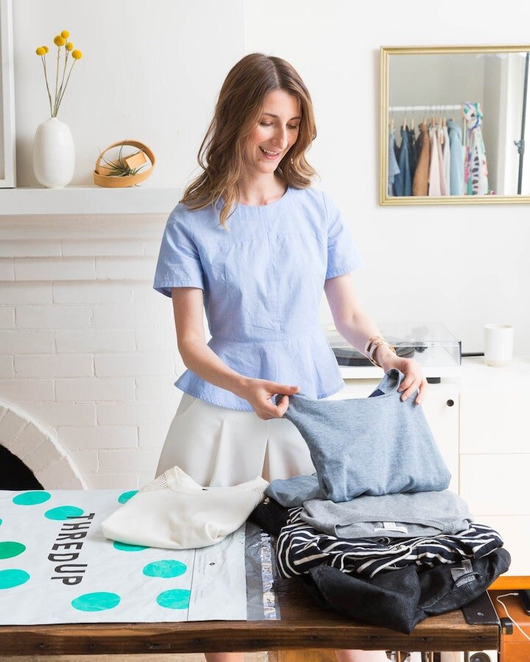
Involved in
Key Responsibilities
Caitlin Young
Online Clothes Seller
Drivers
IT/Technical Knowledge
Web/Social Media Usage
Language Editing
Eye for the Details
Video Development
Tech Profile
Frustrations

