Slide 1



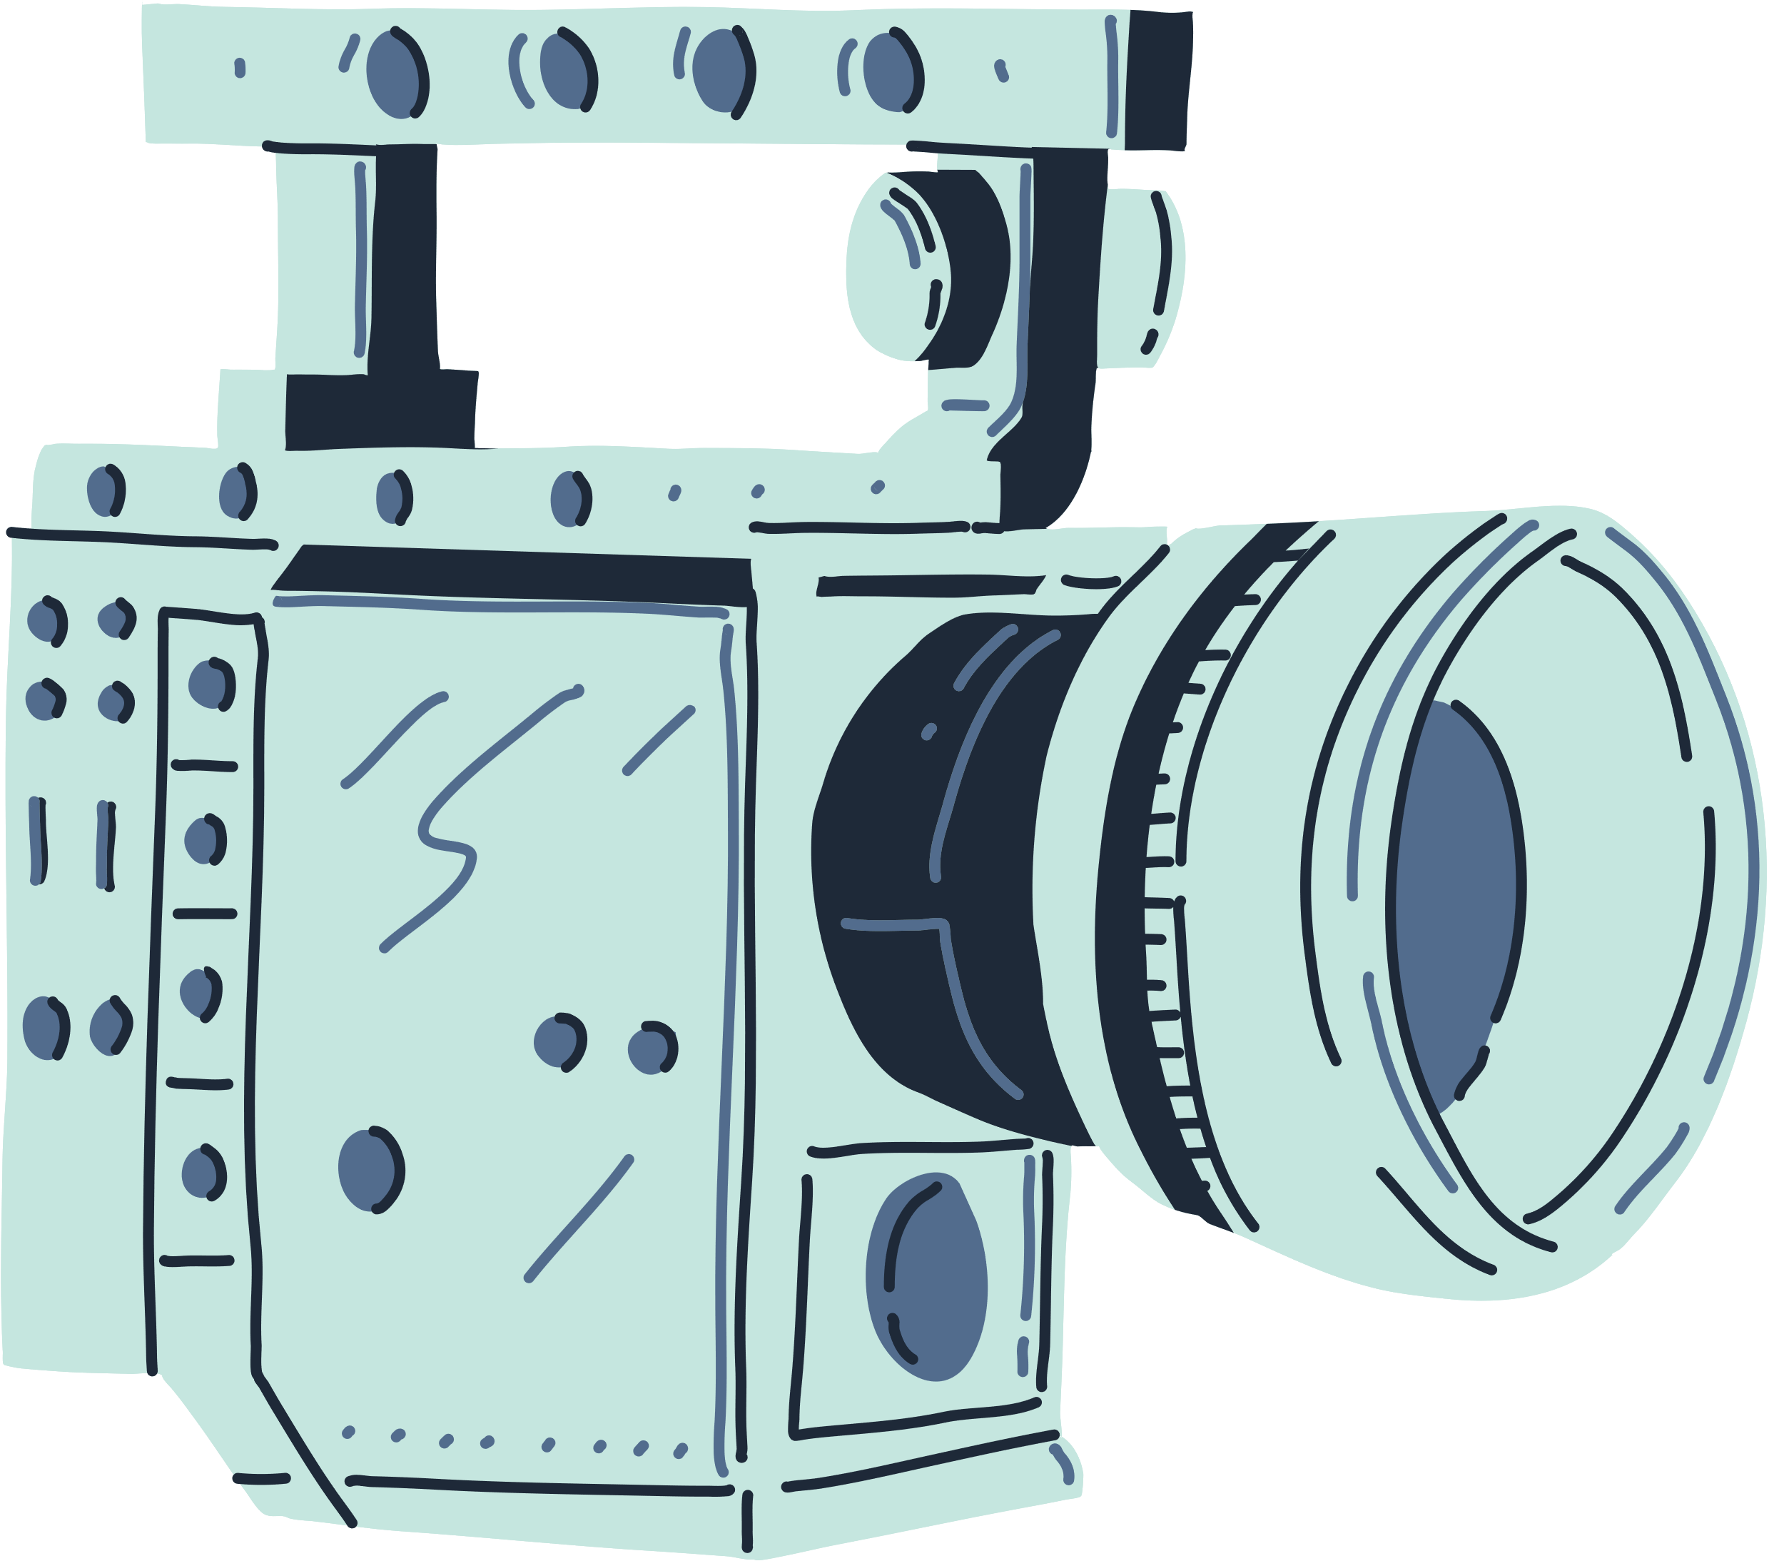

Film as a Medium of Mass Communication and as an Industry
Presented by: Afra, Aiesha, Munesha,
Sabah, and Saniya

Slide 2



Contents
Introduction: Whatis Film?
1
Film as a Communicative Medium
2
Film Industry as a Business
3
4
Impacts, Challenges, and Conclusion

Slide 3




Defining
Film

Slide 4



What is a film?
Film is a powerful form of mass communication that conveys messages, emotions, and narratives to a wide audience.
As a communication medium, the purpose of a film is to inform, entertain, educate, and influence public opinion.
On the flip side, it has a bit more of a materialistic agenda, i.e., generating billions of dollars through production, distribution, and exhibition.

Slide 5

As a Medium of Mass Communication
Films can be created for a variety of reasons. Their purpose might be:
Visual storytelling: Combines sound, motion, and imagery to communicate ideas.
Universal appeal: Crosses cultural and linguistic barriers.
Emotional and psychological impact: Shapes public perception, attitudes, and social behaviors.
Medium for advocacy and awareness: Addresses social issues, politics, history, and human rights.

Slide 6

Slide 4: Functions of Film in Communication
When analyzing films, it’s essential to recognize that, despite their ability to reflect reality, they are shaped by strategic decisions to influence audience perception. Key considerations include:
The selection of what to depict: What stories, themes, or perspectives are highlighted or ignored?
The framing and staging of scenes: How is the subject presented visually and contextually?
The role of editing: What sequences, details, and angles are emphasized or omitted?
The impact of consent and control: Who decides how events or individuals are portrayed?

Slide 7
Historical Impact of Film in Communication
Films are often viewed as reflections of their time, but they are also shaped by the social, political, and technological forces behind their creation, as well as the version of reality perceived by their creator(s). Their impact depends upon:
The cultural and historical context: How do films reinforce or challenge prevailing ideologies? How do they represent their maker’s ideologies?
The role of government and institutions: Who funds, censors, or promotes specific narratives?
The technological advancements of the era: How does available technology influence storytelling techniques?
The intended audience and reception: How do different demographics interpret the same film differently?

Slide 8
The Multi-
Billion-Dollar
Industry

Slide 9

Film as a Business
Industry
The film industry blends artistic expression with commercial strategy, shaping both content and accessibility. Like the news media, market trends influence which films get made and how they reach audiences. At the same time, storytelling remains central, with drama, narrative appeal, and audience engagement driving financial success. From mainstream blockbusters to independent films, documentaries, and animation, each sector follows its own economic model, balancing creativity with commercial demands in an evolving marketplace.

Slide 10

The Film Production Process
Every film undergoes a structured development process that influences the final product. Each stage involves critical choices, including:
Development: Who determines which scripts get funded and produced?
Pre-production: How do casting decisions and location choices shape the film’s narrative?
Production: What directorial styles, cinematographic techniques, and performance choices define the film?
Post-production: How do editing, visual effects, and sound design alter the story’s impact?
Distribution and marketing: How does promotion shape audience expectations and engagement?

Slide 11

The rise of digital technology has transformed how films are made, distributed, and consumed. This shift is shaped by:
Streaming services: Who controls access to films, and how does this change audience habits?
Advancements in CGI and special effects: How do visual technologies shape what stories can be told?
Social media and marketing: How do viral campaigns and direct audience interaction influence a film’s success?
Independent filmmaking: How do lower production costs and digital platforms challenge traditional studios?
The Impact of Digital Technology on Film

Slide 12

Challenges in the Film Industry
Despite its reach and influence, the film industry faces ongoing challenges that shape its evolution, including:
Piracy and revenue loss: How do illegal downloads and unauthorized streaming affect profitability?
High production costs: What financial risks do filmmakers take, and how do budgets impact creative decisions?
Censorship and regulations: Who decides what content is acceptable, and how do these rules differ across regions?
Changing audience preferences: How do filmmakers adapt to evolving viewing habits and cultural shifts?

Slide 13

The Future of Film Industry: AI, Tech and Beyond
1. AI in Filmmaking
Scriptwriting: AI tools (ChatGPT, Jasper) generate drafts & predict hits.
Deepfake Tech: Recreate actors (e.g., *de-aged De Niro in The Irishman).
Post-Production: AI edits footage, enhances VFX, auto-generates trailers.
2. Virtual Production
LED Volume Stages (à la The Mandalorian) replace green screens.
VR/AR Films: Immersive storytelling (e.g., Oculus VR cinema).

Slide 14

3. Streaming & Personalization
AI Algorithms: Netflix/Disney+ recommend (and even commission) content.
Interactive Movies: Choose-your-own-adventure films go mainstream.
4. Ethical Challenges
Job Threats: Will AI replace writers, animators, editors?
Deepfake Abuse: Who controls an actor’s digital likeness?
5. Sustainable Tech
AI-Powered Sets: Reduce waste, energy use, and travel emissions.
Final thought:
"Will AI make films more creative—or just more corporate?"

Slide 15

Conclusion

Slide 16

At the end of the day…
Film is often seen as a reflection of society, but it is just as much a product of the choices made behind the camera. Every decision—from what stories get told to how they are framed, edited, and distributed—shapes the way audiences interpret the world.
While the industry thrives on creativity, it is also driven by financial interests, technological advancements, and shifting audience expectations.
As new platforms emerge and traditional models evolve, the question remains: who controls the narratives we consume, and how does that influence the way we see reality?

