Slide 1
SUSTAINABLE DOVELOPMENTAL GOALS
SABA SHAHID – 048
AFRA ASAD -092
MUNEHA -070

Slide 2
IN THE PRESENTATION
01
02
03
04
INTRODUCTION
WHAT ARE THE SDGs
PURPOSE OF THE SDGs
CALL TO ACTION

Slide 3
"Imagine a world where no one goes hungry, everyone has equal opportunities, and our planet thrives for generations to come. Sounds like a dream, right? Well, that’s the vision of the Sustainable Development Goals!"

Slide 4
01
INTRODUCTION

Slide 5
The Sustainable Development Goals (SDGs) are a set of 17 global goals established by the United Nations in 2015 as part of the 2030 Agenda for Sustainable Development. These goals aim to address the world's most pressing challenges by promoting peace, prosperity, and environmental sustainability for all.

Slide 6
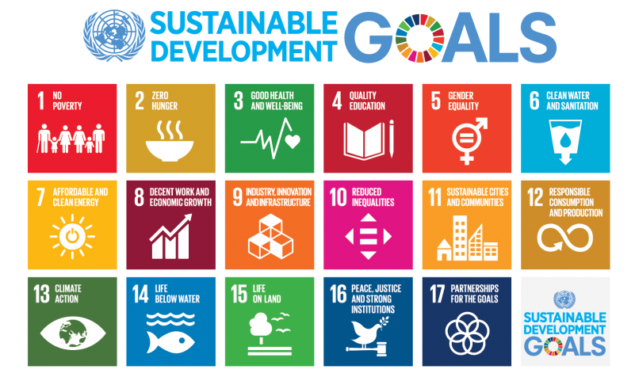

Slide 7
02
WHAT ARE THE SDGs

Slide 8
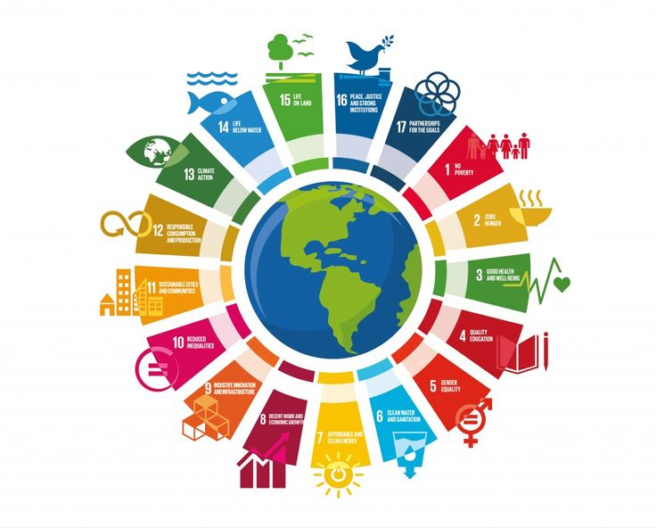
THE 17 SDGs

Slide 9
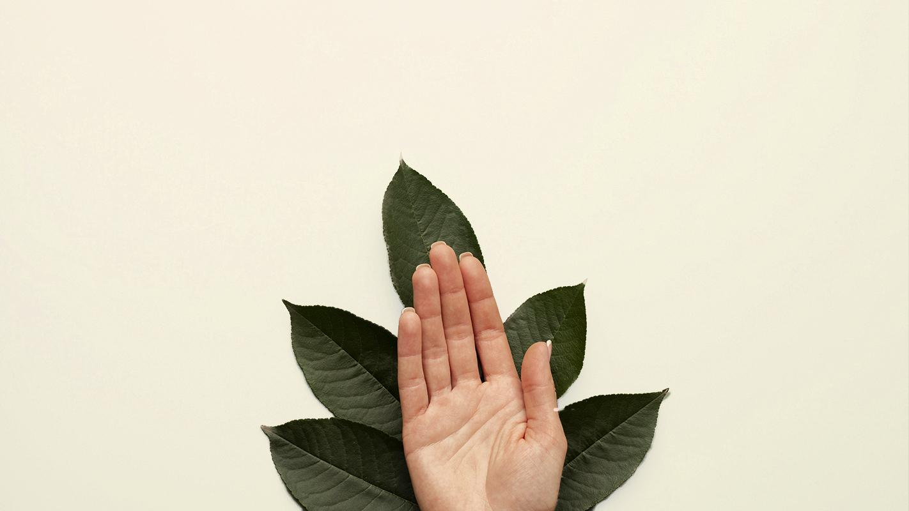
A PICTURE IS WORTH A THOUSAND WORDS

Slide 10
03
PURPOSE OF SDGs

Slide 11
ANSOFF GROWTH MATRIX
Do you know what helps you make your point clear? Lists like this one:
They’re simple
You can organize your ideas clearly
You’ll never forget to buy milk!
And the most important thing: the audience won’t miss the point of your presentation
V

Slide 12
BUSINESS CASE
1 | Mercury is the closest planet to the Sun
BUSINESS NAME
4 | Jupiter is the biggest planet of them all
COMPANY LOGO HERE
2 | Venus is the second planet from the Sun
5 | Saturn is a gas giant and has rings
3 | Mars is actually a very cold place
6 | Neptune is very far away from Earth
XX/XX/XX

Slide 13
COMPETITOR COMPARISON
 | A | B | C
PRICE | $270 | $500 | $789
QUALITY | Low | Medium | High
CUSTOMER | 3,200 | 2,000 | 4,600
REPUTATION | Average | Bad | Good
LOCATION | Mercury | Venus | Mars

Slide 14

OUR TARGET
HOBBIES
WEB
TRAVEL
ECONOMY
SALARY
$20,152
NAME: | Jenna Doe
AGE: | 30 years old
OCCUPATION: | Digital business
DESCRIPTION
Venus has a beautiful name and is the second planet from the Sun. It’s terribly hot, even hotter than Mercury, and its atmosphere is extremely poisonous

Slide 15
IMPLEMENT, TRACK & MANAGE PROGRESS
MANAGE PROGRESS
PROGRESS |  |  | STATUS | LINK
Venus |  | 10% |  | www.yourlinkhere.com
Mars |  | 20% |  | www.yourlinkhere.com
Neptune |  | 30% |  | www.yourlinkhere.com
Jupiter |  | 40% |  | www.yourlinkhere.com
Earth |  | 50% |  | www.yourlinkhere.com
Ceres |  | 60% |  | www.yourlinkhere.com

Slide 16
CHANGE MANAGEMENT STRATEGY & PLAN
Size of the change
Extreme | Insert name of the change | Insert name of the change | Insert name of the change
High |  |  | Insert name of the change | Insert name of the change | Insert name of the change
Medium |  |  |  | Insert name of the change
Moderate
Low
Complexity of the change
1 team impacted
1 business unit
1 division
Half company
Extreme

Slide 17
04
IMPLEMENTING CHANGES
You can enter a subtitle here in case you need it

Slide 18
SALES & STRATEGY PLAN
1
2
IMPLEMENTATION
INTERNAL ANALYSIS
5
3
SALES PLAN
EXTERNAL ANALYSIS
4
SALES STRATEGY

Slide 19
$8,0931
Big numbers catch your audience’s attention

Slide 20
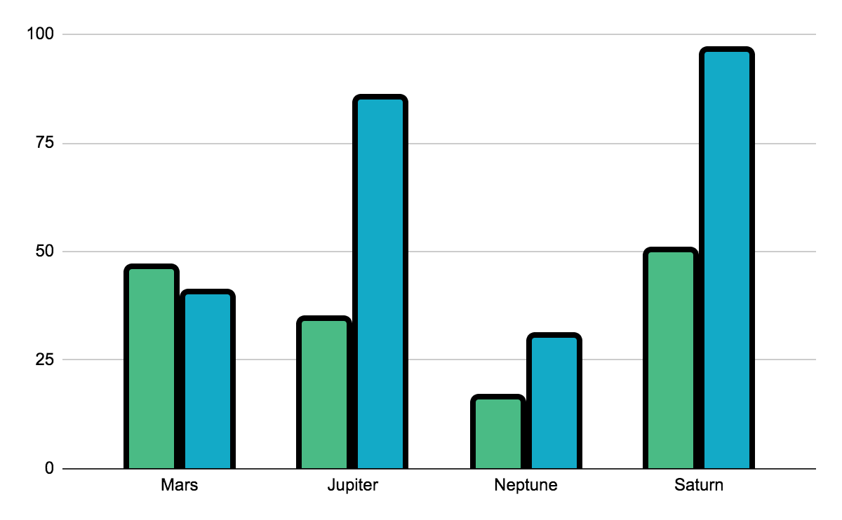
ABOUT THE TERMS OF THE AGREEMENT
VENUS
Venus is the second planet from the Sun
MERCURY
Despite being red, Mars is a very cold place
Follow the link in the graph to modify its data and then paste the new one here. For more info, click here

Slide 21
$10,000
$15,000
$20,000
Despite being red, Mars is a cold place
Venus is the second planet from the Sun
Mercury is the closest planet to the Sun

Slide 22
MANAGEMENT APPROACH
Jupiter is the biggest planet in the Solar System
Saturn is a gas giant and has several rings
JUL
AUG
SEP
OCT
Venus is the second planet from the Sun
Despite being red, Mars is a very cold place

Slide 23
STRATEGIC ALLIANCES
VENUS
It has a beautiful name and is the second planet from the Sun
MERCURY
Mercury’s name has nothing to do with the liquid metal

Slide 24
ANSWER AND ARGUMENTS
WRITE YOUR QUESTION
WRITE YOUR ANSWER
MARS
Despite being red, Mars is actually a cold place. It's full of iron oxide dust, which gives the planet its reddish cast
MERCURY
Mercury’s name has nothing to do with the liquid metal, since this planet was named after a Roman god
VENUS
It has a beautiful name and is the second planet from the Sun. It’s terribly hot and its atmosphere is poisonous

Slide 25
WATERFALL MANAGEMENT PLAN
REQUIREMENTS
Neptune is the farthest planet from the Sun
DESIGN
Jupiter is the biggest planet of them all
IMPLEMENTATION
Mercury is the closest planet to the Sun
VERIFICATION
Saturn is a gas giant and has several rings
MAINTENANCE
Venus is the second planet from the Sun

Slide 26
MATURITY MODEL
20%
40%
80%
BASIC
STANDARD
ADVANCED
Mercury is the closest planet to the Sun and the smallest
Venus has a beautiful name and is the second planet from the Sun
Despite being red, Mars is a very cold place full of iron oxide dust

Slide 27
PROBABILITY RATIOS
WORST PEER
BEST PEER
Return on sales (%)
%
%
Return on equity (%)
%
%
Return on assets (%)
%
Return capital (%)
%
%
Return on funds (%)
%
%
%
Company 1
%
Company 2
%
Company 3

Slide 28
TOP 10 QUESTIONS OF BUSINESS PLAN
1 | What is your current situation? | 6 | What is the requirements?
2 | What is your vision? | 7 | What are the economics?
3 | How will you reach your vision? | 8 | What will be the marketing plan?
4 | What do you offer? | 9 | How will you differentiate yourself?
5 | How big is the market you are? | 10 | Who are the key players?

Slide 29

SOFTWARE AND APP DEMO
You can replace the image on the screen with your own work. Just right-click on it and select “Replace image”

Slide 30

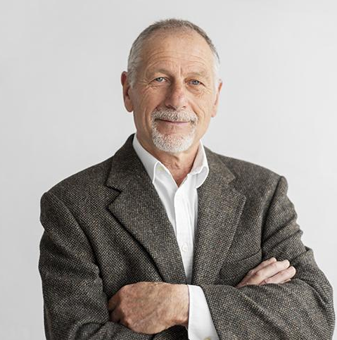
OUR TEAM
JENNA DOE
JOHN JAMES
You can speak a bit about this person here
You can speak a bit about this person here

Slide 31
THANKS
Do you have any questions?
addyouremail@freepik.com +91 620 421 838
yourwebsite.com
Please, keep this slide for the attribution

