Slide 1

CSL-113
Discovering Knowledge
Computer Programming Lab
Spring 2024 BSCS 1(Section)
FLIGHT MANAGEMENT SYSTEM
https://sites.google.com/site/

Slide 2
Discovering Knowledge
Group Members:
Enrollment | Name
02-13241-048 | SABA SHAHID
02-134241-004 | IBAD UR REHMAN
02-134241-018 | JIBRAIL AMEEN
Submitted to:
Mrs. Azeema Sadia
Ms. Hafsa Munawar

Slide 3
Project Introduction

Slide 4
Background:The Flight Management System is designed to assist users in planning their travel itineraries efficiently. Leveraging fundamental programming concepts such as loops, arrays, functions, if-else statements, and switches, our system provides a user-friendly experience. Implemented as a console application, it features a straightforward user interface and clear instructions, ensuring accessibility for a wide audience.

Slide 5
Problem Statement/Motivation: Efficient travel planning is crucial in today's fast-paced world, where travelers face an overwhelming amount of information and choices. Traditional travel planning methods, such as using travel agents or manually compiling data, are often time-consuming and error-prone. Existing digital tools are either too complex or lack essential features, making them inaccessible to users with limited technical skills.

Slide 6
Scope: The Flight Management System project extends its scope to include not only the core functionalities of itinerary planning but also aspects of user engagement and system optimization.

Slide 7
Objectives:
Simplify travel planning
Save time
Give useful recommendations

Slide 8
Methodology

Slide 9
Programming Language: C++ IDE: Visual Studio Data Structures: utilized arrays for storing the input user data File Handling: To store user data and match passwords to login

Slide 10
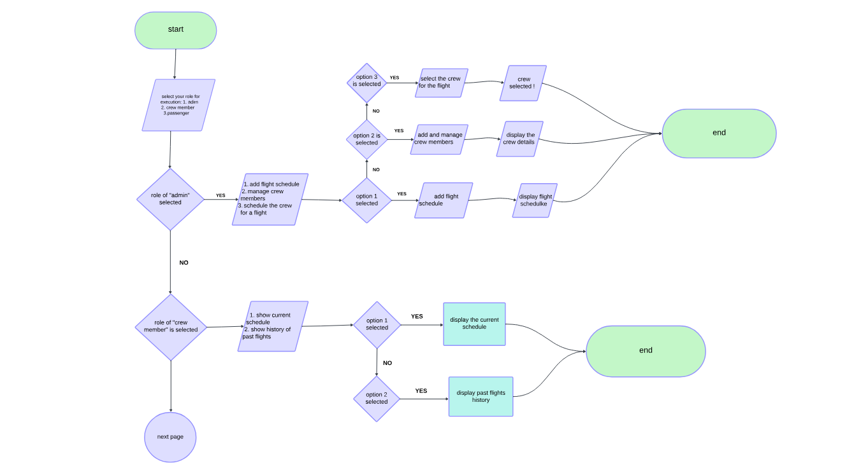

Slide 11
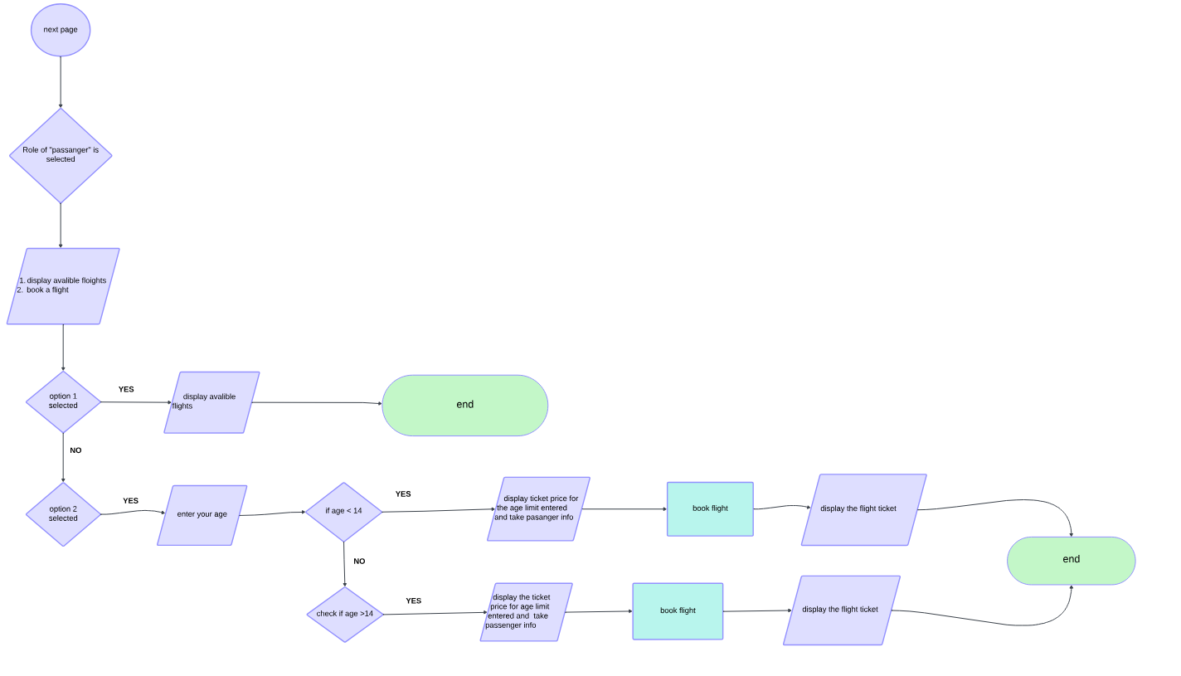

Slide 12
Implementation

Slide 13
Key Features and Functionalities
Sign In for admin
Sign Up for crew members
Schedule and edit a flight schedule
Assign the crew
See past flight record
Book a flight
Display flight avalibility

Slide 14
Conclusion

Slide 15
The flight management system successfully fulfills its objectives by providing comprehensive functionality for administrators, crew members, and passengers.

Slide 16
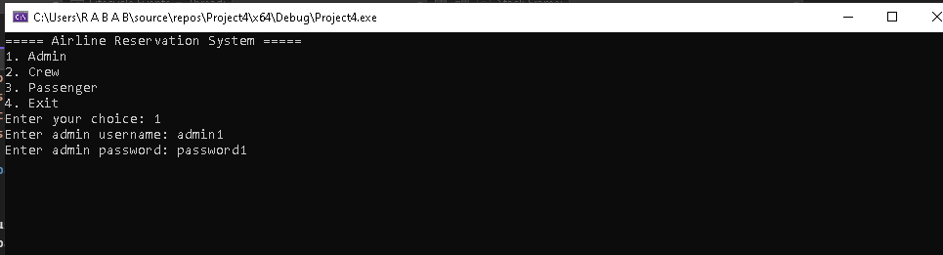
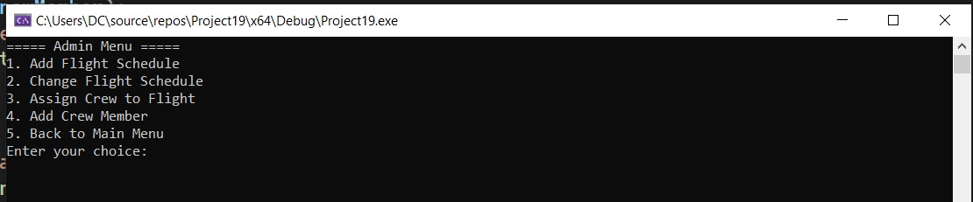
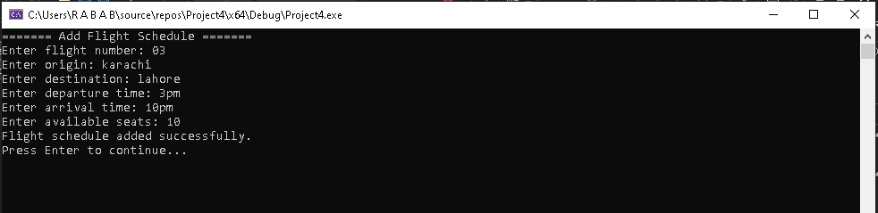

Slide 17
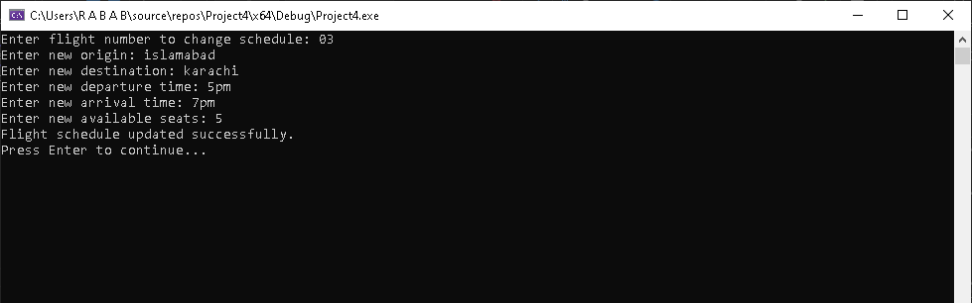

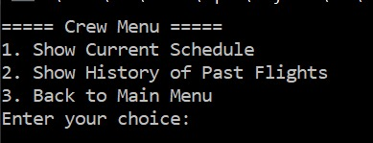

Slide 18
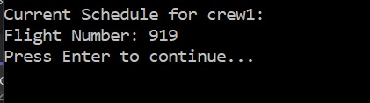
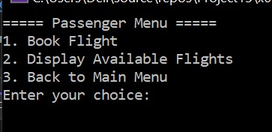
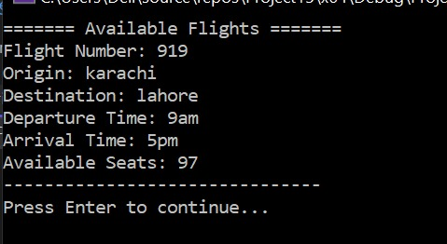

Slide 19
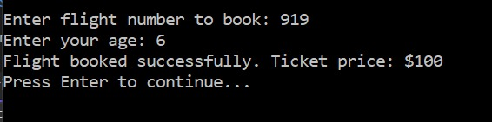

Slide 20
THANKYOU

