Slide 1
Cache like a pro with "fusion cache"
Enrico Sabbadin

Slide 2
Agenda
Why we cache?
Caching Patterns
In memory vs distributed (shared) cache
Introduction to fusion cache

Slide 3
Why we cache?
There are only two hard things in Computer Science: cache invalidation and naming things.
-- Phil Karlton
The good
Offload the origin (source of true)
Speed up application
Using a cache brings a set of new issues and "patterns"
The bad
Stale data (Cache invalidation is hard to implement)
Cache stampede
Node synchronization (if a memory or a two-level cache is used)

Slide 4
Caching Patterns: read aside (cache aside)
The most "known" and used
responsibility of setting the cache if there is a cache miss
var ret = await _cache.GetStringAsync(location);
if(ret == null)
{
ret = await _dataSources.GetCurrentTime(location);
await _cache.SetStringAsync(location, ret);
}
return ret;

Slide 5
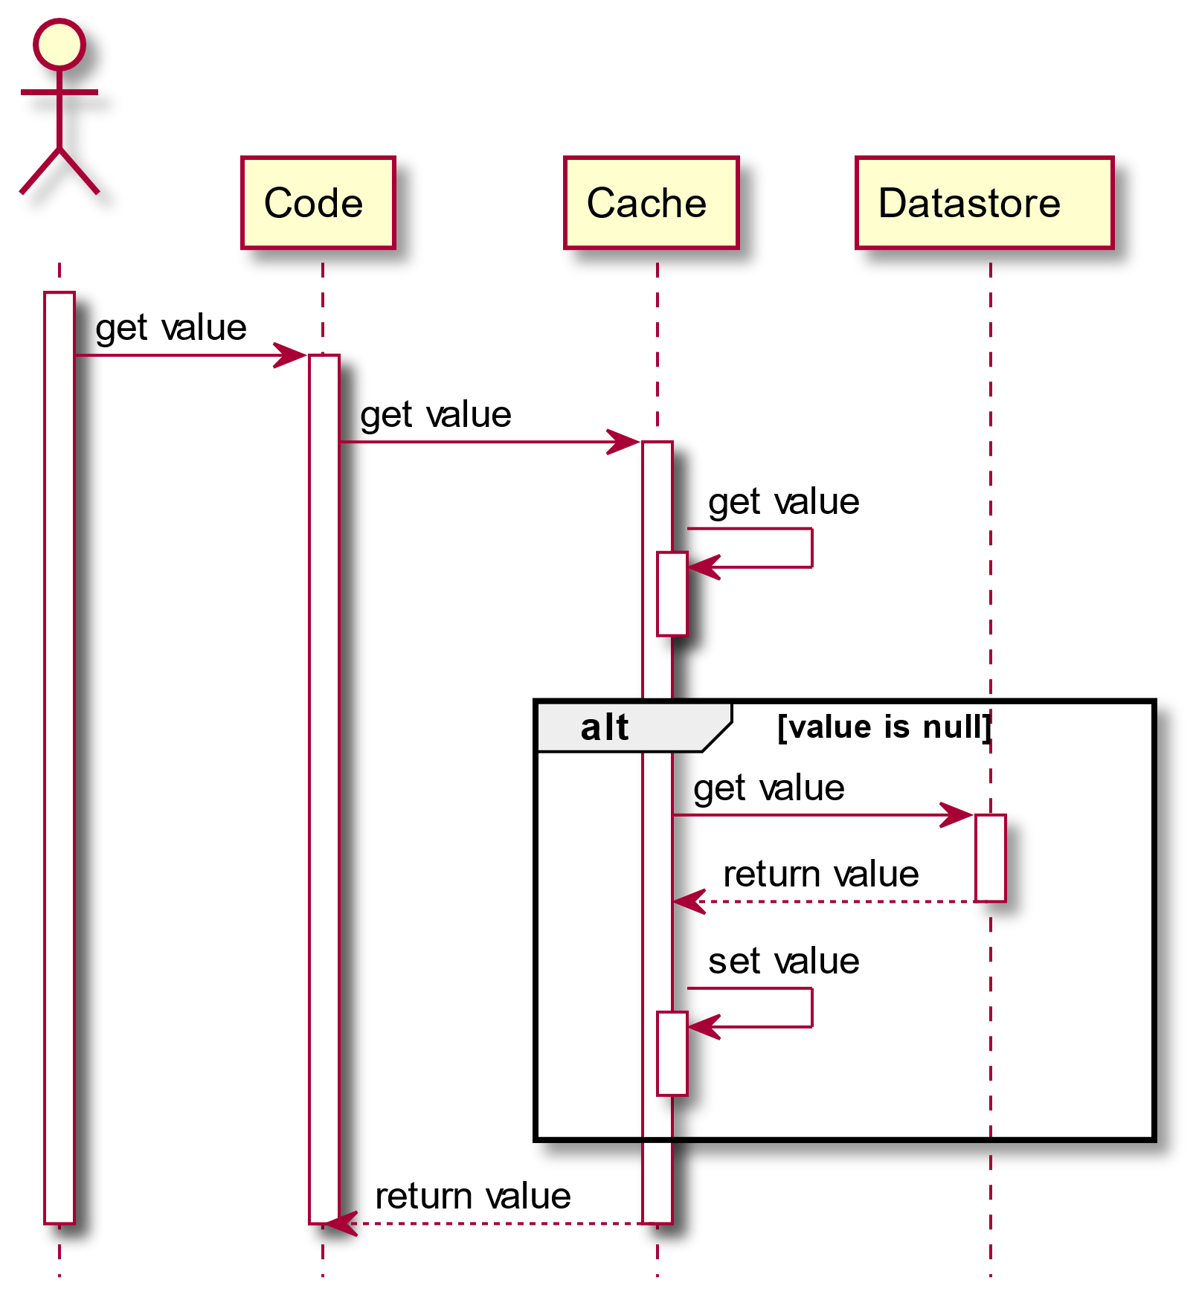
Caching Patterns: Read-Through
Cache is responsible to get the data

Slide 6
Caching Patterns: Read-"compromise"
Application code maintains responsibility to get the data
Cache can apply policies on the "data factory" (e.g. timeouts, fail safe)
var ret = await _cache.GetOrCreateAsync(location, async cacheEntry=>
{
cacheEntry.AbsoluteExpiration = DateTimeOffset.UtcNow + TimeSpan.FromMinutes(1);
return await _dataSources.GetCurrentTime(location, throwEx);
});
return ret;

Slide 7
Caching Patterns: Write-*
Data is written to cache along with the change in the source of true
App responsibility: write-aside
Cache responsibility: write-through

Slide 8
Caching Patterns: Invalidate-*
Cache is invalidated (removed) and not updated when the source of true data change
Avoid stale data
Not trivial to get cache invalidation right
in real world, the same piece of data can be changed in different places
the scope of change in the DB does not match the scope of cache items

Slide 9
In memory vs distributed (shared) cache
In memory
Less cache hits in web farm scenario
Faster
Monitor memory usage
Distributed
Improved cache hits
Redis is fast, still you are still doing a network roundtrip
Watch out caching keys clashing (per service prefix)

Slide 10
We need more than just raw cache api .. to cache like a pro ☺
IMemoryCache and IDistributedCache are the two abstractions provided by .NET
MS clearly state it will not merge the twos into one
There are a few IDistributedCache implementations (Redis, SqlServer, Ncache, Azure Cosmo Db, etc..)
There are cache "frameworks" that add features on top of the IMemoryCache and IDistributedCache implementations
Multi level cache (in memory on top of distributed)
Manage some cache specific issues (cache stampede)
Fail safe
etc…

Slide 11
We need more than just raw cache api
https://github.com/ZiggyCreatures/FusionCache/blob/main/docs/Comparison.md
name | stars | first nuget release | last nuget release (as of 9/15 /2024)
Cache Manager | 2.3K stars | 16/2/2014 | 6/12/2018
Lazy Cache (memory only) | 1.7K stars | 28/4/2014 | 1/9/2021
Easy caching | 1.9K stars | 14/1/2018 | 6 months ago
Cache Tower | 582 stars | 17/10/2019 | 9 months ago
Fusion Cache | 1.3K stars | 31/12/2020 | 15 days ago

Slide 12
Introduction to fusion cache
Backplane
Sync values across nodes
Cache stampede
"All" rush to origin to get same key when it expires
Fail-Safe
Provide expired values if origin fails or takes too long to reply
Factory Timeouts
Auto-Recovery
Queue locally XXX and backplane actions in case of temporary network failures
Adaptive Caching
Custom caching duration

Slide 13
DEMO Time

