Slide 1
Azure Web App con un "caching" da professionista usando "FusionCache"
Enrico Sabbadin (MSC Technology Italy)

Slide 2
Agenda
Why we cache?
In memory vs distributed (shared) cache
Caching Patterns
FusionCache

Slide 3
Cache ABC
When you need to retrieve "often" the same data, typically, from an external service (e.g. database or rest api). When that piece of data doesn't change "often" When it "takes time" to get that data from the service .. When taking the data put "pressure" on the service .. Consider to store (cache) that piece of information in a a key-value pair "store" (something like a <string,object> dictionary) .. and retrieve it from that store instead of going to the actual service. (Note: most likely you will set an expiration)

Slide 4
Caching pseudo-code
public void PlaceOrder(Order order, string userName) {
var userInfo = _myCache.Get<UserInfo>($"userInfo{userName}");
if (userInfo == null) {
var userInfo = _userRepository.GetUserInfo(userName);
_myCache.Add($"userInfo{userName}", userInfo);
}
if(!userInfo.CanPlaceOrder()) {
throw new Exception(..
}
// proceed with order
}

Slide 5
Why we cache?
There are only two hard things in Computer Science: cache invalidation and naming things.
-- Phil Karlton
The good
Speed up application
Offload the origin (source of true)
Using a cache brings a set of new
Opportunities
Issues
Stale data (Cache invalidation is hard to implement)
Cache stampede
Node synchronization (if a memory or a two-level cache is used)
Hence, we need patterns and best practices, and "smart" libraries ☺

Slide 6
In memory cache
In memory
Faster
Less cache hits in web farm scenario
Monitor memory usage
MS implementation: IMemoryCache

Slide 7
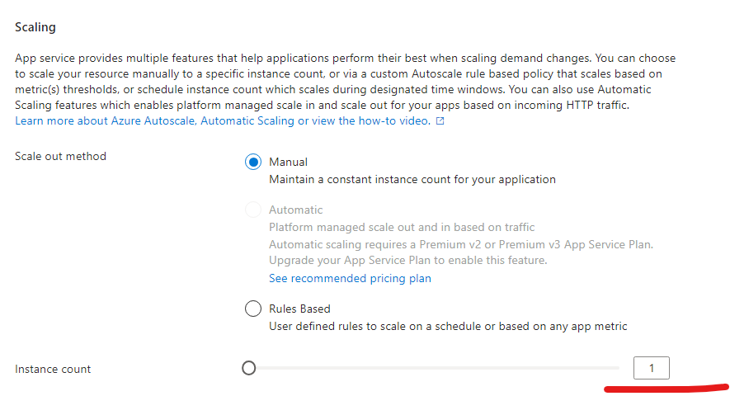
Single instance web app
PAAS
IAAS

Slide 8
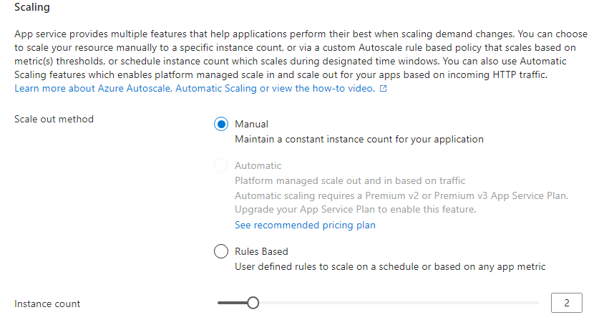

Multiple instance web app (web farm)
PAAS
IAAS
1
1
1
2
Every instance has its own memory cache

Slide 9
Distributed (shared) cache
To centralize cached data
Improved cache hits
Some solutions (Redis) are fast, still remember you are still doing a network roundtrip
Watch out CPU usage (deserialization)
Watch out caching keys clashing (use per service key prefix)

Slide 10
Distributed (shared/centralized) cache
Microsoft provide IDistributedCache
There are "many" IDistributedCache implementations (Redis, SqlServer, Ncache, Azure Cosmo Db, etc..)

Slide 11
Multiple instance web app (web farm) with distributed cache
PAAS
1
1
2
3
4
Scaled to 4 instances
All instances share the same cache. Note: Instead of Redis you can use other centralized stores

Slide 12
Azure Web app with HA
West Europe region
North Europe region
n instances (web farm)
n instances (web farm)

Slide 13
Azure Web app with HA for this demo
In West Europe region
In North Europe region
West 1 (1 instance)
West 2 (1 instance)
North 1 (1 instance)
North 2 (1 instance)
We can point specific Azure web app (for demo purposes)

Slide 14
Demo Setup
Bicep for provisioning
ADO (Azure Devops) pipelines for building and deploy

Slide 15
Distributed cache gotcha: DEMO
Heavy load on remote distributed cache
get-big-cache-payload-in-memory
vs
get-big-cache-payload-redis
See the load when using "badly" a remote cache - app plan cpu percentage - web app cpu time - data in

Slide 16
That was just a "simple" example to understand that: We need more than just raw cache api .. to cache like a pro ☺
There are cache "frameworks" that add "features" on top of the IMemoryCache and IDistributedCache implementations
Multi level cache (in memory on top of distributed)
Manage some cache specific issues (cache stampede)
Fail safe
etc…

Slide 17
Caching Patterns

Slide 18
Caching Patterns: read aside (cache aside)
The most "known" and used
Application code is responsible to push the value in the cache if there is a "cache miss"
var ret = await _cache.GetStringAsync(location);
if(ret == null)
{
ret = await _dataSources.GetCurrentTime(location);
await _cache.SetStringAsync(location, ret);
}
return ret;

Slide 19
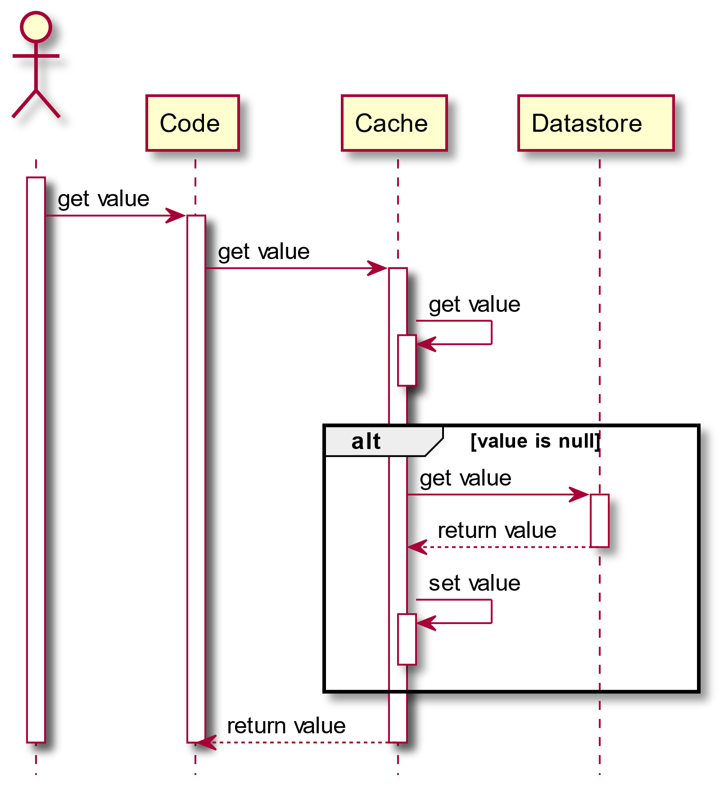
Caching Patterns: Read-Through
Cache is responsible to get the data - typically implemented with something like a decorator (wrapper) patterns

Slide 20
Caching Patterns: Read-"compromise"
Application code maintains responsibility to get the data providing a factory
Cache can apply policies on the "data factory" (e.g. timeouts, fail safe)
// _cache -> IMemoryCache var ret = await _cache.GetOrCreateAsync(location, async cacheEntry=>
{
cacheEntry.AbsoluteExpiration = DateTimeOffset.UtcNow + TimeSpan.FromMinutes(1);
return await _dataSources.GetCurrentTime(location, throwEx);
});
return ret;

Slide 21
Caching Patterns: Write-*
Data is written to cache along with the change in the source of true
App responsibility: write-aside
Cache responsibility: write-through

Slide 22
Caching Patterns: Invalidate-*
Cache is invalidated (removed) and not updated when the source of true data change
Avoid stale data
Not trivial to get cache invalidation right
in real world, the same piece of data can be changed in different places
the scope of change in the DB does not match the scope of cache items (need to invalidate a set of data)
Invalidate notification must be sent to all processes holding the cached value in memory

Slide 23
.. at last ..
FusionCache

Slide 24
We need more than just raw cache api
https://github.com/ZiggyCreatures/FusionCache/blob/main/docs/Comparison.md
name | stars | first nuget release | last nuget release (as of 9/15 /2024)
Cache Manager | 2.3K stars | 16/2/2014 | 6/12/2018
Lazy Cache (memory only) | 1.7K stars | 28/4/2014 | 1/9/2021
Easy caching | 1.9K stars | 14/1/2018 | 6 months ago
Cache Tower | 582 stars | 17/10/2019 | 9 months ago
FusionCache | 1.6K stars | 31/12/2020 | 15/06/2024

Slide 25
FusionCache credits
Microsoft Data API builder uses FusionCache
https://devblogs.microsoft.com/azure-sql/data-api-builder-ga/
First "issue" in new Nuget spotlight repo (11/07/2024)
This repository is designed to spotlight popular and upcoming NuGet packages, providing a central place for developers to discover new tools and libraries that can enhance their projects
https://github.com/NuGet/Spotlight/issues/1

Slide 26
FusionCache: set up
builder.Services.AddFusionCache() .WithDefaultEntryOptions( new FusionCacheEntryOptions{ … })
.WithSerializer( new FusionCacheSystemTextJsonSerializer())
.WithDistributedCache(
new RedisCache(new RedisCacheOptions { InstanceName = "fusionCacheApi", Configuration = builder.Configuration["redis:connectionString"] })) .WithBackplane(new RedisBackplane(new RedisBackplaneOptions() { Configuration = builder.Configuration["redis:connectionString"] })
);
Note: no need to register IMemoryCache and (Redis) IDistributedCache explicitly

Slide 27
FusionCache: use it
IFusionCache: the interface to have injected
The main api: GetOrSetAsync, it requires
Function to get the data is there is a cache miss
Optional FusionCacheEntryOptions (if not provided a default one registered at startup is used)
Duration
DistributedCacheDuration (optional)
JitterMaxDuration (introduce a degree of randomization in the expiration)
..and many others we will cover in next slides

Slide 28
GetOrSetAsync
[HttpGet(template: "get-or-set-cache-entry-raw", Name = "GetOrSetCacheEntryRaw")]
public async Task<string> GetCacheEntryRaw(string key) {
var ret = await _fusionCache.GetOrSetAsync(key, // sample demo only implementation of the factory async _ => await Task.FromResult(new Random().Next().ToString() ,new FusionCacheEntryOptions {
Duration= TimeSpan.FromMinutes(1)
} );
return ret;
}
Note: you can specify a different cache duration for the distribute d cache using DistributedCacheDuration property

Slide 29
FusionCacheEntryOptions: TimeOuts
FactoryHardTimeout
Return exception if factory takes longer then the specified value (more on it later)
AllowTimedOutFactoryBackgroundCompletion
Enabled by default, lets the timed-out factory keep running in the background and update the cached value as soon as it finishes

Slide 30
DEMO
Factory time out
get-or-set-cache-entry-raw-hard-timeout
A small wrapper to ready FusionCacheEntryOptions from config
get-or-set-cache-entry-with-wrapper

Slide 31
Cache stampede
Avoid "All" rush to origin to get same key when it expires (see demo). JitterMaxDuration mitigate the problem, still ..
Fusion cache will not call the same factory more than once concurrently
Works at node (process) level

Slide 32
DEMO
Cache stampede
cache-stampede-in-memory (IMemoryCache)-> KO
vs
cache-stampede-with-wrapper (IFusionCache) -> OK

Slide 33
Fail-Safe
Provide expired values if origin fails or takes too long to reply (times out)
IsFailSafeEnabled
FailSafeMaxDuration (internally extend the cache duration to this value)
FailSafeThrottleDuration
FactorySoftTimeout: (apply when failsafe is true only) will return expired entry (if any) if factory takes longer than this value
FailSafe Default Value is specified
Returns the default if no value is present in the internal cache and (FactoryHardTimeout has passed, or an exception is thrown in the factory)

Slide 34
DEMO
Fail Safe
get-or-set-cache-entry-raw-fails-safe

Slide 35
Adaptive Caching
Within the same factory, set expiration NOT according to CacheEntryOption, but within the factory
You can decide expiration based on the data returned from "the origin"
DEMO : get-or-set-cache-entry-with-adaptive-cache

Slide 36
Named caches
// startup services.AddFusionCache("Products")….;
public MyController(IFusionCacheProvider cacheProvider)
{
_cache = cacheProvider.GetCache("Products");
}

Slide 37
Backplane
Sync values across nodes (in-memory cache)
Need Redis for the pub-sub

Slide 38
DEMO
Back Plane
set-cache-entry-raw on W1
get-cache-entry-raw on W2, N1, N2

Slide 39
Auto-Recovery
Transient failures when connecting to the distributed cache or the backplane are managed using an internal auto-recovery queue
From the docs: where items are put when something bad happened during the distributed side of things: the queue is then actively processed, periodically, to ensure that as soon as possible everything will be taken care of.

Slide 40
Plugins
Listen to events
Hit: when a value was in the cache (there's also a flag to indicate if the data was stale or not)
Miss: when a value was not in the cache
Remove: when an entry has been removed
Eviction: when an eviction occurred, along with the reason (only for the memory level)
FailSafeActivation: when the fail-safe mechanism kicked in
Run in background

Slide 41
Plugins
Implement IFusionCachePlugin
Start and Stop methods
services.AddTransient<IFusionCachePlugin, MyFirstPlugin>();
services.AddTransient<IFusionCachePlugin, MySecondPlugin>();
services.AddFusionCache().WithAllRegisteredPlugins();

Slide 42
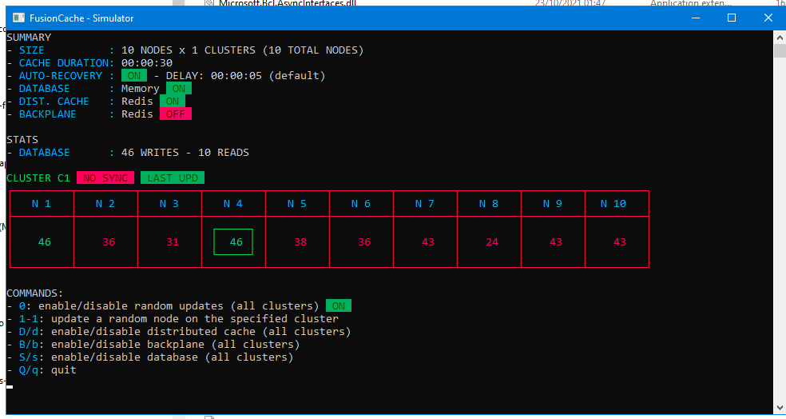
Emulator
https://github.com/ZiggyCreatures/FusionCache/blob/main/docs/Simulator.md
Under test/ZiggyCreatures.FusionCache.Simulator

Slide 43
Questions?

