Slide 1
Cache like a pro with "fusion cache"
Enrico Sabbadin

Slide 2
Agenda
Why caching
Caching Patterns
In memory vs distributed (shared) cache
Introduction to fusion cache

Slide 3
Why caching
Offload the origin (source of true)
Speed up application
Stale data issues
Cache invalidation is hard to implement
There are only two hard things in Computer Science: cache invalidation and naming things.
-- Phil Karlton

Slide 4
Caching Patterns: read aside (cache aside)
The most "known" and used
responsibility of setting the cache if there is a cache miss
var ret = await _cache.GetStringAsync(location);
if(ret == null)
{
ret = await _dataSources.GetCurrentTime(location);
await _cache.SetStringAsync(location, ret);
}
return ret;

Slide 5
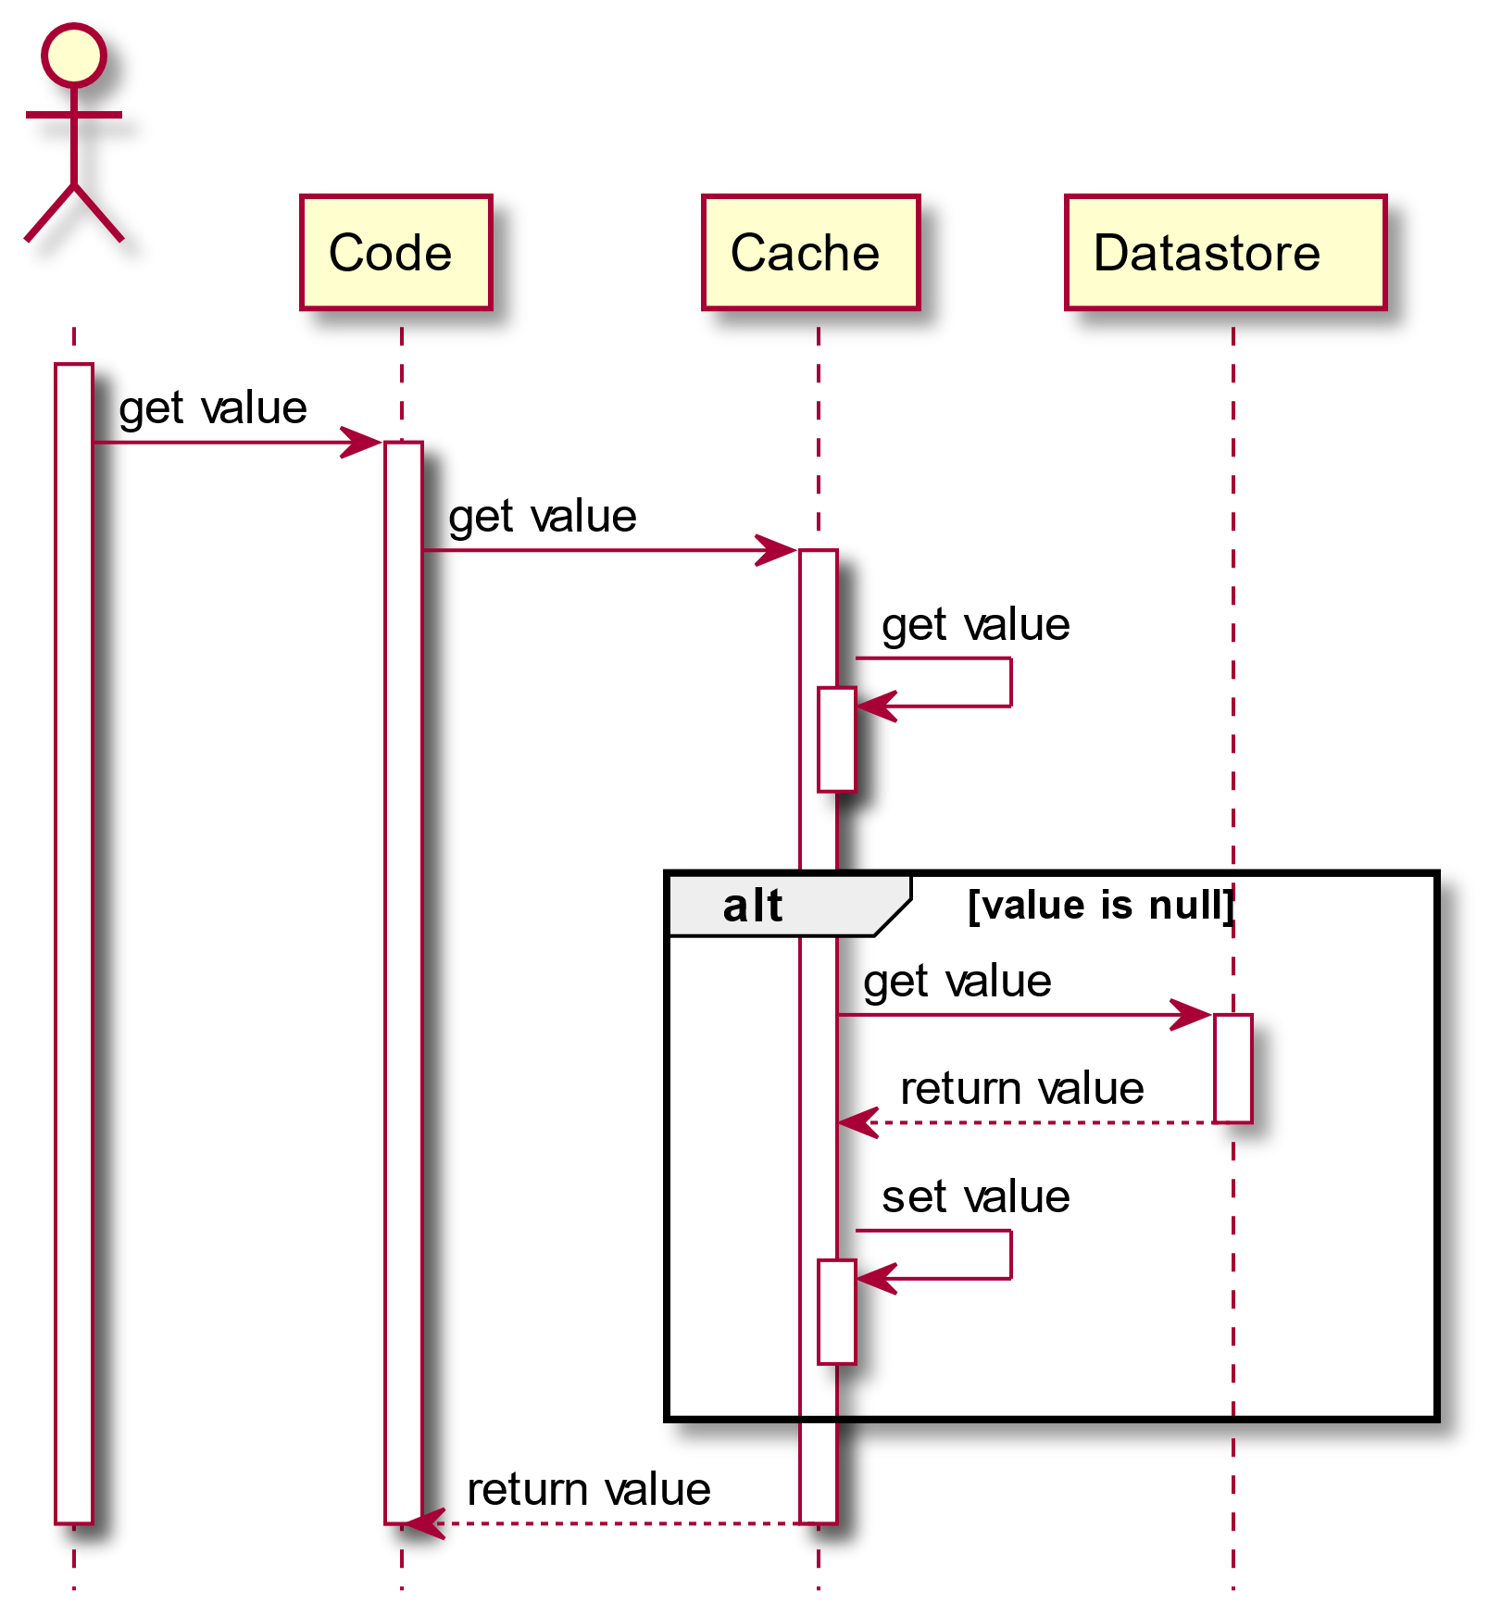
Caching Patterns: Read-Through
Cache is responsible to get the data

Slide 6
Caching Patterns: Read-"compromise"
Code is responsible to get the data to be cached
Cache can apply policies on the "data factory" (e.g. timeouts)
var ret = await _cache.GetOrCreateAsync(location, async cacheEntry=>
{
cacheEntry.AbsoluteExpiration = DateTimeOffset.UtcNow + TimeSpan.FromMinutes(1);
return await _dataSources.GetCurrentTime(location, throwEx);
});
return ret;

Slide 7
Caching Patterns: Write-*
Data is written to cache along with the change in the source of true
App responsibility: write-aside
Cache responsibility: write through

Slide 8
Caching Patterns: Invalidate-*
Cache is invalidated (removed) and not updated when the source of true data change
Avoid stale data
Not trivial to get cache invalidation right
in real world, the same piece of data can be changed in different places
the scope of change in the DB does not match the scope of cache items

Slide 9
In memory vs distributed (shared) cache
In memory
Less cache hits in web farm scenario
Faster
Monitor memory usage
Distributed
Improved cache hits
Redis is fast, still you are still doing a network roundtrip
Watch out caching keys clashing (per service prefix)

Slide 10
Cache related gotchas
Multi level cache
In memory on top of distributed
Cache stampede
Origin temporary unavailable
Reuse expired cache entry
Auto recovery
…
https://github.com/ZiggyCreatures/FusionCache/blob/main/docs/Comparison.md

Slide 11
We need more than just raw cache api
IMemoryCache and IDistributedCache are the two abstractions provided by .NET
MS clearly state it will not merge the twos into one
There are cache "frameworks" on top of the 2 interfaces allowing the switch if cache implementation transparently
Cache Manager (2.3K stars) – started at about 2015 – last commit about Jan 2019
Lazy Cache (1.7K stars) (memory only) – started at abouthalf 2014 – last commit about half 2020
Easy caching (1.9K stars) – started at about end of 2017 – last commit about May 2024
CacheTower (582 stars) ) – started at about half 2019 – last commit about August 2023
Fusion Cache (1.3K stars) – started at about Jan 2021– last commit May 2024

Slide 12
Introduction to fusion cache
Backplane
Cache stampede
Fail-Safe
Factory Timeouts
Auto-Recovery
Adaptive Caching

