Slide 1
C# meets ChatGpt
Setup your "domain expert" chatbot without Phyton ☺

Slide 2
OpenAi models
Models and trained models
A model is the "algorithm" (engine) on open.ai api : GET https://api.openai.com/v1/engines
A trained model is an instance of the algorithm trained with data on open.ai api : GET https://api.openai.com/v1/models
Family of Large language models (LLM)
Da-vinci family
ChatGpt 3.0: da vinci trained with a lot of data
ChatGpt 3.5 turbo
Codex
ChatGpt 4.0

Slide 3
Open.ai vs Azure Open.ai
Open.ai
Chatgpt web ui (free and plus version, the plus version allows to use plugins)
Open.ai api (pay per usage)
Azure Open.ai
Added as additional offer in the MS AI ecosystem
Requires submission and approval of a request form
A lot of announcements on Azure open.ai at MSBuild 2023
Prompt flow
Plugins
MS is betting his ass on this ☺

Slide 4
OpenAi ChatGpt web site and openAi api
"Human" interface : https://chat.openai.com/
Rest Api
https://platform.openai.com/docs/api-reference/introduction
Chat complition endpoint -> "equivalent" to : https://chat.openai.com/ POST https://api.openai.com/v1/chat/completions
embedding endpoint (more on it later) POST https://api.openai.com/v1/embeddings
Others i don't have played with yet
edits, images (from text), audio (text from audio),

Slide 5
Chat complition endpoint: request
Header : Authorization: Bearer $OPENAI_API_KEY
{
"model": "gpt-3.5-turbo",
"messages": [ {"role": "system", "content": "you are the chat bot Q&A assistant for mymsc web site"}
{"role": "user", "content": "how do I place a booking ? "} ]
}

Slide 6
Chat complition endpoint: response
{
"id": "chatcmpl-123",
"object": "chat.completion",
"created": 1677652288,
"choices": [{
"index": 0,
"message": {
"role": "assistant",
"content": "\n\nHello there, how may I assist you today?",
},
"finish_reason": "stop"
}],
"usage": {
"prompt_tokens": 9,
"completion_tokens": 12,
"total_tokens": 21
}
}

Slide 7
Fine Tuning
It costs a lot
Training it
Running it (or having it hosted in the azure cloud)
Current best model "no wait list needed" (gpt-3.5-turbo) cannot be custom trained
Search for "ChatGpt Fine Tuning" or "ChatGpt Custom training" topic in google .. You will find many entries suggesting to use embeddings as an alternative solution
Original model
Your custom training

Slide 8
What the hell are embeddings ?
An embedding model converts a block of text into a vector (array) of floats that "captures" the context/meaning of the provided text
text-embedding-ada-002 is currently recommended one
vector has 1536 elements
To find similarity between two block of texts
Get the corresponding 2 embeddings vectors
Calculate the "distance" of the corresponding two embedding vectors
Cosine similarity is currently the recommended method to calculate the distance

Slide 9
Token limits
First pass when processing a question is remove irrelevant words (such as "please")
Next words are split into tokens
You can think of tokens as pieces of words used for natural language processing
For English text, 1 token is approximately 4 characters or 0.75 words, e.g. text of 100 chars * 4/3 => about 133 tokens
Each model has a token limit for each request (question + answer)
gpt-3.5-turbo : max tokens is 4096
So keep track of it when setting up request to ChatGpt
There are existing libraries to calculate tokens from words (no open.ai api endpoint exposed for that)

Slide 10
How can embeddings can help me then? a) Chatbot up-front setup
Documentation Embeddings preparation
Use openAi embedding api endpoint to get corresponding embedding of your relevant "documents"
Track token count of embedded text since the text will be sent to chat/completion endpoint that have a global token limit (chatgpt 3.5 turbo : 4096) Suggestion is to try to stay below 500
Store embedding and original text
There are vectors databases that provide vector operations out-of-the-box (e.g. cosine similarity, more on it later)
SQL server is ok to start with

Slide 11
How can embeddings can help me then? b) user question arrives to "your" ChatBot
Prepare payload to be sent to open.ai completion api as follow
Add Role="System" message(s) (drive behavior of model)
Pick up text from your database whose embeddings are closer to the question embedding using cosine proximity push text blocks as Role="user" messages
It would appear more logical to put documents as role=System, but better stick to Role="user" , at least for chatgpt 3.5 turbo
Add end user question as Role="user" message

Slide 12
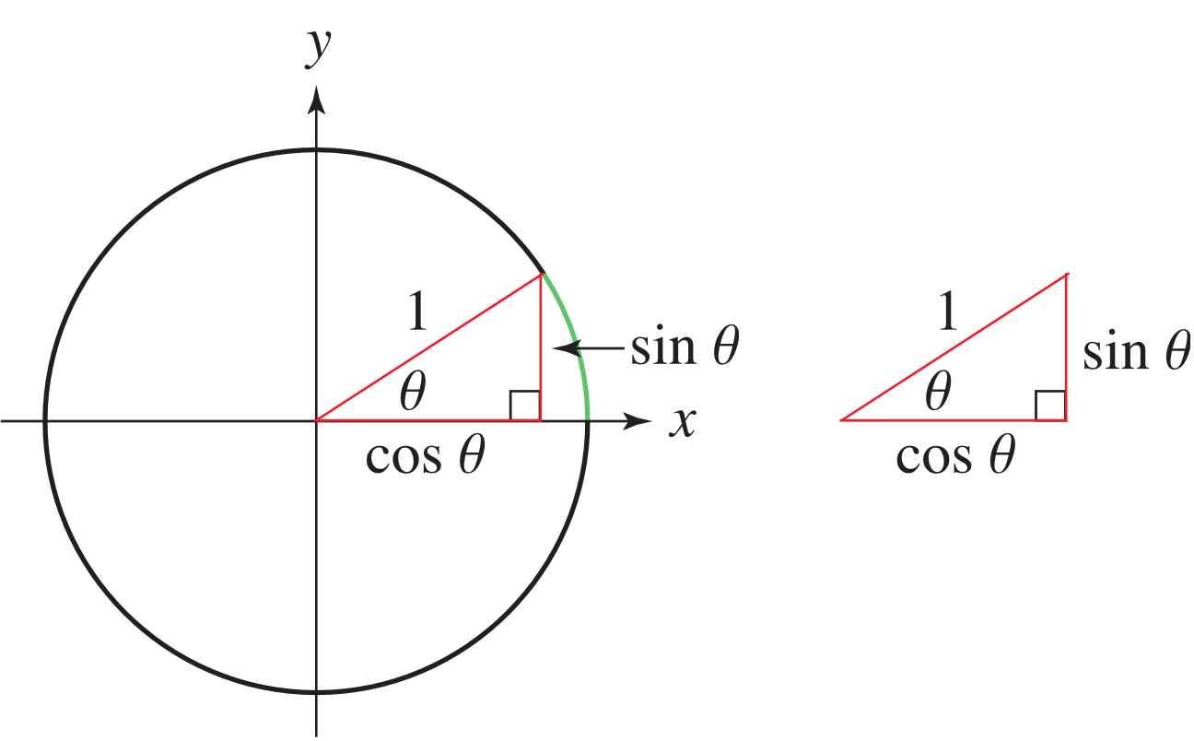
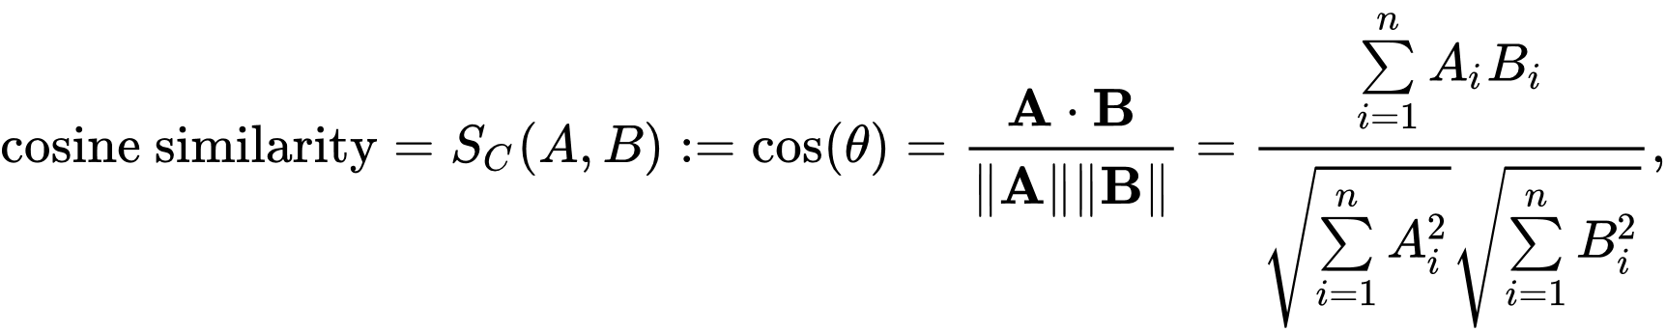

And now a little math
y
V1 (0.5,1)
V2 (0.7,0.7)
x
V3 (-1.5,-0.5)
Don't be afraid : this is a for loop ☺

Slide 13
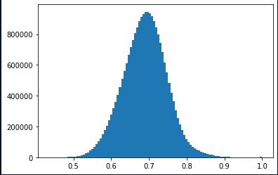
Note on Cosine proximity
With random vectors distribution it ranges from -1 to 1
Vectors coming from text-embedding-ada-002 have a bias, values always positive, approximately distributed in a gaussian way around 0.7
Experiment with values in the range like 0,75 – 0.8 for minimum proximity threshold
https://community.openai.com/t/embeddings-and-cosine-similarity/17761/10

Slide 14
Conversation awarenesse
ChatGpt has no concept of conversation built-in
But https://chat.openai.com/ has it !, how does it work then ?
It's under "your" responsibility
Record user question and ChatGpt answer
When next user question arrives, add previous user questions and ChatGpt answers in proper sequential order, then add the last user question
Use role="assistant" to send back previous ChatGpt replies

Slide 15
Pipeline a la "LangChain" (Phyton library) but in C#
-> Conversation manager: read from db and push conversation history in request
User Question legth guard
Add system message
Add relevant contextual documents via embeddings
Token limits check *
Set api call options
<- Conversation manager: save user question and chatgpt reply
* : purge oldest conversation items and / or least relevant documents

Slide 16
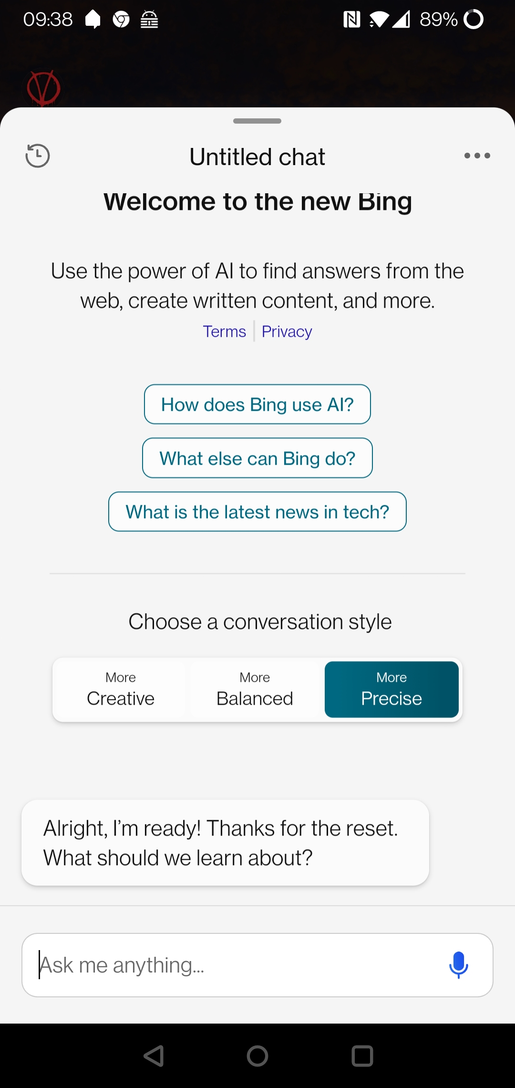
Temperature
Input parameter to completion api from 0 to 1
Control the "creativity" of the model
Smaller : more precise response
Greater : more creative response
Stick around 0.25 / 0.35 for precise responses

Slide 17
DEMO
https://github.com/sabbadino/csharp-meets-chatgpt
Based on information gathered on the web about msBuild 2023
Knowledge of chatgpt-3.5-turbo ends in September 2021

Slide 18
