Slide 1
Compute Engine Fundamentals

Slide 2

Google Compute Engine (GCE)
In corporate data centers, applications are deployed to physical servers
Where do you deploy applications in the cloud?
Rent virtual servers
Virtual Machines - Virtual servers in GCP
Google Compute Engine (GCE) - Provision & Manage Virtual Machines

Slide 3
Compute Engine - Features
Create and manage lifecycle of Virtual Machine (VM) instances
Load balancing and auto scaling for multiple VM instances
Attach storage (& network storage) to your VM instances
Manage network connectivity and configuration for your VM instances

Slide 4
Compute Engine Machine Family
What type of hardware do you want to run your workloads on?
Different Machine Families for Different Workloads:
General Purpose (E2, N2, N2D, N1) : Best price-performance ratio
Web and application servers, Small-medium databases, Dev environments
Memory Optimized (M2, M1): Ultra high memory workloads
Large in-memory databases and In-memory analytics
Compute Optimized (C2): Compute intensive workloads
Gaming applications

Slide 5
Compute Engine Machine Types
How much CPU, memory or disk do you want?
Variety of machine types are available for each machine family
Let's take an example : e2-standard-2:
e2 - Machine Type Family
standard - Type of workload
2 - Number of CPUs
Memory, disk and networking capabilities increase along with vCPUs

Slide 6
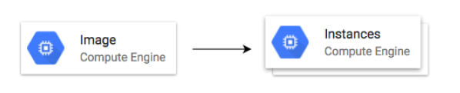
Image
What operating system and what software do you want on the instance?
Type of Images:
Public Images: Provided & maintained by Google or Open source communities or third party vendors
Custom Images: Created by you for your projects

Slide 7
Internal and External IP Addresses
External (Public) IP addresses are Internet addressable.
Internal (Private) IP addresses are internal to a corporate network
You CANNOT have two resources with same public (External) IP address.
HOWEVER, two different corporate networks CAN have resources with same Internal (private) IP address
All VM instances are assigned at least one Internal IP address
Creation of External IP addresses can be enabled for VM instances
(Remember) When you stop an VM instance, External IP address is lost
Scenario : How do you get a constant External IP address for a VM instance?
Quick and dirty way is to assign an Static IP Address to the VM!

Slide 8
Static IP Addresses
Scenario : How do you get a constant External IP address for a VM instance?
Quick and dirty way is to assign an Static IP Address to the VM!
Static IP can be switched to another VM instance in same project
Static IP remains attached even if you stop the instance. You have to manually detach it.
Remember : You are billed for an Static IP when you are NOT using it as well!
Make sure that you explicitly release an Static IP when you are not using it.

Slide 9
Compute Engine - Demo

Slide 10
Simplify VM HTTP server setup
How do we reduce the number of steps in creating an VM instance and setting up a HTTP Server?
Let's explore a few options:
Startup script
Instance Template
Custom Image

Slide 11
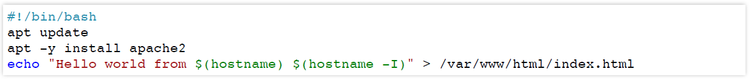
Bootstrapping with Startup script
Bootstrapping: Install OS patches or software when an VM instance is launched.
In VM, you can configure Startup script to bootstrap

Slide 12
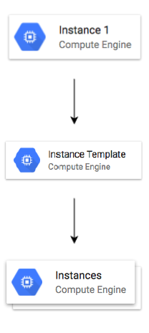
Instance templates
Why do you need to specify all the VM instance details (Image, instance type etc) every time you launch an instance?
How about creating a Instance template?
Define machine type, image, labels, startup script and other properties
Used to create VM instances and managed instance groups
Provides a convenient way to create similar instances
CANNOT be updated
To make a change, copy an existing template and modify it
(Optional) Image family can be specified (example - debian-9)
Latest non-deprecated version of the family is used

Slide 13
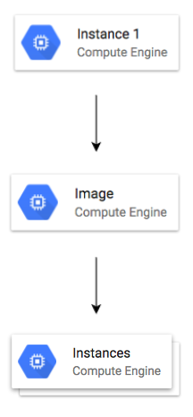
Reducing Launch Time with Custom Image
Installing OS patches and software at launch of VM instances increases boot up time
How about creating a custom image with OS patches and software pre-installed?
Can be created from an instance, a persistent disk, a snapshot, another image, or a file in Cloud Storage
Can be shared across projects
(Recommendation) Deprecate old images (& specify replacement image)
(Recommendation) Hardening an Image - Customize images to your corporate security standards
Prefer using Custom Image to Startup script

Slide 14
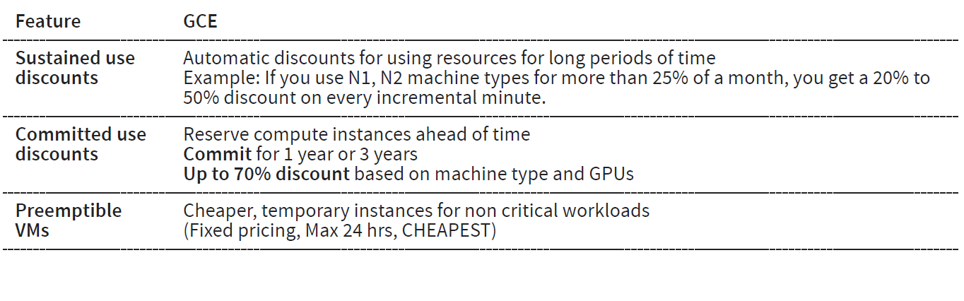
Reducing Costs - Compute Engine Virtual Machines

Slide 15
Compute Engine : Live Migration & Availability Policy
How do you keep your VM instances running when a host system needs to be updated (a software or a hardware update needs to be performed)?
Live Migration
Your running instance is migrated to another host in the same zone
Does NOT change any attributes or properties of the VM
NOT SUPPORTED for GPUs and preemptible instances
Important Configuration - Availability Policy:
On host maintenance: What should happen during periodic infrastructure maintenance?
Migrate (default): Migrate VM instance to other hardware
Terminate: Stop the VM instance
Automatic restart - Restart VM instances if they are terminated due to non-user-initiated reasons (maintenance event, hardware failure etc.)

Slide 16
Virtual Machine - Best Practices
Choose Zone and Region based on:
Cost, Regulations, Availability Needs, Latency and Specific Hardware needs
Distribute instances in multiple zones and regions for high availability
Choose right machine type for you needs:
Play with them to find out the right machine type
Use GPUs for Math and Graphic intensive applications
Reserve for "committed use discounts" for constant workloads
Use preemptible instances for fault-tolerant, NON time critical workloads
Use labels to indicate environment, team, business unit etc

Slide 17
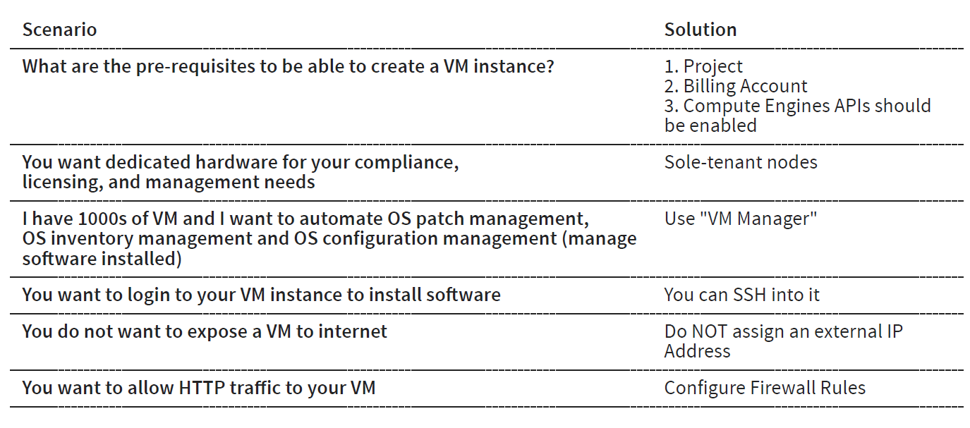
Virtual Compute Engine Scenarios

Slide 18
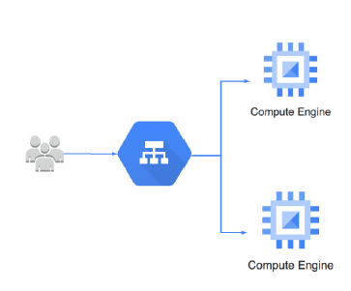
Instance Groups
How do you create a group of VM instances?
Instance Group - Group of VM instances managed as a single entity
Manage group of similar VMs having similar lifecycle as ONE UNIT
Two Types of Instance Groups:
Managed : Identical VMs created using a template:
Features: Auto scaling, auto healing and managed releases
Unmanaged : Different configuration for VMs in same group:
Does NOT offer auto scaling, auto healing & other services
NOT Recommended unless you need different kinds of VMs
Location can be Zonal or Regional
Regional gives you higher availability (RECOMMENDED)

Slide 19
Managed Instance Groups (MIG)
Managed Instance Group - Identical VMs created using an instance template
Important Features:
Maintain certain number of instances
If an instance crashes, MIG launches another instance
Detect application failures using health checks (Self Healing)
Increase and decrease instances based on load (Auto Scaling)
Add Load Balancer to distribute load
Create instances in multiple zones (regional MIGs)
Regional MIGs provide higher availability compared to zonal MIGs
Release new application versions without downtime
Rolling updates: Release new version step by step (gradually). Update a percentage of instances to the new version at a time.
Canary Deployment: Test new version with a group of instances before releasing it across all instances.

Slide 20
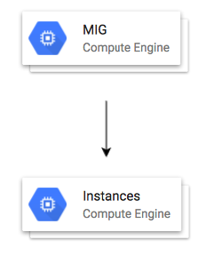
Creating Managed Instance Group (MIG)
Instance template is mandatory
Configure auto-scaling to automatically adjust number of instances based on load:
Minimum number of instances
Maximum number of instances
Autoscaling metrics: CPU Utilization target or Load Balancer Utilization target or Any other metric from Stack Driver
Cool-down period: How long to wait before looking at auto scaling metrics again?
Scale In Controls: Prevent a sudden drop in no of VM instances
Example: Don't scale in by more than 10% or 3 instances in 5 minutes
Autohealing: Configure a Health check with Initial delay (How long should you wait for your app to initialize before running a health check?)

